Slide 1
ECOBIKE
GROUP 5
final-project
Here is where your presentation begins

Slide 2
Team member
A slide structure based on a medical breakthrough, which you can easily adapt to your needs. For more info on how to edit the template, please visit Slidesgo School or read our FAQs.
An assortment of illustrations that are suitable for use in the presentation can be found in the alternative resources slide.
A thanks slide, which you must keep so that proper credits for our design are given.
A resources slide, where you’ll find links to all the elements used in the template.
Instructions for use.
Final slides with:
The fonts and colors used in the template.
A selection of illustrations. You can also customize and animate them as you wish with the online editor. Visit Storyset by Freepik to find more.
More infographic resources, whose size and color can be edited.
Sets of customizable icons of the following themes: general, business, avatar, creative process, education, help & support, medical, nature, performing arts, SEO & marketing, and teamwork.
You can delete this slide when you’re done editing the presentation.

Slide 3
Table of Contents
1
4
2
5
3
6
Objective
Objective
Objective
Objective
Objective
Objective

Slide 4
Objective
- The goal of the project is to create a system to manage and rent bicycles.
- The system would have administrators who would manage the databases, and users who would buy cards and rent bikes.
- The system would have two separate sub-systems, a website for information and transaction, and a mock app for a machine near the bike stations

Slide 5
Technology
FRONT-END: ReActJS Framework, with HTML, CSS, SCSS
BACK-END: Java SpringBoot Framework, supported by MySQL database

Slide 6
Analogy/Design
- For functions, we allowed the users to be able to buy rental cards, search for stations, rent and return bike, make payments, and sign in to view their information.
- Admins can view all the transactions, orders, status of bikes and stations, and add/edit in CRUD fashion.
- For database, we have a database for: bikes, stations, cities and district, card and card types, customers, and orders.
*Anh gi do*

Slide 7
Goals
98
32
55
Mars
Jupiter
Saturn
Despite being red, Mars is actually a cold place
It’s a gas giant and the biggest planet of them all
Yes, this is the ringed one. It’s a huge gas giant

Slide 8
Methods
Neptune
Neptune is very far away from Earth
Venus
Venus has a beautiful name, but is hot
Jupiter
It’s a gas giant and the biggest planet
Saturn
Saturn is a gas giant and has rings

Slide 9
Research and
Publications
Venus has a beautiful name and is the second planet from the Sun. It’s terribly hot
by Venus
Mercury is the closest planet to the Sun and the smallest one in the Solar System
Despite being red, Mars is actually a very cold place. It’s full of iron oxide dust
by Mercury
by Mars

Slide 10
OUTCOME
User functions are finished, core functions are finished.
Admin function are mostly finished, with few features missing.
The result will be displayed below

Slide 11
CUSTOMER JOURNEY
1
2
3
4
Mercury is the closest planet to the Sun
Venus has a beautiful name, but is terribly hot
Jupiter is the biggest planet in the Solar System
Yes, this is the ringed one. It’s a huge gas giant
Register
Top up
Ride
Return

Slide 12
This Is a Map
Venus
Venus has a
beautiful name
Jupiter
Jupiter is the
biggest planet
Mercury
Mercury is the smallest planet

Slide 13
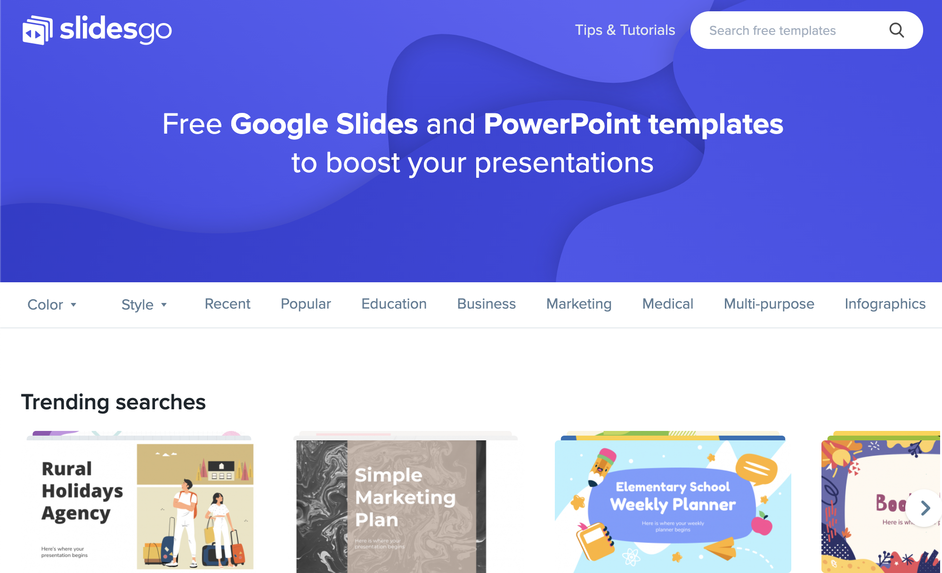
Desktop Software
You can replace the image on the screen with your own work. Just delete this one, add yours and center it properly

Slide 14
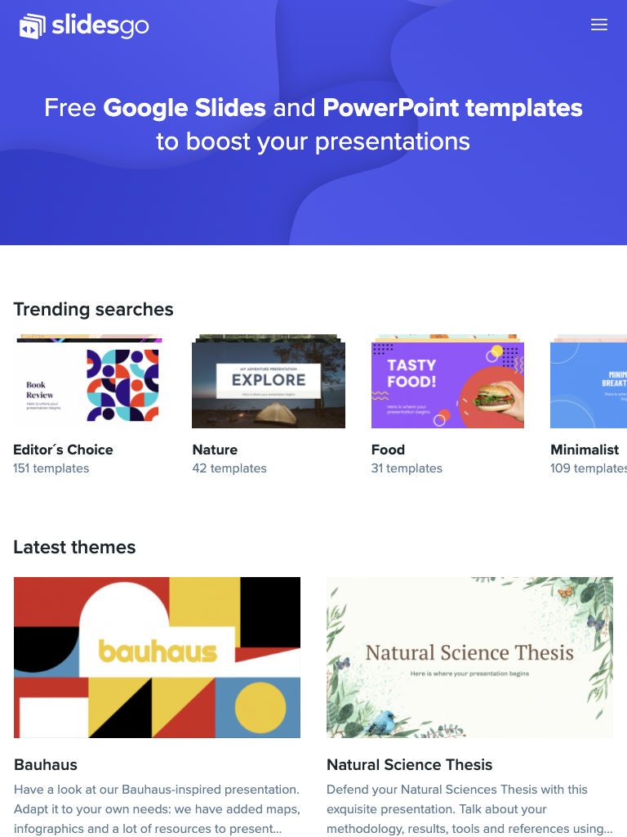
Tablet App
You can replace the image on the screen with your own work. Just delete this one, add yours and center it properly

Slide 15
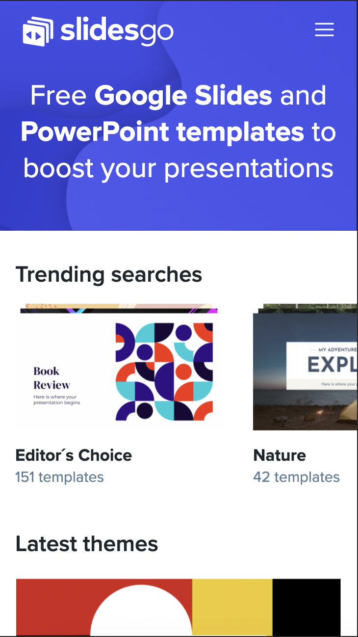
Mobile Web
You can replace the image on the screen with your own work. Just delete this one, add yours and center it properly

Slide 16
Thank You
Do you have any questions?

Slide 17
Thank You
Do you have any questions?

