Slide 1





Slide 2





Slide 3
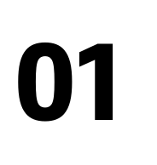












Slide 4

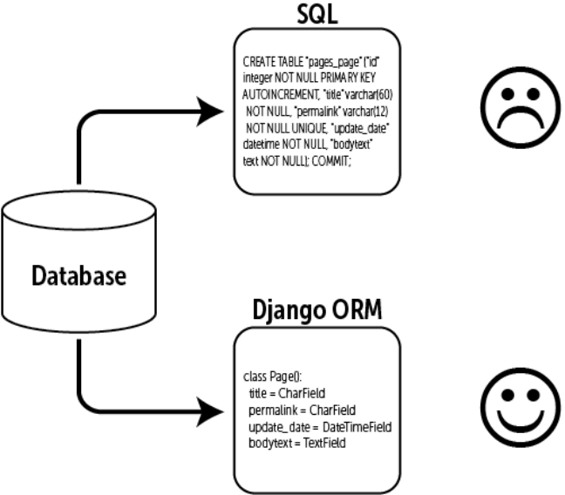




Slide 5

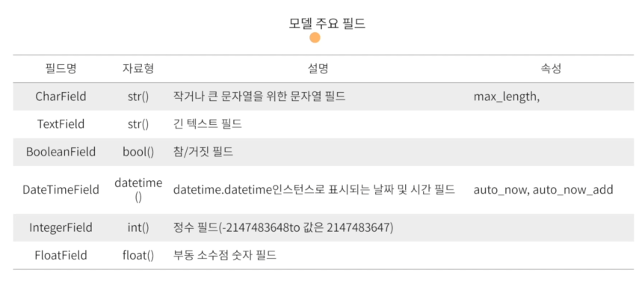

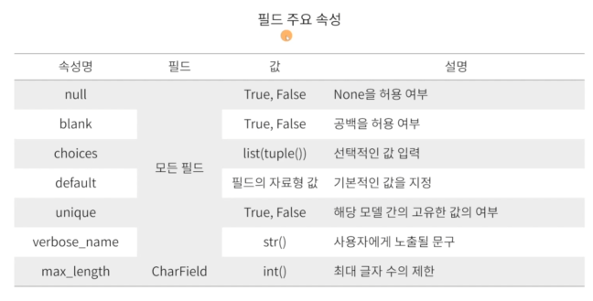


Slide 6



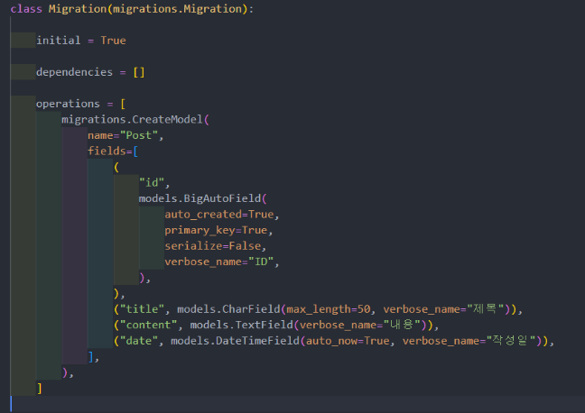


Slide 7

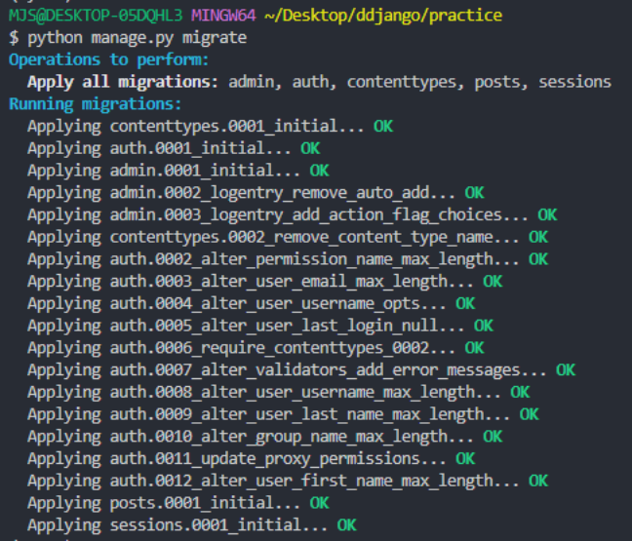
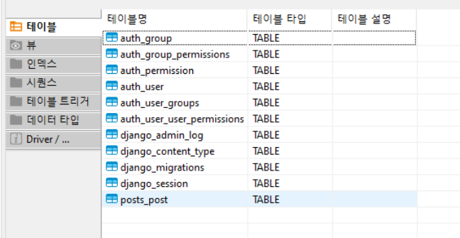



Slide 8



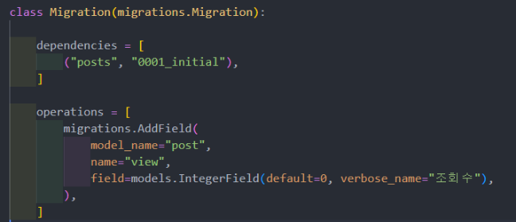


Slide 9
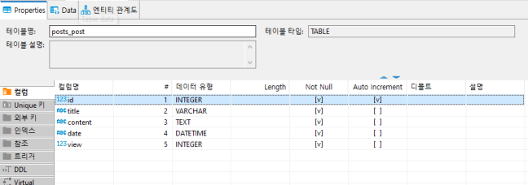


Slide 10








Slide 11




Slide 12

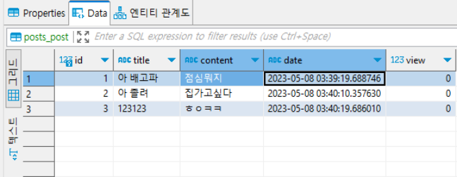





Slide 13


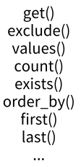



Slide 14





Slide 15




Slide 16

https://velog.io/@magnoliarfsit/ReDjango-7.-ORM%EA%B3%BC-Queryset
https://velog.io/@kimkrh/Django-Django-QuerySet-API
https://techit.education/
(테크잇 강의)

Slide 17



