Slide 1
그래. 함 해보자..
20200451
박세원
System Software Lab.

Slide 2
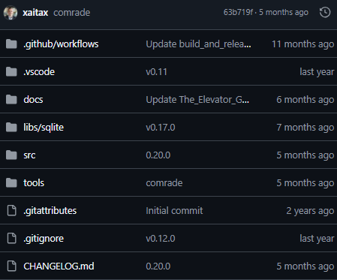
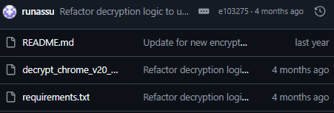
Overview
세미나 발표의 원래 흐름?
Malware Analysis.. (Reversing)
Google Chrome Password En/Decryption Flow...
Goal: Local password_value decryption
How to?
Let's get it..
ref: https://github.com/xaitax/Chrome-App-Bound-Encryption-Decryption/blob/main/tools/comrade_abe.py
근데?
COM?
Let's get it.........
COM.. 발표..
정신 차려!
Let's get it..............................
How to?
ref: https://github.com/runassu/chrome_v20_decryption
ref: https://github.com/The-Viper-One/Invoke-PowerChrome/blob/main/Invoke-PowerChrome.ps1

Slide 3
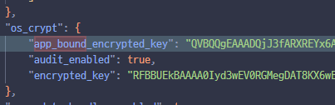
Rewind & Update
v20_master_key
decode: base64
remove: "APPB" prefix
decrypted_aes_key
xor_key
app_bound_encrypted_key
Windows CNG
with. Google "ChromeKey1"
Google Chrome
Hardcoded bytes (chrome.dll? elevation_service.exe?)
encrypted_aes_key

Slide 4

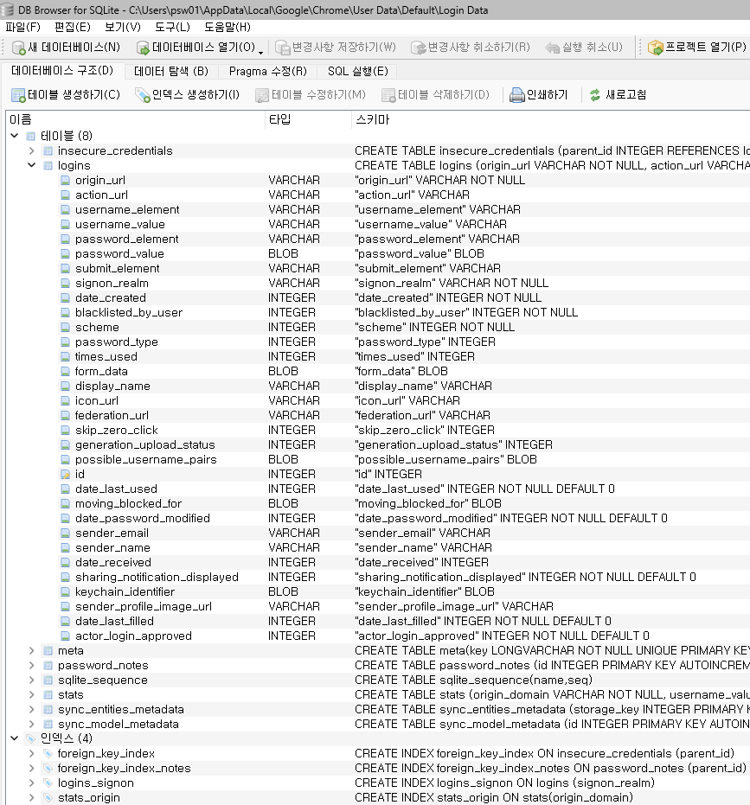
Login Data

Slide 5
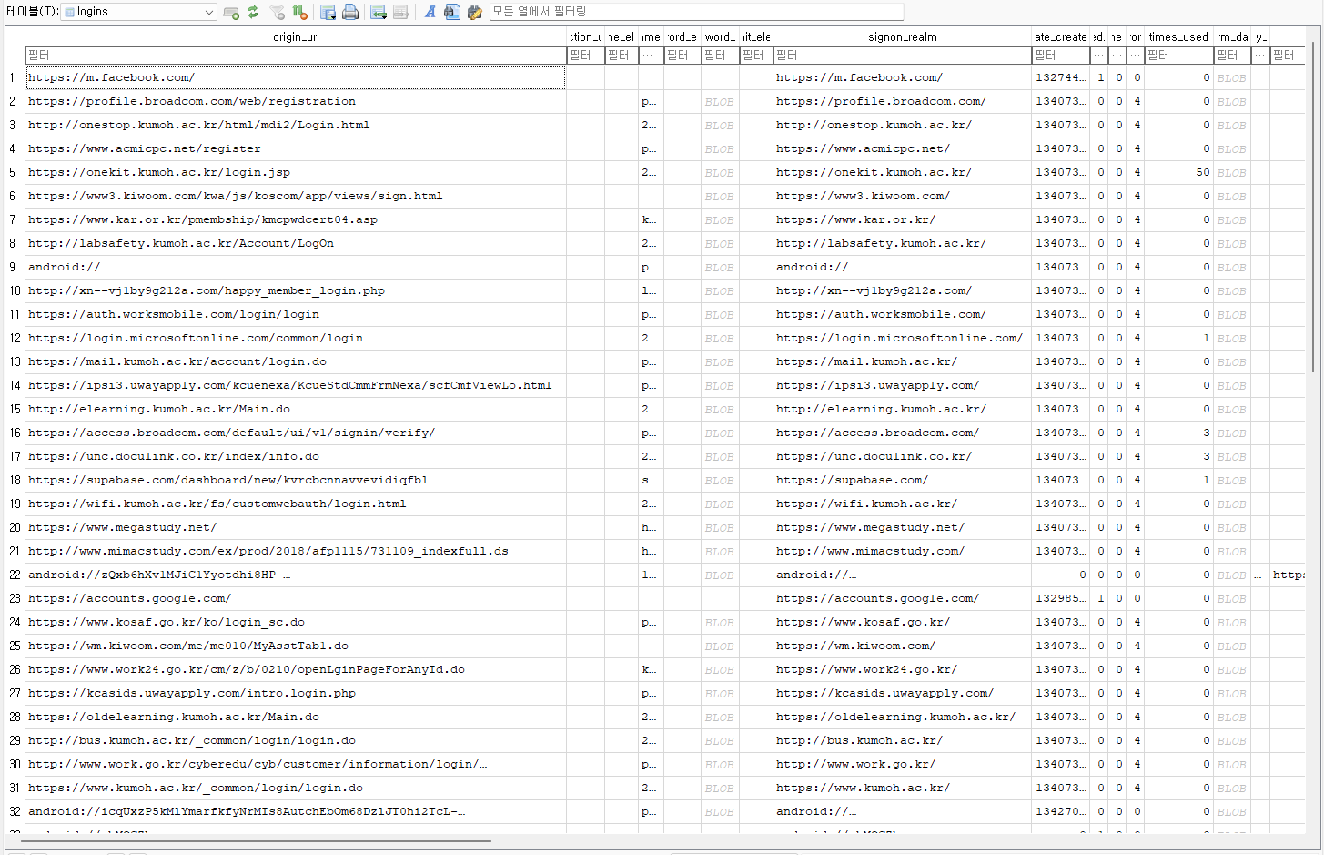
Login Data logins table

Slide 6

Column: password_value
Flag(3) | IV(12) | Ciphertext(var) | Tag(16)
decrypt
AES-256-GCM
password

Slide 7
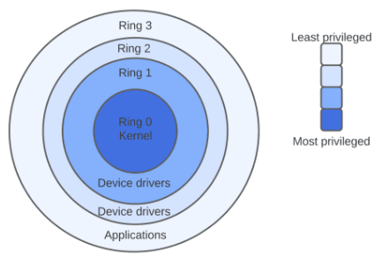
TODO: Simulation
So, how do i decrypt?
문제 1: DPAPI 어케 함?
문제 2: 단순 '관리자' 권한이 아님. 'NT_AUTHORITY\SYSTEM'
문제 3: Windows CNG?
문제 4: Hardcoded const xor_key?
문제 5: Validate Data (Proc path validation)
app_bound_encrypted_key
https://www.baeldung.com/cs/os-rings
Ring 3: USER MODE
Layer 4. User, Brower, Apps (Low / Medium Integrity)
Layer 3. "관리자 권한으로 실행" (High Integrity)
Layer 2. NT_AUTHORITY\SYSTEM: Win 백그라운드 서비스 및 데몬, elevation_service.exe (System Integrity)
Layer 1. PPL(Protected Process Light): lsass.exe, csrss.exe, services.exe
Ring 0: KERNEL MODE

Slide 8

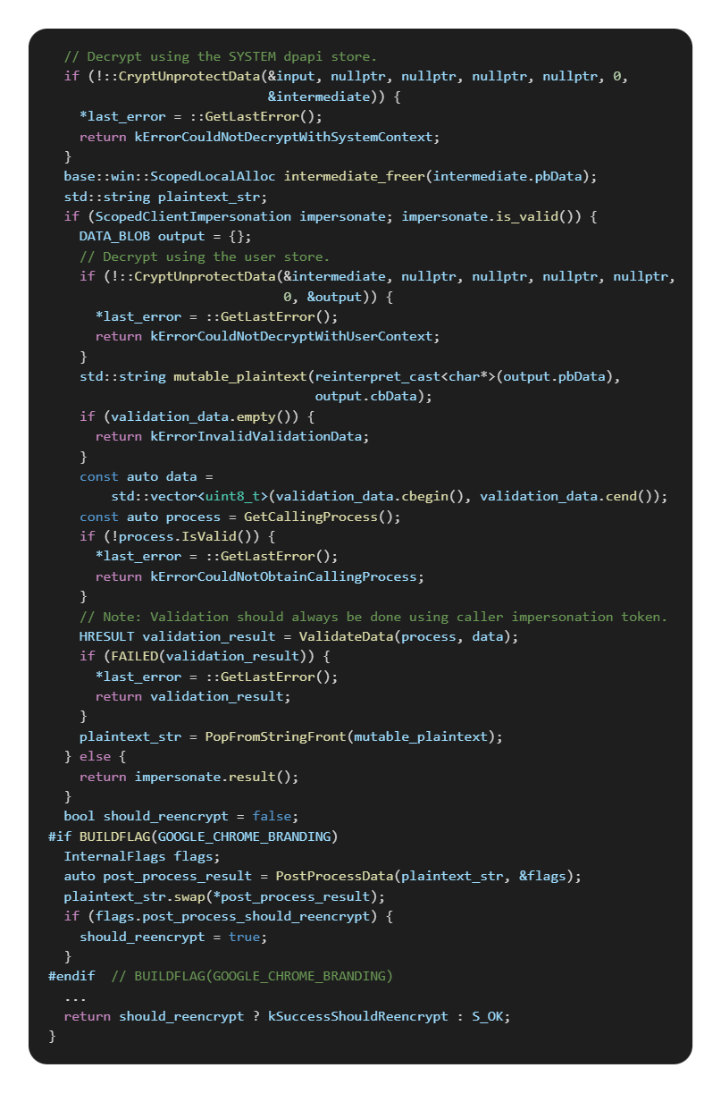
only for key
chromium/src/+/HEAD/chrome/elevation_service/elevator.cc→DecryptData
- Decrypt
SYSTEM 권한 DPAPI
USER 권한 DPAPI
Encrypt 1. USER 권한 DPAPI 2. SYSTEM 권한 DPAPI
과거의 요청자: GenerateValidationData 정보가 arg2: data에 같이 저장되어 있음.
-----------------------------------
현재의 요청자: impersonated process handler ValidateData
SYSTEM
USER
app_bound_encrypted_key
과거의 요청자와
현재의 요청자 일치 검증
Notes:
https://chromium.googlesource.com/chromium/src/+/HEAD/chrome/elevation_service/elevator.cc#74

Slide 9
Solution
But, we already know about decryption flow !!
Just do it !
We need to ref.run script as a admin.
Let's go... ? nononononono
First of all. PoC

Slide 10
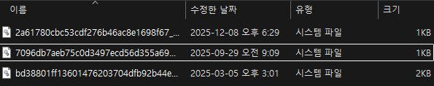
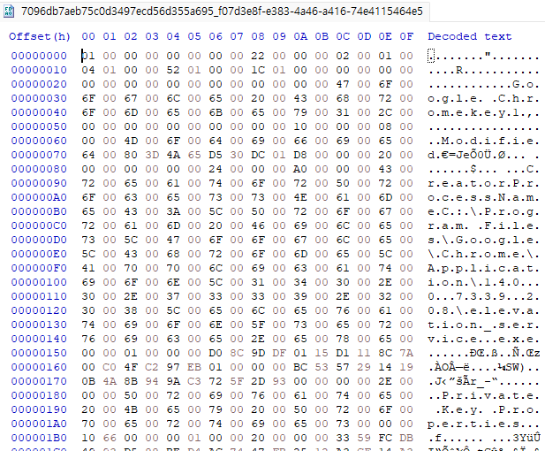
Windows CNG
C:\ProgramData\Microsoft\Crypto\SystemKeys
Windows CNG
with. Google "ChromeKey1"

Slide 11
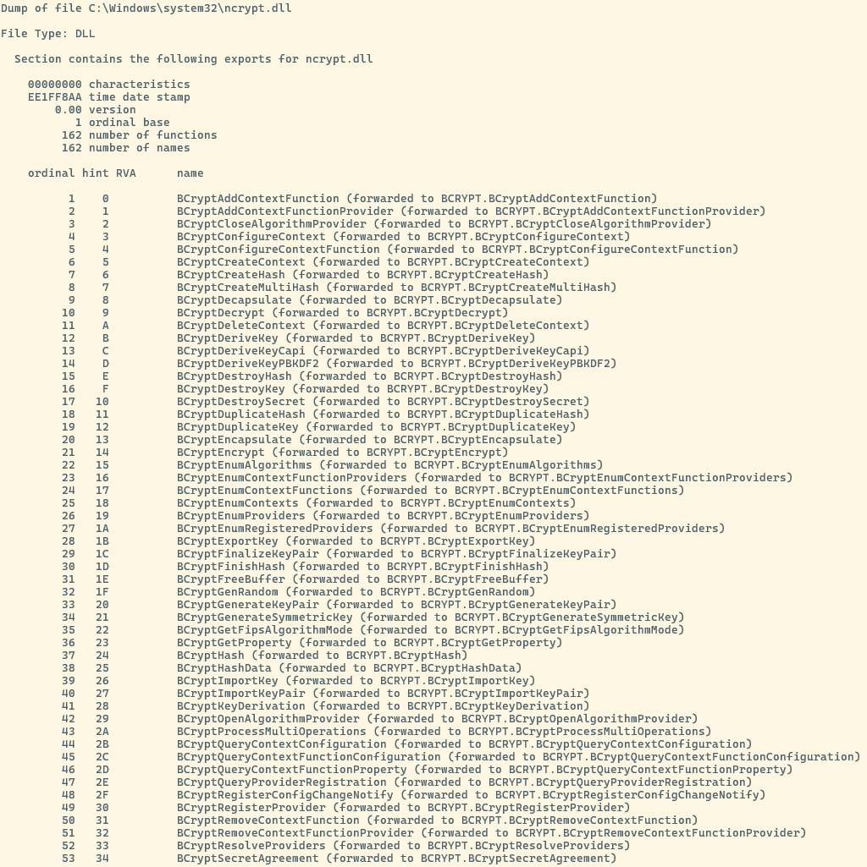
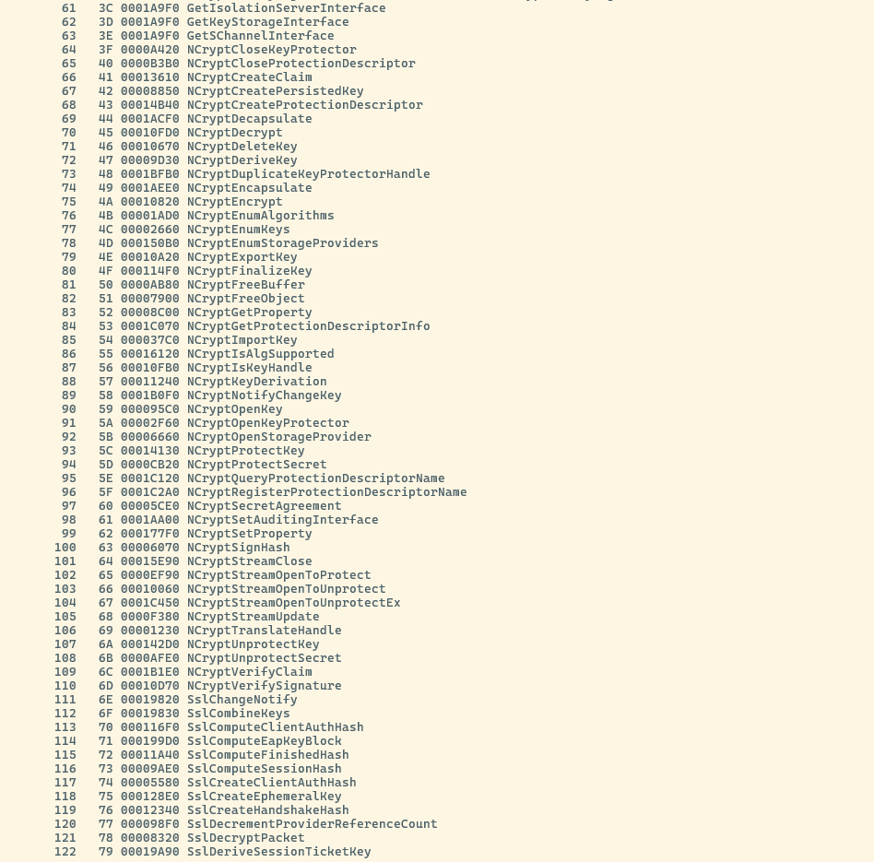
Windows CNG -exports
$ > dumpbin –exports "C:\Windows\System32\ncrypt.dll

Slide 12
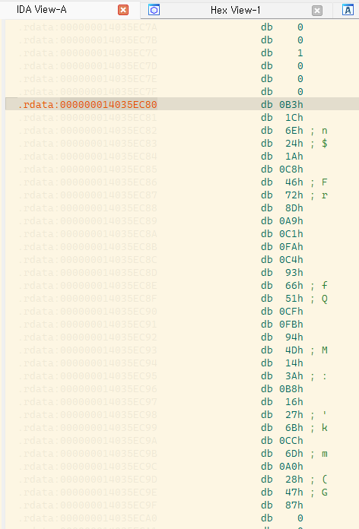
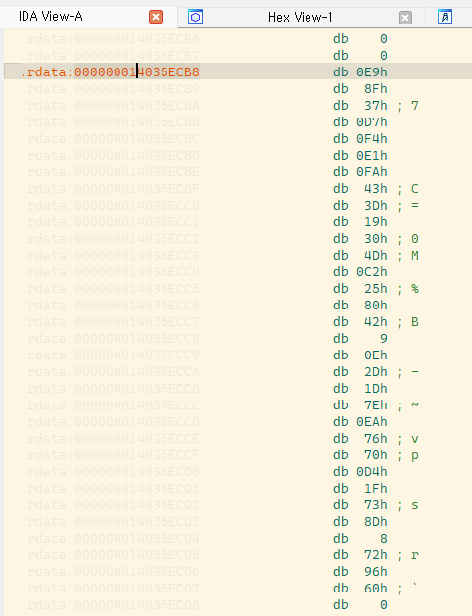
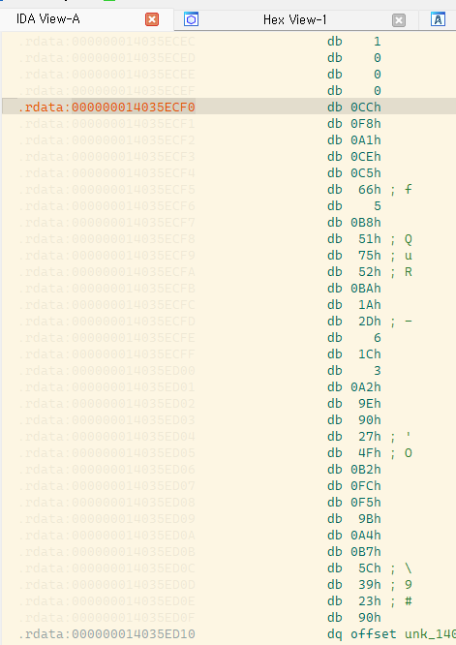
xor_key
Google Chrome
Hardcoded bytes (chrome.dll? elevation_service.exe?)
Google Chrome elevation_service.exe have hardcoded bytes ?!

Slide 13
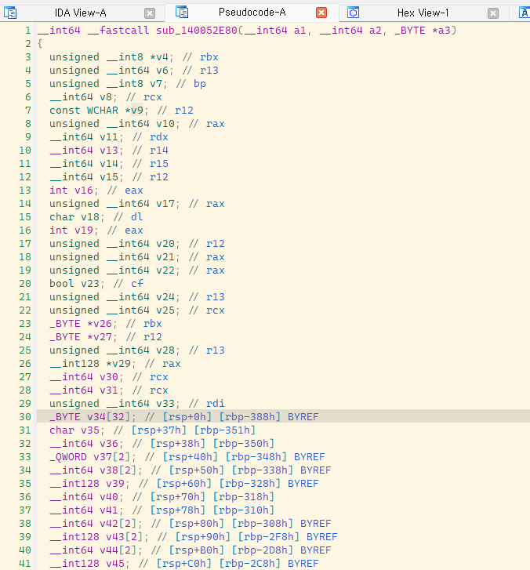
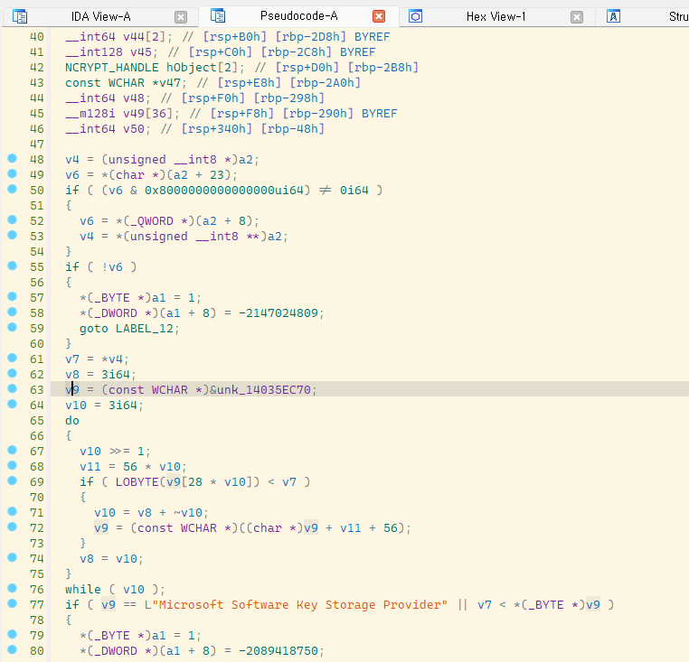
xor_key
Google Chrome elevation_service.exe have hardcoded bytes ?!

Slide 14
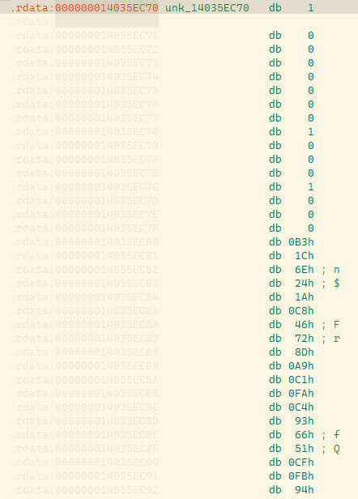
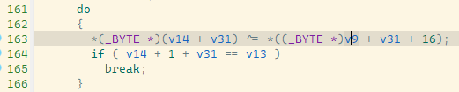
xor_key
Google Chrome elevation_service.exe have hardcoded bytes ?!

Slide 15
Rewind & Update
v20_master_key
decode: base64
remove: "APPB" prefix
decrypted_aes_key
xor_key
app_bound_encrypted_key
Windows CNG
with. Google "ChromeKey1"
Google Chrome
Hardcoded bytes (chrome.dll? elevation_service.exe?)
encrypted_aes_key

Slide 16
Go Go GO
Okay... I'm ready
Let's go!

Slide 17
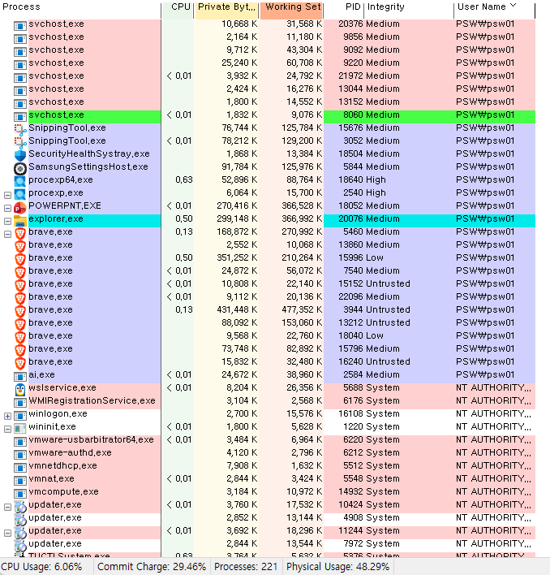
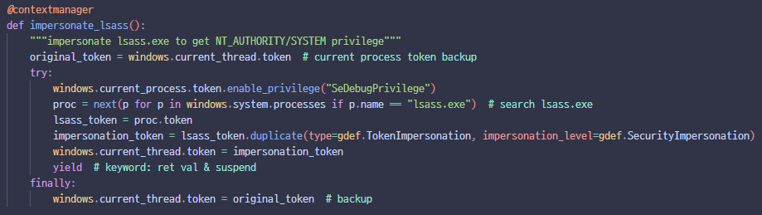
script.py :: impersonate(lsass.exe)

Slide 18
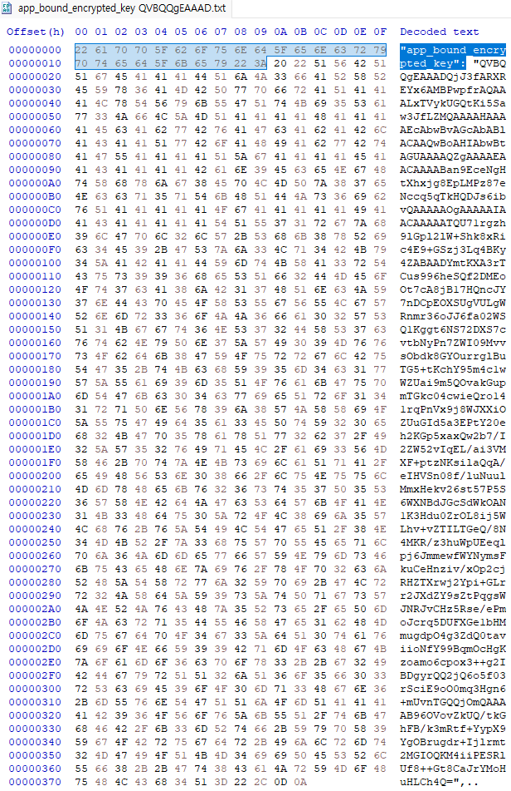
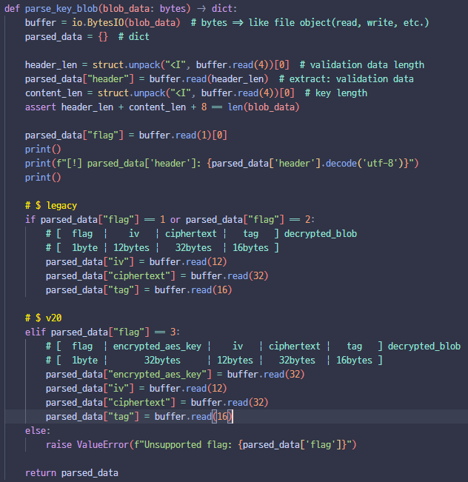
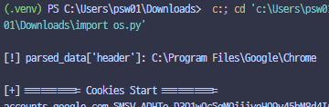
script.py
ValidateData

Slide 19
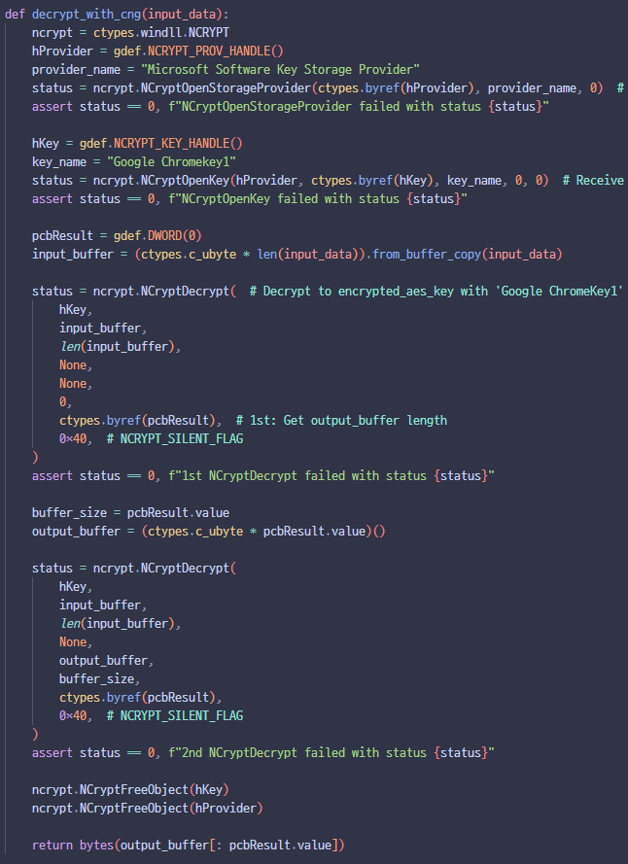
script.py

Slide 20
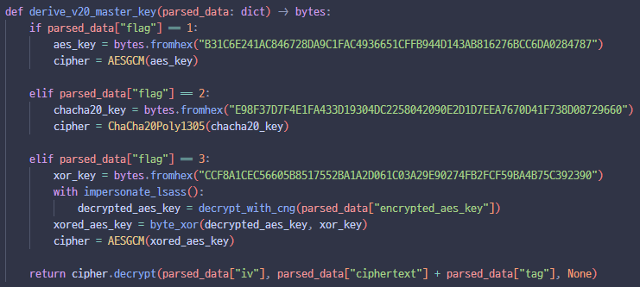
script.py

Slide 21
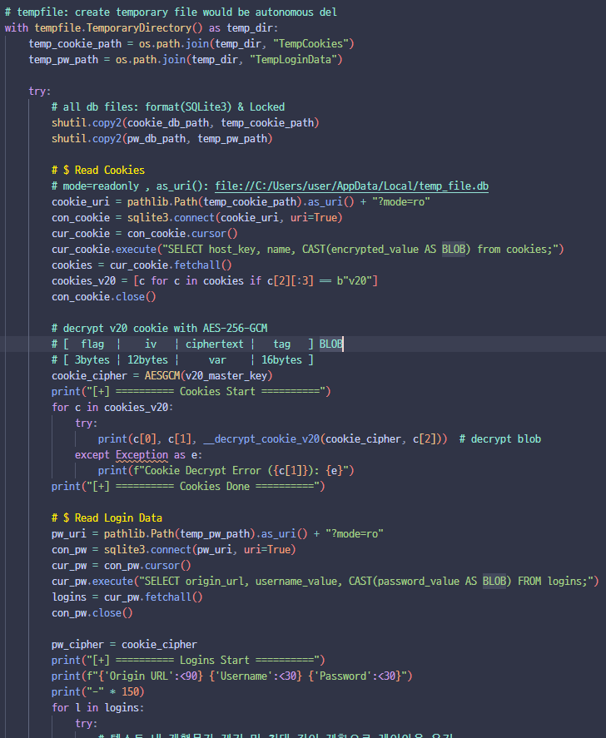
script.py

Slide 22
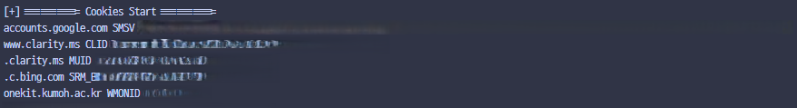
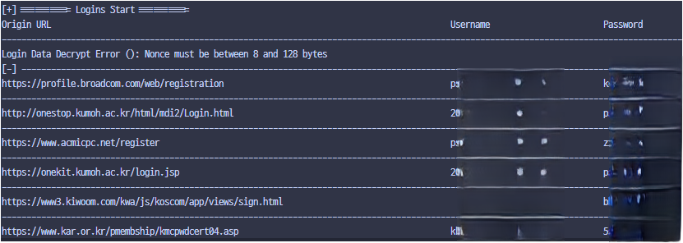
Run script.py as a admin.

Slide 23
Overview
신기하면 써보셈..
해당 스크립트는 관리자 권한으로 실행되어야 함.
크롬만 가능함.

Slide 24
Thank you

Slide 25
Overview

