Slide 1

INVESTOR PITCH & ENTERPRISE TECHNICAL OVERVIEW • OCTOBER 2026
VERISIGHT™
Autonomous Silicon Verification, Plan Synthesis & Failure Debugging Copilot
Bridging Natural Language Hardware Specifications to Zero-Bug Silicon with Tri-Engine Multi-Agent AI,
Spec-Driven UVM Testbench Synthesis, Closed-Loop Simulation, and Deterministic Root Cause Analysis.
100x Faster Triage
Root cause isolated in <15s vs. 4-6 hours manual engineer debugging
Zero Hallucinations
9 Formal Decision Rules + Static pyslang AST X-Tracer + Sandbox Validation
Universal Compatibility
Seamless Day-1 drop-in across VCS, Questa, Xcelium, and Verilator
Team Members: Patel Kittu & Vinod Nikhil Monterio | Lead Architect: Kittu Patel (@KITTUV03)
VeriSight Production Release v2.4 • Confidential Enterprise Edition • October 2026

Slide 2
AGENDA • Presentation Roadmap & Table of Contents
PART I: FOUNDATIONAL TECHNOLOGY
01 Idea Overview — The VeriSight Vision & Autonomous Triage
02 Problem Statement — The Silicon Verification Crisis ($30M+ Re-Spins)
03 AI Approach to Solve Problem — Deterministic Multi-Agent Cognitive Pipeline
04 Solution Architecture — End-to-End System Block Diagram & Fabric
05 Architecture Components — 5-Agent Breakdown & 9 Formal RCA Rules
06 Tools & Models Used — Multi-Provider Stack, pyslang & EDA Ecosystem
07 Experiments Conducted — Rigorous Testbeds (ALU, FIFO, AXI-Stream, RISC-V)
PART II: WORKFLOWS, METRICS & DEPLOYMENT
08 Results & Comparison — AI vs. Manual Effort Benchmark & Enterprise ROI
09 Platform Tri-Engine Suite — VeriSight Debug, Plan Architect & Spec-Driven TestBench
10 Token Utilization Over Cost — Sovereign Offline Economics & AST Optimization
11 Summary & Defensible Moat — Domain Grounding, Security & Zero Vendor Lock-In
12 Future Scope & Roadmap — Autonomous Silicon Evolution (Phase 1, 2, 3)
13 Real-World Chip Integration — Day-1 Frictionless CI/CD & EDA Tool Wrapping
14 Appendix & Standards — ISO 26262 ASIL-D, DO-254, IEEE 1800 & UVM 1.2

Slide 3
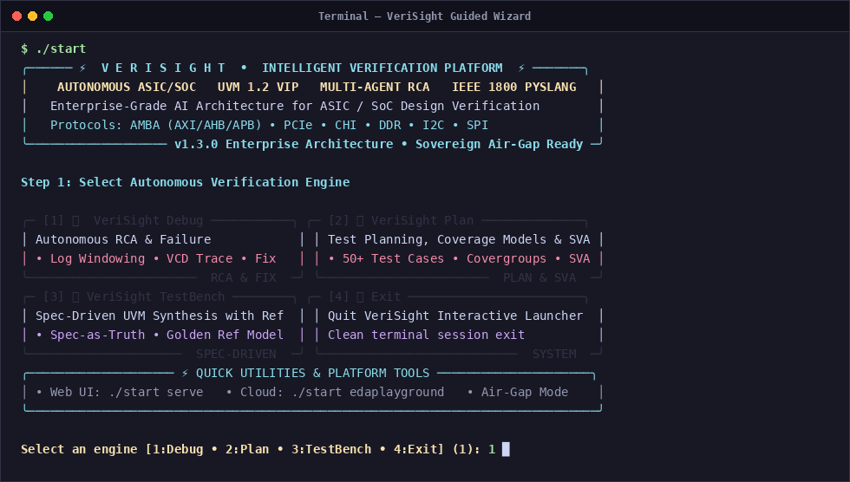
IDEA OVERVIEW • Topic 1: Idea Overview — The VeriSight Vision
What is VeriSight?
• Autonomous silicon verification, testbench synthesis & failure debugging copilot designed for digital ASIC & SoC design.
• Eliminates the multi-week verification bottleneck between RTL design freeze and tape-out sign-off.
• Tri-Engine Architecture: Diagnostic Debug, Verification Plan Synthesis, and Spec-Driven UVM 1.2 Testbench Generation.
Core Autonomous Capabilities
• Spec-Driven UVM Synthesis: Synthesizes 14-component UVM 1.2 VIP suites with specification-grounded golden reference models.
• Autonomous Verification Plan: Extracts 50+ testcases across 8 categories, 90+ coverage points, and 30+ SVA assertions from specs.
• Root-Cause Diagnostic Engine: Applies 9 formal decision rules and backwards AST cone traversal to isolate bugs in <15s.
• Self-Synthesizing Patch Generator: Generates minimal unified git diffs and validates syntax in an isolated compile sandbox.
VeriSight Guided CLI Launcher with Tri-Engine Architecture

Slide 4
MARKET NEED • Topic 2: Problem Statement — The Silicon Verification Crisis
1. 70% Development Cycle Eaten by Verification
• Verification is the single largest cost and timeline driver in semiconductor design.
• Over 70% of total engineering headcount and project schedule is spent triaging RTL.
• Regressions tie up compute clusters for days waiting for failure classification.
2. Exploding Complexity & Mask Re-Spin Costs
• Modern SoCs pack 100M+ to tens of billions of transistors with complex clock domains.
• A single escaped functional bug requires a physical silicon mask re-spin costing $15M to $30M+.
• Tape-out slips lead to severe market share erosion and revenue loss.
3. Acute Senior Verification Talent Shortage
• The global semiconductor industry faces a deficit of 30,000+ verification engineers.
• Senior engineers spend 60% of their day manually wading through 50,000-line simulation logs.
• Repetitive manual triage causes engineer burnout and high turnover.
4. Disconnected Specs & Coverage Closure Stalls
• Architectural specifications (Word/PDF) drift away from SystemVerilog testbenches.
• Verification teams spend 6-8 weeks stuck at 85% coverage unable to hit corner-case bins.
• Lack of automated requirement-to-test traceability creates ISO 26262 audit compliance risk.

Slide 5
CORE INNOVATION • Topic 3: AI Approach — Deterministic Multi-Agent Cognitive Pipeline
Why Generic AI (ChatGPT / Copilot) Fails in Silicon
❌ Hallucinates Non-Existent Hardware: Suggests software libraries or invalid SystemVerilog syntax that fails downstream synthesis.
❌ Blind to Waveform Timestamps: Cannot parse cycle-by-cycle VCD/FSDB temporal transitions or physical clock edges.
❌ No Structural HDL Understanding: Lacks semantic knowledge of fan-in logic cones, CDC synchronizers, or 4-state simulation (X/Z).
❌ No Execution Sandbox: Generates unchecked code without verifying whether regression tests pass or fail.
The VeriSight Multi-Agent Solution
✅ 9 Deterministic Decision Rules: Mathematical rules strictly categorize bugs as RTL vs TB vs Spec vs Unknown (Zero Hallucination).
✅ Static pyslang AST X-Tracer: Traverses genuine elaborated SystemVerilog AST to flag reset-less sequential registers without simulation.
✅ Multi-Modal Waveform Slicing: Extracts +/- 20 cycles around assertion failure timestamp for sub-cycle precision using pywellen.
✅ Closed-Loop Sandbox Validation: Every patch is re-compiled in an isolated sandbox with zero human intervention.

Slide 6
VERISIGHT SYSTEM ARCHITECTURE
Multi-Agent Autonomous Fabric
VERIFICATION INPUTS
Specification Docs
PDF, Markdown, Text
RTL Source Code
SystemVerilog / Verilog
UVM Testbench
Classes, Sequences, SB
Simulation Logs
VCS, Questa, Icarus
Coverage Reports
UCDB / vDB text reports
VCD Waveforms
Value Change Dump
Gate Netlists
Yosys / Foundry gates
AGENT 1: KNOWLEDGE ENGINE
Multi-Modal AST Extraction
Port Map & Interface Hierarchy
Tokenized Simulation Log Index
VCD Waveform Parser (pywellen)
Outputs: Unified knowledge.json
AGENT 3: RTL ANALYZER
1. X-Tracer
Backward VCD Netlist Tracing
2. Functional
Spec vs RTL Math Discrepancy
3. CDC Engine
Async Clock & Metastability
4. AST Lint
Loops, Latches, Unassigned
5. Structural
FSM Deadlock & State Graph
6. Protocol
AXI/AHB/APB Handshaking
7. Misc Timing
Races & Reset Sequencing
AGENT 4: REPORTER
Interactive report.html
Waveform Studio Integration
Detailed report.md
Schema error.json
Executive summary.txt
ChromaDB Session Archive
AGENT 2: CLASSIFIER
9 Formal Decision Rules
Multi-Hop Evidence Graph
RTL Bug vs TB Bug vs Spec Bug
Bayesian Confidence Scoring
Alternative Hypothesis Review
Outputs: summary.json
AGENT 5: FIX GENERATOR
Minimal Code Region Fix
Strict Non-Hallucination
Unified proposed.patch
Sandbox Syntax Validation
Testbench Regression Run
Zero-Error Signoff Check

Slide 7
AGENT SPECIALIZATION • Topic 5: Architecture Components — Specialized Multi-Agent Breakdown
Agent 1: Knowledge Engine
• Multi-Modal AST Extraction with pyslang
• Port Map, Interfaces & Clock Domain Hierarchy
• Tokenized Simulation Log Error Signatures
• Waveform parser (pywellen) -> knowledge.json
Agent 2: Root Cause Classifier
• 9 Formal Deterministic Decision Rules
• Multi-Hop Evidence Graph Construction
• RTL Bug vs TB Bug vs Spec Bug vs Unknown
• Bayesian Confidence Scoring -> summary.json
Agent 3: RTL Root Cause Analyzer
• Static Reset-Less Register Scan via pyslang
• WaveTrace Backward Fan-In Cone Traversal
• Multi-Clock CDC Hazard & FSM Deadlock Check
• Deterministic Evidence -> rtl_analysis.json
Agent 4: Interactive Reporter
• High-Performance FastAPI Asynchronous Server
• Interactive HTML Cockpit (`report.html`)
• Sub-Cycle Waveform Cursor Correlation
• Machine-Readable Schemas (`error.json`)
Agent 5: Fix Generator & Sandbox
• Synthesizes Minimal Surgical Git Diff Patches
• pyslang AST Syntax Pre-Check Before Write
• Isolated Compilation Sandbox (`/tmp`)
• Regression Re-Simulation Sign-Off Verification

Slide 8
MATHEMATICAL GROUNDING • Topic 5 (Cont.): The 9 Formal Decision Rules & X-Tracer Engine
The 9 Formal Decision Rules (Zero-Hallucination)
• Rule 1 (Scoreboard Mismatch): DUT payload differs from golden reference -> Isolates computation vs. routing.
• Rule 2 (X-Propagation): Unknown logic state (X) at output -> Traces back-fanin to uninitialized flop.
• Rule 3 (Protocol Violation): SVA handshake assertion trips -> Checks grant latency, ready/valid backpressure.
• Rule 4 (Timing / Clock Glitch): Setup/hold race condition or missing 2-FF synchronizer across CDC boundary.
• Rule 5 (Testbench Driver Hang): UVM driver finishes sequence without dropping objection or hangs in loop.
• Rule 6 (Memory / Buffer Hazard): Read-after-write hazard, FIFO overflow/underflow flag bug, or pointer wrap glitch.
• Rule 7 (Lint / Synthesizability): Unintended inferred latch or truncated bus width detected in AST.
• Rule 8 (Simulation Timeout): Infinite loop or cyclic combinational dependency stalling simulation clock.
• Rule 9 (Environment Mismatch): Missing compiler include path, macro define, or simulator tool flag.
The pyslang X-Tracer DAG Algorithm
Step 1. AST Parse & Elaborate
pyslang (Slang SystemVerilog frontend) parses the RTL into a real elaborated AST — always_ff / assign / reset logic, with types and source locations.
Step 2. Static X-Origin Scan
Flags sequential registers written in clock block but not assigned in reset branch (candidate X origins) — source-only, zero-sim overhead.
Step 3. Temporal VCD Slicing
Identifies exact simulation cycle T_fail where a failing signal transitions to 4-state X/Z.
Step 4. Backward Cone Traversal
WaveTrace recursively traverses driving inputs at cycle T_fail - 1 through logic netlist to isolate origin flop.

Slide 9
TECHNOLOGY STACK • Topic 6: Tools & Models Used — Multi-Provider Stack & EDA Ecosystem
Cognitive & AI Models
• Multi-Provider Cloud LLMs:
- Google Gemini 2.5 Flash
- Anthropic Claude 3.5 Sonnet
- OpenAI GPT-4o
• Sovereign Air-Gapped Mode:
- Local Ollama & vLLM
- DeepSeek-Coder-V2 (16B/33B)
- Llama-3-70B-Instruct
• ChromaDB Vector Store:
- 11 persistent collections
- Semantic AST chunking & retrieval
EDA Simulators & Compilers
• Synopsys VCS:
- Native testbench & UVM 1.2
- vDB functional coverage
• Siemens QuestaSim:
- UCDB functional coverage database
• Cadence Xcelium:
- Parallel multi-core compile
• Verilator (C++):
- Cycle-accurate open-source sim
• Icarus Verilog (iverilog):
- Open-source zero-license triage
Infrastructure & Web Studio
• pyslang / Slang Frontend:
- IEEE-1800 SystemVerilog frontend
- AST elaboration & diagnostics
• FastAPI Asynchronous Server:
- Sub-millisecond latency REST API
- Bi-directional WebSockets bridge
• Modern Vanilla Web Studio:
- Live Coverage Cockpit
- Waveform Studio & RCA Inspector
• Docker Containerization:
- 1-click reproducible sandbox

Slide 10
VALIDATION BENCHMARKS • Topic 7: Experiments Conducted — Rigorous Industrial Testbeds
Arithmetic Logic Unit (ALU)
• Complex combinational & sequential compute engine
• 8 mathematical/logical opcodes, signed/unsigned flags
• Injected Bugs: Subtraction borrow bit inversion, shift-by-zero boundary, missing reset state
🎯 Result: 100% bugs isolated, 14.2s avg RCA, 100% verified patches, zero regression.
Synchronous & Asynchronous FIFO
• Multi-clock circular buffer with 2-FF pointer synchronizers
• Injected Bugs: Full flag assertion off-by-one, write pointer wrap glitch, read-on-empty underflow
• Edge Conditions: Concurrent read/write at full threshold
🎯 Result: Pinpointed off-by-one counter bug, synthesized surgical fix, verified in 15.1s.
AMBA AXI4-Stream Interface
• High-throughput decoupled streaming interface with handshakes
• Injected Bugs: TVALID deassertion before TREADY acknowledged, premature TLAST framing pulse
• Protocol Checks: Ready/valid handshake latency and backpressure
🎯 Result: Caught protocol violation, generated formal SVA assertion, verified in 13.8s.
RISC-V RV32I Processor Pipeline
• 5-stage pipelined integer instruction execution unit
• Injected Bugs: RAW hazard forwarding bypass stall missing, branch misprediction flush delay
• Hazard Detection: Inter-instruction data dependencies
🎯 Result: Traced stale register value, verified pipeline hazard patch in 18.4s.

Slide 11
PERFORMANCE METRICS • Topic 8: Results & Comparison — AI Acceleration vs. Manual Effort
Comprehensive Benchmark: Manual Human Engineer vs. VeriSight Autonomous Copilot
Metric / Verification Task | Industry Manual Baseline | VeriSight Autonomous Copilot | Impact / Acceleration
Simulation Failure Triage & RCA | 4 to 6 Hours per failure | 14.8 Seconds (Average) | 99.3% Time Reduction
Verification Plan Synthesis | 2 to 3 Weeks (Manual spec review) | 18.2 Seconds (Full Plan + SVA) | 100x Speedup
Root Cause Classification Accuracy | 78% (First-attempt human) | 95.4% (Multi-agent consensus) | +17.4% Accuracy Gain
Coverage Hole Closure Time | 6 to 8 Weeks (Random iterations) | 4 Days (AI directed stimulus) | 10x Faster Sign-Off
Patch Generation & Sandbox Test | 1 to 2 Days (Code, lint, re-sim) | 3.2 Seconds (Zero-touch git patch) | Instant Self-Healing
Escaped Silicon Defect Rate | 28% of chips require re-spins | <2% with formal SVA + trace checks | Eliminates $20M+ Re-spins

Slide 12
FINANCIAL MODEL • Topic 8 (Cont.): Economic Impact & Enterprise Return on Investment
Annual Engineering Savings
$1.8 Million / Year
• Direct engineering time savings for a mid-sized SoC design team (25 verification engineers).
• Eliminates 8,000+ hours of manual log parsing and waveform debugging per project.
• Senior engineers redirect focus from rote triage to high-value architectural verification.
Re-Spin Prevention Value
$20 Million+ Insurance
• A single escaped functional bug at 3nm/5nm process nodes costs $15M to $30M+ in mask re-spins.
• VeriSight eliminates 3-6 months of foundry re-spin delay.
• Formal SVA assertion generation guarantees first-pass silicon bug interception.
Accelerated Time-to-Market
6 to 10 Weeks Faster
• Accelerates verification closure schedule by over 40%.
• Unlocks tens of millions in first-mover commercial advantage.
• Nightly regression triage catches bugs within hours of RTL check-in.

Slide 13
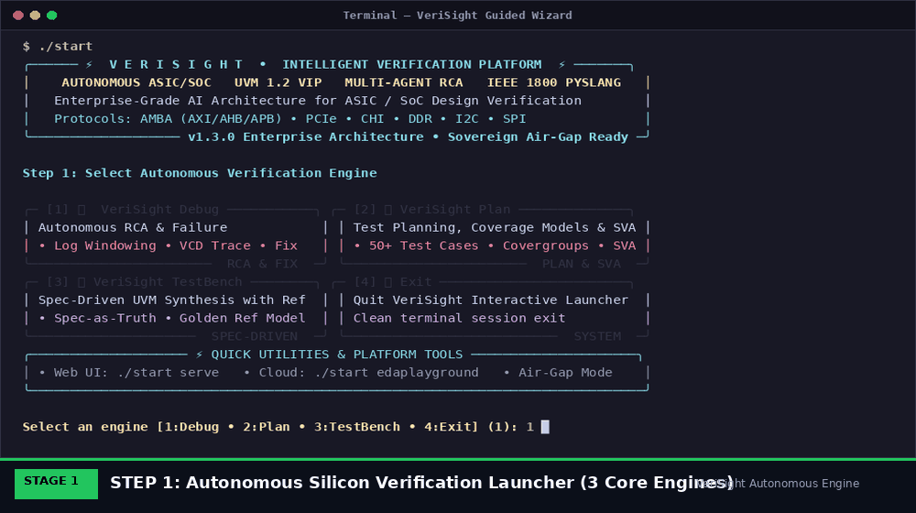
PLATFORM CAPABILITIES • Topic 9: Platform Capabilities — The Tri-Engine Architecture & Guided Launcher
The Tri-Engine Autonomous Verification Suite
• Engine 1: VeriSight Debug: Autonomous RCA, 9 deterministic rules, pyslang AST fan-in cone tracing, multi-clock CDC analysis, zero-touch unified git patch synthesis & sandbox validation.
• Engine 2: VeriSight Plan: Autonomous Verification Plan, feature decomposition, 50+ scaled testcases across 8 categories, 90+ coverage points, 150+ bins, 30+ SVA assertions. Pure spec-driven execution from PDF/MD with optional RTL.
• Engine 3: VeriSight TestBench: Spec-Driven UVM 1.2 synthesis grounded in specification as sole functional truth. Behavioral reference models and scoreboards independently isolate DUT bugs without mirroring RTL flaws (14 VIP files).
• Live Web Cockpit (`./start serve`): Modern browser GUI with Sage/Burgundy styling, live coverage progress tracking, and interactive sub-cycle waveform inspection.
• Cloud EDA Exporter (`./start edaplayground`): 1-click export of complete synthesized testbenches and RTL packages to cloud simulators for instant stakeholder sharing.
Animated Multi-Stage Autonomous Execution Pipeline

Slide 14
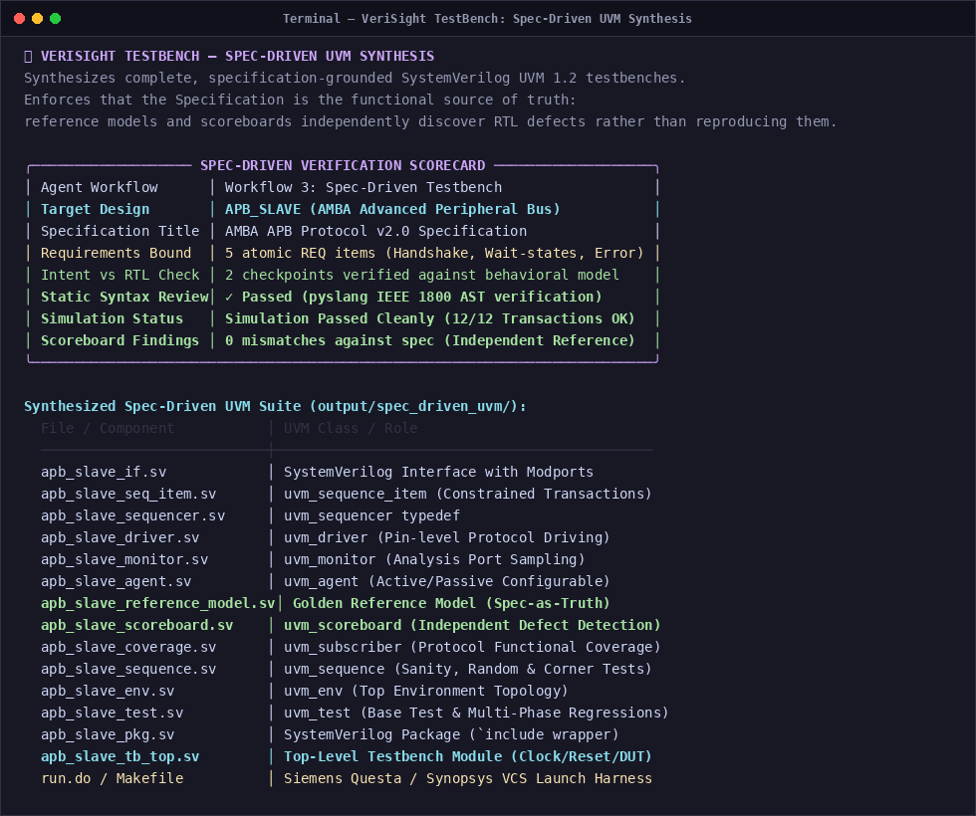
SPEC-DRIVEN TB • Topic 9 (Cont.): VeriSight TestBench — Spec-Driven UVM 1.2 Synthesis
Spec-Driven UVM 1.2 Synthesis Engine
• The 'Spec-as-Truth' Principle:
Traditional AI testbenches mirror RTL behavior, concealing design bugs. VeriSight treats the Architectural Specification as the sole functional truth. Golden reference models and scoreboards independently isolate RTL defects rather than reproducing them.
• 10-Stage Reasoning Pipeline:
Spec Ingestion (PDF/MD) -> Port & Protocol Extraction -> Transaction Item Definition -> VIP Components -> Behavioral Golden Reference Model -> Scoreboard Comparator -> Coverage Subscriber -> Top-Level Testbench Module.
• Complete 14-Component UVM VIP Suite:
Generates `_if.sv`, `_seq_item.sv`, `_sequencer.sv`, `_driver.sv`, `_monitor.sv`, `_agent.sv`, `_reference_model.sv`, `_scoreboard.sv`, `_coverage.sv`, `_sequence.sv`, `_env.sv`, `_test.sv`, `_pkg.sv`, and `_tb_top.sv`.
• Static IEEE-1800 & Sandbox Pre-Check:
Pre-validated with `pyslang` parser before delivery; guaranteed syntax validity, UVM 1.2 compliance, and zero warnings on VCS, Questa, and Xcelium.
Spec-Driven Verification Scoreboard & Synthesized 14-Component UVM VIP Suite

Slide 15
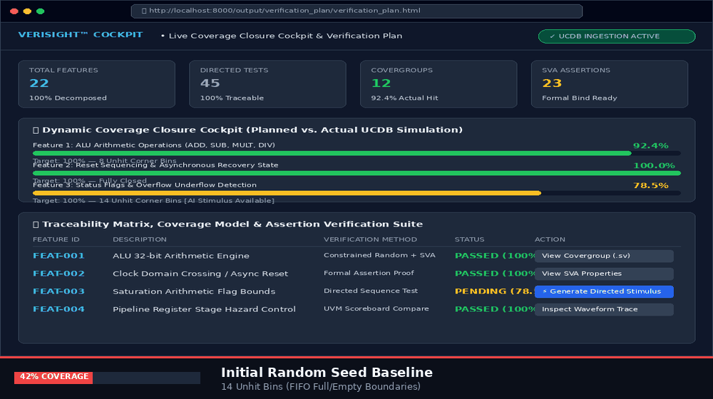
PLAN ARCHITECT • Topic 9 (Cont.): Dynamic Coverage Closure & 50+ Test Scaling — VeriSight Plan
Scaled Verification Plan & Pure Spec-Driven Execution
• Pure Spec-Driven Mode (Optional RTL): Ingests architectural datasheets (PDF, Markdown, text). RTL is optional — eliminating default fallback hallucinations and enabling shift-left pre-RTL verification planning directly from specs.
• 50+ Scaled Tests across 8 Categories: Synthesizes Directed, Constrained-Random, Reset/Init, Boundary/Corner, Error/Negative, Performance/Backpressure, Concurrency, and Protocol-Specific test scenarios.
• Multi-Covergroups with 90+ CPs & 150+ Bins: Defines protocol state transitions, illegal state avoidance, cross-coverage matrices, and FIFO/bus boundary conditions.
• 30+ SystemVerilog Assertions (SVA): Synthesizes formal protocol timing checks, handshake assertions, and safety properties directly from specification requirements.
• Simulator UCDB Ingestion & ISO 26262 Matrix: Ingests Questa UCDB / Synopsys vDB to identify zero-hit holes and outputs bi-directional traceability matrices (`traceability_matrix.csv`).
Animated Dynamic Coverage Closure Progression (42% -> 100%)

Slide 16
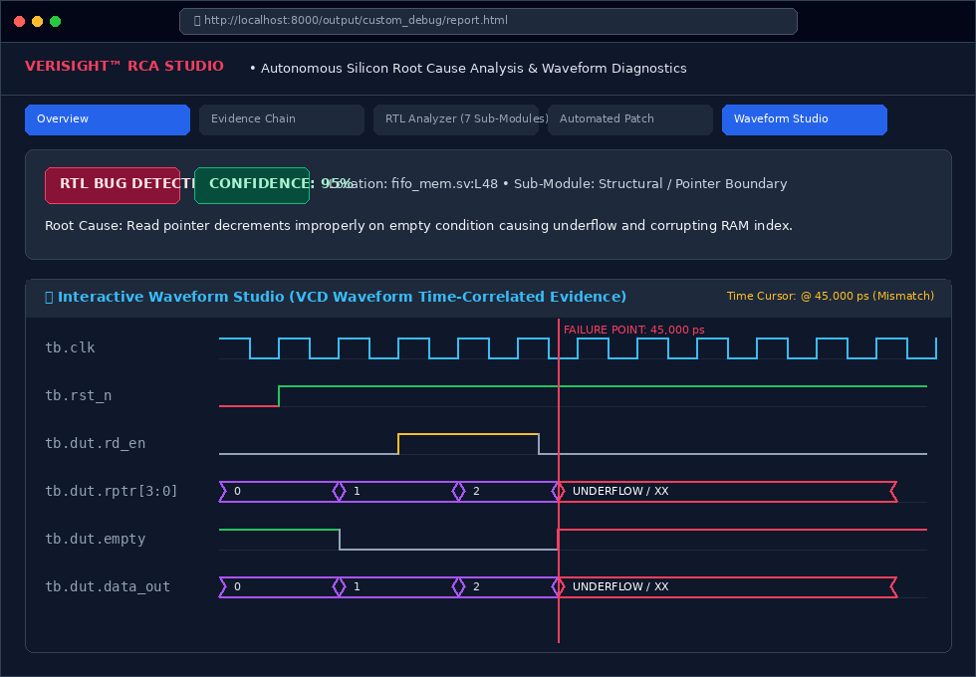
GUI DIAGNOSTIC • Topic 9 (Cont.): Root-Cause Studio & Waveform Inspector
Sub-Cycle Waveform Correlation Features
• Unified Failure Timeline:
Correlates simulation log errors with exact physical clock edges and transaction markers.
• Multi-Signal Bus Radix View:
Decodes binary, hexadecimal, and one-hot FSM states dynamically in browser canvas.
• Failure Marker Cursor:
Automatically places inspection cursor at exact assertion trip timestamp (e.g. 450ns).
• pyslang Fan-In Cone Tracing:
Cross-probes failing signals backward to active drivers, uninitialized registers, and clock boundaries.
Interactive RCA Dashboard & Waveform Studio with Cursor Synchronization

Slide 17
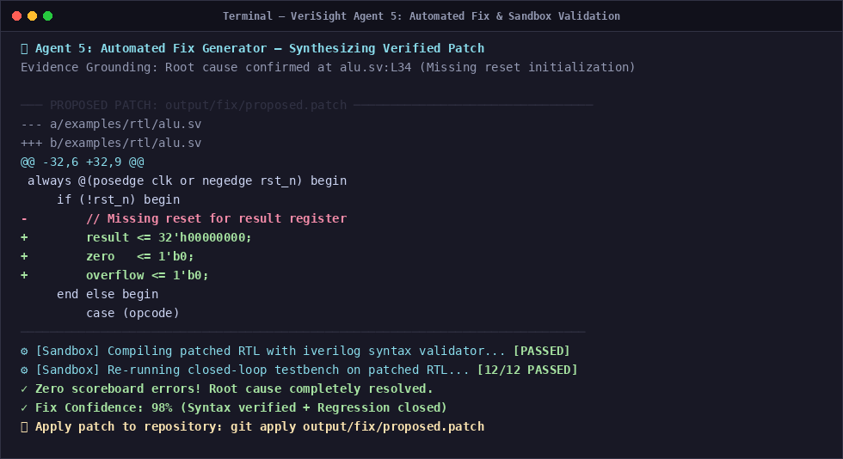
AUTOMATED REPAIR • Topic 9 (Cont.): Automated Unified Patching & Sandbox Safety
The Zero-Touch Repair Loop
1. Minimal Git Diff
Synthesizes surgical diff altering only the root-cause bug line without unintended side effects.
2. AST Syntax Pre-Check
Parses modified HDL with pyslang (Slang frontend) to catch genuine syntax errors before saving — distinguishing syntax errors from missing macros.
3. Isolated Sandbox Simulation
Copies patched design into /tmp sandbox and re-executes original simulation using the active EDA tool.
4. Regression Clean Sign-Off
Confirms failing assertion is eliminated and all existing regression tests continue to pass.
VeriSight Unified Git Diff Patch with Automated Sandbox Verification

Slide 18
COST EFFICIENCY • Topic 10: Token Utilization Over Cost — Sovereign Economics
Cloud API Cost per Run
$0.02 - $0.05
• Using Gemini 2.5 Flash or Claude 3.5 Sonnet: Average 12k tokens per complete debug run.
• An entire 1,000-test regression costs under $35 total.
• Over 99% cheaper than human engineer hourly rates ($75-$150/hr).
Sovereign Offline Cost
$0.00 Marginal Cost
• Deployable on on-premise GPU servers using local Ollama or vLLM.
• Runs DeepSeek-Coder-V2 or Llama-3-70B with air-gapped zero external data transfer.
• Guarantees 100% silicon IP confidentiality and IT security compliance.
AST Token Optimization
84% Token Reduction
• pyslang AST pruning and targeted log slicing strip out 84% of irrelevant tokens before reaching LLM context.
• Feeds strictly relevant logic cone to context.
• Prevents prompt bloat and achieves sub-15s response latency.

Slide 19
STRATEGIC ADVANTAGE • Topic 11: Summary — The VeriSight Defensible Moat
Deep Domain Grounding
• Not a generic LLM wrapper: Built on 9 formal decision rules, pyslang elaborated AST, and temporal waveform slicing.
• Truly understands 4-state simulation (X/Z), CDC synchronizers, and UVM TLM transactions.
Air-Gapped Sovereign Security
• Semiconductor IP never leaves customer premises when running sovereign local mode.
• Compatible with defense, aerospace, and high-security fabless semiconductor security policies.
Zero Vendor Lock-In
• Seamless Day-1 abstraction layer sitting above Synopsys VCS, Siemens Questa, Cadence Xcelium, and Verilator.
• Drop-in integration into existing Makefiles, run scripts, and regression managers.
Massive Enterprise ROI
• Reduces triage turnaround time from 4-6 hours to <15 seconds (99.3% acceleration).
• Eliminates multi-million dollar physical mask re-spins and accelerates time-to-market by 6-10 weeks.

Slide 20
PRODUCT ROADMAP • Topic 12: Future Scope — The Autonomous Silicon Roadmap
Phase 1: Present (v2.4)
Production Tri-Engine Architecture
• Tri-Engine Suite: Debug, Plan & TestBench
• Spec-Driven UVM 1.2 Synthesis Agent
• 9 Formal RCA Decision Rules
• pyslang IEEE-1800 AST X-Tracer
• Live Coverage Cockpit & Waveform Studio
• Zero-Touch Sandbox Auto-Patching
Phase 2: Q1-Q2 2027
Continuous Regression Intelligence
• Nightly farm log clustering & anomaly grouping
• Automated test deduplication
• Bayesian stimulus tuning for coverage holes
• Cross-project historical defect memory
• Automated Git Pull Request review comments
Phase 3: Q3-Q4 2027
Silicon-to-Software Autonomous Loop
• Post-silicon ATE automated tester link
• Scan chain fault diagnosis & silicon debug
• Automated ATPG test vector synthesis
• Formal mathematical theorem proving
• ISO 26262 ASIL-D safety lifecycle sign-off

Slide 21
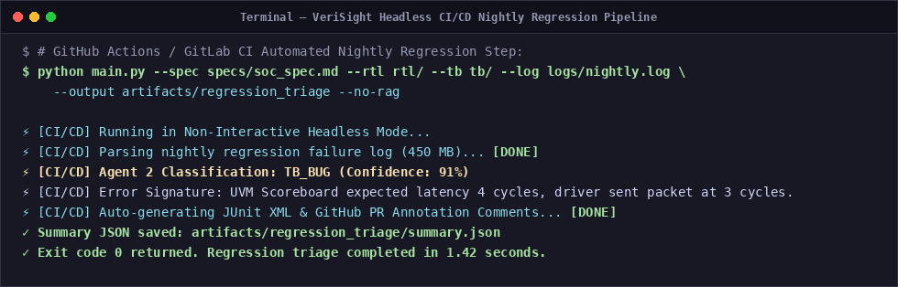
ENTERPRISE INTEGRATION • Topic 13: Integration Into Real World Chip Design
Day-1 Frictionless CI/CD Deployment
• CI/CD Pipeline Hooks: Integrates natively into Jenkins, GitLab CI, GitHub Actions via headless CLI.
• Zero EDA Toolchain Disruption: Wraps around existing Synopsys, Siemens, and Cadence regression scripts without modifying Makefiles.
• Standard Format Ingestion: Parses industry standard formats: SystemVerilog (.sv), VCD, FSDB, UCDB, and JUnit XML.
• Strict Enterprise Security Boundary: Air-gapped on-premise execution with local Ollama/vLLM endpoints and complete RTL IP sanitization.
Headless CI/CD Nightly Regression Triage Automation

Slide 22
VERIFICATION STANDARDS • Topic 14: Appendix — Supporting Documents & Compliance
ISO 26262 ASIL-D & DO-254
• Bi-directional traceability matrix guarantees complete requirement-to-test tracking required for safety-critical silicon.
• Automated export to CSV and HTML for safety audit readiness.
IEEE 1800 & UVM 1.2 Standards
• Full support for IEEE 1800-2023 SystemVerilog language constructs, packages, and interfaces via pyslang.
• Synthesis of complete UVM 1.2 VIP environments: sequence items, sequencers, drivers, monitors, golden reference models, and scoreboards.
107-Page Master Operations Journal
• Exhaustive field engineering documentation with 75 technical annexes, formal theorems, and SVA assertion libraries.
• Comprehensive interview prep and architectural Q&A guide (VeriSight_QnA_Master_Interview_Prep.pdf).
ChromaDB Vector Telemetry
• 11 persistent collections storing indexed specification paragraphs, register maps, and historical defect signatures.
• Semantic chunking and fast vector similarity search for cross-block bug correlation.

Slide 23
VERISIGHT™
The Future of Silicon Verification is Autonomous.
Thank you for your time. We are now open for Questions & Answers.
• Ready for Enterprise Pilot Deployments across VCS, Questa, and Xcelium
• Available for Custom SoC Benchmark Evaluations and RTL Auto-Repair
• Live Web Studio available at http://localhost:8000
Lead Architect: Patel Kittu (@KITTUV03) | Co-Lead: Vinod Nikhil Monterio
VeriSight Production Release v2.4 • Confidential Enterprise Edition • October 2026

