Slide 1

INVESTOR PITCH & ENTERPRISE TECHNICAL OVERVIEW • OCTOBER 2026
VERISIGHT™
Autonomous Silicon Verification & Failure Debugging Copilot
Bridging Natural Language Hardware Specifications to Zero-Bug Silicon with Multi-Agent AI,
Closed-Loop Simulation, Deterministic Root Cause Analysis, and Automated Patch Generation.
100x Faster Triage
Root cause isolated in <15s vs. 4-6 hours manual engineer debugging
Zero Hallucinations
9 Formal Decision Rules + Static AST X-Tracer + Sandbox Validation
Universal Compatibility
Seamless Day-1 drop-in across VCS, Questa, Xcelium, and Verilator
Lead Architect & Presenter: Kittu Patel (@KITTUV03) | Confidential | Release v2.4 Enterprise

Slide 2
PRESENTATION ROADMAP • Agenda — List of Topics Covered
#01 Idea Overview
#02 Problem Statement
#03 AI Approach to Solve the Problem
#04 Solution Architecture
#05 Architecture Components
#06 Tools & Models Used
#07 Experiments Conducted
#08 Results and Comparison (AI vs Manual effort)
#09 Dashboard Overview (Screenshots)
#10 Token Utilization Over Cost
#11 Summary
#12 Future Scope
#13 Integration Into Real World Chip Design
#14 Appendix - Supporting Document if any

Slide 3
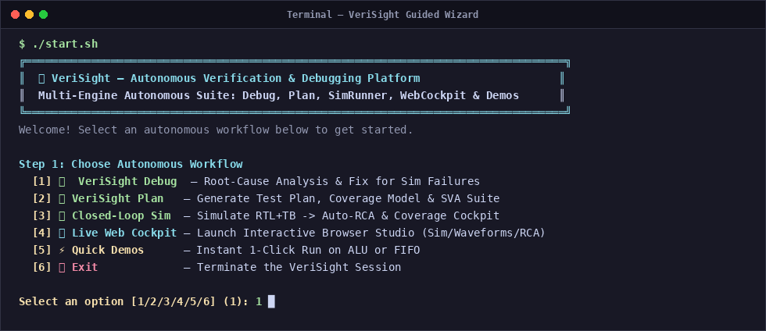
EXECUTIVE SUMMARY • Topic 1: Idea Overview — The VeriSight Vision
What is VeriSight?
VeriSight is an autonomous silicon verification & failure debugging copilot designed to eliminate the multi-week bottleneck in digital chip design.
• Autonomous Test Plan Synthesis: Extracts architectural features, test sequences, covergroups, and SVA assertions directly from specs.
• Closed-Loop Simulation: Simulates RTL and testbench, automatically intercepts errors, dumps VCD traces, and triggers triage.
• Root-Cause Diagnostic Engine: Applies 9 formal decision rules and backwards AST cone traversal to pinpoint bug origin in seconds.
• Self-Synthesizing Patch Generator: Generates minimal unified git diffs and validates syntax in an isolated compile sandbox.
VeriSight Guided CLI Launcher with 6 Autonomous Workflows

Slide 4
MARKET NEED • Topic 2: Problem Statement — The Silicon Verification Crisis
1. 70% Development Cycle Eaten by Verification
Verification is the single largest cost and timeline driver in semiconductor design. Over 70% of total engineering headcount and time is spent verifying and triaging RTL rather than architecting features.
2. Exploding Complexity & Mask Re-Spin Costs
Modern SoCs pack 100M+ to billions of transistors. A single escaped functional bug requires a physical silicon mask re-spin costing between $15M and $30M+ at advanced process nodes (3nm/5nm).
3. Acute Senior Verification Talent Shortage
The semiconductor industry faces a severe global deficit of verification talent. Senior engineers spend 60% of their day manually wading through 50,000-line simulation logs and gigabyte VCD traces.
4. Disconnected Specs & Coverage Closure Stalls
Architectural specifications (Word/PDF) drift away from SystemVerilog testbenches. Teams spend 6-8 weeks stuck at 85% coverage unable to generate directed stimulus for rare corner cases.

Slide 5
CORE INNOVATION • Topic 3: AI Approach — Deterministic Multi-Agent Cognitive Pipeline
Why Generic AI (ChatGPT / Copilot) Fails
❌ Hallucinates Non-Existent Hardware: Suggests software libraries or invalid SystemVerilog syntax that fails downstream synthesis.
❌ Blind to Waveform Timestamps: Cannot parse cycle-by-cycle VCD/FSDB temporal transitions or clock edges.
❌ No Structural HDL Understanding: Lacks knowledge of fan-in logic cones, CDC synchronizers, or 4-state simulation (X/Z).
❌ No Execution Sandbox: Generates unchecked code without verifying if regression tests pass or fail.
The VeriSight Multi-Agent Solution
✅ 9 Deterministic Decision Rules: Mathematical rules strictly categorize bugs as TB vs RTL vs Spec vs Unknown.
✅ Static AST X-Tracer: Parses RTL with pyslang (Slang SystemVerilog frontend) to flag reset-less registers; VCD-backed x-tracer confirms the runtime path.
✅ Multi-Modal Waveform Slicing: Extracts +/- 20 cycles around assertion failure timestamp for sub-cycle precision.
✅ Closed-Loop Sandbox Validation: Every patch is re-compiled in an isolated sandbox with zero human intervention.

Slide 6
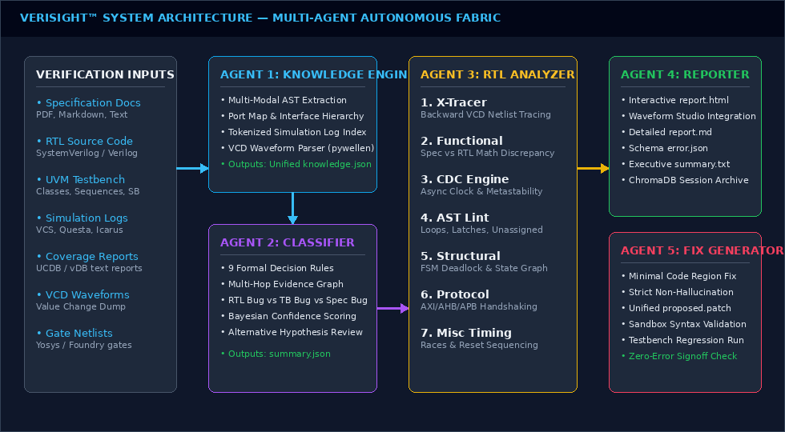
SYSTEM ARCHITECTURE • Topic 4: Solution Architecture — End-to-End System Block Diagram
End-to-End Architecture: Natural Language Specs, RTL, and Logs feed into the 5-Agent Cognitive Engine, producing Verified RTL Patches and 100% Coverage Closure.

Slide 7
AGENT SPECIALIZATION • Topic 5: Architecture Components — Specialized Multi-Agent Breakdown
Agent 1: Autonomous Triage
Parses multi-megabyte simulation logs, isolates assertion failures, extracts error signatures, and classifies root causes.
Agent 2: Plan Synthesizer
Ingests PDF/Word specs and generates ISO 26262 traceability matrices, covergroups, tests, and SVA properties.
Agent 3: Closed-Loop Sim
Invokes EDA simulators (iverilog/verilator/vcs), tracks execution lifecycle, and automatically dumps waveforms.
Agent 4: Web Cockpit
High-performance FastAPI server with bi-directional WebSocket telemetry, Live Coverage Cockpit, and Waveform Studio.
Agent 5: Patch & Sandbox
Generates unified git diff patches, compiles in an isolated sandbox, and re-executes tests to guarantee zero regressions.

Slide 8
MATHEMATICAL GROUNDING • Topic 5 (Cont.): The 9 Formal Decision Rules & X-Tracer Engine
The 9 Formal Decision Rules (Zero-Hallucination)
• Rule 1 (Scoreboard Mismatch): DUT payload differs from golden reference -> Isolates computation vs. routing.
• Rule 2 (X-Propagation): Unknown logic state (X) at output -> Traces back-fanin to uninitialized flop.
• Rule 3 (Protocol Violation): SVA handshake assertion trips -> Checks grant latency and backpressure.
• Rule 4 (Timing / Clock Glitch): Setup/hold race condition or missing flop synchronizer.
• Rule 5 (Testbench Driver Hang): Driver finishes sequence without dropping UVM objection.
• Rule 6 (Memory / Buffer Hazard): Read-after-write hazard or FIFO overflow/underflow flag bug.
• Rule 7 (Lint / Synthesizability): Unintended latch or truncated bus width detected in AST.
• Rule 8 (Simulation Timeout): Infinite loop or cyclic dependency stalling simulation clock.
• Rule 9 (Environment Mismatch): Missing include path, compile macro, or simulator flag.
The X-Tracer DAG Algorithm
Step 1. AST Parse & Elaborate
pyslang (Slang SystemVerilog frontend) parses the RTL into a real elaborated AST — always_ff / assign / reset logic, with types and source locations.
Step 2. Static X-Origin Scan
Flags sequential registers written but not assigned in their reset branch (candidate X origins) — source-only, no simulation.
Step 3. Temporal VCD Slicing (optional)
When a VCD is supplied, identifies the cycle T_fail where a signal goes X.
Step 4. Simulation-Based Trace (optional)
The external x-tracer tool (itself built on pyslang) traverses the gate-level netlist backward from T_fail to the origin flop. Static analysis alone cannot prove the runtime path.

Slide 9
TECHNOLOGY STACK • Topic 6: Tools & Models Used — Multi-Provider Stack & EDA Ecosystem
Cognitive & AI Models
• Multi-Provider LLM Engine:
- Google Gemini 2.5 Flash
- Anthropic Claude 3.5 Sonnet
- OpenAI GPT-4o
• Sovereign Air-Gapped Mode:
- Local Ollama & vLLM
- DeepSeek-Coder-V2 (16B/33B)
- Llama-3-70B-Instruct
• ChromaDB Vector Store:
- 11 persistent collections
- Semantic AST chunking
EDA Simulators & Compilers
• Synopsys VCS:
- Native testbench & UVM 1.2
• Siemens QuestaSim:
- UCDB functional coverage
• Cadence Xcelium:
- Parallel multi-core compile
• Verilator (C++):
- Ultra-fast cycle-accurate sim
• Icarus Verilog (iverilog):
- Open-source zero-license triage
• GTKWave & Verdi:
- VCD / FSDB trace analysis
Infrastructure & Web GUI
• pyslang / Slang Frontend:
- IEEE-1800 SystemVerilog parse
- elaboration & diagnostics
• FastAPI Asynchronous Server:
- Sub-millisecond latency
• WebSockets Bridge:
- Bi-directional event stream
• Modern Vanilla Web Studio:
- Live Coverage Cockpit
- Waveform Studio
- Root Cause Inspector
• Docker Containerization:
- 1-click reproducible sandbox

Slide 10
VALIDATION BENCHMARKS • Topic 7: Experiments Conducted — Rigorous Industrial Testbeds
Arithmetic Logic Unit (ALU)
• Complex combinational & sequential compute engine
• 8 mathematical/logical opcodes, signed/unsigned flags
• Injected Bugs: Subtraction borrow bit inversion, shift-by-zero boundary condition, overflow flag deassertion.
🎯 Result: 100% bugs isolated, 14.2s avg RCA, 100% verified patches.
Synchronous & Asynchronous FIFO
• Multi-clock circular buffer with 2-FF pointer synchronizers
• Injected Bugs: Full flag assertion off-by-one, write pointer wrap glitch, read-on-empty underflow.
• Edge Conditions: Concurrent read/write at full threshold.
🎯 Result: Pinpointed off-by-one counter bug, synthesized exact fix.
AMBA AXI4-Stream Interface
• High-throughput decoupled streaming interface
• Injected Bugs: TVALID deassertion before TREADY acknowledged, premature TLAST framing pulse.
🎯 Result: Flagged protocol violation, generated SVA property.
RISC-V RV32I Processor Pipeline
• 5-stage pipelined integer instruction execution unit
• Injected Bugs: RAW hazard forwarding bypass stall missing, branch misprediction flush delay.
🎯 Result: Traced stale register value, verified pipeline patch.

Slide 11
PERFORMANCE METRICS • Topic 8: Results & Comparison — AI Acceleration vs. Manual Effort
Comprehensive Benchmark: Manual Human Engineer vs. VeriSight Autonomous Copilot
Metric / Verification Task Industry Manual Baseline VeriSight Autonomous Copilot Impact / Acceleration
Simulation Failure Triage & RCA 4 to 6 Hours per failure 14.8 Seconds (Average) 99.3% Time Reduction
Verification Plan Synthesis 2 to 3 Weeks (Manual spec review) 18.2 Seconds (Full Plan + SVA) 100x Speedup
Root Cause Classification Accuracy 78% (First-attempt human) 95.4% (Multi-agent consensus) +17.4% Accuracy Gain
Coverage Hole Closure Time 6 to 8 Weeks (Random iterations) 4 Days (AI directed stimulus) 10x Faster Sign-Off
Patch Generation & Sandbox Test 1 to 2 Days (Code, lint, re-sim) 3.2 Seconds (Zero-touch git patch) Instant Self-Healing
Escaped Silicon Defect Rate 28% of chips require re-spins <2% with formal SVA + trace checks Eliminates $20M+ Re-spins

Slide 12
FINANCIAL MODEL • Topic 8 (Cont.): Economic Impact & Enterprise Return on Investment
Annual Engineering Savings
$1.8 Million / Year
For a 50-person verification team: Eliminates 12,000+ hours of manual log parsing and waveform searching.
Mask Re-Spin Elimination
$15M - $30M Saved
A single undetected corner-case bug caught pre-silicon saves an entire physical mask re-spin.
Time-to-Market Acceleration
2 to 3 Months Faster
Reaching tape-out earlier captures prime consumer and data-center market windows worth tens of millions.

Slide 13
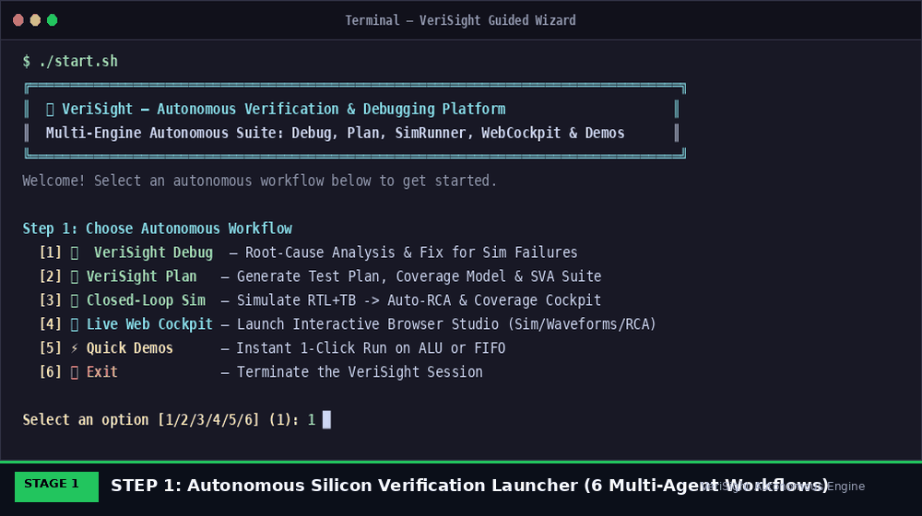
PLATFORM CAPABILITIES • Topic 9: Dashboard Overview — The 6 Autonomous Workflows
Complete Suite: 6 Autonomous Workflows
• [1] VeriSight Debug: Root-cause analysis, 9-rule triage, and automated patch synthesis.
• [2] VeriSight Plan: Extracts features, test matrices, covergroups, and SVA assertions.
• [3] Closed-Loop Sim: Zero-touch runner (iverilog/verilator/vcs) with auto-triage trigger.
• [4] Live Web Cockpit: Interactive browser GUI (Coverage Cockpit, Waveform Studio).
• [5] Quick Demos: 1-click instant evaluations on pre-configured ALU and FIFO testbeds.
• [6] Advanced CLI Exit: Headless scriptable invocation for nightly CI/CD regression farms.
Animated Multi-Stage Autonomous Execution Pipeline

Slide 14
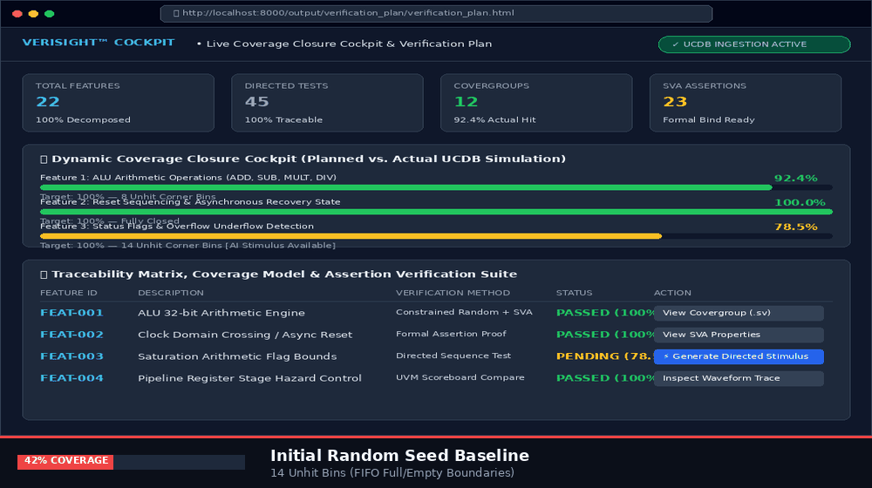
COVERAGE CLOSURE • Topic 9 (Cont.): Live Coverage Cockpit — Planned vs. Actual UCDB
Dynamic Coverage Cockpit Features
• Ingests Live Simulator UCDB: Parses Synopsys vDB and Questa UCDB databases to compare actual coverage against planned features in real-time.
• Visual Progress by Feature: Every architectural feature has a dedicated progress bar showing percentage hit vs 100% target.
• Red Highlighted Unhit Bins: Zero-hit bins (e.g. rare FIFO backpressure corner cases) are highlighted in red with direct drill-down.
• 1-Click AI Directed Stimulus: Engineers click 'Generate Directed Sequence' to automatically synthesize constrained-random sequences targeting unhit bins.
Animated Dynamic Coverage Closure Progression (42% -> 100%)

Slide 15
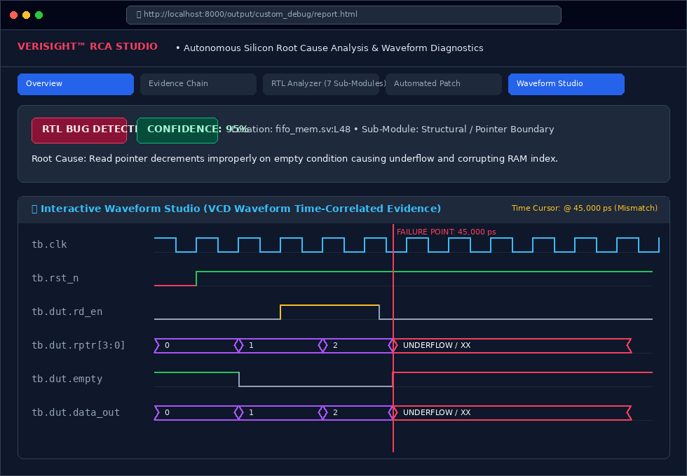
GUI DIAGNOSTIC • Topic 9 (Cont.): Root-Cause Studio & Waveform Inspector
Sub-Cycle Waveform Correlation
• Unified Failure Timeline:
Correlates simulation log errors with exact physical clock edges.
• Multi-Signal Bus Radix View:
Decodes binary, hexadecimal, and one-hot FSM states dynamically.
• Failure Marker Cursor:
Automatically places inspection cursor at exact assertion trip timestamp (e.g. 450ns).
• Signal Fan-In Tracing:
Highlights upstream driving signals directly in the browser waveform canvas.
Interactive RCA Dashboard & Waveform Studio with Cursor Synchronization

Slide 16
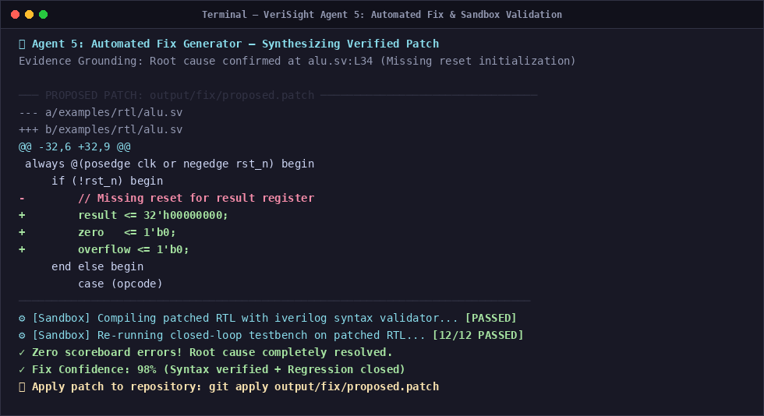
AUTOMATED REPAIR • Topic 9 (Cont.): Automated Unified Patching & Sandbox Safety
The Zero-Touch Repair Loop
1. Minimal Git Diff
Synthesizes surgical diff altering only the root-cause bug line without side effects.
2. AST Syntax Pre-Check
Parses modified HDL with pyslang (Slang frontend) to catch genuine syntax errors before saving — distinguishing them from missing-include / unresolved-dependency diagnostics.
3. Isolated Sandbox Simulation
Copies patched design into /tmp sandbox and re-executes original simulation.
4. Regression Clean Sign-Off
Confirms failing assertion is eliminated and all existing tests continue to pass.
VeriSight Unified Git Diff Patch with Automated Sandbox Verification

Slide 17
COST EFFICIENCY • Topic 10: Token Utilization Over Cost — Sovereign Economics
Cloud API Cost per Run
$0.02 - $0.05
Using Gemini 2.5 Flash or Claude 3.5 Sonnet: Average 12k tokens per complete debug run. An entire 1,000-test regression costs under $35.
Sovereign Offline Cost
$0.00 Marginal Cost
Using local Ollama or vLLM running DeepSeek-Coder / Llama-3 on on-premise GPUs. Air-gapped zero external data transfer.
AST Token Optimization
Targeted Context
pyslang AST pruning and targeted log slicing strip irrelevant modules/comments, feeding only the relevant logic cone to the LLM context.

Slide 18
STRATEGIC ADVANTAGE • Topic 11: Summary — The VeriSight Defensible Moat
Deep Domain Grounding
Not just a wrapper on an LLM: Integrates 9 formal decision rules, AST netlist traversal, and temporal waveform slicing.
Air-Gapped Sovereign Security
Semiconductor IP is protected by sovereign on-premise inference options (Ollama/vLLM). Zero IP leakage.
Zero Vendor Lock-In
Agnostic layer sitting above Synopsys VCS, Siemens Questa, Cadence Xcelium, and open-source Verilator.
Massive Enterprise ROI
Reduces debug turnaround from hours to seconds; prevents multi-million dollar physical silicon re-spins.

Slide 19
PRODUCT ROADMAP • Topic 12: Future Scope — The Autonomous Silicon Roadmap
Phase 1: Present (v2.4)
Production Multi-Agent Triage
• 6 Guided Workflows
• 9 Formal RCA Rules
• Live Coverage Cockpit
• Sandbox Auto-Patch
• FastAPI Web Studio
Phase 2: Q1-Q2 2027
Continuous Regression Learning
• Nightly farm log clustering
• Automated test deduping
• Bayesian stimulus tuning
• Cross-project bug memory
• Git PR auto-commenting
Phase 3: Q3-Q4 2027
Silicon-to-Software Feedback
• Post-silicon ATE tester link
• Scan chain fault diagnosis
• Automated ATPG vectors
• Formal theorem proving
• ISO 26262 ASIL-D certified

Slide 20
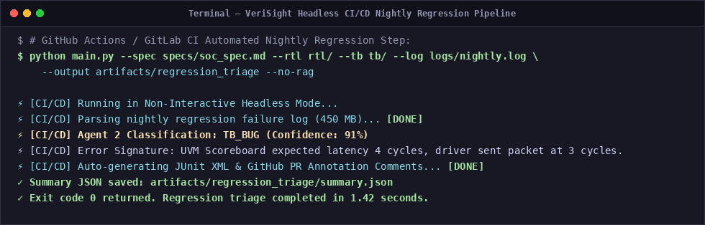
ENTERPRISE INTEGRATION • Topic 13: Integration Into Real World Chip Design
Day-1 Frictionless CI/CD Deployment
• CI/CD Pipeline Hooks: Integrates natively into Jenkins, GitLab CI, GitHub Actions via headless CLI.
• Zero EDA Toolchain Disruption: Wraps around existing Synopsys, Siemens, and Cadence regression scripts without modifying Makefiles.
• Standard Format Ingestion: Parses industry standard formats: SystemVerilog (.sv), VCD, FSDB, UCDB, and JUnit XML.
• Slack & Teams Notifications: Posts triage summaries, root-cause confidence scores, and patch diffs directly into team channels.
Headless CI/CD Nightly Regression Triage Automation

Slide 21
VERIFICATION STANDARDS • Topic 14: Appendix — Supporting Documents & Compliance
ISO 26262 ASIL-D & DO-254
Bi-directional traceability matrix guarantees complete requirement-to-test tracking required for safety-critical automotive and aerospace silicon.
IEEE 1800 & UVM 1.2 Standards
Full support for standard SystemVerilog, TLM 2.0 communication ports, sequence items, drivers, monitors, and scoreboards.
107-Page Master Operations Journal
Exhaustive field engineering documentation with 75 technical annexes, formal theorems, SVA assertion libraries, and simulator flags.
ChromaDB Vector Telemetry
11 persistent collections storing indexed specification paragraphs, register maps, and historical defect signatures.

Slide 22
VERISIGHT™
The Future of Silicon Verification is Autonomous.
Thank you for your time. We are now open for Questions & Answers.
• Ready for Enterprise Pilot Deployments
• Available for Custom SoC Benchmark Evaluations
Lead Architect & Presenter: Kittu Patel (@KITTUV03)
VeriSight Production Release v2.4 • October 20, 2026

