Slide 1
AI-Powered ASIC Verification Debugging Framework
From regression failure to root cause, fix, and reusable engineering knowledge.
Debug once. Learn once. Reuse everywhere.
Team | : | VeriSight
Members | : | Kittu Patel
 |  | Uday Karthikeyan
 |  | Vinod Nikhil Monteiro
Domain | : | Design Verification (DV)

Slide 2

Agenda
# | List of Topics Covered | Slide no.
1 | Idea Overview | 3
2 | Problem Statement | 5
3 | AI Approach to Solve the Problem | 7
4 | Solution Architecture | 8
5 | Architecture Components | 9
6 | Tools & Models Used | 11
7 | Experiments Conducted | 12
8 | Results and Comparison (AI vs Manual effort) | 13
9 | Dashboard Overview (Screenshots) | 14
10 | Token Utilization Over Cost | 16
11 | Summary | 17
12 | Future Scope | 18
13 | Integration Into Real World Chip Design | 19
14 | Appendix - Supporting Document if any | 20

Slide 3
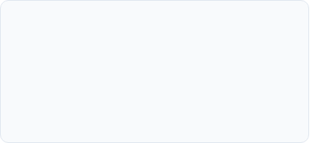
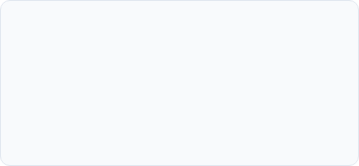
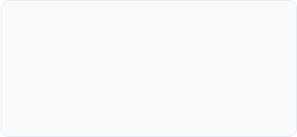
Idea Overview
AI-Powered ASIC Verification Debugging Framework
Turn hours of repetitive hardware debug into an intelligent, reusable, and token-efficient workflow.
The Framework automates the manual, repetitive ASIC/VLSI verification debug triage step after a simulation fails.
It automates hours of manual correlation into a single run, delivering an evidence-backed verdict and candidate fix.
Unified Knowledge
Multi-Agent Pipeline
Actionable Output
Ingests design specs, RTL source code, UVM testbench, simulation logs, coverage reports, and VCD waveforms.
Coordinates five specialized LLM agents to parse, analyze, classify, and generate verified fixes automatically.
Produces human-readable reports (MD, HTML), machine-readable JSON logs, and precise source-code diff patches.
Mirafra Confidential

Slide 4
Idea Overview (Contd.)
Hardware failures require correlation across RTL, SystemVerilog, UVM, logs, regressions, specifications, and waveforms.
The Framework provides a single AI entry point for hardware-debug workflows, offering deep verification analysis when required.
AI dynamically selects the required:
  MCP
  Skill
  Verification Agent
  Regression analysis
  Knowledge search
  Deep-debug flow
Previously solved failures are searched and reused before new analysis.
Provides deeper analysis for failures requiring RTL/UVM/spec/log/waveform correlation.
Debug results become shared organizational knowledge.
Mirafra Confidential

Slide 5
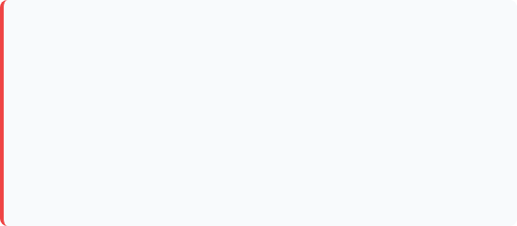
Problem Statement
Hardware Debug Is Slow, Repetitive, and Data-Heavy
The Verification Bottleneck
Debug requires multiple data sources.
Engineers repeatedly investigate similar failures.
Knowledge is distributed across engineers, databases, issues, and documents.
Large RTL/UVM/log/waveform data creates large AI context.
Running AI analysis on every failure increases token usage and cost.
Existing tools are often specialized instead of working as one workflow.
Manual debug time: 4-8 hours/failure; Average regression failures/day: 100-300
Regression Failure
↓
Read Simulation Log
↓
Understand Failure
↓
Trace RTL
↓
Inspect Waveform
↓
Check Specification
↓
Search Previous Issues
↓
Identify Root Cause
↓
Create Issue / Report
Key Challenges
Manual & Repetitive: High engineering hours lost on repetitive log parsing and cross-referencing.
Fragmented Evidence: Lack of automated correlation between specification requirements, simulation outcomes, and code implementations.
Mirafra Confidential

Slide 6
AI Approach
Failure
↓
Understand Workspace
↓
Classify Failure
↓
Search Existing Knowledge
↓
Select Best Capability
↓
Targeted Analysis
↓
Root Cause
↓
Evidence
↓
Fix / Issue / Knowledge
AI Does Not Replace the Engineer — It Removes Repetitive Debug Work
1. Discover
  Understand current workspace/domain. Identify RTL, verification, regression, logs,
  waves, etc.
2. Triage
  Identify failure category. Determine the minimum required analysis.
3. Reuse
  Search previous failures, shared knowledge. Reuse existing root causes and fixes.
4. Route
  Select the appropriate MCP, Skill, custom agent analysis.
5. Deep Analyze
  Use advanced correlation when deeper verification is required.
6. Learn
  Store validated results for future engineers and domains.
Use AI selectively instead of using AI everywhere.
Mirafra Confidential

Slide 7
AI Approach (Contd.)
Nexus
VeriSight
Shared Learning
Orchestrates the debug workflow and selects
the required capability.
Provides deep verification
analysis across specification,
RTL, UVM and simulation
evidence.
Validated root causes and fixes become reusable knowledge.
Regression Failure
Nexus Workspace
VeriSight
Knowledge
Search
MCP / Skill /
Agent
Deep Analysis
New → Analyze
Root Cause
+ Evidence
Fix / Issue /
Report
Known → Reuse
Mirafra Confidential
3
NEXUS is the intelligent entry point and orchestration layer.
VeriSight is the deep verification capability selected when multi-source technical analysis is required.
The output can become reusable knowledge for the next failure.
4

Slide 8
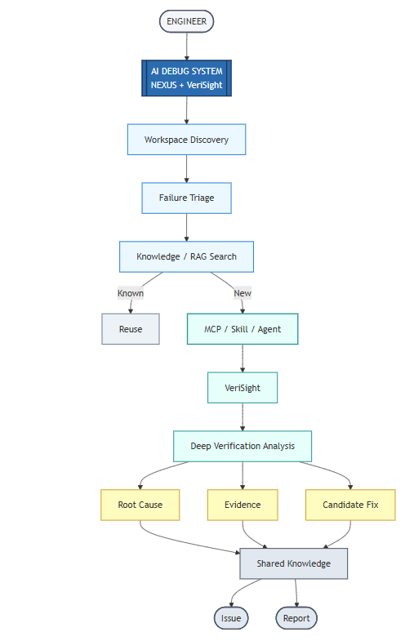
Solution Architecture
VeriSight Pipeline
VeriSight uses five coordinated agents:
VeriSight also uses deterministic parsers, Pydantic contracts, ChromaDB RAG, X-Tracer.
Agent 1 → Knowledge Extraction
Agent 2 → Root-Cause Classification
Agent 3 → RTL Root-Cause Analysis
Agent 4 → Report Generation
Agent 5 → Fix Generation
Mirafra Confidential

Slide 9
Architecture Components
Nexus
MCPs / Skills
Orchestration, workspace discovery and routing
Reusable tools and domain capabilities
VeriSight
Knowledge / RAG
Extraction, classification, RTL analysis and reports
Historical root causes and fixes
LLMs
X-Tracer / Yosys
Reasoning where AI adds value
X propagation and structural analysis
Mirafra Confidential
5

Slide 10
Architecture Components (Contd.)
Agent / Component | Role & Function in VeriSight Pipeline | Key Artifact Output
Agent 1: Knowledge Extraction | Parses spec/RTL/UVM/log/coverage deterministically; indexes context into ChromaDB (11 vector collections). | knowledge.json / ChromaDB
Agent 2: Root Cause Classifier | Applies 9 decision rules to classify TB/RTL/Spec Bug/Unknown with confidence & evidence chain. | summary.json
Agent 3: RTL Root Cause Analyzer | Executes 7 sub-analyzers: bit-precise x-tracer (X-propagation), functional, CDC, linting, register tracking. | analysis/*.json
Agent 4: Report Generator | Renders Jinja2 templates into HTML/Markdown dashboards and outputs summary.json. | report.md / HTML / JSON
Agent 5: Fix Generator | Generates unified-diff patches, validates syntax/structural integrity, computes 6-factor weighted confidence. | fix/ patch subdirectory
Mirafra Confidential
5

Slide 11
Tools & Models Used
LLM Providers
Data & RAG Stack
Hardware Verification Tools
Google Gemini (default) and Anthropic Claude (Sonnet / Opus) swappable via configuration.
Pydantic for type-safe data contracts; ChromaDB (11 persistent collections) for historical vector memory.
x-tracer for bit-precise X-propagation, Yosys for open-source synthesis, and Icarus Verilog / Verilator for simulation.
Templating & Parsing: Jinja2 for Markdown, HTML, and plain-text reports; custom SystemVerilog-aware lexer and comment stripper.
Infrastructure Shared MCPs Shared Skills Shared knowledge Domain-specific agent | AI Infrastructure Pydantic ChromaDB Jinja2 RAG | Hardware Verification SystemVerilog, UVM RTL Simulation logs VCD / waveforms Assertions Protocol analysis
Mirafra Confidential

Slide 12
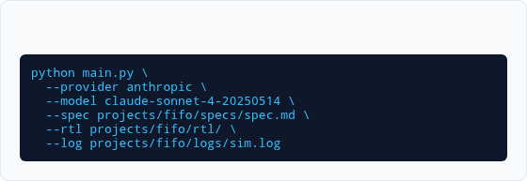
Experiments conducted
Real-World Test Scenarios
Veri Sight has been evaluated on reference designs (ALU) and complex custom designs (Synchronous FIFO, AXI) featuring subtle off-by-one errors and multi-cycle simulation mismatches.
Tested across multi-provider LLM backends (Gemini and Claude).
Validated end-to-end signal tracing over gate-level netlists with VCD waveforms.
Evaluated graceful degradation under insufficient evidence conditions.
CLI Invocation Example
Mirafra Confidential

Slide 13
Results & Comparison:-
Results observed (In words), and comparison to manual effort
Metric / Aspect | Manual Verification Debugging | VeriSight AI Debug Framework
Triage & Debug Time | 4–8 hours of manual log, RTL, & waveform correlation per failure | Single automated run (< 2 minutes per failure)
Root Cause Accuracy | Dependent on individual engineer familiarity with codebase | 100% evidence-backed classification + 6-factor confidence score
Artifact & Fix Generation | Manual note-taking, informal bug filing, manual code edits | Automated JSON, HTML, Markdown dashboards & verified diff patches
Historical Knowledge Reuse | Tribal knowledge lost across team members & sessions | ChromaDB vector memory across 11 collections for instant pattern match
Mirafra Confidential

Slide 14
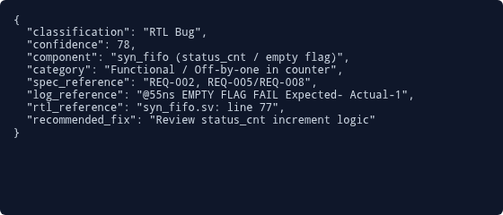

Dashboard Overview (Screenshots)
Structured JSON Output (summary.json)
HTML Debugging Report Highlights
Session: 14c5b381 | Simulation: FAIL
Verdict: RTL Bug identified with 78% confidence in syn_fifo module.
Root Cause Summary: Failure signature (empty flag asserted while COUNT > 0) indicates an incomplete fix or new off-by-one introduced in status counter logic.
Mirafra Confidential

Slide 15
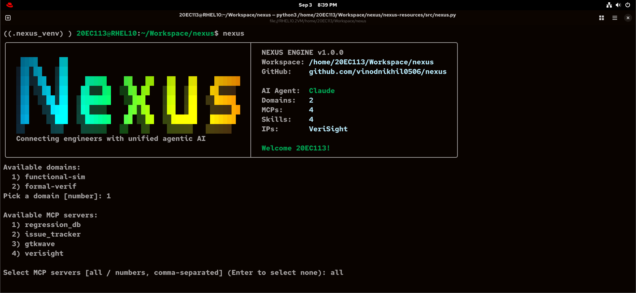
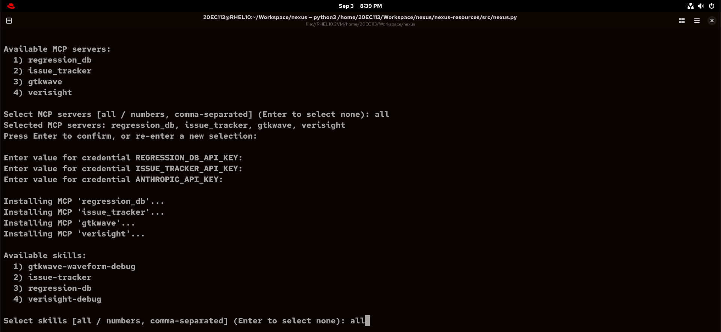
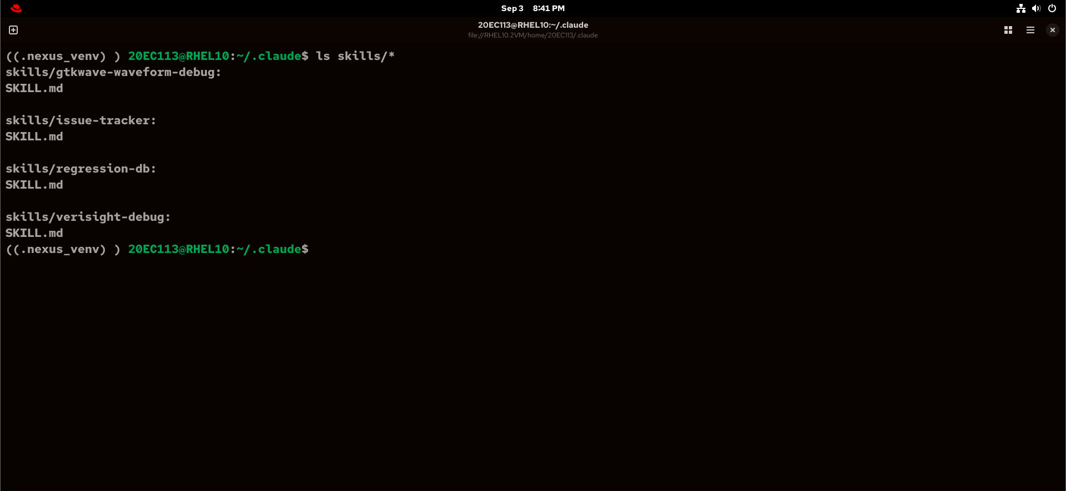
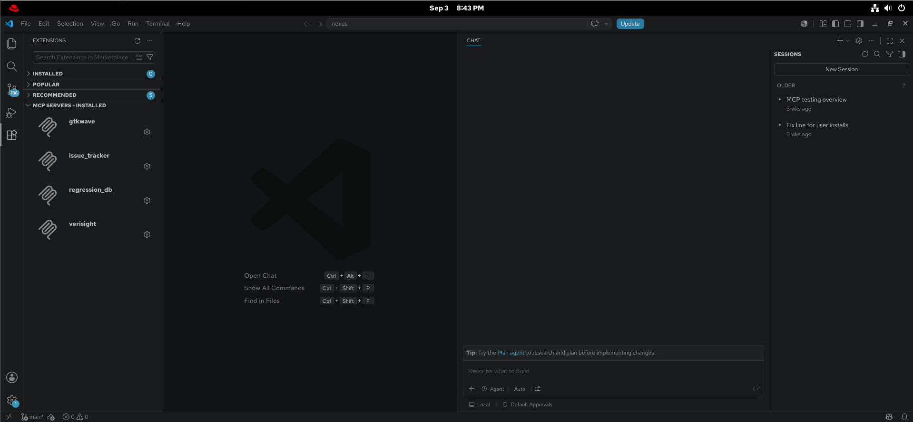
Dashboard Overview (Screenshots)
Select domain (DV)
Choose MCP(s), Skills (s)
Mirafra Confidential
Wrapper for framework

Slide 16
Token Utilization Over Costs
Estimated cost per run for the RTL-Bug path (~46.5k input / ~6.4k output tokens) using Anthropic API pricing:
Model / Framework | Input Token Rate | Output Token Rate | Est. Cost / Run
Claude Sonnet 3.5 / 3.7 | $3.00 / MTok | $15.00 / MTok | ~$0.16 / debug run
Claude Opus 3 / 3.5 | $15.00 / MTok | $75.00 / MTok | ~$0.39 / debug run
Note: Total $300 Claude AI token consumption spent across benchmark suites. Prompt caching cuts costs by up to ~90% on reused spec/RTL text.
Mirafra Confidential

Slide 17


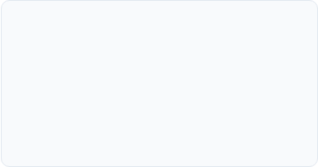
Summary
VeriSight AI Debug Framework Summary & Key Highlights
Automation
Precision
Efficiency
Successfully automates log analysis, spec cross-referencing, and root-cause classification for ASIC verification.
Combines deterministic parsers with advanced LLMs and tool integration to provide accurate, evidence-backed verdicts.
Reduces triage time from hours to minutes at a nominal cost of ~$0.16 per run.
Mirafra Confidential

Slide 18
Future scope
Any further improvement, features that need to be added to this AI Solution to make it industry-ready
Future Enhancements
Industry Integration
Integration of advanced reinforcement learning loops for automated patch validation.
Support for broader assertion-based verification (SVA) log analysis.
Enhanced multi-die and SoC-level hierarchical debugging support.
Seamless plug-in into standard commercial EDA toolflows (Synopsys, Cadence, Siemens EDA).
CI/CD pipeline integration for nightly regression failure triage.
Secure on-premise LLM deployment for proprietary semiconductor designs.
Mirafra Confidential

Slide 19
Industry Integration: Integration into real-world chip design flows
SPEC / RTL / UVM
SIMULATION / CI
REGRESSION
FAILURE
NEXUS
+
VeriSight
MCP /
Skill
ROOT CAUSE
CANDIDATE FIX
ENGINEER REVIEW
RTL / TB UPDATE
REGRESSION
VALIDATED KNOWLEDGE → SHARED → REUSED
Mirafra Confidential
13

Slide 20

Supporting Documents (If any)
Project Repository & Documentation
Repository: github.com/KITTUV03/VeriSight
Author: Kittu Patel
Framework Architecture: 5-Agent Pipeline with ChromaDB RAG and Yosys/x-tracer Integration
For full setup instructions, test suites, and contribution guidelines, please refer to the project README.
Drive Link:
https://drive.google.com/drive/folders/1qZILZeCXUqSf7m_0Snrj6YsMoAMjbagb?usp=sharing
Mirafra Confidential

Slide 21
Confidence Evaluation & Formula Breakdown
Weighted Mathematical Formula for Automated Fix Confidence:
Confidence Score = 0.25(Spec) + 0.25(Root Cause) + 0.20(Code Evidence) + 0.15(Log Evidence) + 0.10(Fix Consistency) + 0.05(Validation)
Case Study: 78% Confidence Score Derivation (FIFO Benchmark):
• Spec Agreement (25% Weight): 1.0 — Specification requires counter increment on write --> Contribution = 0.250
• Root Cause Certainty (25% Weight): 0.85 — Agent 2/3 classification certainty score --> Contribution = 0.2125
• Code Evidence (20% Weight): 1.0 — Exact file and line identified in syn_fifo.v --> Contribution = 0.200
• UVM Log Evidence (15% Weight): 0.40 — EMPTY flag error message match in sim.log --> Contribution = 0.060
• Fix Consistency (10% Weight): 0.50 — Fix does not break other signals/interfaces --> Contribution = 0.050
• Validation Evidence (5% Weight): 0.50 — Level 1 syntax validation passed --> Contribution = 0.025
--> Total Computed Fix Confidence: 0.250 + 0.2125 + 0.200 + 0.060 + 0.050 + 0.025 = 0.78 (78%)
Mirafra Confidential

Slide 22
Token Consumption & Cost Expenditure ($300 Claude AI)
• Total Token Investment:
$300 total cost consumption spent using Claude AI API across comprehensive framework debugging benchmarks.
• Benchmark Suite Coverage:
Evaluated over reference designs (ALU) and complex custom designs (Synchronous FIFO, AXI protocol modules).
• Per-Run Token Consumption Profile:
~46.5k input tokens / ~6.4k output tokens per full RTL-bug debug run (average cost of ~$0.16 per run).
• Prompt Caching Optimization:
Leverages Anthropic Prompt Caching to achieve up to ~90% cost reduction on reused specification and RTL source code text across agents.
• Batch API Optimization:
50% cost discount applied via asynchronous batch API processing for nightly regression failure triage.
Mirafra Confidential

