Slide 1
Food App: KiWi
Made by:
Amir Bairamov
Anastasia Malakhova

Slide 2
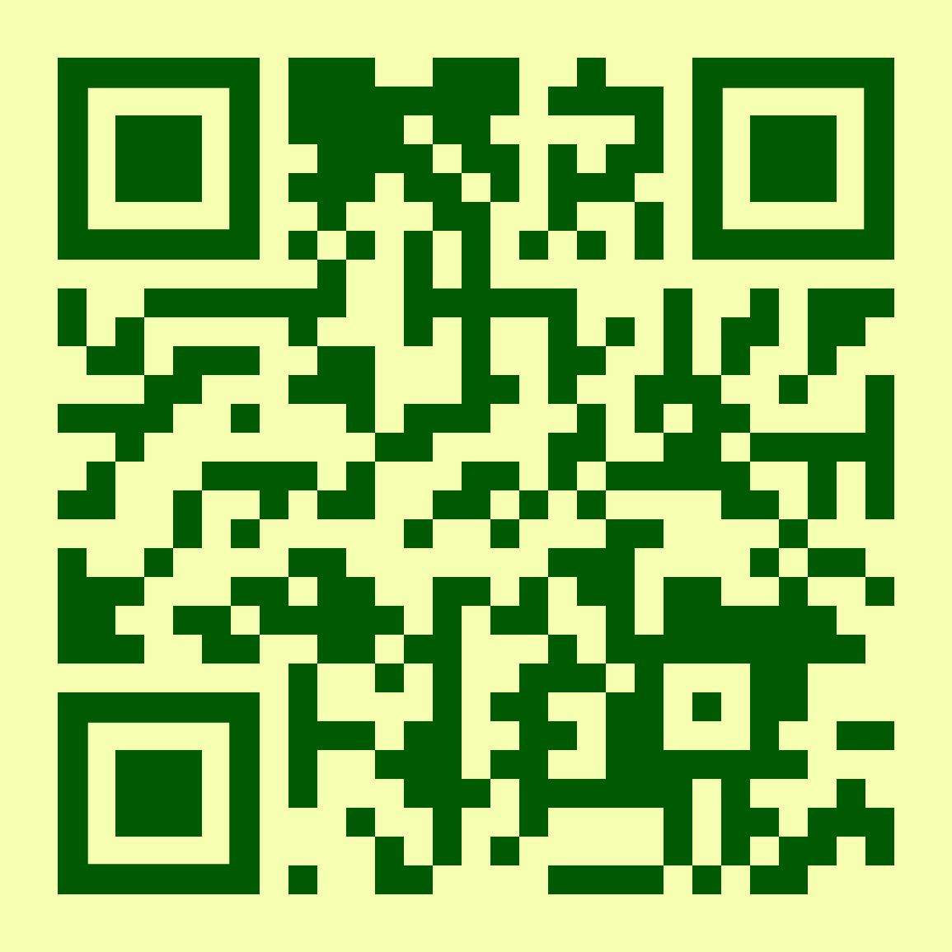

Slide 3
Problem Statement
Our app is designed to help people control their diet

Slide 4
App functionality

Slide 5
WELKOME
SIGN IN
DAYS LIST
RESULT
DIARY
TIMER
CALCULATION

Slide 6
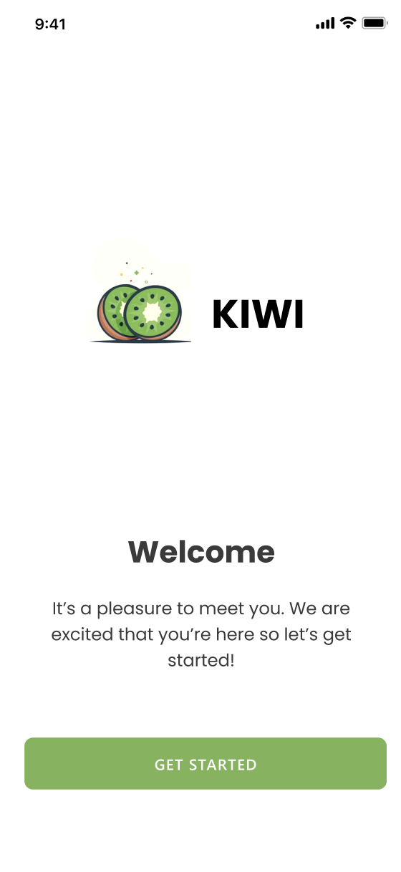
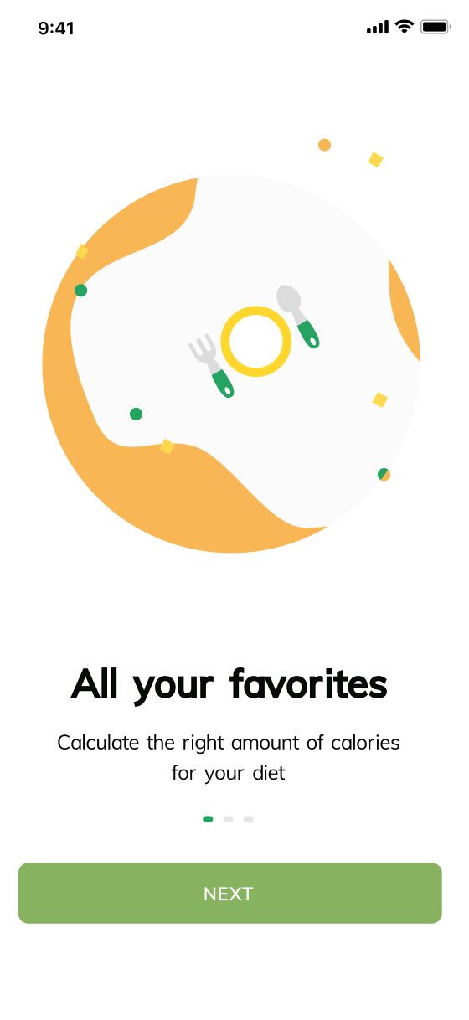
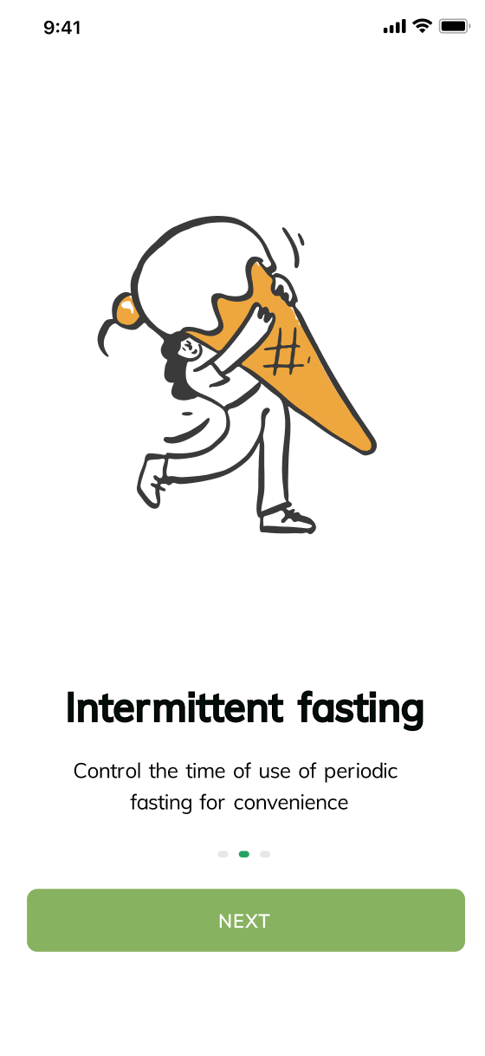
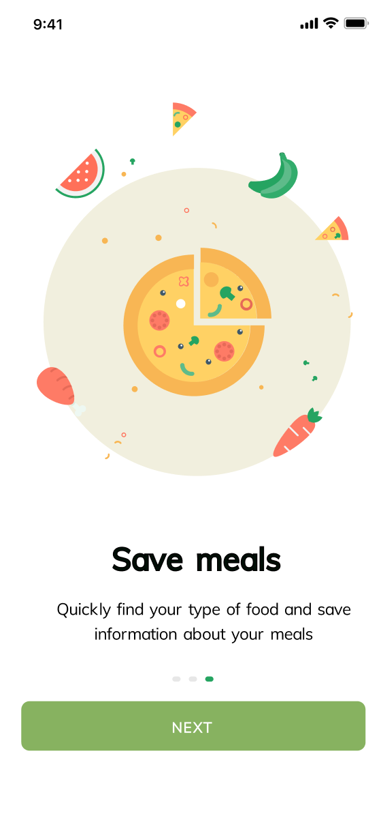
Welcome pages
Home
In this pages user read about app

Slide 7
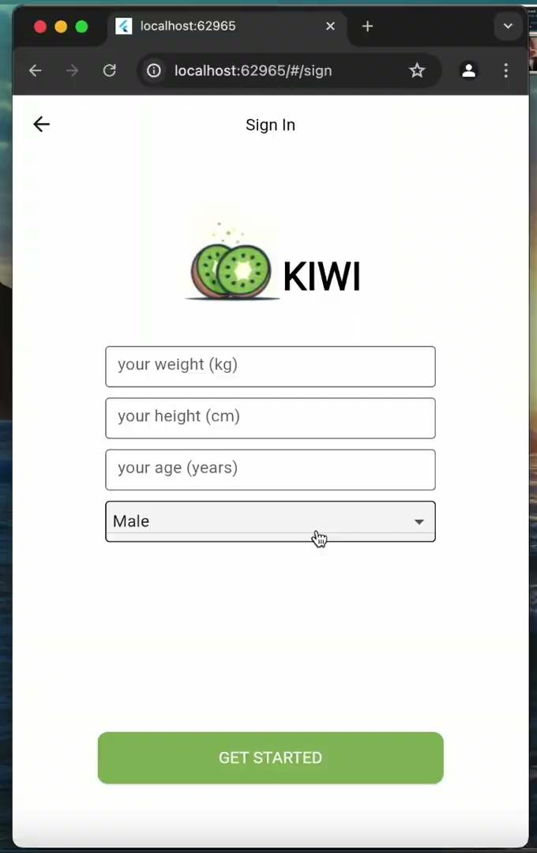
Home
Sing In & Setting
Add the parameters
Сalculate norm of the calories for day
Сhange the parameters in “setting”

Slide 8
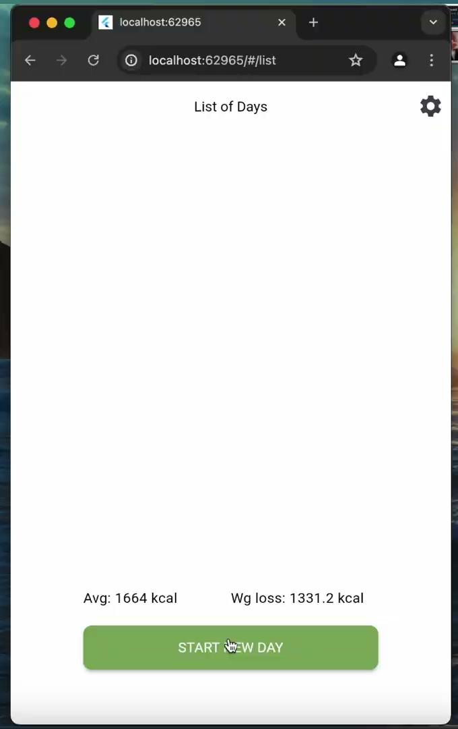
Home
Diary
User can add their breakfast, lunch, dinner and other snacks.

Slide 9
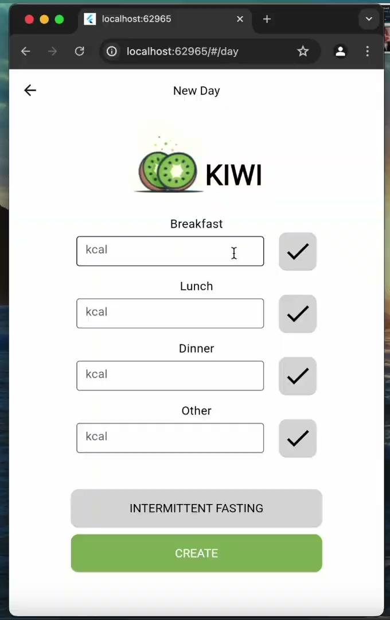
Home
Calculations
App calculate the total calories for the day.
The user can rate his day

Slide 10
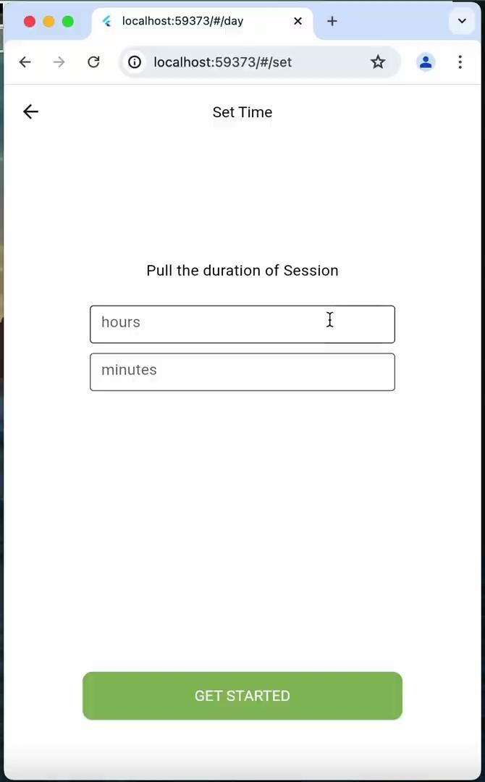
Home
Timer
Start and control interval starvation

Slide 11
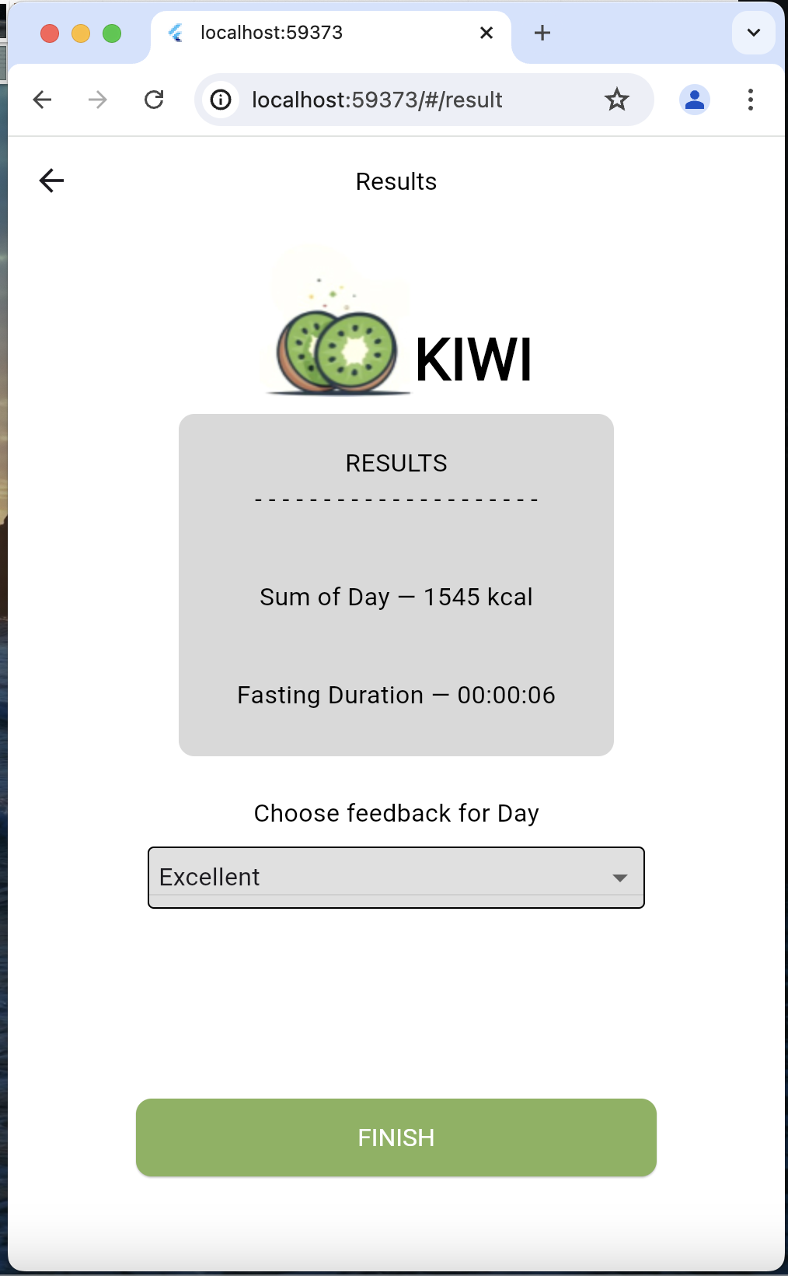
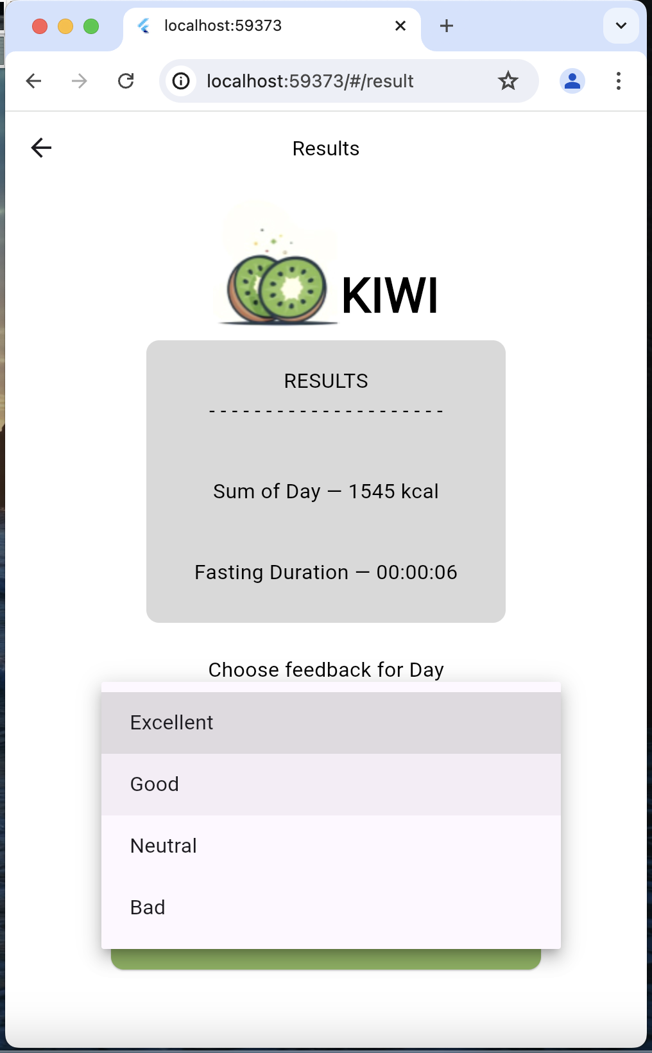




Home
Result
Result of users day
(calories and interval starvation)

Slide 12
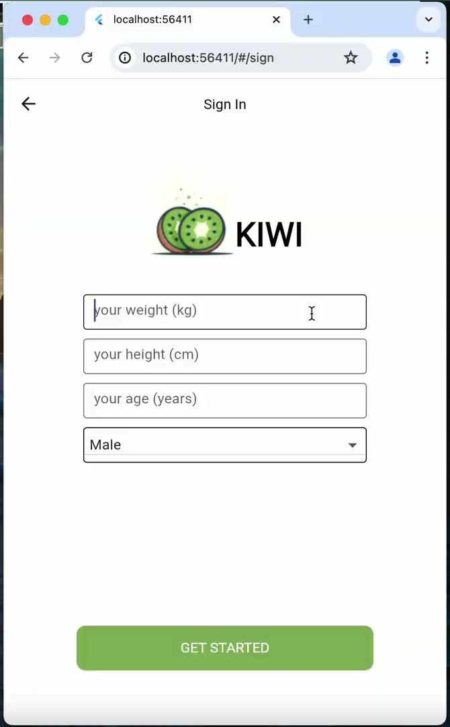
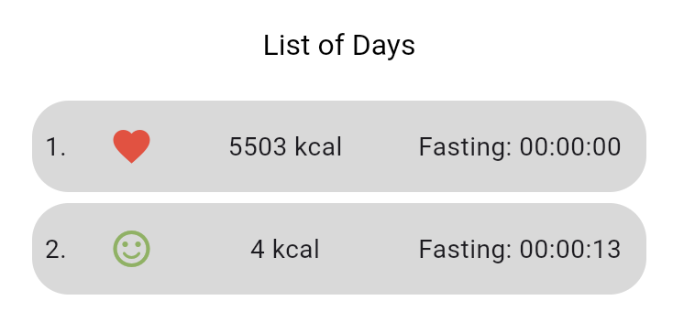
Home
Days list
List with all past days, which user marked

Slide 13
Challenges and Solutions

Slide 14
Challenge
Solution
In our project,
we couldn't add photos for a long time
We were able to solve this with the help of TA

Slide 15
Challenge
Solution
One team member's laptop broke down
He was working from another person's laptop or doing documentation

Slide 16
Challenge
Solution
Animation
didn't work
Information search and 5 hours of work

Slide 17
DEMO

