Slide 1

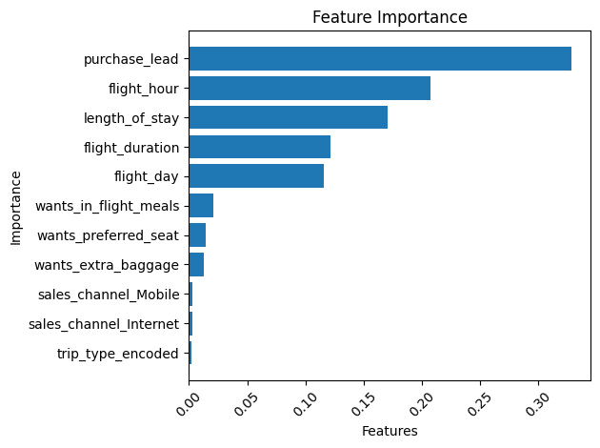
Prediction for Customer booking
We build a model for predicting customer booking by using RandomForest Classifier.
Metrics :
Accuracy = 84.44%
Recall = 7.36%
Precision = 37.07%
Purchase_lead, flight_hour, length_of_stay are most affecting features for the prediction.

