Slide 1
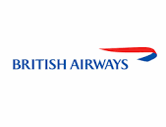
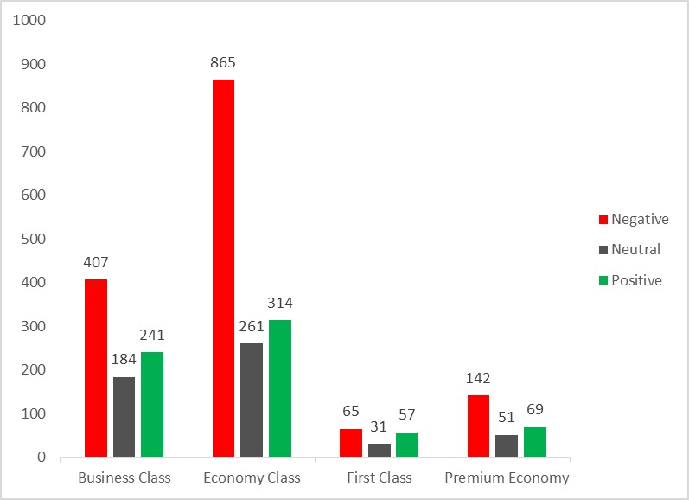
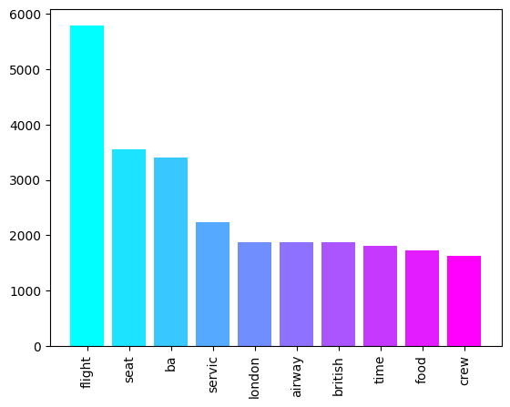
Customer REVIEW ANALYSIS
Top 10 words used in Reviews

Slide 2
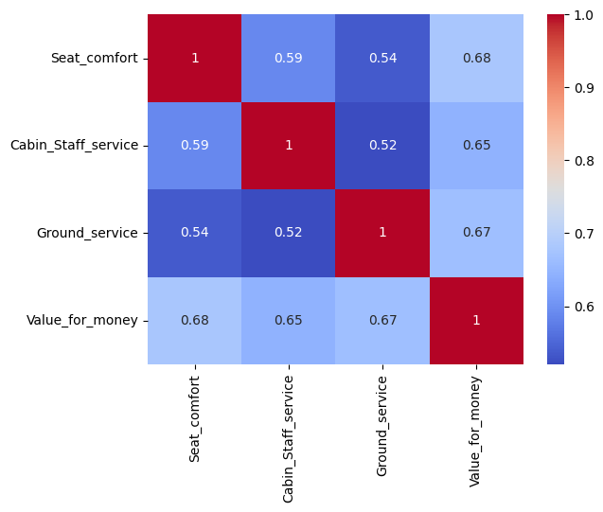
Overall Experience
Many customers have provided negative feedback due to lack of good services.
Most of negative feedback are from economy class.
By evaluating most used words from reviews we understand that we must improve our flight time, seats, food service , Cabin staff, etc.
Correlation Heat-map
Experience | Rating out of 5
Seat comfort | 2.79
Cabin Staff Service | 3.18
Ground Service | 2.84
Value for Money | 2.60

