Slide 1

Startup Fail or Success
Kaushal Joshi
Heeta Parmar

Slide 2
Introduction
Startup refers to a company that is in their first stages of operations.
Startups can be founded by one or more entrepreneurs who are working on developing a product or service.
Funding
Multiple rounds (seed, Series A, B, C…etc) from investors like VCs.
Challenges
Goal
High Costs, limited revenue, requiring significant capital.
Acquistion by another company or becoming publicly traded.
03
02
04
What are they?
Startup investment can be very risky due to the high failure rate of startups. People like angel investors and venture capitalists have a very high risk while they are investing in startups.
New Trend
New businesses developing innovative products & services.
CrowdFunding allows broader participation in startup investment.
01
05
Notes:
Thank you for Downloading our item form Premast Plus
-------------------------------
You must attribute the graphics to plus.premast.com :
In order to use content or a part of it, you must attribute it to plus.premast.com,
so we will be able to continue creating new free PowerPoint graphic resources every day.
You are free to use this item:
- For both personal and commercial projects and to modify it.
- In a website or presentation template or as part of your design.
You are not allowed to:
- Sub-license, resell or rent it.
- Include it in any online or offline archive or database.

Slide 3
Objective
To assist startup investors with their decisions, in this project we aim to find the important features that lead to startup success and forecast a company’s success with supervised machine learning methods.

Slide 4
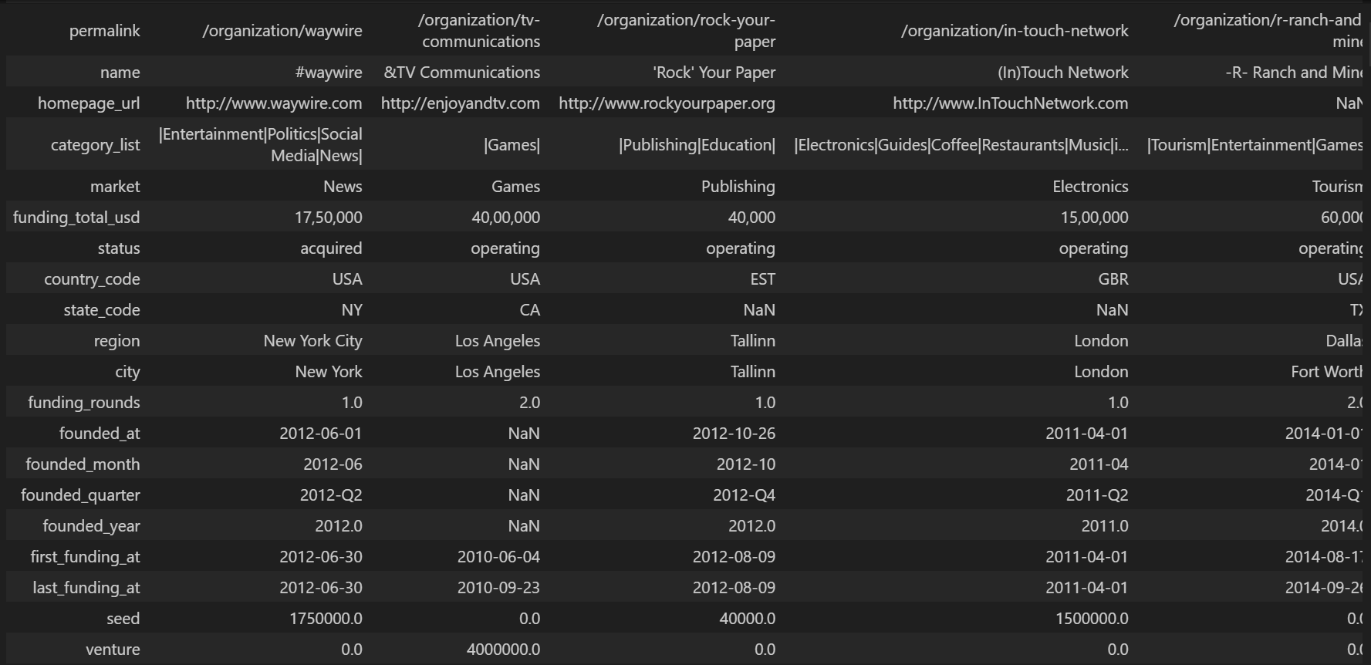
DATA

Slide 5
The data has been collected from Crunchbase which is a leading website for company insights from early stage startups to Fortune 1000.
The data had around 54k rows and 39 columns
The dataset had company information such as :
name of the company
url
Market
Country
State
Region
City
founded date
first funding date & last funding date.
It also had data on different investment types such as :
Seed
venture equity crowdfunding
undisclosed funding
convertible note
debt financing
Angel
Grant
private equity
post ipo equity
post ipo debt
secondary market
product crowdfunding
round A-H series funding.

