Slide 1
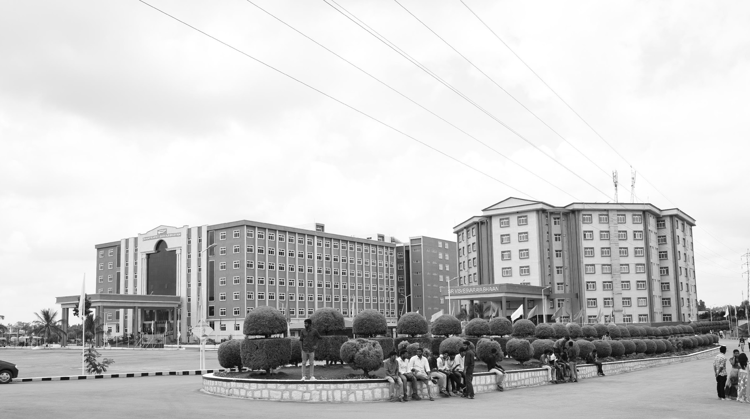

Development of Drone for Emergency Services
AY 2020-24
GITAM UNIVERSITY
Major Project
Project ID: CS17
A University should be a place of light, of liberty, and of learning.
Department of Electrical Electronics and Communication Engineering
Project Team:
Jagannath Sagar Karri
Project Mentor:
Sanhita Manna
www.gitamedu.com

Slide 2


Project Group – Details
Photo
Track
Roll No
Name
EECE AI/ML
BU21EECE0100162
Jagannath Sagar Karri

Slide 3
Objective and Goals
Objective
Brief Description
Objective: The project aims to develop an assistance drone specifically designed to enhance the capabilities of emergency services. The drone will focus on providing real-time situational awareness, reconnaissance, and support for rescue operations in hard-to-reach or disaster-affected areas.
Goals
Main Goals
Implement high-resolution imaging for detailed situational assessment.
Integrate real-time communication capabilities for continuous data transmission.
Achieve a flight time of up to 40 minutes and a 1-kilometer operational range.
Autonomous Navigation complimented with Geo-Fencing
Additional Goals
Ensure the drone can withstand harsh environmental conditions.
Utilize dual-band for reliable communication.
Focus on reducing response times by up to 50%.

Slide 4
5 days
5 days
5 days
5 days
5 days
5 days
5 days
5 days
5 days
5 days
5 days
5 days
5 days
2024
Project Plan
Today
Sep
Oct
Nov
Dec
2024
Sep 1 - Sep 8
Initial Research and Requirement Gathering
Research and Design
Sep 8 - Sep 15
System Architecture Design
Sep 15 - Sep 22
Component Selection and Prototyping
Sep 22 – Oct 20
Integration of Imaging and Communication Systems
Development
Oct 20 - Oct 27
System Integration Testing
Oct 27 - Nov 3
Detailed Performance Testing
Testing and Validation
Nov 3 - Nov 10
Detailed Performance Testing
Nov 10 - Nov 17
Iterative Improvements
Nov 17 - Nov 24
Final Validation Testing
Nov 24 - Dec 1
Preparation for Deployment
Deployment and Documentation
Dec 1 - Dec 8
Preparation for Deployment
Dec 8 - Dec 15
Project Documentation
Dec 15 - Dec 22
Presentation and Project Handover

Slide 5
Literature Survey
Key Publications
APPLICATIONS OF UNMANNED AERIAL VEHICLES: A REVIEW
http://dx.doi.org/10.17993/3ctecno.2019.specialissue3.85-105
A review of UAV autonomous navigation in GPS-denied environments
https://doi.org/10.1016/j.robot.2023.104533
Reliable Flying IoT Networks for UAV Disaster Rescue Operations
https://doi.org/10.1155/2018/2572460
UAV- based Photogrammetry and Geocomputing for Hazards and Disaster Risk Monitoring – A Review
https://doi.org/10.1186/s40677-016-0060-y
Key Resources – Whitepaper| Application Notes | Datasheet| Others
Component: Ublox NEO-M8N GPS Module Datasheet
Component: Sharp GP2Y0A21YK0F Analog Distance Sensor Datasheet
Component: HC-SR04 Ultrasonic Distance Sensor datasheet
Existing Implementations – Products| Opensource| GitHub etc
Aerial Drones for Fire Disaster Response
10.5772/intechopen.1002525
DJI ENTERPRISE – Firefightinng
https://enterprise.dji.com/public-safety/firefightingFirefighting

Slide 6
Analysis - SWOT
Strengths
Weaknesses
W1. Battery limitations restrict flight time and range.
W2. Dependence on communication infrastructure may affect performance in areas with poor connectivity.
S1. High-resolution imaging provides detailed situational awareness.
S2. Real-time communication enhances coordination and decision-making.
S3. Autonomous navigation allows for operation in challenging environments without constant human intervention.
Opportunities
Threats
T1. Potential for signal interference or hacking, compromising communication and control
T2. Environmental challenges (e.g., severe weather conditions) that could affect drone operation.
O1. Increasing need for efficient disaster response solutions worldwide.
02. Potential partnerships with government agencies, NGOs, and private sectors involved in disaster management.
O3. Expansion into other applications, such as surveillance, wildlife monitoring, and infrastructure inspection.

Slide 7
Analysis – 4W1H
Why:
To provide emergency responders with immediate, reliable situational awareness to make informed decisions quickly, improving response times and reducing risks to human life.
What:
A multi-functional drone equipped with advanced sensors, high-resolution cameras, and reliable communication systems to support emergency services in disaster-affected areas.
Where:
Can be deployed in various scenarios, including urban disaster sites, remote natural disaster areas, and hazardous environments where human access is limited or dangerous
When:
During natural disasters (e.g., earthquakes, floods, wildfires), man-made incidents (e.g., industrial accidents, terrorist attacks), and in search and rescue operations.
How:
By leveraging state-of-the-art UAV technology, integrating high-resolution cameras, and ensuring robust, real-time communication to transmit critical data to emergency control centers

Slide 8
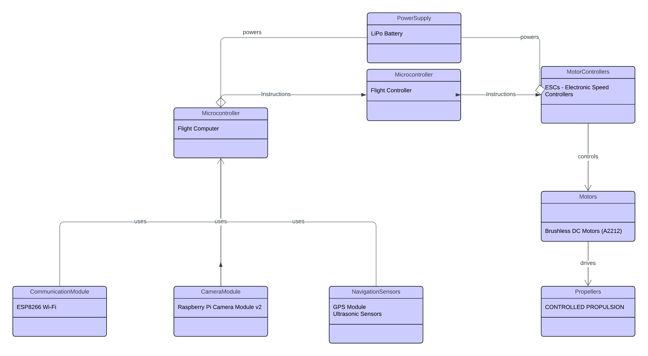
Architecture
Structural Diagram & Behaviour Diagram
Pixhawk 6C
Pixhawk 6C
3dr Radio Telemetry
Drone FPV Camera
Neo – 7M GPS Accelerometers
Gyroscopes
Compass

Slide 9
Use Cases & Testing
Use Cases
Scenario 1: Urban Disaster Site Monitoring: The drone flies over a collapsed building, providing real-time images and thermal scans to locate trapped victims.
Scenario 2: Remote Area Surveillance: In a wildfire scenario, the drone captures high-resolution footage to map fire spread and help direct firefighting efforts.
Scenario 3: Hazardous Environment Assessment: The drone assesses a chemical spill site, providing situational awareness without exposing responders to toxic conditions.
Test Cases
Verify the effectiveness of autonomous navigation in different terrains
.
Test the range and reliability of real-time data transmission under various network conditions.
Evaluate the drone’s durability and performance in harsh environmental conditions (e.g., rain, wind)

Slide 10
Implementation and Results – Iteration 1
Iteration 1 : Results

Slide 11
Implementation and Results – Iteration 2
Iteration : Results + Validation against the use cases and test cases

Slide 12
Implementation and Results – Iteration 3 (Optional)
Iteration : Results + Validation against the use cases and test cases

Slide 13
Contribution
Team Progress and Movement
Xx
Xx
X
X
Individual Contribution
Key contributions: Team Member Name
XX
XX
Key contributions: Team Member Name
XX
XX
Key contributions: Team Member Name
XX
XX
Key contributions: Team Member Name
XX
XX
Key contributions: Team Member Name
XX
XX

Slide 14
Conclusion & Future Work
Summary and Conclusion
Future Work

Slide 15

THANK YOU

