Slide 1
OpenChain Update
Korea Work Group Meeting #22 – 2024-06-20

Slide 2
Our Community News

Slide 3

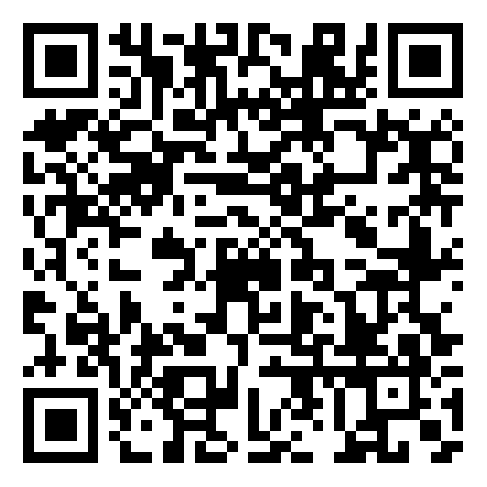
Volvo Cars Announces Adoption of ISO/IEC 5230

Slide 4

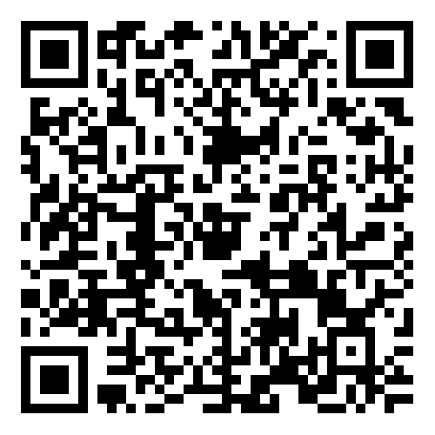
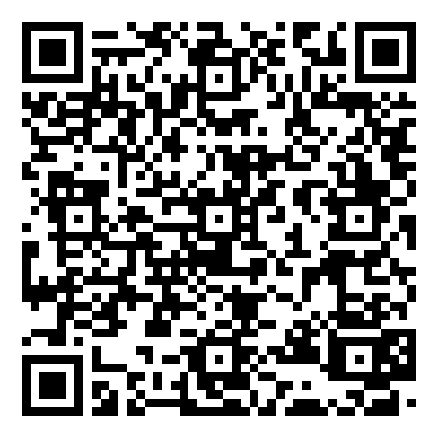
openEuler Adopts ISO/IEC 18974 + Case Study
News
Case Study

Slide 5

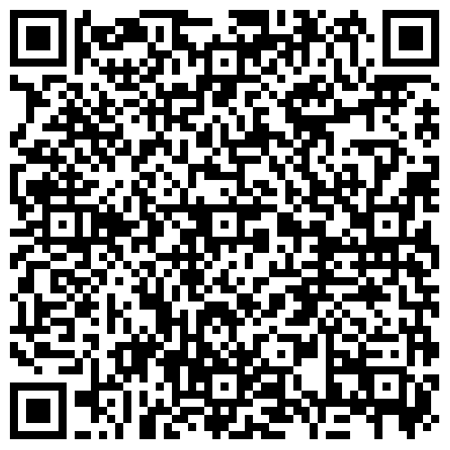
Socionext Recertification of ISO/IEC 5230

Slide 6

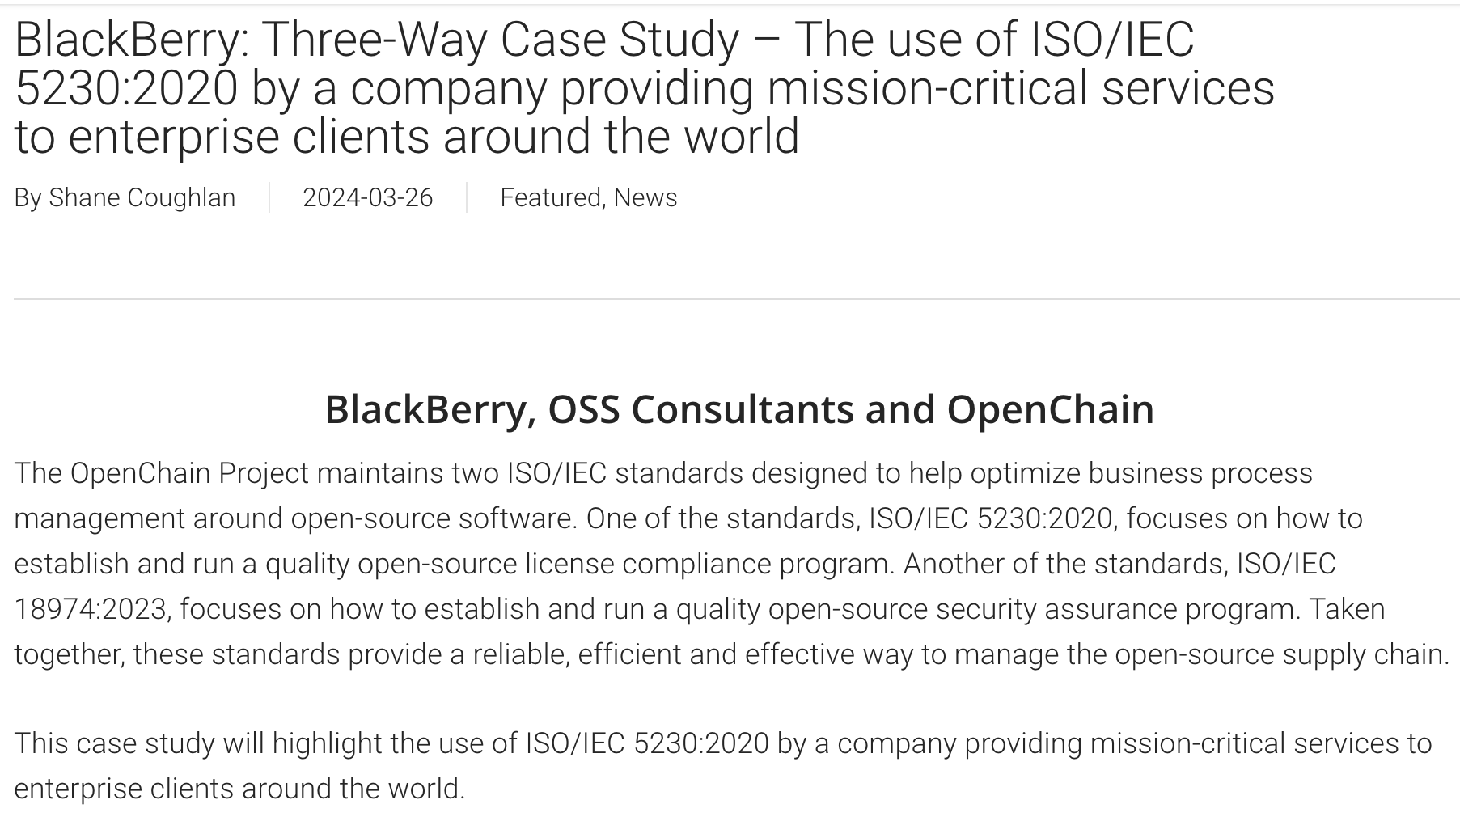
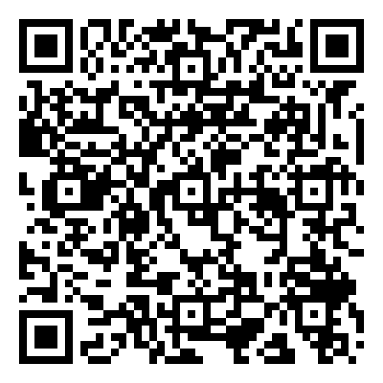
ISO/IEC 5230 Three-Way Case Study

Slide 7

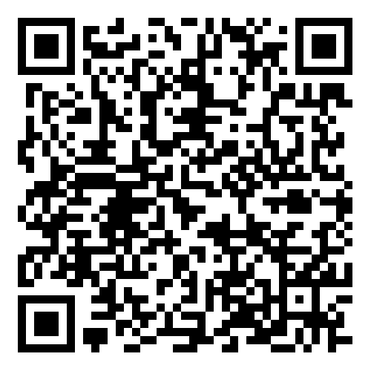
Policy and Regulation Webinar Series:

Slide 8
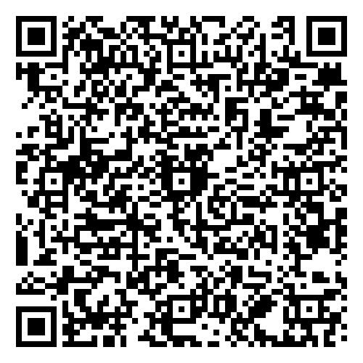
AI Study Group Update
June
Workshops held once per month:
April: https://openchainproject.org/news/2024/04/09/openchain-ai-study-group-monthly-workshop-for-north-america-and-europe-2024-04-02-full-recording
May
https://openchainproject.org/news/2024/05/12/openchain-ai-study-group-monthly-workshop-for-north-america-and-europe-2024-05-07-full-recording
June
https://openchainproject.org/news/2024/06/11/openchain-ai-study-group-monthly-workshop-for-north-america-and-europe-2024-06-04-recording

Slide 9
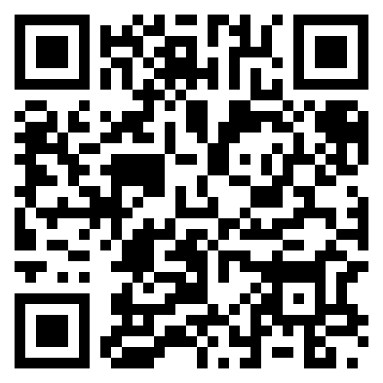
Webinars Held Q2 2024:
Our webinar series has ~90 freely available talks, include these new releases:
AboutCode and Beyond – End-to-End SCA
Eclipse Apoapsis
LF Management & Best Practices Portal
All Our Webinars

Slide 10
OpenChain @ Events
OpenChain @ Open Source Summit North America https://openchainproject.org/news/2024/04/17/openchain-open-source-summit-north-america-get-the-slides
OpenChain @ FINOS Open Source Readiness SIG https://openchainproject.org/news/2024/05/02/openchain-finos-open-source-readiness-sig-2024-05-01
OpenChain @ LF Japan Executive Briefing https://openchainproject.org/news/2024/05/14/openchain-lf-japan-executive-briefing
OpenChain @ AI Open Innovation Day 2024 https://openchainproject.org/news/2024/05/15/openchain-ai-open-innovation-day-2024
OpenChain Supply Chain Security & Compliance Workshop in Shenzhen https://openchainproject.org/news/2024/05/22/supply-chain-security-compliance-may-2024
OpenChain @ International Open Source Trends For Industries in Taipei https://openchainproject.org/news/2024/06/04/openchain-international-open-source-trends-for-industries-building-the-opensource-ecosystem-in-taiwan-2024-06-04
OpenChain @ OSBC Open Source Conference 2024 https://openchainproject.org/news/2024/06/16/coming-soon-openchain-osbc-open-source-conference-2024-2024-06-19

Slide 11
Data-Driven Approaches

Slide 12
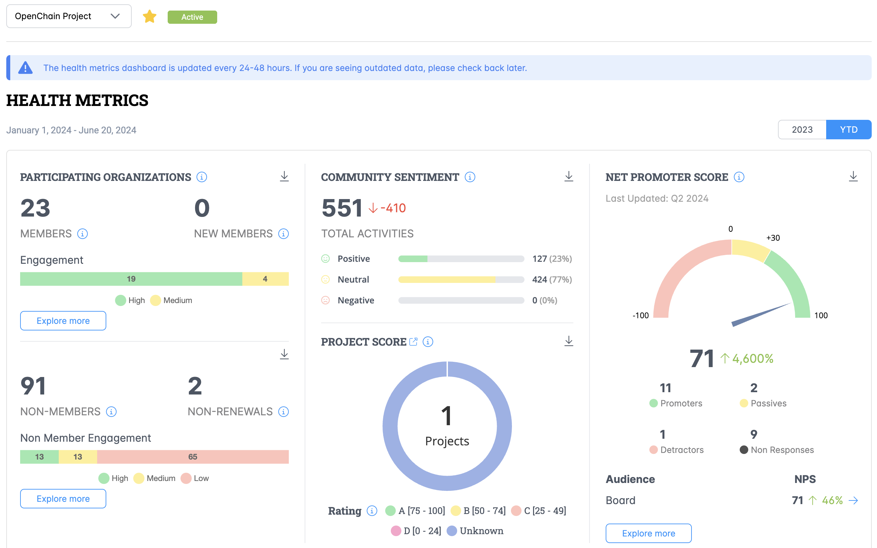
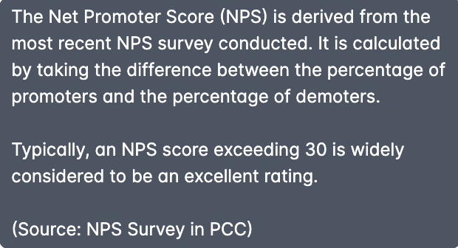
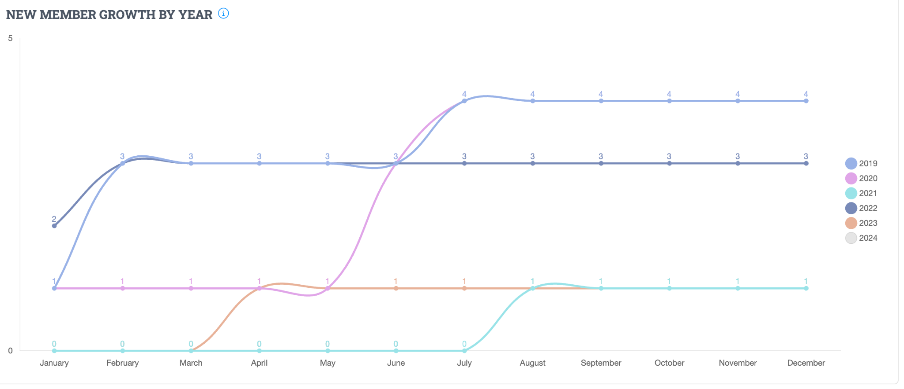
LFX Health Metrics: Insights So Far

Slide 13
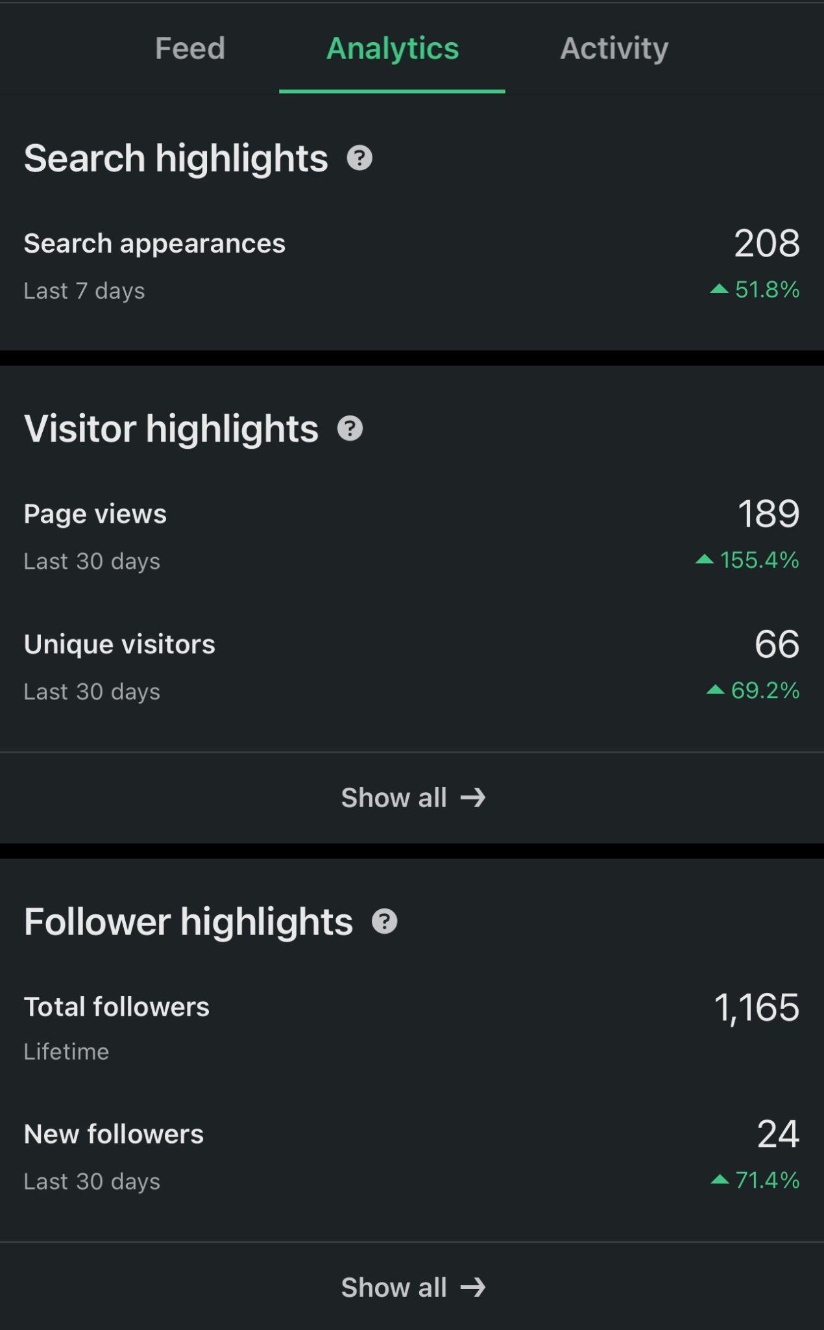
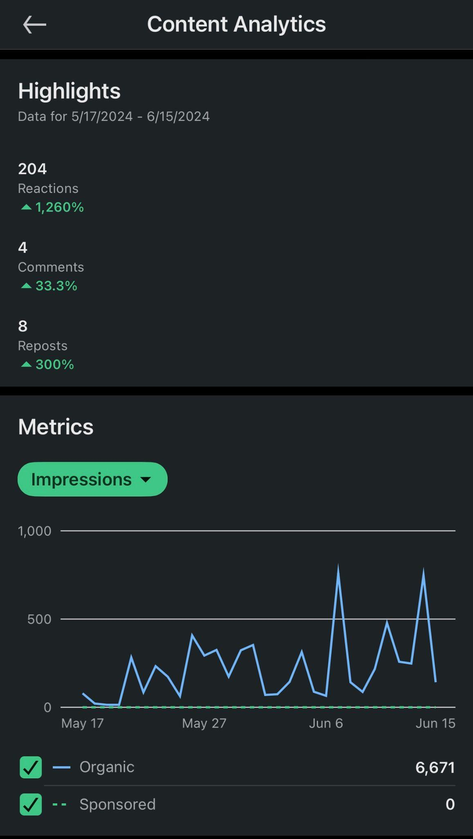
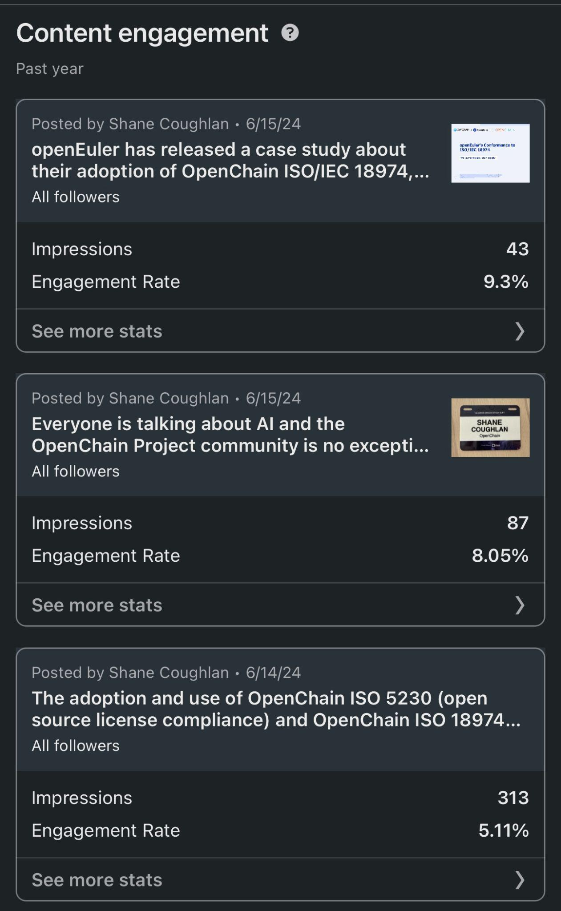
Social Media - LinkedIn Focus and Snapshot

Slide 14
One More Thing…

Slide 15

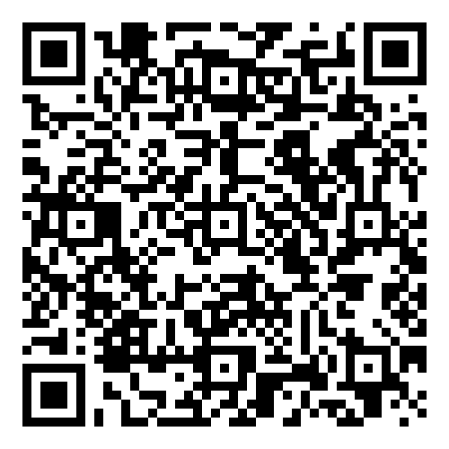
Starting 2024-06-19 ~ Ending 2024-012-19
The OpenChain Project has announced the beginning of its six month Public Comment Period for proposed draft updates to the open source license compliance (ISO/IEC 5230:2020) and open source security assurance (ISO/IEC 18974:2023) specifications.
As per our specification development process outlined in the project FAQ, this Public Comment Period will run for six months, and it will be followed by a three month Freeze Period.

Slide 16
Thank You
Let’s Keep Building The Future Of A Trusted Supply Chain

