Slide 1
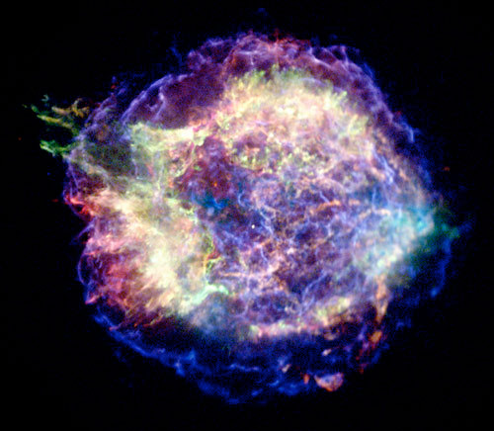
Blowing up a polytropic star
Justin Lietz – Code
Kaitlin Cook – Analysis
Sherwood Richers – Inputs

Slide 2
Motivations
Polytropic EOS gives a nice toy model of a star
Sedov Blast waves give a nice toy model of a shock
May be combined to give a toy supernova blast, and we can then follow the nucleosynthesis.
Acts as a good way to combine the tools from last week

Slide 3
Aims
Solve the Lane-Emden equation for a polytropic star.
Recast VH1 for Lagrangian coordinates.
Use the polytropic star as input for VH1 and simulate a blast.
Take the output, cast into realistic units, and use as input for XNET with 150 isotope network.
Follow the nucleosynthesis in the blast.

Slide 4
Key Challenges
Working out the realistic units
Recasting VH1 in Lagrangian coordinates
Writing a wrapper script to take output from VH1 to XNET
Displaying the results in a meaningful way.

Slide 5
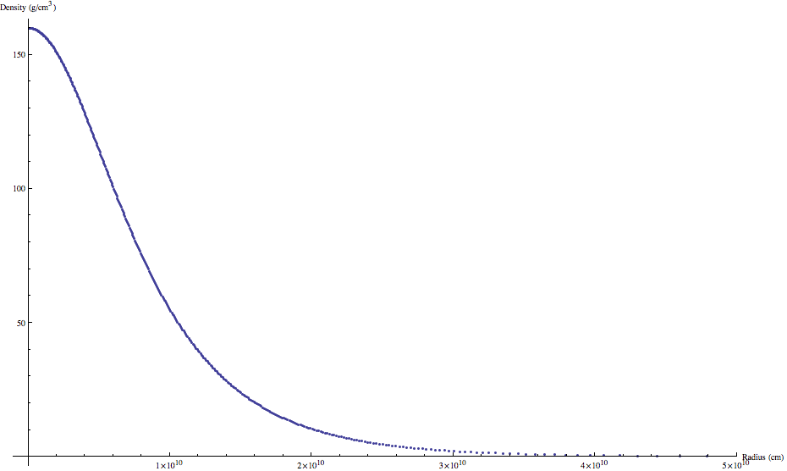




Polytropic Stars: Lane-Emden Solutions
Plot of a solution to Lane-Emden
Poisson Equation:
Hydrostatic Equilibrium:
Polytropic EOS:
Lane-Emden:

Slide 6
Sedov Blasts
The Sedov blast is what happens when a large amount of energy is dumped into a small region.
Using VH1, we can simulate this by having a very high pressure in the very zone, and much smaller pressures in all of the other zones.
This leads to fun effects. (Videos on next slide)

Slide 7
Lagrangian Coordinates
We need Lagrangian coordinates because we want to follow the nucleosynthesis of packet of stellar matter.
Eulerian coordinates allows for matter to pass between the zone boundaries.
Lagrangian coordinates moves the zone boundaries so that each zone follows the matter packet.

Slide 8
VH1 Lagrangian
VH1 computes the hydrodynamic flow using Lagrangian coordinates on each step, then remaps the information back onto an Eulerian grid.
We got rid of the Eulerian remap from the ppmlr.f90 file so that the code remains in Lagrangian coordinates.

Slide 9
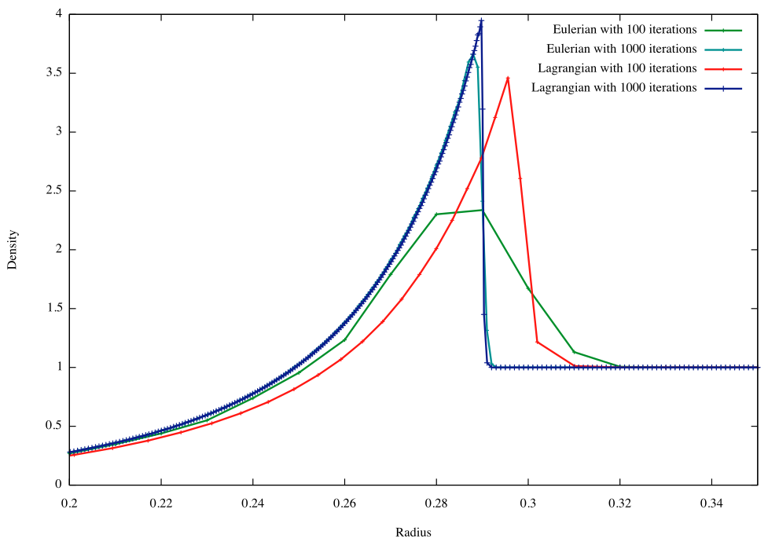
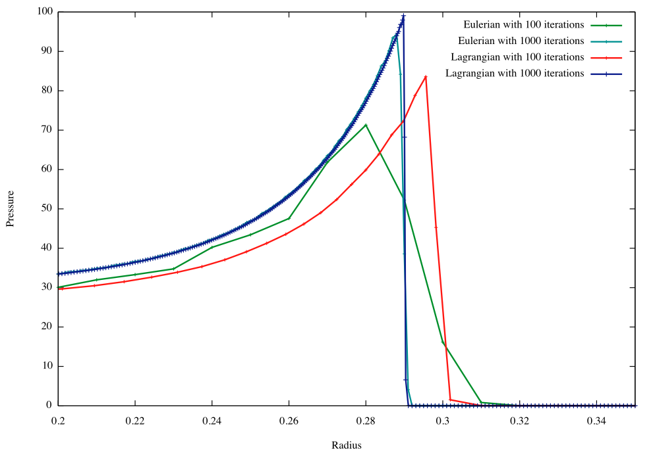
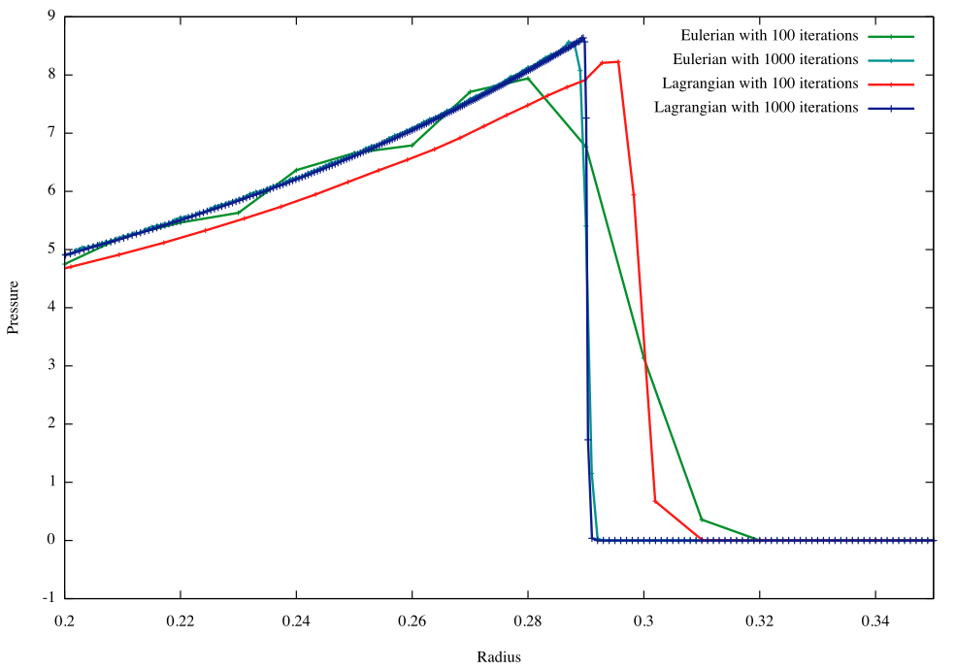
Lagrangian vs Eulerian

Slide 10
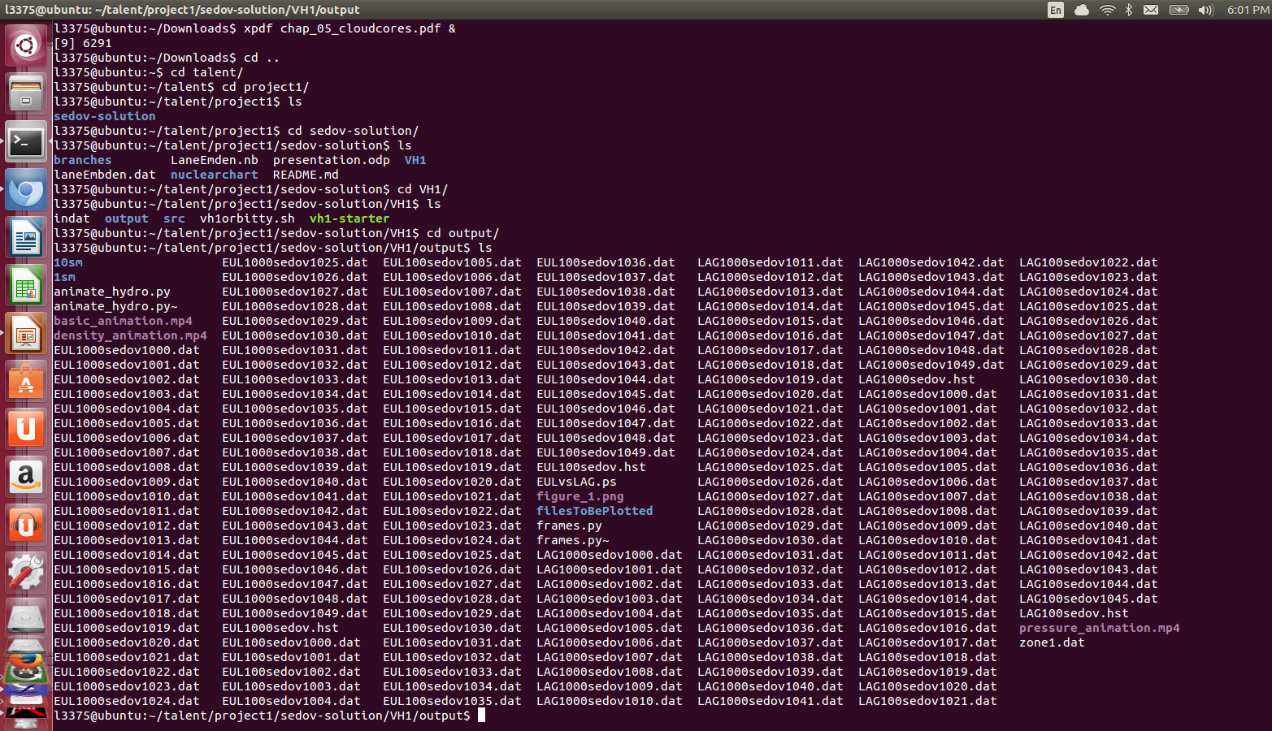
Connecting VH1 to Xnet
VH1 output looks familiar to a lot of you by now:

Slide 11
Hydro Results – 1Msol + 10^41 ergs

Slide 12
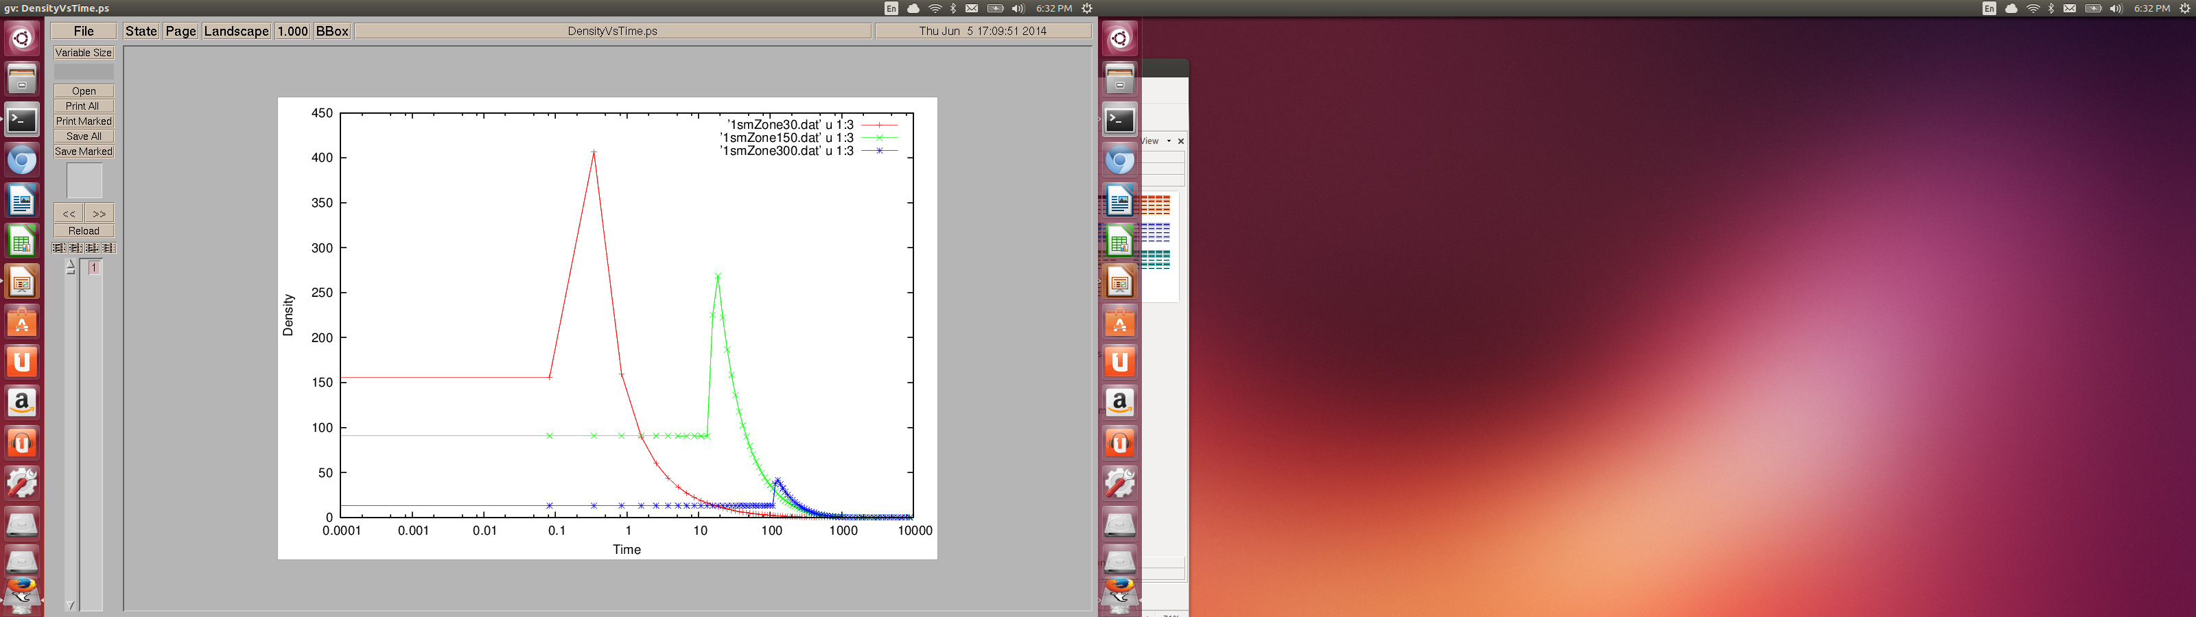

Slide 13
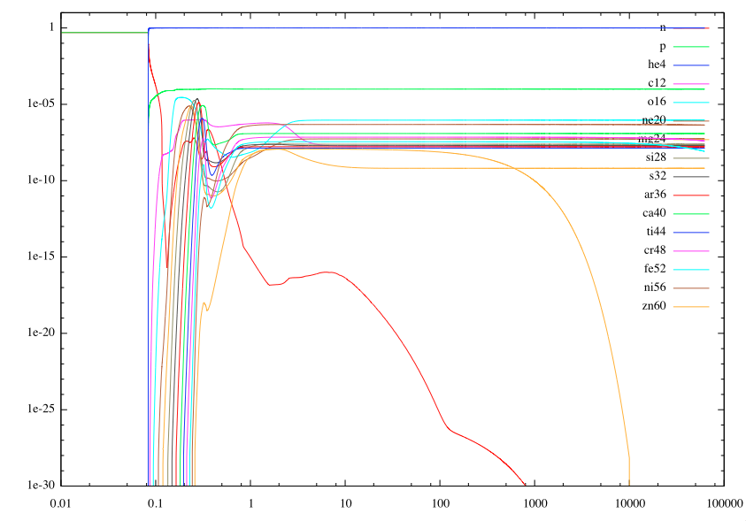
Nucleosynthesis 1 Msol + 10^41 ergs zone 30

Slide 15
What else we would have done:
Gravity
Different EOS

