Slide 1
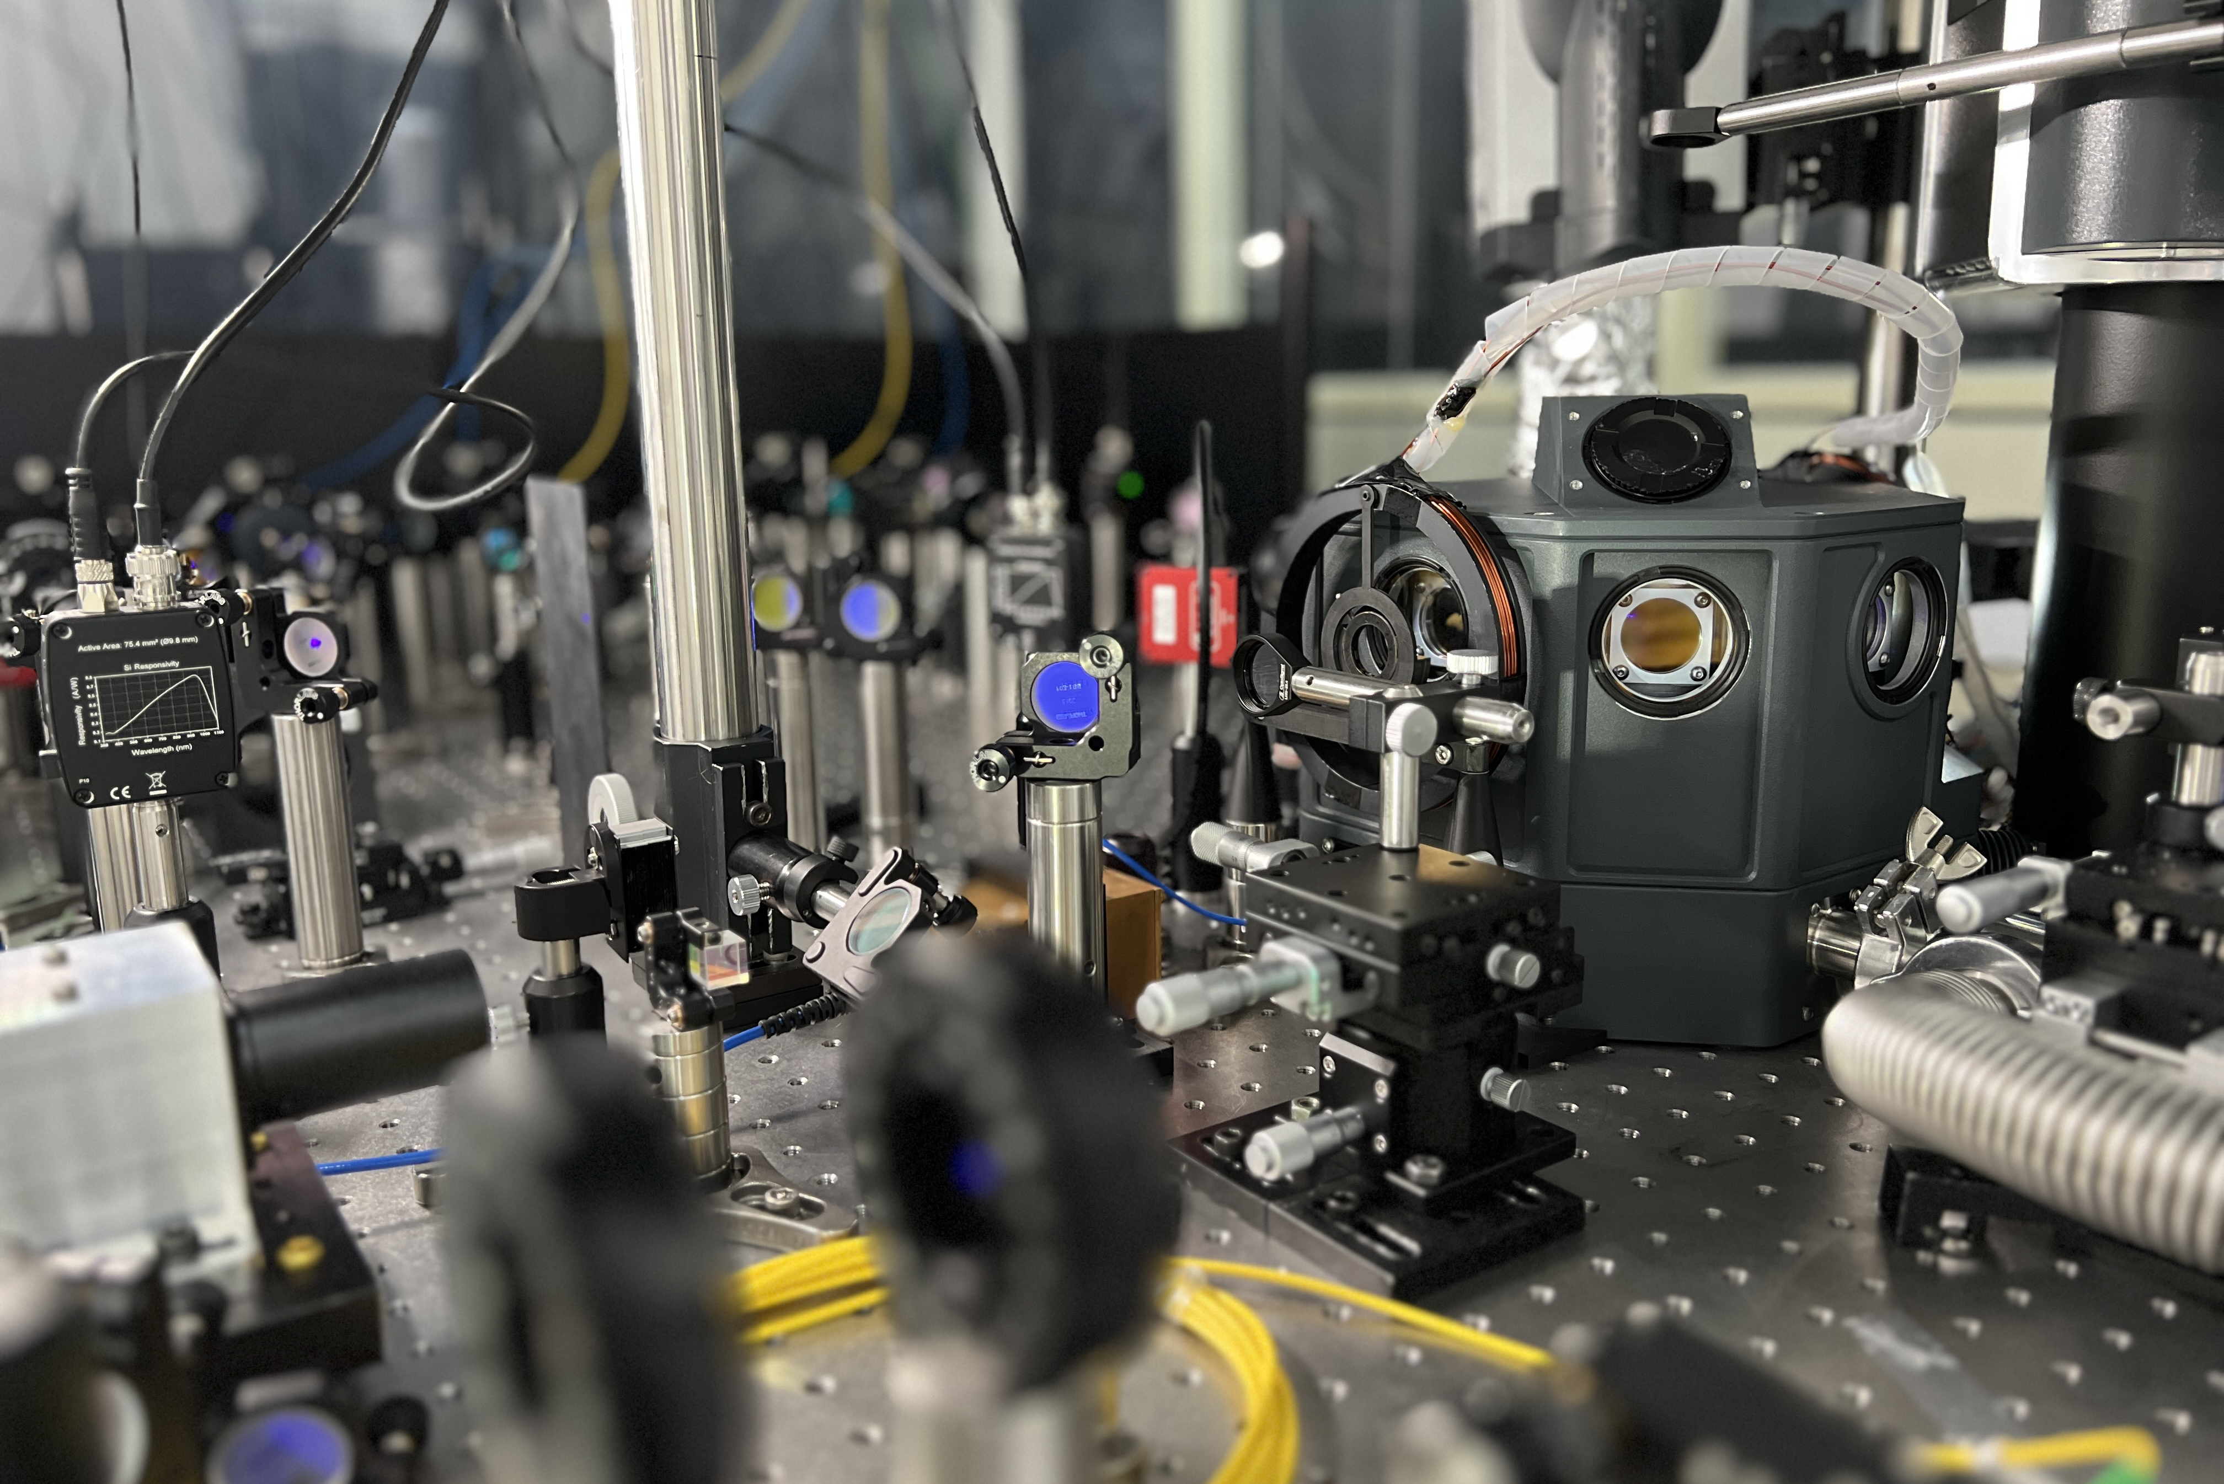
(a)
(b)
(c)
Imaging system
(d)
Laser stabilization system
Helical resonator
Cryogenic station
Ablation loading system
Vacuum pumping system

