Slide 1
Mid semester project review– August 2026
22AIE450 Reinforcement Learning
SupplyAI-RL: Explainable Supply Chain Optimization
[Team Member Names and Roll Numbers]
Batch and Group Number:
Date of the Presentation:
[Mid Project Review]

Slide 2
Outline
Introduction and Motivation
Problem Definition
Literature Review and Gaps Identified
Objectives
Methodology: simulator, RL formulation, LLM explanation layer
Dataset Description and Calibration
Preliminary Results: tuned classical policies vs the RL agent
Interim Summary and Completion Plan
[Mid Project Review]

Slide 3
Introduction and Motivation
Retail inventory is a daily decision under uncertainty, and both errors are expensive.
  Order too much: capital is tied up, storage is paid for, and unsold stock is marked down or written off.
  Order too little: the sale is lost permanently, because the customer buys elsewhere.
Classical policies treat each product in isolation and assume demand is well behaved.
  Real demand is not. In our data the variance of daily demand is roughly 216 times its mean, so the standard Poisson assumption fails badly.
Reinforcement learning can express what a formula cannot: a joint ordering and sourcing policy that adapts to season, volatility and supplier state.
But a manager will not act on a number they cannot interpret.
  Hence the motivation: pair an RL decision-maker with an LLM that states the reason for every order in business language.
[Mid Project Review]

Slide 4
Problem Definition
Each simulated day, for every one of 10 products, decide two things together: how much to order, and from which of three suppliers.
EconoSource
cheap but slow
RapidTrade
fast but expensive
MidWay Supply
middling but unreliable
unit cost: baseline
lead time: 5-8 days
fill rate: 90%
min order: 100 units
order fee: ₹2,100
outage risk: low
unit cost: +35%
lead time: 1-3 days
fill rate: 98%
min order: 20 units
order fee: ₹4,725
outage risk: very low
unit cost: +15%
lead time: 3-5 days
fill rate: 80%
min order: 50 units
order fee: ₹3,150
outage risk: highest
Why this is hard
No column dominates. The cheap supplier ties up a week of demand in transit; the fast one erodes margin; the reliable-looking middle option ships only 80% of what is ordered and goes offline most often. The right answer changes with stock cover, season and volatility -- which is exactly what a fixed reorder rule cannot express.
Scale: 21 options per product across 10 products is about 1.7 x 10^13 combinations per day, and the choices are coupled -- today's order is next week's stock, and all 10 products share one 20,000-unit warehouse.
[Mid Project Review]

Slide 5
Literature Review
Sl No | Title and year | Journal / Conference | Methodology | Key findings | Limitations
1 | Proximal Policy Optimization Algorithms (2017) | arXiv preprint | Clipped surrogate policy-gradient objective | Stable, sample-efficient on-policy RL; the default modern baseline | General purpose; no supply-chain structure
2 | A Deep Q-Network for the Beer Game (2022) | M&SOM | DQN on a serial beer-game supply chain | DRL matches or beats base-stock policies under cooperation | Single product, serial chain, no sourcing choice
3 | Can Deep RL Improve Inventory Management? (2022) | M&SOM | A3C on lost-sales and dual-sourcing problems | Competitive with tuned heuristics but not clearly superior | Heavy tuning cost; no explanation layer
4 | Deep RL for Inventory Control: A Roadmap (2022) | EJOR | Survey and research roadmap | Names fair benchmarking and interpretability as open problems | Conceptual; no implementation or results
5 | A Closer Look at Invalid Action Masking in Policy Gradient Algorithms (2022) | FLAIRS | Action masking inside policy-gradient methods | Masking is a valid gradient and scales to large action spaces | Not demonstrated on inventory or sourcing
[Mid Project Review]

Slide 6
Gaps Identified
Weak benchmarks. Most DRL inventory papers compare against textbook-default heuristics rather than properly tuned ones, which inflates the reported gain.
Narrow problem settings. Single-product or serial chains dominate; joint quantity and supplier selection under one shared capacity is rarely modelled.
Explainability is deferred. Learned policies output a number, not a reason, so they stay in simulation and never reach a decision-maker.
Stress testing is hand-built. Demand spikes and supplier failures are coded case by case, so coverage is narrow and hard to extend.
No existing work couples an RL inventory agent with an LLM that both explains its decisions and generates the scenarios used to test it.
[Mid Project Review]

Slide 7
Objectives
1. Build a supply chain simulator calibrated from real retail transaction data.
2. Train a reinforcement learning agent to choose reorder quantity and supplier jointly.
3. Use an LLM to explain each decision in business language.
4. Use an LLM to generate demand-spike and supplier-delay scenarios for stress testing.
5. Compare the RL agent against properly tuned classical inventory policies.
Objectives 1, 2 and 5 are complete. Objectives 3 and 4 are the next phase.
[Mid Project Review]

Slide 8
Methodology
The problem is posed as a Markov decision process and solved with PPO. Concretely, that means:
The decision loop, repeated for 180 days
Formal specification
State - 88 values. Per product: stock, in transit, days of cover, 7-day mean, volatility, trend, backlog. Plus weekday, season, and each supplier's availability and recent fill rate.
Action - per product, one joint choice from 7 quantity buckets x 3 suppliers = 21 options. Joint rather than separate: how much to order and who to order it from are not independent.
Reward - that day's profit: revenue less purchase, holding, ordering, lost-sale and overflow costs. Episode: 180 days.
Action masking - suppliers in outage and orders exceeding free capacity are blocked before the agent chooses. Worth about 3x on its own.
PPO AGENT
MaskablePPO, MLP 256x256
action
state + reward
SIMULATOR
demand, suppliers, warehouse, costs
Why the comparison is fair
The four classical policies are grid-search tuned rather than left at textbook defaults, plug into the same environment, face the same customers on the same seeds, and choose from the same 21 options. All policies are then scored on 30 held-out seeds, disjoint from every seed used for tuning or checkpoint selection, and compared with a paired test.
[Mid Project Review]

Slide 9
System Architecture
DAILY STATE
one day, t of 180
what the agent sees
1. DEMAND
CALIBRATION
UCI Online Retail II
2. SUPPLY CHAIN
SIMULATOR
Gymnasium environment
3. STATE FEATURE
EXTRACTION
88 values, rebuilt daily
4. MASKABLE PPO
AGENT
the learned policy
10 products
3 suppliers
stock on hand
orders in transit
1,067,371 transactions cleaned
Gamma-Poisson demand fitted
weekday and month factors
variance about 216x the mean
fitted before 1 Jun 2011 only
3 suppliers, 1-8 day lead time
80-98% fill rate, MOQ, outages
one shared 20,000-unit store
revenue, holding, ordering,
lost-sale and overflow costs
stock, in transit, days of cover
7-day mean, volatility, trend
unmet backlog per product
weekday and season
supplier lead time and fill
input: the 88 features
MLP, two 256-unit layers
21 choices per product:
7 quantities x 3 suppliers
illegal choices masked out
ORDER
qty + supplier
HOLD
no order today
action applied, next day begins
HOW IT WORKS
Real sales history is reduced to demand statistics, which drive the simulator. Each simulated day the simulator hands the agent 88 numbers describing stock, demand and supplier health.
The agent picks a quantity and a supplier for all 10 products at once; illegal choices are blocked before it chooses. The simulator applies the order, returns that day's profit, and the loop repeats for 180 days.
Next phase: an LLM turns each decision into a business-language explanation, and generates the disruption scenarios used to stress test it.
EPISODE OUTCOME
180 days of profit, scored on 30 held-out seeds
against four grid-search tuned classical policies
[Mid Project Review]

Slide 10
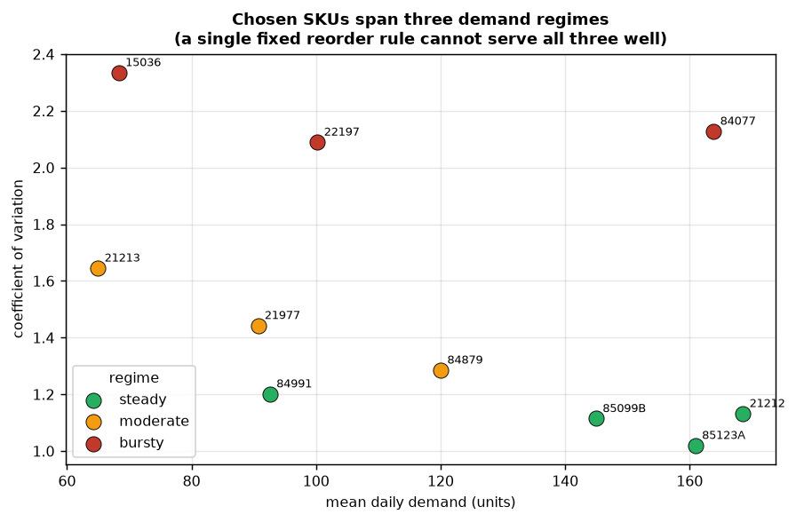
Dataset Description
UCI Online Retail II: about 1 million transaction lines from a UK gift retailer, Dec 2009 - Dec 2011.
Cleaning: cancellations, returns, negative quantities and missing product codes removed. Saturdays dropped entirely, as the retailer never traded then; zero-filling would teach a false weekly collapse.
10 SKUs selected to span three demand regimes, so that no single fixed rule can serve them all.
  steady (CV 1.02-1.20), moderate (1.29-1.65), bursty (2.09-2.34)
Calibrated only on data before 1 June 2011; later data is held back.
Demand model: Gamma-Poisson (negative binomial), because variance is about 216x the mean.
A second dataset (Kaggle retail inventory) was screened and rejected: it showed no weekday effect and no seasonality, i.e. synthetic noise.
[Mid Project Review]

Slide 11
Preliminary Results and Discussion
All five classical policies were tuned by grid search on 12 separate seeds, then scored on 30 held-out seeds. Profit is per 180-day run, in rupees (1 GBP = ₹105; the data is from a UK shop).
Method | Profit | Spread | Fill rate | Stockout cost | Ordering fees
forecast + safety stock | ₹87.8 lakh | ₹4.6 lakh | 97.9% | ₹6.1 lakh | ₹2.9 lakh
newsvendor | ₹86.2 lakh | ₹4.4 lakh | 98.0% | ₹7.4 lakh | ₹3.4 lakh
EOQ + reorder point | ₹75.9 lakh | ₹7.4 lakh | 96.8% | ₹10.5 lakh | ₹2.8 lakh
(s, S) policy | ₹73.9 lakh | ₹7.1 lakh | 94.9% | ₹16.5 lakh | ₹3.1 lakh
constant order (control) | ₹53.3 lakh | ₹13.4 lakh | 92.3% | ₹29.0 lakh | ₹3.5 lakh
random (sanity check) | -₹35.9 lakh | ₹13.6 lakh | 94.2% | ₹20.9 lakh | ₹15.6 lakh
Tuning mattered: widening the search lifted the best method from ₹69.7 lakh to ₹89.2 lakh. Beating an untuned method would have proved nothing.
[Mid Project Review]

Slide 12
Preliminary Results and Discussion
Same 30 held-out seeds, same action granularity, identical customers per seed, so the difference is skill and not luck.
Method | Profit | Fill rate | Ordering fees
forecast + safety stock (best classical) | ₹87.8 lakh | 97.9% | ₹2.9 lakh
AI agent, tuned, 2M steps | ₹79.7 lakh | 95.1% | ₹5.8 lakh
AI agent, untuned, 1M steps | ₹74.8 lakh | 94.3% | ₹7.4 lakh
AI agent, no action masking, 1M steps | ₹23.7 lakh | 94.8% | ₹14.7 lakh
The classical method still wins, by ₹8.1 lakh per run (paired t = -6.45, n = 30, significant). The AI reaches 90.8% of its profit and beats two of the four classical methods.
Where the gap comes from: the AI runs out of stock more often (95.1% fill against 97.9%) and spreads orders across suppliers, paying twice the ordering fees (₹5.8 lakh against ₹2.9 lakh).
Action masking was the biggest single improvement (about 3x). Tuning then closed 38% of the remaining gap, from ₹13.0 lakh to ₹8.1 lakh.
The search picked the lowest learning rate on offer and the larger network: the earlier runs were unstable because they learned too fast, not because the network was too small.
[Mid Project Review]

Slide 13
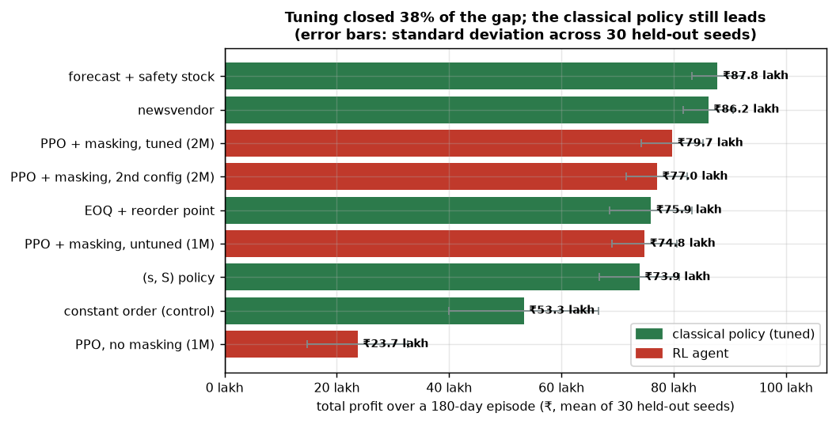
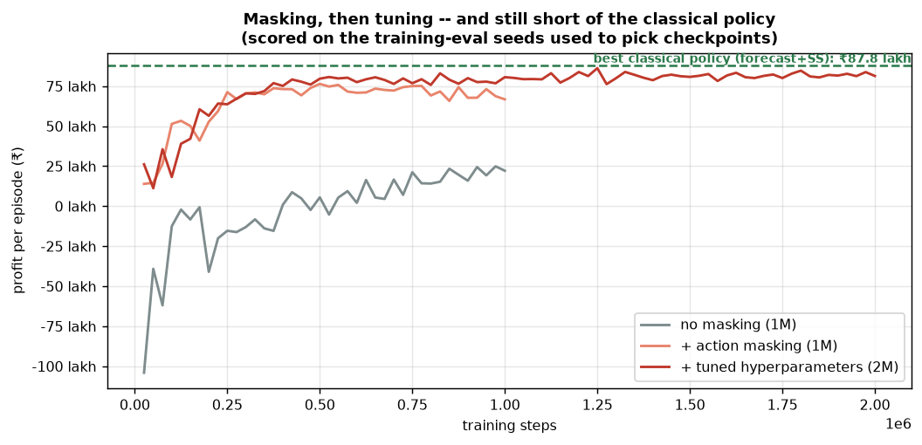
Preliminary Results and Discussion
Visual evidence for the numbers on the previous slide, generated directly from the stored result files.
Left: every policy on the 30 held-out reporting seeds. The tuned agent sits third, above two classical policies; the spread across seeds is wide enough that only a paired test can settle the ordering.
Right: learning progress on the training-eval seeds. Masking lifts the whole curve; tuning lifts it again and trains to 2M steps. The tuned run flattens just under the classical reference line rather than crossing it.
[Mid Project Review]

Slide 14
Interim Summary/Conclusion
Built and verified: the simulator, four tuned classical policies, the RL training pipeline, and a held-out evaluation harness. 92 automated tests pass.
The dataset decision is evidence-based: one candidate dataset was screened and rejected for having no weekday or seasonal structure.
Action masking is the largest single contributor to agent performance so far (3x improvement).
Honest current finding: the tuned classical policy still beats the RL agent by ₹8.1 lakh per run, and the difference is statistically significant.
This is a meaningful result rather than an artefact, because the comparison is fair by construction: same environment, same seeds, same action set.
Remaining work is the LLM explanation and scenario layer, which is the novel contribution of the project.
[Mid Project Review]

Slide 15
Completion plan for the next phase
Engineering is complete; the remaining phases deliver the explainability contribution and the report.
Phase | Work item | Deliverable | Status
5 | Finalise held-out evaluation and hyperparameter sweep | Final RL vs classical comparison table | In progress
6 | LLM explanation module via OpenRouter | Plain-English reason for every order decision | Next
7 | LLM scenario generator | Demand-spike and supplier-failure stress tests | Planned
8 | Streamlit decision-support dashboard | Interactive interface for a manager | Planned
9 | LLM-guided curriculum training | Agent trained on generated hard scenarios | Planned
10 | Final report and documentation | Written report, figures, reproducible code | Planned
[Mid Project Review]

Slide 16
References
Schulman, J., Wolski, F., Dhariwal, P., Radford, A., Klimov, O. (2017). Proximal Policy Optimization Algorithms. arXiv:1707.06347.
Oroojlooyjadid, A., Nazari, M., Snyder, L. V., Takac, M. (2022). A Deep Q-Network for the Beer Game. Manufacturing & Service Operations Management.
Gijsbrechts, J., Boute, R. N., Van Mieghem, J. A., Zhang, D. (2022). Can Deep Reinforcement Learning Improve Inventory Management? Manufacturing & Service Operations Management.
Boute, R. N., Gijsbrechts, J., van Jaarsveld, W., Vanvuchelen, N. (2022). Deep Reinforcement Learning for Inventory Control: A Roadmap. European Journal of Operational Research.
Huang, S., Ontanon, S. (2022). A Closer Look at Invalid Action Masking in Policy Gradient Algorithms. FLAIRS-35.
Chen, D., Sain, S. L., Guo, K. (2012). Data mining for the online retail industry. Journal of Database Marketing & Customer Strategy Management.
Dua, D., Graff, C. Online Retail II Data Set. UCI Machine Learning Repository. https://archive.ics.uci.edu/dataset/502
Raffin, A. et al. (2021). Stable-Baselines3: Reliable Reinforcement Learning Implementations. Journal of Machine Learning Research 22(268).
[Mid Project Review]

Slide 17
                Thank you
[Mid Project Review]

