Slide 1
MID-SEMESTER PROJECT REVIEW · AUGUST 2026
SupplyAI-RL
Explainable Supply Chain Optimization
A reinforcement learning agent decides what to reorder and from which supplier; a large language model will explain those decisions and stress-test them.
SANTOSH
K. KOUSHIK
CB.SC.U4AIE23310
CB.SC.U4AIE23312
DHARANI PRATHAP
SRINITH
CB.SC.U4AIE23330
CB.SC.U4AIE23357
Batch & Group D-06
20 August 2026

Slide 2
AGENDA
What we'll cover
1
Introduction & motivation
7
Dataset details
2
Problem statement
8
System architecture
3
Objectives
9
Preliminary results
4
Literature review
10
Status & next phases
5
Gaps identified
11
References
6
Novelty
SupplyAI-RL · Mid-Semester Review
Agenda
2

Slide 3
INTRODUCTION
A daily decision, made expensive by uncertainty
A retailer decides, every day, per product: how much to reorder and from which supplier.
WHY CLASSICAL RULES BREAK
216× the variance of daily demand, relative to its mean, in our data.
Order too much — capital is frozen, storage is paid for, unsold stock is written off.
The standard Poisson assumption — variance equal to the mean — fails badly here. Classical rules also treat every product in isolation.
Order too little — the sale is lost for good; the customer buys elsewhere.
THE MOTIVATION
Reinforcement learning can express what a formula cannot: a joint ordering-and-sourcing policy that adapts to season, volatility and supplier state.
But a manager will not act on a number they cannot interpret — so we pair the agent with an LLM that states the reason for every order.
SupplyAI-RL · Mid-Semester Review
Introduction & Motivation
3

Slide 4
PROBLEM STATEMENT
Ten products, three suppliers, one shared warehouse
10
180
20,000
21
products × 3 suppliers
day planning horizon
unit shared warehouse
choices per product, per day
THE JOINT DECISION
SCALE
Each day, for every product: decide quantity AND supplier together — not two separate calls.
Suppliers differ in unit cost, lead time (1–8 days), fill reliability (80–98%), MOQ and outage risk.
Objective: maximise total profit = revenue − purchase − holding − ordering fees − lost-sale penalty.
Decisions are coupled in time (today’s order is next week’s stock) and across products (shared capacity).
Every decision must also come with a business-readable justification.
21
options per product (7 quantities × 3 suppliers)
≈ 1.7 × 10¹³
combinations per day across all 10 products — enumeration is impossible.
SupplyAI-RL · Mid-Semester Review
Problem Statement
4

Slide 5
OBJECTIVES
Five objectives — three complete, two next
1
DONE
2
DONE
3
DONE
Build a supply chain simulator
Train an RL agent
Benchmark fairly
calibrated from real retail transaction data.
to choose reorder quantity and supplier jointly.
against properly tuned classical inventory policies.
4
NEXT
5
NEXT
LLM decision explainer
LLM scenario generator
state the reason for each order in business language.
create demand-spike and supplier-delay stress tests.
Objectives 1, 2 and 3 are complete and evaluated. Objectives 4 and 5 are the immediate next phase.
SupplyAI-RL · Mid-Semester Review
Objectives
5

Slide 6
LITERATURE REVIEW
Six papers that frame this project
#
Title & Year
Methodology
Limitation / Gap
1
J. Schulman et al., “Proximal Policy Optimization Algorithms,” arXiv:1707.06347, 2017.
Clipped surrogate policy gradient
Default modern on-policy RL baseline
2
A. Oroojlooyjadid et al., “A Deep Q-Network for the Beer Game,” M&SOM, 2022.
DQN on a serial beer-game chain
Single product, no sourcing choice
3
J. Gijsbrechts et al., “Can Deep RL Improve Inventory Management?,” M&SOM, 2022.
A3C, lost-sales & dual-sourcing
Competitive, not clearly superior; no explanation layer
4
R. Boute et al., “Deep RL for Inventory Control: A Roadmap,” EJOR, 2022.
Survey and research roadmap
Names fair benchmarking & interpretability as open problems
5
S. Huang and S. Ontanón, “A Closer Look at Invalid Action Masking in Policy Gradient Algorithms,” FLAIRS-35, 2022.
Action masking inside policy gradients
Not demonstrated on inventory or sourcing
6
B. Li et al., “Large Language Models for Supply Chain Optimization,” arXiv:2307.03875, 2023.
LLM narrates optimizer output
Explains a solver, not a learned RL policy
SupplyAI-RL · Mid-Semester Review
Literature Review
6

Slide 7
GAPS IDENTIFIED
What the existing literature does not do
✕
Weak benchmarks
✕
Narrow settings
Papers compare against textbook-default heuristics, not properly tuned ones — inflating the reported gain.
Single-product or serial chains dominate; joint quantity + supplier choice under shared capacity is rarely modelled.
✕
Explainability deferred
✕
Hand-built stress tests
Learned policies output a number, not a reason, so they stay in simulation and never reach a decision-maker.
Demand spikes and supplier failures are coded case by case — narrow coverage, hard to extend.
No existing work couples an RL inventory agent with an LLM that both explains its decisions AND generates the scenarios used to test it.
SupplyAI-RL · Mid-Semester Review
Gaps Identified
7

Slide 8
NOVELTY
What this project adds beyond the literature
1
Grounded explanation, not narration
2
LLM-generated, schema-validated stress tests
The LLM never invents a reason. It receives facts the simulator already computed and is checked back against them before display — not asked to reason about a black box.
Disruption scenarios are strict JSON, clamped to safe ranges, executed by the same simulator — not hand-coded edge cases.
3
The scenarios feed back into training
4
A fairness-first benchmark
Generated crises become curriculum data for a second agent, then both are tested on unseen crises — closing the loop from explanation to improvement.
Baselines are grid-search tuned, not left at textbook defaults; every policy meets identical seeds — so any RL claim means something.
SupplyAI-RL · Mid-Semester Review
Novelty
8

Slide 9
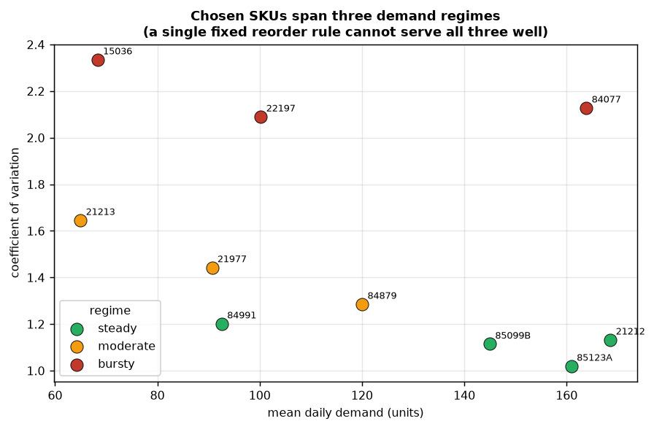
DATASET DETAILS
Real transactions, honestly screened
UCI Online Retail II ~1,067,371 transaction lines, UK gift retailer, Dec 2009 – Dec 2011.
Cleaned & reshaped Cancellations, returns, negatives removed; Saturdays dropped (retailer never traded then).
10 SKUs, 3 regimes steady (CV 1.02–1.20) · moderate (1.29–1.65) · bursty (2.09–2.34).
Calibrated pre-split Fitted only on data before 1 June 2011; later data held back for testing.
Demand model Gamma-Poisson (negative binomial) — variance is ~216× the mean; Poisson cannot express this.
Three demand regimes — a single fixed rule cannot serve all three well.
A second candidate (Kaggle retail inventory) was screened and rejected: no weekday or seasonal effect — synthetic noise.
SupplyAI-RL · Mid-Semester Review
Dataset Details
9

Slide 10
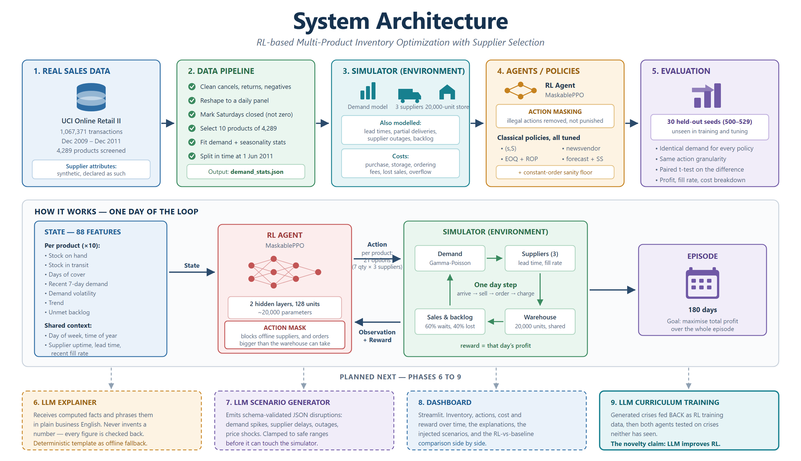
SYSTEM ARCHITECTURE
From real transactions to a masked RL decision
SupplyAI-RL · Mid-Semester Review
System Architecture
10

Slide 11
PRELIMINARY RESULTS
Classical policies, tuned fairly first
All five classical policies were grid-search tuned on 12 separate seeds, then scored on 30 held-out seeds. Profit is per 180-day episode, GBP.
Policy
Profit
Std Dev
Fill Rate
Stockout Cost
Ordering Cost
forecast + safety stock
83,624
4,389
97.9%
5,821
2,729
newsvendor
82,049
4,222
98.0%
7,057
3,275
EOQ + reorder point
72,302
7,028
96.8%
9,988
2,626
(s, S) policy
70,365
6,782
94.9%
15,677
2,905
constant order (control)
50,751
12,723
92.3%
27,644
3,334
random (sanity check)
−34,144
12,971
94.2%
19,900
14,869
Tuning mattered. Widening the search grid lifted the best policy from 66,395 to 84,920 during tuning. Beating an untuned baseline would have proved nothing.
SupplyAI-RL · Mid-Semester Review
Preliminary Results
11

Slide 12
PRELIMINARY RESULTS
The RL agent, against the strongest baseline
Same 30 held-out seeds, same action granularity, identical customers per seed — the difference is skill, not luck.
Policy
Profit
Fill Rate
Ordering Cost
forecast + safety stock (best classical)
83,624
97.9%
2,729
MaskablePPO agent, 1M steps
71,227
94.3%
7,068
PPO without action masking, 1M steps
22,566
94.8%
13,988
Honest current finding. The tuned classical policy still beats the RL agent by 12,397 GBP per episode (paired t = −9.22, n = 30, statistically significant).
~4,700
~4,300 (2.6× baseline fees)
~2,900
Stockouts
Fragmented sourcing
Lost revenue
Action masking is the single largest lever so far — tripling agent profit (23,717 → 72,740). A hyperparameter sweep (8 configs, 6M steps) is testing whether the remaining gap can close.
SupplyAI-RL · Mid-Semester Review
Preliminary Results
12

Slide 13
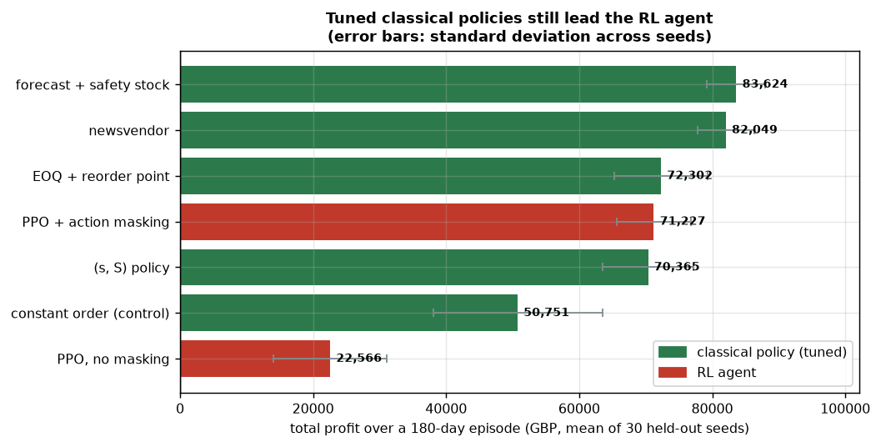
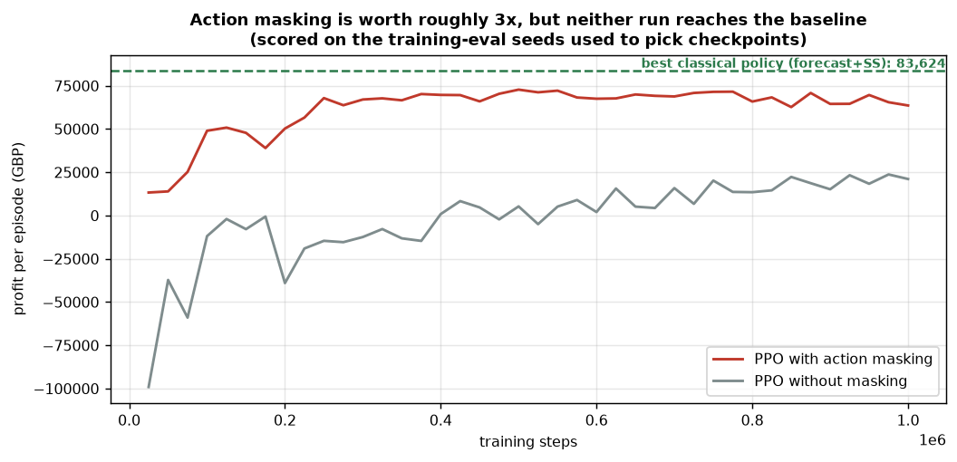
PRELIMINARY RESULTS
The evidence, in figures
Left. Every policy on the 30 held-out reporting seeds. The best classical policy leads; the spread across seeds is wide enough that only a paired test settles the difference.
Right. Training progress on the training-eval seeds. Masking lifts the whole curve; both runs flatten below the classical reference — the unmasked run was still improving at 1M steps.
SupplyAI-RL · Mid-Semester Review
Preliminary Results
13

Slide 14
CURRENT STATUS
Five phases complete, evidence-based throughout
5 / 10
92
30
1,067,371
phases complete
automated tests pass
held-out evaluation seeds
real transactions calibrated
Built & verified
Simulator, four tuned classical policies, RL training pipeline, held-out evaluation harness.
Dataset decision is evidence-based
One candidate dataset was screened and rejected for having no weekday or seasonal structure.
Action masking is the largest single lever so far
3× improvement in agent profit — the strongest result of the engineering phase.
Honest current finding
The tuned classical policy still beats the RL agent by 12,397/episode; the difference is significant. Fair by construction: same environment, seeds, action set.
SupplyAI-RL · Mid-Semester Review
Current Status
14

Slide 15
NEXT PHASES
Engineering is done; explainability is next
Phase
Work Item
Deliverable
Status
5
Finalise held-out evaluation & hyperparameter sweep
Final RL vs classical comparison
In progress
6
LLM explanation module via OpenRouter
Plain-English reason per order
Next
7
LLM scenario generator
Demand-spike & supplier-failure tests
Planned
8
Streamlit decision-support dashboard
Interactive interface for a manager
Planned
9
LLM-guided curriculum training
Agent trained on generated hard scenarios
Planned
10
Final report & documentation
Written report, figures, reproducible code
Planned
SupplyAI-RL · Mid-Semester Review
Next Phases
15

Slide 16
REFERENCES
IEEE format
[1] J. Schulman, F. Wolski, P. Dhariwal, A. Radford, and O. Klimov, “Proximal Policy Optimization Algorithms,” arXiv:1707.06347, 2017.
[2] A. Oroojlooyjadid, M. Nazari, L. V. Snyder, and M. Takáč, “A Deep Q-Network for the Beer Game,” Manuf. Serv. Oper. Manag., 2022.
[3] J. Gijsbrechts, R. N. Boute, J. A. Van Mieghem, and D. Zhang, “Can Deep Reinforcement Learning Improve Inventory Management?,” Manuf. Serv. Oper. Manag., 2022.
[4] R. N. Boute, J. Gijsbrechts, W. van Jaarsveld, and N. Vanvuchelen, “Deep Reinforcement Learning for Inventory Control: A Roadmap,” Eur. J. Oper. Res., 2022.
[5] S. Huang and S. Ontanón, “A Closer Look at Invalid Action Masking in Policy Gradient Algorithms,” in Proc. FLAIRS-35, 2022.
[6] B. Li et al., “Large Language Models for Supply Chain Optimization,” arXiv:2307.03875, 2023.
[7] D. Chen, S. L. Sain, and K. Guo, “Data Mining for the Online Retail Industry,” J. Database Mark. Cust. Strategy Manag., 2012.
[8] D. Dua and C. Graff, “Online Retail II Data Set,” UCI Machine Learning Repository, 2019. [Online]. Available: https://archive.ics.uci.edu/dataset/502
[9] A. Raffin et al., “Stable-Baselines3: Reliable Reinforcement Learning Implementations,” J. Mach. Learn. Res., vol. 22, no. 268, 2021.
SupplyAI-RL · Mid-Semester Review
References
16

Slide 17
Thank you
Questions & discussion

