Slide 1
22AIE450 Reinforcement Learning
SupplyAI-RL: Explainable Supply Chain Optimization
Name | Roll number
Koushik | CB.SC.U4AIE23312
Santosh | CB.SC.U4AIE23310
Srinith | CB.SC.U4AIE23357
Dharani Pratap | CB.SC.U4AIE23330
Batch and Group Number: ______
Date: ____________
[Final Project Review]
Notes:
Opening. One sentence: we built a decision-support system that decides how much stock a shop should order and from which supplier, tested an RL agent against tuned classical methods, and added an LLM that explains each decision and writes the crises we test with. Fill in the batch/group number and the presentation date before presenting.

Slide 2
Outline
1 Introduction and motivation
2 Problem definition
3 Literature review and gaps
4 Objectives and status
5 System architecture
6 Methodology: the agent, the baselines
7 Dataset description
8 LLM explainer and crisis generator
9 Dashboard: screenshots
10 Results: comparison and ablation
11 Robustness to crises
12 Explainer accuracy
13 Conclusion and future work
[Final Project Review]
Notes:
Roadmap. The first half is what we built; the second half is the evidence that it works and where it does not.

Slide 3
Introduction and Motivation
Order too much
• Money is stuck in the warehouse
• Storage costs keep adding up
• Seasonal goods lose value
Order too little
• The customer goes elsewhere
• The sale is lost for good
• We also pay a penalty
Pick the wrong supplier
• Cheap but slow
• Fast but costly
• Looks fine but ships only 80%
• A chain of decisions. Today’s order becomes next week’s stock, so every choice affects the next ones.
• Old rules fall short. Textbook rules (like (s,S) and EOQ) look at each product alone and expect steady demand. In our data, daily demand swings about 216× more than a simple model expects.
• Our idea. A reinforcement learning (RL) agent can learn when to order and from whom, and adapt to the season and to supplier problems, which a fixed formula cannot.
• Trust matters. A manager will not follow a number they cannot understand. So a language model (LLM) explains each order in plain words, and every number it quotes is checked.
[Final Project Review]
Notes:
Motivation in one minute. Both ways of ordering wrong cost money, and supplier choice adds a second decision. The honest framing: RL is a hypothesis we test, not an assumption.

Slide 4
Problem Definition
What | Details
Products | 10 real products from a UK shop’s sales data
Suppliers | 3, made up by us (no public data on suppliers)
Time | 180 days per run; the first 14 days are a warm-up and not counted
Warehouse | one shared store, 20,000 units; extra goods are turned away
Decision | every day, for each product: 7 quantities × 3 suppliers = 21 choices
Goal | maximise profit = sales − purchases − storage − fees − lost sales − wasted goods
Supplier | Price | Delivery | Delivers | Fee
EconoSource | base | 5–8 d | 90% | ₹2,100
RapidTrade | +35% | 1–3 d | 98% | ₹4,725
MidWay | +15% | 3–5 d | 80% | ₹3,150
No supplier is best: the cheap one is slow, the fast one costs more, and the middle one is unreliable.
≈ 17 trillion
different order combinations every day
216×
how much more daily demand swings than a simple model expects
Joint choice
quantity and supplier are chosen together
[Final Project Review]
Notes:
The decision is small to state and huge to search: 21 options per product across 10 products is about 17 trillion combinations a day. No supplier is best, which is what makes it a real trade-off.

Slide 5
Literature Review
# | Work | Approach | Key finding | Limitation
1 | Proximal Policy Optimization (2017) | A stable way to train an RL agent | Reliable; a common default | General purpose; not built for supply chains
2 | A Deep Q-Network for the Beer Game (2022) | Deep RL on a simple supply chain | Matches or beats standard ordering rules when teams cooperate | One product, no supplier choice
3 | Can Deep RL Improve Inventory Management? (2022) | Deep RL on lost sales and two suppliers | As good as well-tuned rules, not clearly better | Needs a lot of tuning; no explanations
4 | Deep RL for Inventory Control: A Roadmap (2022) | Survey of the field | Says fair comparisons and explanations are still open problems | Ideas only; no experiments
5 | A Closer Look at Invalid Action Masking (2022) | Blocking impossible actions during training | Works well even with very many actions | Not tried on inventory
[Final Project Review]
Notes:
Five anchor papers. The pattern: deep RL has been competitive with tuned heuristics, not clearly better, and masking is what makes large action spaces tractable.

Slide 6
Gaps Identified, and What We Did
1
Problems are too simple
Most studies use one product or a simple chain. Choosing quantity and supplier together, with one shared warehouse, is rarely studied.
What we did
We model 10 products, 3 suppliers and one shared warehouse, and choose both together.
2
No explanations
A learned agent gives a number, not a reason, so it stays in simulation.
What we did
An LLM explains each decision using facts from the simulator, and every number is checked.
3
Stress tests are made by hand
Crises are coded one by one, so only a few are ever tested.
What we did
An LLM writes crises that overlap; each is checked and kept within safe ranges.
4
Weak comparisons
Old rules are often left untuned, so a new method looks good for free.
What we did
We tuned all four classical methods first, on separate test runs.
[Final Project Review]
Notes:
Each gap on the left has a concrete answer on the right. We claim only what we tested: no claim that nobody has combined these before beyond this single setting.

Slide 7
Objectives and Status
# | Objective | Status | Evidence
1 | Build a supply-chain simulation from real data | Done | Built from 1.07M real sales; sensible ordering earns profit, silly ordering loses
2 | Train an RL agent to choose quantity and supplier | Done | Tuned agent, 2M training steps; earns 90.8% of the best classical method
3 | LLM explains each decision in plain business language | Done | 100% of explanations shown were correct; 83% before our check, which caught every invented number
4 | LLM creates demand-spike and supplier-delay scenarios | Done | 6 unseen crises used for testing; crisis training also tried
5 | Compare the RL agent with traditional policies | Done | 30 unseen test runs: the classical method still wins
Objective 5 says compare, not win. The result went against the AI, and we say so. What we can defend: RL reaches 90.8% of a strong, well-tuned baseline, and we know why it falls short.
[Final Project Review]
Notes:
All five objectives are met. The fifth is a comparison, and the honest result is that the tuned classical method wins. Say this first, before the examiner asks.

Slide 8
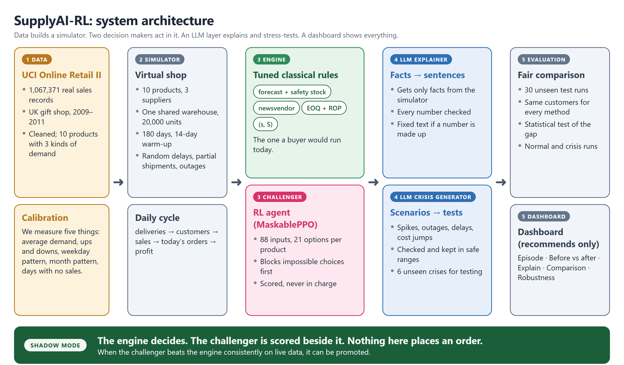
System Architecture
[Final Project Review]
Notes:
Walk left to right. Data builds the simulator. Two decision makers act in it: the tuned classical engine and the RL challenger. The LLM layer explains decisions and writes crises. Evaluation and the dashboard sit on the right. The green strip is the deployment story: shadow mode, nothing places an order.

Slide 9
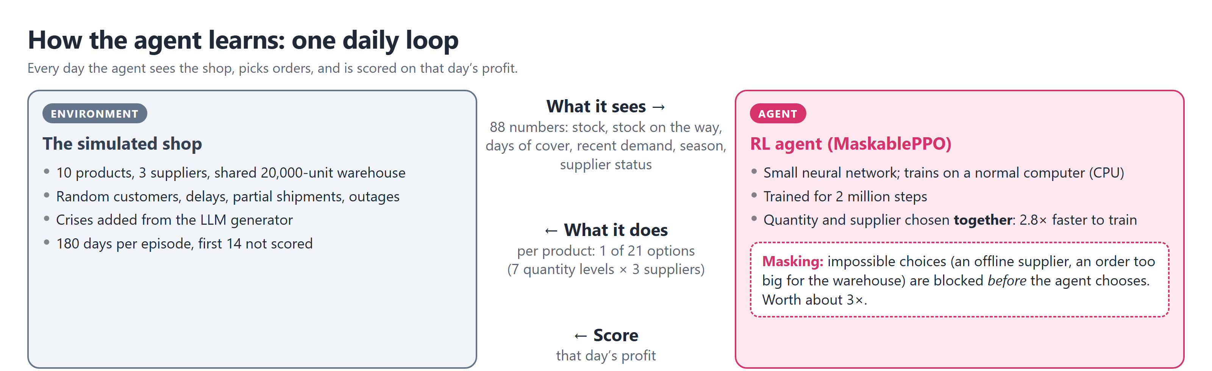
Methodology: How the Agent Learns
Why masking
• Masking blocks impossible choices first
• Score: ₹24.9 lakh → ₹76.4 lakh (3×)
Why one joint choice
• Quantity and supplier chosen together
• Trains 2.8× faster, fits real life
Why tuning
• Tried 8 settings, ran the best 2 longer
• A slower learning rate worked best
[Final Project Review]
Notes:
If asked for detail: the simulator runs five steps a day (deliveries, customers, sales, orders, profit), with storage at 0.15% of cost per day, leftover stock worth 60% of cost, and one shared 20,000-unit warehouse. The agent sees 88 numbers and picks one of 21 options per product; the winning settings were learning rate 5e-5, entropy 0.005, gamma 0.995, rollout 1024, network 2 x 256, from an 8-configuration search with the best two run to 2M steps. The loop: state in, action out, reward back. Action masking is the biggest single improvement: it stops the agent wasting training on choices that are never legal.

Slide 10
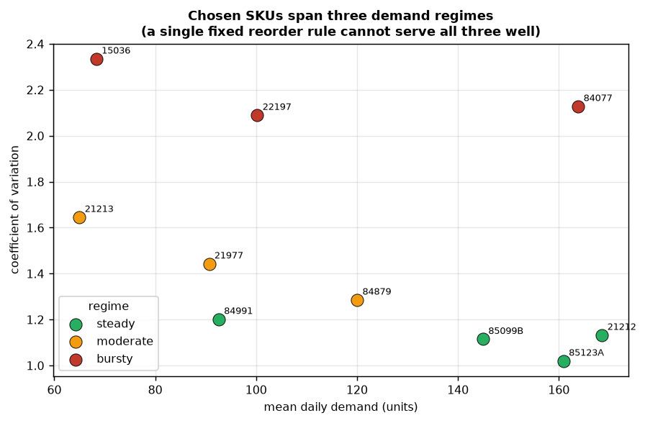
Dataset Description
UCI Online Retail II
• 1,067,371 sales records from a UK online gift shop
• Cleaned: cancellations, returns and bad rows removed; one row per product per day; Saturdays dropped (the shop never opened)
• 10 products picked on purpose: 4 steady, 3 moderate, 3 bursty (very spiky sales)
• The agent never sees the raw sales. We measure five things (average, ups and downs, weekday pattern, month pattern, zero-sale days) and the simulator recreates them
Three kinds of demand: steady, moderate, bursty
If all ten products behaved the same, one simple rule would work for all and an AI would have nothing to learn.
[Final Project Review]
Notes:
Why this dataset: real and public, with enough variety. Why not the newer one: it is synthetic noise, and newer-but-fake is worse than older-but-real. Money is converted from pounds at 1 GBP = 105 rupees for display only.

Slide 11
Classical Methods and a Fair Test
Method | Tuned settings
(s, S) | order when stock covers under 11 days; refill up to 16 days
EOQ + reorder point | order at 8 days of stock left, with a safety margin of 1.6
Newsvendor | plan 3 days ahead, use the cheapest supplier
Forecast + safety stock | forecast from yesterday, extra safety stock (about 90% service), check every 4 days
Seeds (test runs) | Used for
100–111 | tuning the classical methods
900–905 | choosing the best RL version
500–529 | final results only; never used to make any choice
• Tuning mattered a lot. Better settings lifted the best classical method from ₹69.7 lakh to ₹89.2 lakh. Without tuning, the AI would have looked better than it really is.
• Same choices for all. Every classical method picks from the same 21 options per product as the AI.
• Same customers for all. Every method faces the same customers and delays on each test run, so we compare them run by run.
[Final Project Review]
Notes:
This is what makes a negative result meaningful. Three disjoint seed groups, tuned baselines, identical customers for every method.

Slide 12
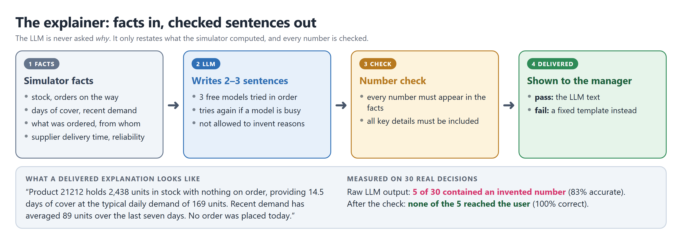
LLM Explainer: Facts In, Checked Sentences Out
The rule: the LLM is never asked why. The agent’s real reason is hidden inside a neural network, so any “because” from the LLM would just be a believable story.
[Final Project Review]
Notes:
The key design decision: the LLM only presents facts the simulator computed. Then every number in its output is checked against those facts. If it invented one, a fixed template is shown instead. Three free models via OpenRouter, tried in order, with retries.

Slide 13
LLM Crisis Generator and Training on Crises
Days | Event (written by the LLM) | Cause it gave
45–65 | demand triples on four products | viral social media trend
50–63 | supplier 2 goes offline | cyberattack on mid-tier supplier
55–72 | supplier 0 delayed by 6 days | port congestion at major hub
60–84 | costs rise 1.6× | raw material shortage
We do not trust what the LLM writes
• The event type must be one we know
• Suppliers and products must exist (wrong ones are dropped)
• Numbers are kept within safe ranges
• Events are moved to fit inside the 180 days
• 6 deliberately bad inputs: none got through as written
These events overlap: a supplier fails during the demand spike. A one-event test never checks that combination.
Training on crises
• 16 sets of crises (from 19 LLM scenarios): 10 for training, 6 for testing
• The agent trains on the 10 and is tested on the 6 it never saw. Everything else matches the plain agent, so crises are the only difference
• The split matters: testing on crises it trained on would only prove it memorised them
[Final Project Review]
Notes:
The LLM's value here is imagination, not trust. We validate everything. The curriculum experiment is controlled: same seed, same settings, same steps.

Slide 14
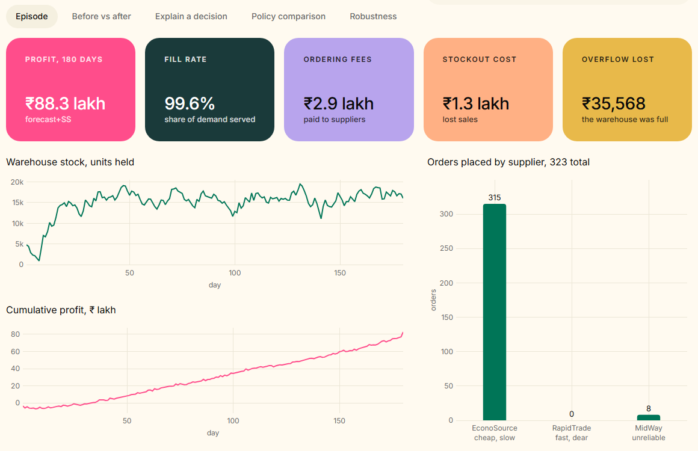
Dashboard (1/5): Episode View, Engine
1
Choose the policy and test run
Sidebar: any policy, any test run, with or without a crisis.
2
Five outcome cards
Profit ₹87.8 lakh, share of demand served, order fees, lost sales, wasted goods.
3
Stock and profit over 180 days
Two simple charts, each with its own scale.
4
Which supplier was used
The engine sends almost every order to the cheap supplier.
Dashboard: forecast + safety stock policy, test run 500
[Final Project Review]
Notes:
Live demo starting point. The dashboard opens on the engine, the policy a buyer would actually run. Everything shown comes from a real episode run on demand; no number on the page is typed in.

Slide 15
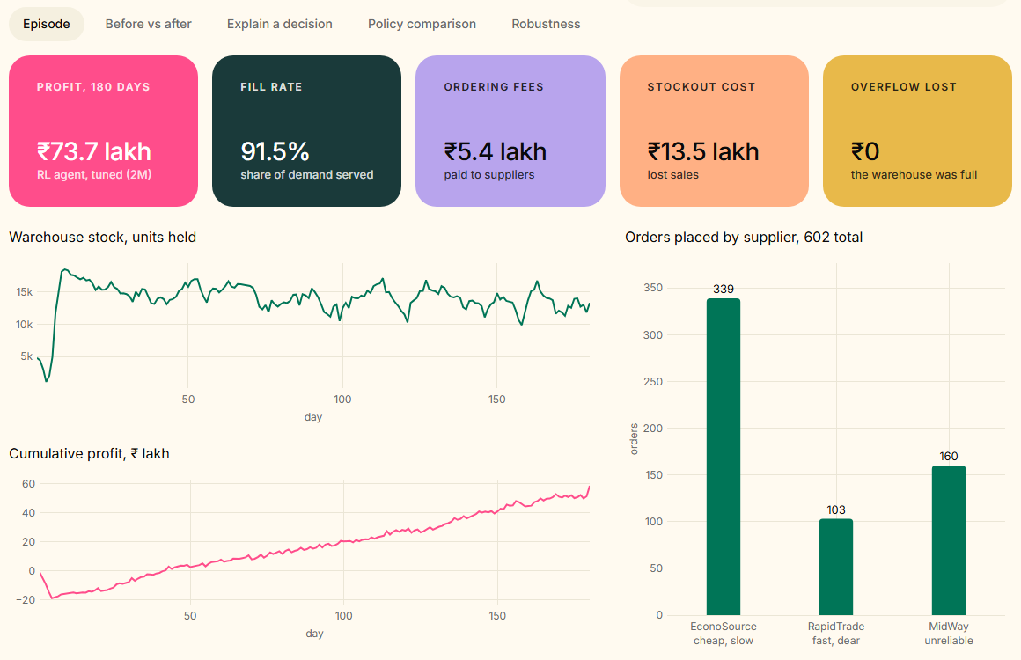
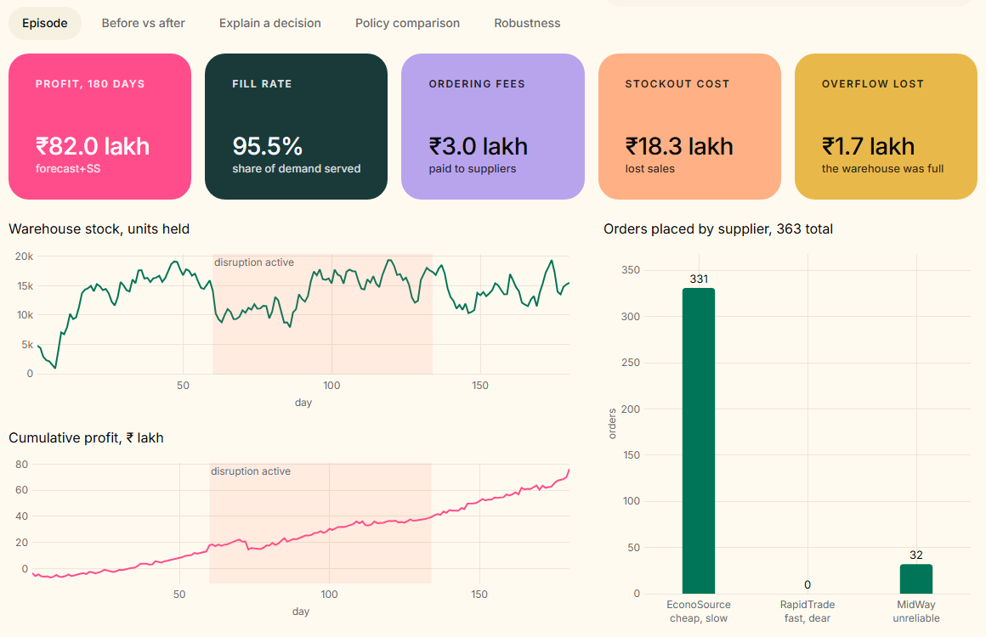
Dashboard (2/5): The Challenger, and a Crisis
RL challenger: orders spread across all three suppliers
Engine with a crisis added: shaded band = disruption
Challenger (left): 602 orders spread over all three suppliers, against 323 for the engine. This splitting is why the agent pays about double the order fees. Crisis (right): the shaded band shows the days of the disruption, so you can read stock and profit against it.
[Final Project Review]
Notes:
Left: switch the policy to the challenger and the supplier bars change completely. This is the visual evidence for the error analysis. Right: the crisis switch injects the LLM-written disruption for the whole run.

Slide 16
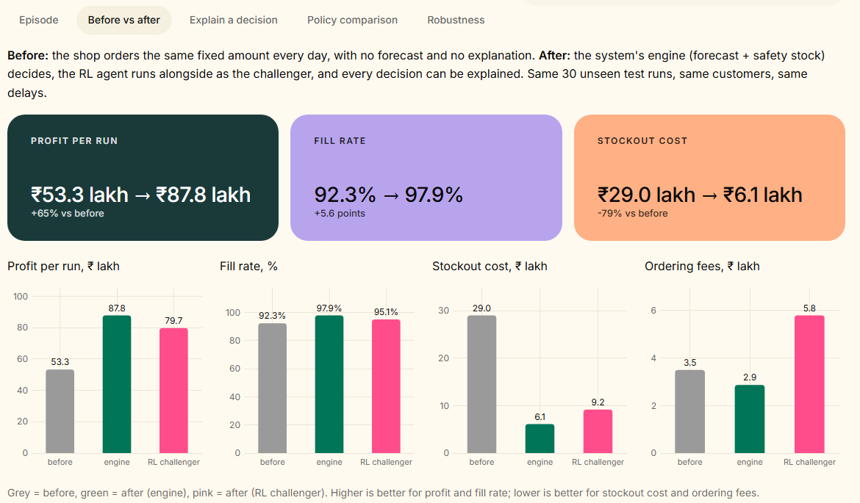
Dashboard (3/5): Before vs After the System
₹53.3 lakh → ₹87.8 lakh
Profit per run +65%
92.3% → 97.9%
Share of demand served +5.6 points
₹29.0 lakh → ₹6.1 lakh
Lost-sales cost -79%
Most of this gain comes from smart forecasting with safety stock (the engine), not from RL.
“Before”: the same fixed order every day. “After”: our engine, with the RL challenger beside it.
[Final Project Review]
Notes:
Before = the shop orders the same fixed amount every day, tuned as carefully as every other baseline. After = the system's engine. Same 30 unseen runs. The honest reading: forecasting plus safety stock does the heavy lifting; the RL challenger also beats the fixed order but trails the engine.

Slide 17
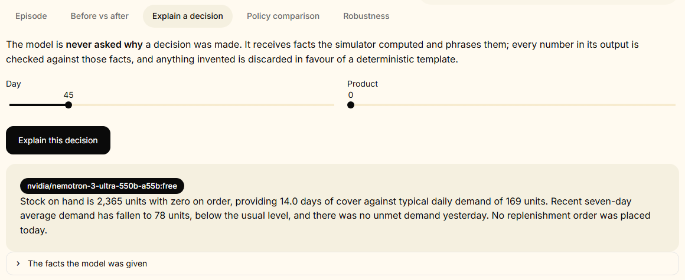
Dashboard (4/5): Explain a Decision
How to use it
• Choose a day and a product
• Press Explain this decision
• Read 2–3 plain sentences
• The black badge shows the writer: a model name, or “template” if our check rejected the LLM
• Open “the facts the model was given” to check every number
Day 45, product 0: explanation written by the LLM; the badge shows who wrote it
Check it yourself: 2,365 units, 14.0 days of cover, demand of 169 units and a 7-day average of 78 all appear in the facts panel. If the model had made up a number, the template would have replaced this text.
[Final Project Review]
Notes:
This is the explainer in action, live. The explanation is a restatement of computed facts, not an account of the neural network's reasoning, and we say so explicitly.

Slide 18
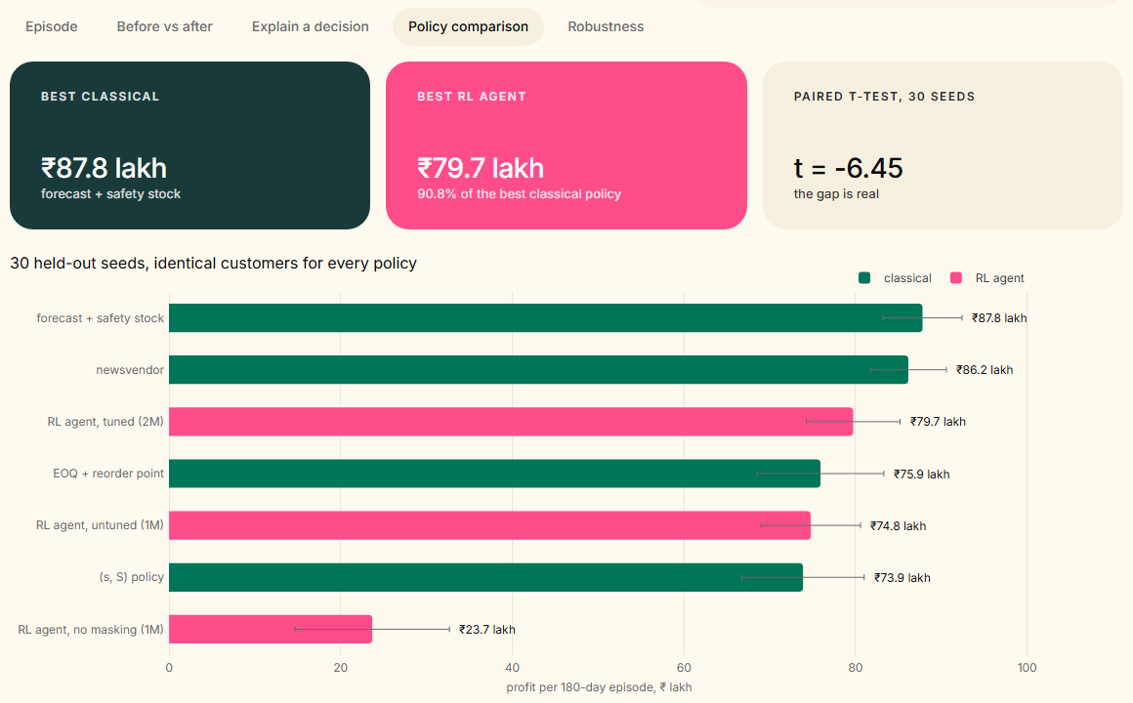
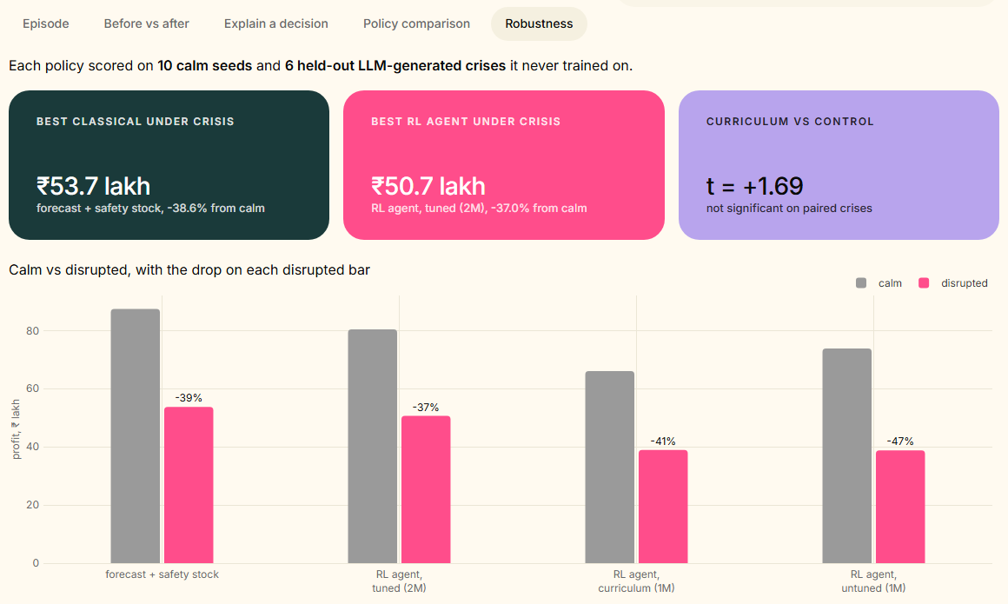
Dashboard (5/5): Policy Comparison and Robustness
Comparison tab: 30 unseen test runs
Robustness tab: normal days vs 6 unseen crises
• Only the rows needed for our claims are shown: the 4 classical methods and 3 RL agents (tuned, untuned, no masking); then the engine, the tuned agent, and the crisis-trained agent beside its control.
• The cards give the key numbers; the table under each chart has the same data for checking.
[Final Project Review]
Notes:
Both tabs read the saved result files, so the dashboard cannot disagree with the report.

Slide 19
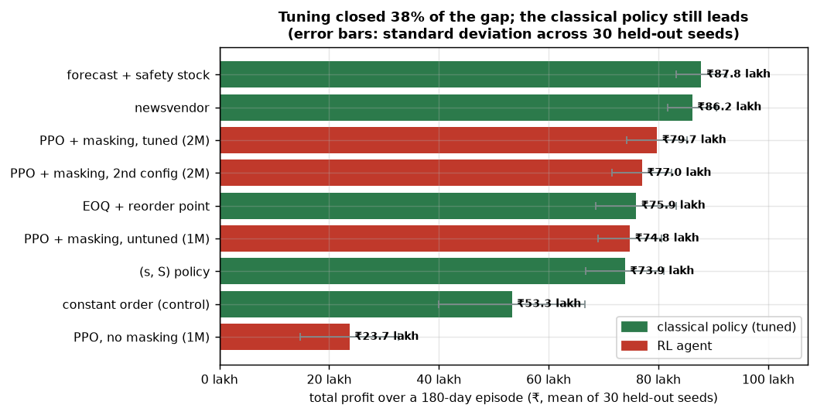
Results (1/4): Main Comparison on 30 Unseen Runs
Method | Profit | Served | Fees | Lost sales
Forecast + safety stock | ₹87.8 lakh | 97.9% | ₹2.9 lakh | ₹6.1 lakh
Newsvendor | ₹86.2 lakh | 98.0% | ₹3.4 lakh | ₹7.4 lakh
RL agent, tuned, 2M | ₹79.7 lakh | 95.1% | ₹5.8 lakh | ₹9.2 lakh
EOQ + reorder point | ₹75.9 lakh | 96.8% | ₹2.8 lakh | ₹10.5 lakh
RL agent, untuned, 1M | ₹74.8 lakh | 94.3% | ₹7.4 lakh | ₹11.0 lakh
(s, S) policy | ₹73.9 lakh | 94.9% | ₹3.0 lakh | ₹16.5 lakh
Fixed daily order (no system) | ₹53.3 lakh | 92.3% | ₹3.5 lakh | ₹29.0 lakh
RL agent, no masking | ₹23.7 lakh | 94.8% | ₹14.7 lakh | ₹11.3 lakh
The best classical method beats the tuned agent, and the gap is real, not luck (95% range: 5.5–10.6 lakh). The agent does beat two of the four classical methods: EOQ and (s,S).
Average profit per 180-day run over 30 unseen test runs. Rupees at 1 GBP = 105.
90.8%
of the best classical profit
−₹8.1 lakh
gap per run (t = −6.45: a real gap)
[Final Project Review]
Notes:
State the result plainly: the classical engine wins by about 8 lakh per run, paired t of minus 6.45. The agent reaches 90.8% of its profit and beats EOQ and (s,S). The constant-order row is the 'no system' baseline.

Slide 20
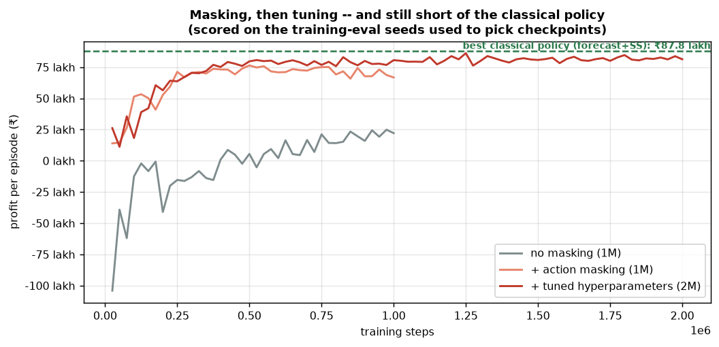
Results (2/4): What Each Step Was Worth
Step | Practice score | Test score | Gap to classical
Basic RL (no masking) | 24.9 lakh | 23.7 lakh | −64.1 lakh
+ masking (block bad choices) | 76.4 lakh | 74.8 lakh | −13.0 lakh
+ tuning, 2M steps | 86.2 lakh | 79.7 lakh | −8.1 lakh
• Masking: about 3×. Without it, the agent wastes most of its training on choices that can never work.
• Tuning: closed 38% of what was left. The gap shrank from 13.0 to 8.1 lakh.
Practice scores use runs 900–905; test scores use unseen runs 500–529.
Learning curves: no masking, masking, tuned
[Final Project Review]
Notes:
Two controlled improvements, each measured: masking about 3x, tuning closes 38% of the remaining gap. The curves show learning progress on the checkpoint-selection seeds; reported scores come from separate held-out seeds.

Slide 21
Results (3/4): Coping with Unseen Crises
Method | Normal | Crisis | Drop
Forecast + safety stock | ₹87.4 lakh | ₹53.7 lakh | -38.6%
RL agent, tuned (no crisis training) | ₹80.4 lakh | ₹50.7 lakh | -37.0%
RL agent, untuned (control) | ₹73.8 lakh | ₹38.8 lakh | -47.5%
RL agent, trained on crises | ₹66.0 lakh | ₹38.9 lakh | -41.1%
Crisis training did not work
• In a crisis it earns ₹38.9 lakh, same as the control’s ₹38.8 lakh
• and it lost ₹7.7 lakh of normal profit
• t = +1.69: not a real difference
• A smaller % drop can mislead when the starting profit is lower: the crisis-trained agent drops less because it had less to lose. We show the drop next to the actual profit so we are not fooled.
• The useful finding: simply tuning the settings made the agent more crisis-proof than crisis training did. The tuned agent never trained on a crisis, yet has the highest crisis profit and the smallest drop of the agents.
Limit: the crisis-trained agent had a harder job with the same training time, so it may simply be under-trained.
[Final Project Review]
Notes:
Every method loses more than a third of its profit in a crisis; RL is not more adaptive than the tuned classical method. Our attempt to fix that with crisis training did not work. We report it as a negative result.

Slide 22
Results (4/4): Explainer Accuracy on 30 Real Decisions
83%
raw LLM accuracy: correct and complete, before our check
100%
delivered accuracy: what the manager actually saw
5 of 30
outputs had an invented number; all 5 caught
Measure | Result
LLM answered (after retries) | 100%
Only real numbers used (before the check) | 83% (25 of 30)
Complete (product, stock, order details) | 100%
Length | 2.9 sentences, 58 words
Why it matters
• The five bad outputs sounded confident and fluent. A buyer would not notice.
• Without the check, 1 explanation in 6 would contain a made-up number.
• An earlier version only scored outputs that had already passed the check, so it showed 100% for a model that made up numbers 17% of the time. We now show both numbers.
[Final Project Review]
Notes:
Be upfront about both numbers. 83% is the model by itself; 100% is the system with the check. The finding is that the check is essential, not decoration.

Slide 23
Conclusion and Future Work
What we showed
• A complete system: simulator, RL agent, 4 tuned classical methods, LLM explainer, crisis generator, dashboard
• The tuned agent earns 90.8% of the best classical method and beats two of the four; the gap is real (t = -6.45) and comes from splitting orders across suppliers
• Masking ≈ 3×; tuning closes 38% of the rest; crisis training did not help
• The explainer is accurate only because it is checked: 83% before, 100% after
• Safe way to use it: the classical engine decides, RL is scored alongside, nothing is executed
Future work
• Give the agent a memory of its own orders (days since last order, last supplier, fees so far) and test again on the same 30 runs: the best chance to close the gap
• Test all methods when the market changes (wilder demand, longer delays)
• Train longer on crises, to see whether the method failed or was just under-trained
• Use recent real data and real supplier terms if a partner can provide them
• Before real use: handle new products, set order limits, keep an audit trail, and flag when a human should decide
[Final Project Review]
Notes:
Close on the honest claim: the project works end to end, the comparison is fair, the classical method wins, and we know why. The next experiment is aimed straight at the cause.

Slide 24
References
[1] J. Schulman, F. Wolski, P. Dhariwal, A. Radford, O. Klimov. Proximal policy optimization algorithms. arXiv:1707.06347, 2017.
[2] S. Huang, S. Ontanón. A closer look at invalid action masking in policy gradient algorithms. FLAIRS-35, 2022.
[3] J. Gijsbrechts, R. N. Boute, J. A. Van Mieghem, D. Zhang. Can deep reinforcement learning improve inventory management? Manufacturing & Service Operations Management, 2022.
[4] R. N. Boute, J. Gijsbrechts, W. van Jaarsveld, N. Vanvuchelen. Deep reinforcement learning for inventory control: a roadmap. European Journal of Operational Research, 2022.
[5] A. Oroojlooyjadid, M. Nazari, L. V. Snyder, M. Takáč. A deep Q-network for the beer game. Manufacturing & Service Operations Management, 2022.
[6] D. Chen, S. L. Sain, K. Guo. Data mining for the online retail industry. Journal of Database Marketing & Customer Strategy Management, 2012.
[7] A. Raffin et al. Stable-Baselines3: reliable reinforcement learning implementations. JMLR 22(268), 2021.
[8] UCI Machine Learning Repository. Online Retail II. https://archive.ics.uci.edu/dataset/502
[Final Project Review]
Notes:
Same eight references as the report. The report has the full paper; this is the short list.

Slide 25
Thank You
[Final Project Review]
Notes:
Likely questions: why the classical method wins (fees from supplier fragmentation, no ordering memory); where the accuracy is (no accuracy in RL; relative profit 90.8%, explainer 100% delivered); is the data too old (stability test); what masking is.

