Slide 1
Mid semester project review– August 2026
22AIE450 Reinforcement Learning
SupplyAI-RL: Explainable Supply Chain Optimization
[Team Member Names and Roll Numbers]
Batch and Group Number:
Date of the Presentation:
[Mid Project Review]

Slide 2
Outline
Introduction and Motivation
Problem Definition
Literature Review and Gaps Identified
Objectives
Methodology: simulator, RL formulation, LLM explanation layer
Dataset Description and Calibration
Preliminary Results: tuned classical policies vs the RL agent
Interim Summary and Completion Plan
[Mid Project Review]

Slide 3
Introduction and Motivation
Retail inventory is a daily decision under uncertainty, and both errors are expensive.
  Order too much: capital is tied up, storage is paid for, and unsold stock is marked down or written off.
  Order too little: the sale is lost permanently, because the customer buys elsewhere.
Classical policies treat each product in isolation and assume demand is well behaved.
  Real demand is not. In our data the variance of daily demand is roughly 216 times its mean, so the standard Poisson assumption fails badly.
Reinforcement learning can express what a formula cannot: a joint ordering and sourcing policy that adapts to season, volatility and supplier state.
But a manager will not act on a number they cannot interpret.
  Hence the motivation: pair an RL decision-maker with an LLM that states the reason for every order in business language.
[Mid Project Review]

Slide 4
Problem Definition
Manage 10 products across 3 suppliers over a 180-day horizon, sharing a single 20,000-unit warehouse.
Each simulated day, for every product, decide two things jointly: how much to order, and from which supplier.
Suppliers differ in unit cost, lead time (1-8 days), fill reliability (80-98%), minimum order quantity and outage risk.
Objective: maximise total profit = revenue - purchase - holding - ordering fees - lost-sale penalty.
Scale: 21 choices per product over 10 products is about 1.7 x 10^13 combinations per day, so enumeration is impossible.
Decisions are coupled in time (today's order becomes next week's stock) and across products (one shared capacity).
Additional requirement: every decision must come with a business-readable justification.
[Mid Project Review]

Slide 5
Literature Review
Sl No | Title and year | Journal / Conference | Methodology | Key findings | Limitations
1 | Proximal Policy Optimization Algorithms (2017) | arXiv preprint | Clipped surrogate policy-gradient objective | Stable, sample-efficient on-policy RL; the default modern baseline | General purpose; no supply-chain structure
2 | A Deep Q-Network for the Beer Game (2022) | M&SOM | DQN on a serial beer-game supply chain | DRL matches or beats base-stock policies under cooperation | Single product, serial chain, no sourcing choice
3 | Can Deep RL Improve Inventory Management? (2022) | M&SOM | A3C on lost-sales and dual-sourcing problems | Competitive with tuned heuristics but not clearly superior | Heavy tuning cost; no explanation layer
4 | Deep RL for Inventory Control: A Roadmap (2022) | EJOR | Survey and research roadmap | Names fair benchmarking and interpretability as open problems | Conceptual; no implementation or results
5 | A Closer Look at Invalid Action Masking in Policy Gradient Algorithms (2022) | FLAIRS | Action masking inside policy-gradient methods | Masking is a valid gradient and scales to large action spaces | Not demonstrated on inventory or sourcing
[Mid Project Review]

Slide 6
Gaps Identified
Weak benchmarks. Most DRL inventory papers compare against textbook-default heuristics rather than properly tuned ones, which inflates the reported gain.
Narrow problem settings. Single-product or serial chains dominate; joint quantity and supplier selection under one shared capacity is rarely modelled.
Explainability is deferred. Learned policies output a number, not a reason, so they stay in simulation and never reach a decision-maker.
Stress testing is hand-built. Demand spikes and supplier failures are coded case by case, so coverage is narrow and hard to extend.
No existing work couples an RL inventory agent with an LLM that both explains its decisions and generates the scenarios used to test it.
[Mid Project Review]

Slide 7
Objectives
1. Build a supply chain simulator calibrated from real retail transaction data.
2. Train a reinforcement learning agent to choose reorder quantity and supplier jointly.
3. Use an LLM to explain each decision in business language.
4. Use an LLM to generate demand-spike and supplier-delay scenarios for stress testing.
5. Compare the RL agent against properly tuned classical inventory policies.
Objectives 1, 2 and 5 are complete. Objectives 3 and 4 are the next phase.
[Mid Project Review]

Slide 8
Methodology
Pipeline: real transactions - statistical calibration - simulator - agent and baselines - held-out comparison - LLM explanation layer.
MDP formulation
  State (88 values): per product stock, in-transit, days of cover, 7-day mean and volatility, trend, backlog; plus weekday, season, and each supplier's availability, lead time and recent fill rate.
  Action: for each product one joint choice of (quantity bucket, supplier) - 7 x 3 = 21 options, as MultiDiscrete over 10 products.
  Reward: that day's realised profit. Episode: 180 days.
Algorithm: MaskablePPO (PPO with invalid-action masking), MLP of two 128-unit hidden layers, trained on CPU.
  Masking blocks suppliers in outage and orders exceeding free capacity. Worth about 3x on its own: best profit rose from 23,717 to 72,740.
Fair comparison by construction: baselines are grid-search tuned, face the same seeds and the same action granularity, and are scored on 30 held-out seeds disjoint from all tuning and training seeds.
[Mid Project Review]

Slide 9
System Architecture
Real transactions
UCI Online Retail II, ~1M lines
Data pipeline
clean - calibrate - time split
demand_stats.json
statistical fingerprint
SUPPLY CHAIN SIMULATOR (Gymnasium environment)
Gamma-Poisson demand - 3 suppliers with lead time, fill rate, MOQ and outages
one shared 20,000-unit warehouse - daily profit accounting - 180-day episodes
4 classical policies
(s,S) - EOQ+ROP - newsvendor - forecast+SS, all grid-search tuned
PPO agent
MaskablePPO - MLP 128x128 - 88-value state - 21 actions per product
Held-out evaluation: 30 unseen seeds, identical per policy, paired significance test
LLM LAYER (next phase)
decision explanations in business language - generated demand-spike and supplier-failure scenarios
Streamlit dashboard for the decision-maker
[Mid Project Review]

Slide 10
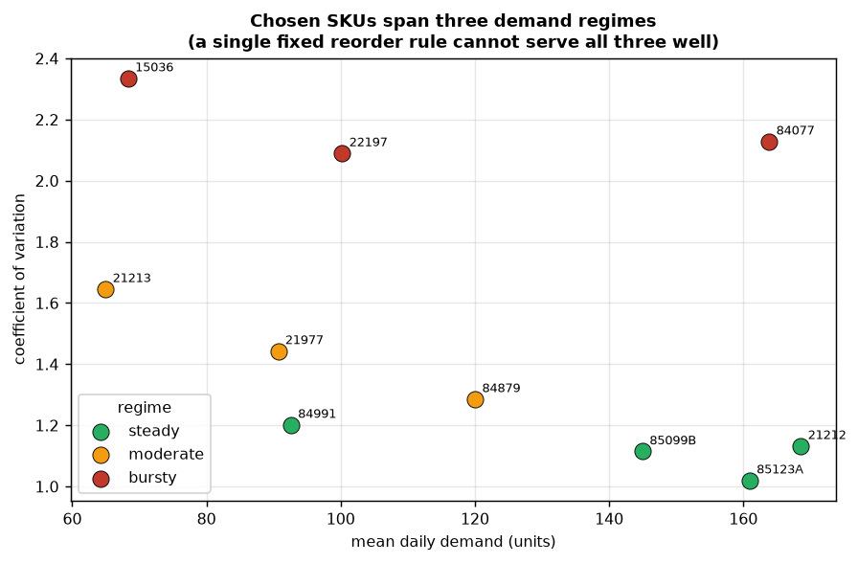
Dataset Description
UCI Online Retail II: about 1 million transaction lines from a UK gift retailer, Dec 2009 - Dec 2011.
Cleaning: cancellations, returns, negative quantities and missing product codes removed. Saturdays dropped entirely, as the retailer never traded then; zero-filling would teach a false weekly collapse.
10 SKUs selected to span three demand regimes, so that no single fixed rule can serve them all.
  steady (CV 1.02-1.20), moderate (1.29-1.65), bursty (2.09-2.34)
Calibrated only on data before 1 June 2011; later data is held back.
Demand model: Gamma-Poisson (negative binomial), because variance is about 216x the mean.
A second dataset (Kaggle retail inventory) was screened and rejected: it showed no weekday effect and no seasonality, i.e. synthetic noise.
[Mid Project Review]

Slide 11
Preliminary Results and Discussion
All five classical policies were tuned by grid search on 12 separate seeds, then scored on 30 held-out seeds. Profit is per 180-day episode, in GBP.
Policy | Profit | Std dev | Fill rate | Stockout cost | Ordering cost
forecast + safety stock | 83,624 | 4,389 | 97.9% | 5,821 | 2,729
newsvendor | 82,049 | 4,222 | 98.0% | 7,057 | 3,275
EOQ + reorder point | 72,302 | 7,028 | 96.8% | 9,988 | 2,626
(s, S) policy | 70,365 | 6,782 | 94.9% | 15,677 | 2,905
constant order (control) | 50,751 | 12,723 | 92.3% | 27,644 | 3,334
random (sanity check) | -34,144 | 12,971 | 94.2% | 19,900 | 14,869
Tuning mattered: widening the search grid lifted the best policy from 66,395 to 84,920 during tuning. Beating an untuned baseline would have proved nothing.
[Mid Project Review]

Slide 12
Preliminary Results and Discussion
Same 30 held-out seeds, same action granularity, identical customers per seed, so the difference is skill and not luck.
Policy | Profit | Fill rate | Ordering cost
forecast + safety stock (best classical) | 83,624 | 97.9% | 2,729
MaskablePPO agent, 1M steps | 71,227 | 94.3% | 7,068
PPO without action masking, 1M steps | 22,566 | 94.8% | 13,988
The classical policy still wins by 12,397 per episode (paired t = -9.22, n = 30, significant).
Where the gap comes from: stockouts about 4,700; fragmented sourcing about 4,300 (the agent pays 2.6x the baseline's ordering fees); lost revenue about 2,900.
Action masking is the single largest lever found so far, tripling agent profit from 23,717 to 72,740.
A hyperparameter sweep of 8 configurations over 6 million steps is running to test whether the remaining gap can be closed.
[Mid Project Review]

Slide 13
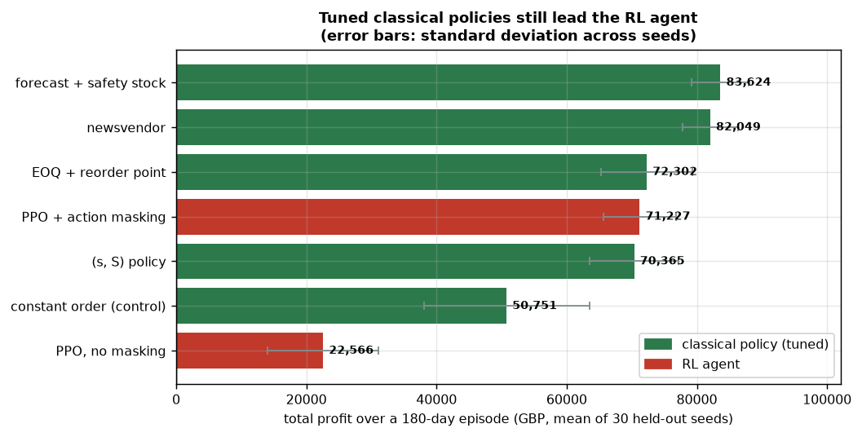
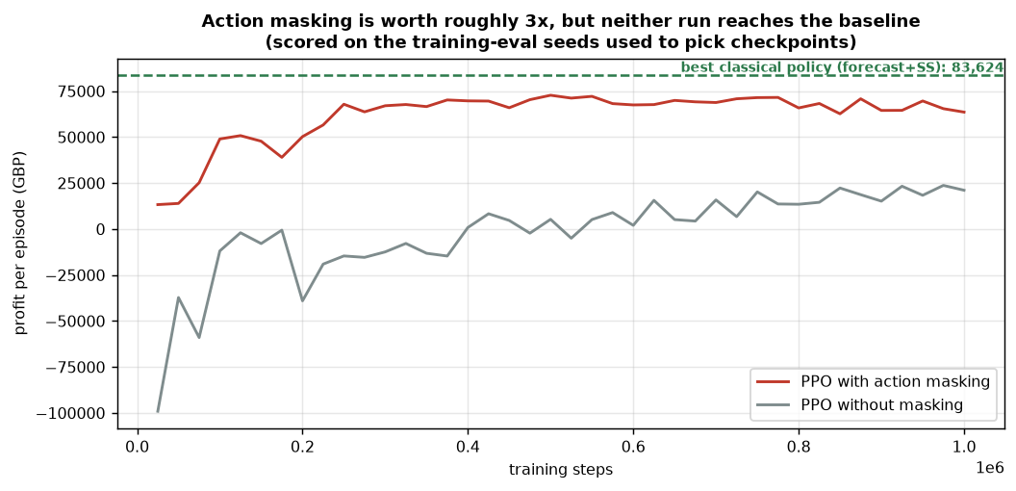
Preliminary Results and Discussion
Visual evidence for the numbers on the previous slide, generated directly from the stored result files.
Left: every policy on the 30 held-out reporting seeds. The best classical policy leads the agent, and the spread across seeds is wide enough that only a paired test can settle the difference.
Right: learning progress on the training-eval seeds. Action masking lifts the whole curve; both runs flatten below the classical reference line, and the unmasked run was still improving at 1M steps, which is why the sweep trains to 2M.
[Mid Project Review]

Slide 14
Interim Summary/Conclusion
Built and verified: the simulator, four tuned classical policies, the RL training pipeline, and a held-out evaluation harness. 92 automated tests pass.
The dataset decision is evidence-based: one candidate dataset was screened and rejected for having no weekday or seasonal structure.
Action masking is the largest single contributor to agent performance so far (3x improvement).
Honest current finding: the tuned classical policy still beats the RL agent by 12,397 per episode, and the difference is statistically significant.
This is a meaningful result rather than an artefact, because the comparison is fair by construction: same environment, same seeds, same action set.
Remaining work is the LLM explanation and scenario layer, which is the novel contribution of the project.
[Mid Project Review]

Slide 15
Completion plan for the next phase
Engineering is complete; the remaining phases deliver the explainability contribution and the report.
Phase | Work item | Deliverable | Status
5 | Finalise held-out evaluation and hyperparameter sweep | Final RL vs classical comparison table | In progress
6 | LLM explanation module via OpenRouter | Plain-English reason for every order decision | Next
7 | LLM scenario generator | Demand-spike and supplier-failure stress tests | Planned
8 | Streamlit decision-support dashboard | Interactive interface for a manager | Planned
9 | LLM-guided curriculum training | Agent trained on generated hard scenarios | Planned
10 | Final report and documentation | Written report, figures, reproducible code | Planned
[Mid Project Review]

Slide 16
References
Schulman, J., Wolski, F., Dhariwal, P., Radford, A., Klimov, O. (2017). Proximal Policy Optimization Algorithms. arXiv:1707.06347.
Oroojlooyjadid, A., Nazari, M., Snyder, L. V., Takac, M. (2022). A Deep Q-Network for the Beer Game. Manufacturing & Service Operations Management.
Gijsbrechts, J., Boute, R. N., Van Mieghem, J. A., Zhang, D. (2022). Can Deep Reinforcement Learning Improve Inventory Management? Manufacturing & Service Operations Management.
Boute, R. N., Gijsbrechts, J., van Jaarsveld, W., Vanvuchelen, N. (2022). Deep Reinforcement Learning for Inventory Control: A Roadmap. European Journal of Operational Research.
Huang, S., Ontanon, S. (2022). A Closer Look at Invalid Action Masking in Policy Gradient Algorithms. FLAIRS-35.
Chen, D., Sain, S. L., Guo, K. (2012). Data mining for the online retail industry. Journal of Database Marketing & Customer Strategy Management.
Dua, D., Graff, C. Online Retail II Data Set. UCI Machine Learning Repository. https://archive.ics.uci.edu/dataset/502
Raffin, A. et al. (2021). Stable-Baselines3: Reliable Reinforcement Learning Implementations. Journal of Machine Learning Research 22(268).
[Mid Project Review]

Slide 17
                Thank you
[Mid Project Review]

