Slide 1
Test Environment Scope of User Space Huge Page
POD
POD
Server Spec
CPU: 20 Cores (2 sockets)
Memory: 256GB
Disk: 2TB
Network Interface : Mellanox 100G
User-mode: DPDK-VPP
Kernel-mode : OVS
Packet Generator
T-Rex traffic generator
Pre-built into the NVFbench container (https://trex-tgn.cisco.com)
vpp-sw
mlx-pmd0
mlx-pmd1
User Space
Kernel Space
eth0
eth1
vf0
vf1
vf0
vf1
P1
P2
Packet Generator (Tx/Rx)

Slide 2
Test Environment
Exclusive CPU Pool
POD
CMK Plugin
Assign dedicated Cpu Core in specific NUMA Zone
Contiv VPP-SW
Binding VPP-CNI interfaces to tap interfaces
Trex Configuration
vpp-sw
mlx-pmd0
mlx-pmd1
User Space
Kernel Space
P1
P2
Packet Generator (Tx/Rx)

Slide 3
Test Configuration
Kubernetes configuration
Container engine
Docker v18.09.7
Container Orchestra Engine
kubernetes 1.16.1-00
CNI
Default network calico
Additional Network
OVS, VPP ...

Slide 4
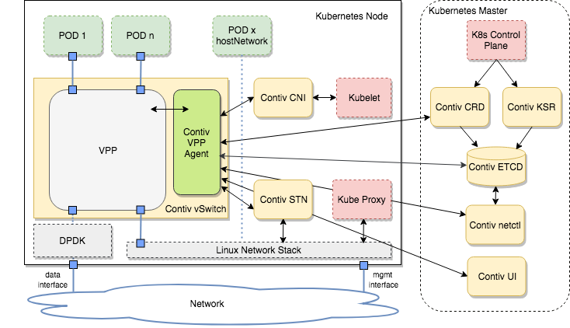
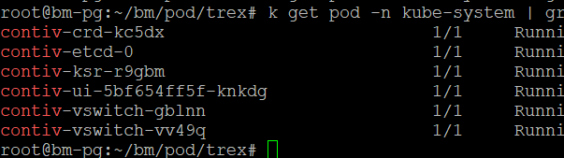
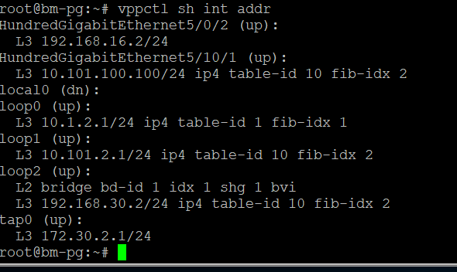
Test Configuration
contiv-vpp
git clone https://github.com/contiv/vpp.git

Slide 5
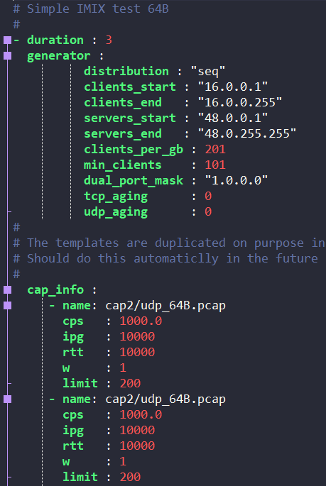
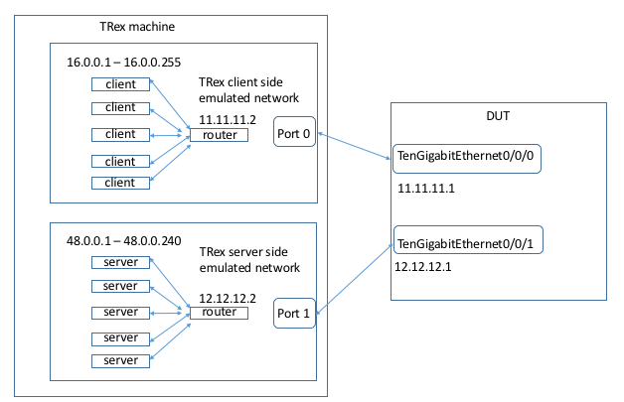
Test Configuration
T-Rex 구성
Client / Server side – 각각 Docker로 구현
[T-Rex scenario configuration]
TRex installation and configuration guide https://trex-tgn.cisco.com/trex/doc/

