Slide 1
Container Networking Benchmarking
IETF 106 Hackathon Plan

Slide 2
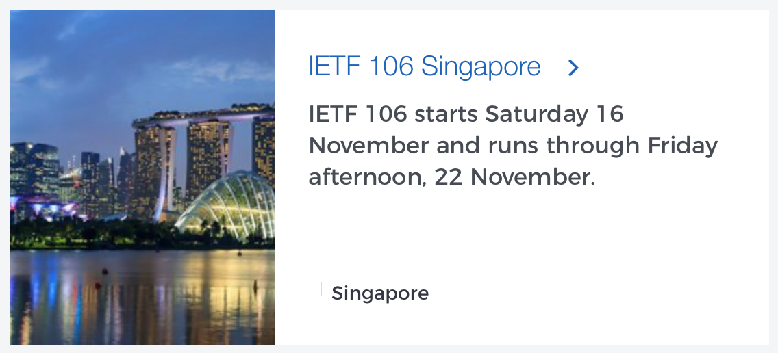
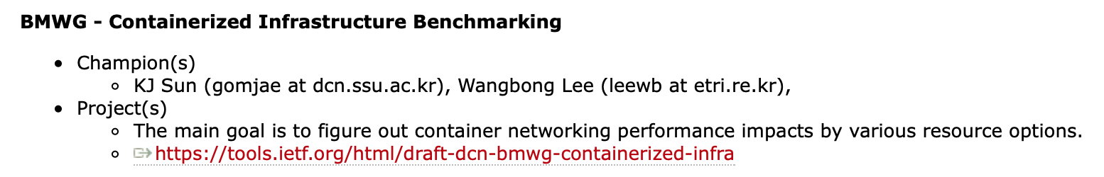
106 Hackathon preview

Slide 3
106 Hackathon Overview
Network Performance Benchmarking based on various Resource Configuration
Huge Page
Huge page 할당 크기에 따른 성능 분석
Kernel 기반 Networking (OVS) – Huge page 미지원
User 기반 Networking (VPP)
NUMA
Kubernetes 기본 스케줄러의 NUMA-deterministic 여부 분석
CMK(CPU Manager for Kubernetes) 구성을 통한 비교 분석
NUMA 노드와 Network Interface 위치에 대한 성능 비교

Slide 4
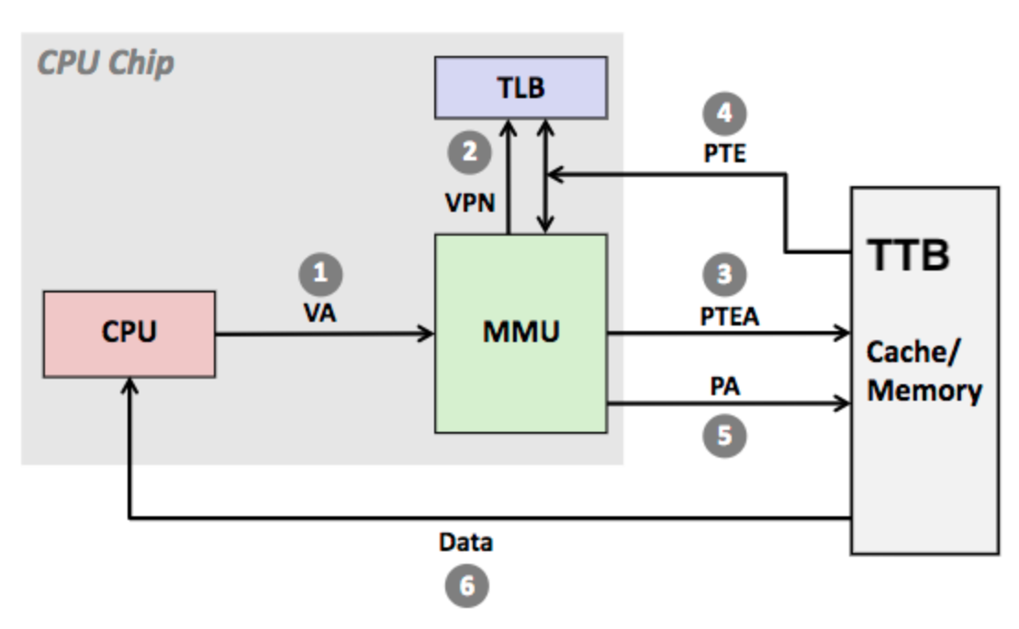
Huge Page – Performance Impacts
What is Huge Page?
TLB(Translation Lookside Buffer)
Virtual Address <-> Physical Address 매핑 정보를 저장
TTB(Translation Table Base Address)를 거치지 않아 엑세스 시간 단축
Default page size = 4KB
TLB issue
TLB Entry가 작으면 hit ratio가 감소하여 메모리 중복 접근으로 인한 성능 저하
대용량 메모리 사용 시 page 개수가 증가 하여, TLB Entry가 커짐
Huge Page
TLB의 용량을 증가시켜 Page 개수를 감소
대용량 Page로 hit ratio 증가

Slide 5
Huge Page – Performance Impacts
Huge Page in VM-based infrastructure
host OS and hypervisor can configure huge page depending on guest OS.
Guest VM with Linux OS requires to set a huge page at least 1G bytes
Virtual Machine
Virtual Machine
Application/Process
Guest Huge Pages
Hypervisor
Host Huge Pages

Slide 6
Huge Page – Performance Impacts
Huge Page - issues in VM-based architecture
Latency
Huge pages expose applications to high latency variation and increased tail latency
Memory bloat
Huge pages can make a process or virtual machine (VM) occupy a large amount of physical memory while much of that memory remains unusable due to internal fragmentation
Unfairness
greedy allocation of huge pages is unfair, causing large and persistent performance variation across identical processes or VMs
Reference : “Coordinated and Efficient Huge Page Management with Ingens,” OSDI'16 Proceedings of the 12th USENIX conference on Operating Systems Design and Implementation, 2016

Slide 7
Huge Page – Performance Impacts
Containerized Infrastructure
Containers are isolated to the application level
Huge pages are dedicated to the application without unusable space
For container, huge page can set more granular level
In Kubernetes, it allows to use of 512Mbytes huge page for the container as default
In Kubernetes, only user-space networking process can be configured with Huge Page setting - DPDK
Container
Container
Application/Process
Host Huge Pages

Slide 8

Huge Page – Performance Impacts
Our benchmarking goal
서로 다른 Huge Page 크기에 따른 네트워크 성능 변화
패킷 사이즈의 증가에 따른 huge page 영향 분석
Packet Size : 64 / 128 / 512 / 1024 / 1500 bytes
Huge page 설정에 따른 비교
Kernel-space Networking (OVS): Default TLB(4KB)
User-space Networking (DPDK-VPP)
Huge page size = 2Mi
128Mi / 256Mi / 512Mi / 1Gi
Huge page size = 1Gi
1Gi
[VPP vswitch POD Deployment YAML file]

Slide 9
NUMA – Network Performance Impacts
NUMA(Non-Uniform Memory Access) is a memory architecture for multiprocessing computer systems where CPUs are directly attached to their own local RAM.
a NUMA node is a grouping of CPU and associated local memory
CPU and memory locality provides less latency

Slide 10
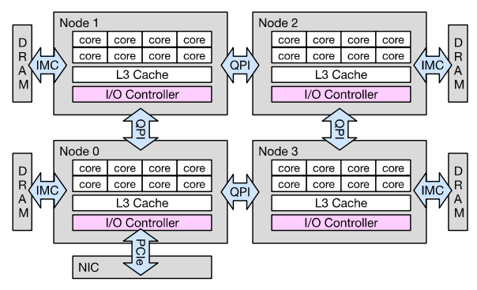
NUMA – Network Performance Impacts
NUMA locality is not limited to CPU and memory only, and It also applies to I/O devices such as network and storage devices
the PCIe slots (on which the devices are connected) also have locality to NUMA nodes through the interconnection bus
IMC: Independent Memory Controller
QPI: Quick Path Interconnect

Slide 11
NUMA – Network Performance Impacts
VM-based Infrastructure
Hypervisor virtualizes physical CPU to vCPU
vCPUs are mapped to VM cores
With NUMA, VM cores select vCPUs from the same NUMA node
Containerized Infrastructure
CPU resources are allocated to container without virtualization
Improving performance for accessing physical CPU process
Improving CPU access performance may effect to networking performance

Slide 12
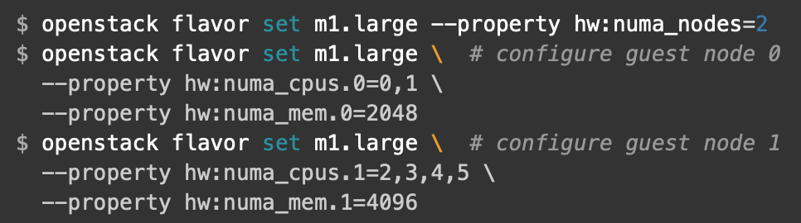
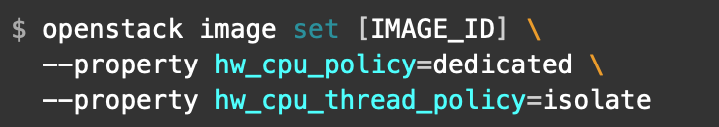
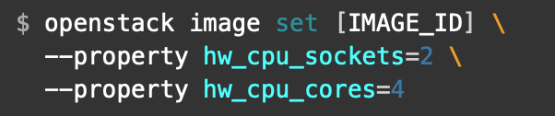
NUMA – Network Performance Impacts
In VM-based architecture(OpenStack), Hypervisor has awareness of NUMA nodes and customizes VM NUMA placement policies
Libvert/KVM and Hyper-V support NUMA awareness function
Restrict an instance's vCPUs to a single host NUMA node
hw:numa_nodes, hw:numa_cpus.N and hw:num_mem.N,
Customizing instance CPU pinning policies
hw:cpu_policy and hw:cpu_thread_policy
Customizing instance CPU topologies
hw:cpu_sockets, hw:cpu_cores and hw:cpu_threads

Slide 13
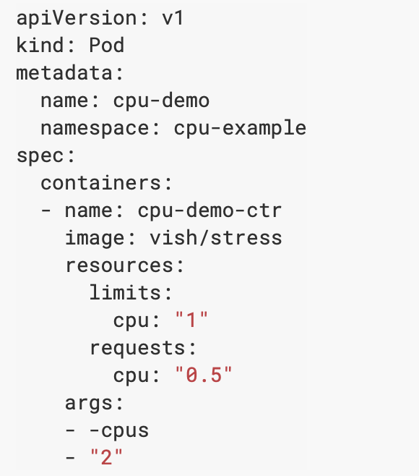
NUMA – Network Performance Impacts
You can specify CPU request or limit for a container, or not.
If you do not specify a CPU limit,
The Container has no upper bound on the CPU resources it can use
The Container is running in a namespace that has a default CPU limit, and the Container is automatically assigned the default limit
Specify a CPU request and a CPU limit
The CPU request for a Pod is the sum of the CPU requests for all the Containers in the Pod
Pod scheduling is based on requests
A Pod is scheduled to run on a Node only if the Node has enough CPU resources available to satisfy the Pod CPU request
CPU is always requested as an absolute quantity, never as a relative quantity
Fractional values are allowed (e.g. 0.5 CPU, 100m CPU)
https://kubernetes.io/docs/tasks/configure-pod-container/assign-cpu-resource/

Slide 14
NUMA – Network Performance Impacts
In the Containerized infrastructure(Kubernetes), Pod can be optionally specified how much CPU and memory (RAM) each Container needs
Limits and requests for CPU resources are measured in cpu units.
Topology Manager in Kubernetes (v.1.16)
Topology Manager stores the preferred NUMA Node affinity for that container
Topology Manager supports four allocation policies
None(Default)
Best-effort : If the affinity is not preferred, Topology Manager will store this and admit the pod to the node anyway
Restricted : If the affinity is not preferred, Topology Manager will reject this pod from the node
single-numa-node : Topology Manager determines if a single NUMA Node affinity is possible
If, however, this is not possible then the Topology Manager will reject the pod from the node
However, until now, it is not possible to allocate specific NUMA node to Pod(Container) as similar as VM-based infrastructure
“Instantiation of C-VNFs is somewhat non-deterministic and apparently NUMA-Node agnostic, which is one way of saying that performance will likely vary whenever this instantiation is performed..”
https://kubernetes.io/docs/tasks/administer-cluster/topology-manager/

Slide 15
NUMA – Network Performance Impacts
CPU and Memory were the only first class resources managed by Kubernetes
This results in non-deterministic behavior
non-deterministic behavior makes it unsuitable for latency sensitive workloads
CPU Manager for Kubernetes* performs a variety of operations to enable core pinning and isolation on a container or a thread level
Discovering the CPU topology of the machine
Advertising the resources available via Kubernetes constructs
Placing workloads according to their requests
Keeping track of the current CPU allocations of the pods, ensuring that an application will receive the requested resources provided they are available
https://builders.intel.com/docs/networkbuilders/cpu-pin-and-isolation-in-kubernetes-app-note.pdf

Slide 16
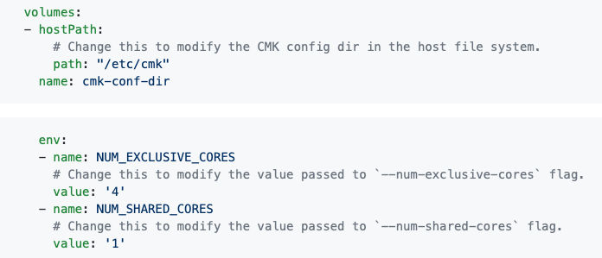
NUMA – Network Performance Impacts
CMK – CPU Manager for Kubernetes (by Intel)
CMK was developed prior to the upstream CPU Manager being available, the reason behind doing this was to enable an immediate solution for CPU Pinning and Isolation in Kubernetes for commercial adoption
As this still provides a limited set of features, CPU Manager for Kubernetes* is being maintained until the upstream solution is feature compatible
CMK uses a directory of pools to represent the cores available on the system
Exclusive - only a single task may be allocated to a CPU at a time
Shared - multiple processes may be allocated to a CPU
Infra – allocate CPU to host infra functions (OS, ..)
https://builders.intel.com/docs/networkbuilders/cpu-pin-and-isolation-in-kubernetes-app-note.pdf

Slide 17
NUMA – Network Performance Impacts
Our benchmarking goal
Kubernetes에서의 NUMA deterministic 여부 확인
Kubernetes Scheduler vs CMK based CPU pining
각 방식에 따라 동일한 개수의 CPU 할당
1 / 2 / 3 / 4 CPU
반복 테스트에 따른 평균값 분석
Test 1x / 5x / 10x
Noisy Neighbor 영향 분석
Network throughput / Latency
NIC의 Node에 따른 네트워크 성능 차이 분석
Container using CPU and NIC located same/different NUMA node
패킷 사이즈에 따른 Throughput / Latency 분석
Packet size – 64 / 128 / 512 / 1028 / 1500 bytes

Slide 18
Testbed
2대의 노드를 Kubernetes Cluster로 구성
BM-PG (Kubernetes-master)
Container Controller
T-Rex POD
CMK for CPU Pinning
BM-WG (Kubernetes-worker)
Simple VNF POD
CMK for CPU Pinning
HOSTNAME : bm-wk
CPU : 2 socket (20 Core)
MEM : 256GB
DISK : 2TB
NIC : control plane 1G
data plane 100G
OS : Ubuntu 18.04.3 LTS
ROLE : Container Worker
HOSTNAME : bm-pg
CPU : 2 socket (18 Core)
MEM : 256GB
DISK : 2TB
NIC : control plane 1G
data plane 100G
OS : Ubuntu 18.04.3 LTS
ROLE : Container Controller
Packet Generator
Testing monitoring

Slide 19
Test Environment
Server Spec
CPU: 20 Cores (2 sockets)
Memory: 256GB
Disk: 2TB
Network Interface : Mellanox 100G
User-mode: DPDK-VPP
Kernel-mode : OVS
Packet Generator
T-Rex traffic generator
Pre-built into the NVFbench container (https://trex-tgn.cisco.com)
POD
POD
vpp-sw
mlx-pmd0
mlx-pmd1
User Space
eth0
eth1
Kernel Space
vf0
vf1
vf0
vf1
P1
P2
Packet Generator (Tx/Rx)

Slide 20
Test Environment
CPU set – using CMK

Slide 21
Test Configuration
서버 설정 – CPU isolation

Slide 22
Test Configuration
서버 설정 – NUMA node configuration

Slide 23
Test Configuration
Kubernetes 설정
Container engine
Docker v18.09.7
Container Orchestra Engine
kubernetes 1.16.1-00
CNI
Default network calico
Additional Network
OVS, VPP ...

Slide 24
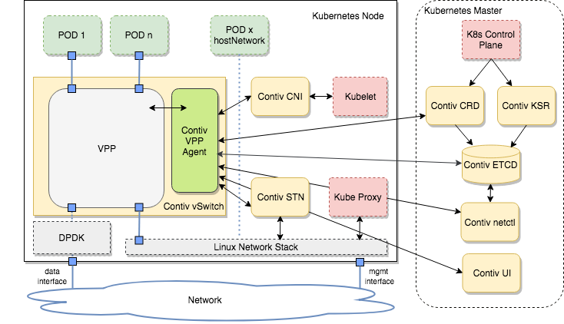
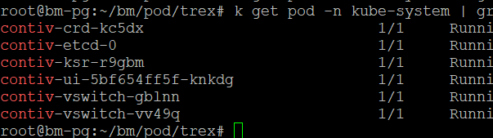
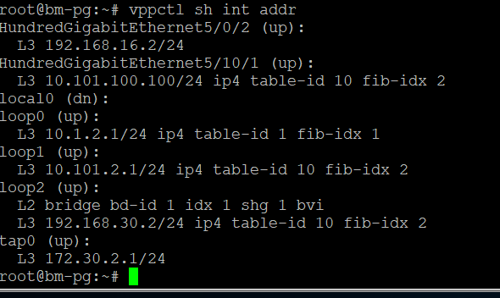
Test Configuration
contiv-vpp
git clone https://github.com/contiv/vpp.git

Slide 25
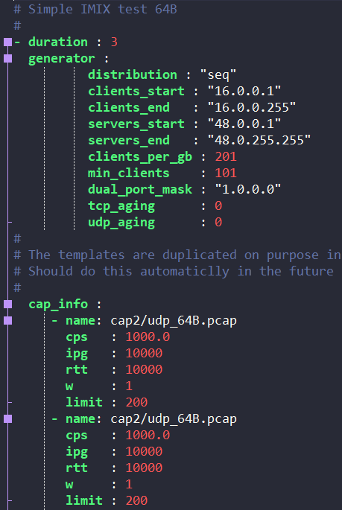
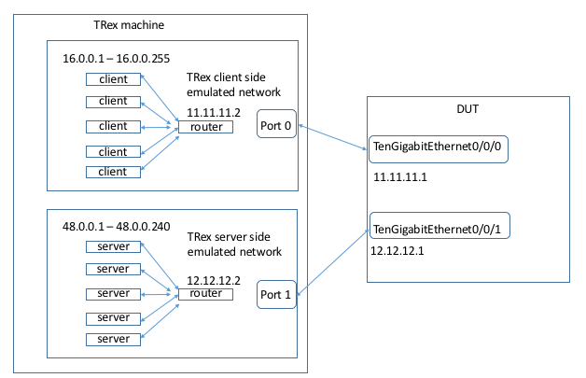
Test Configuration
T-Rex 구성
Client / Server side – 각각 Docker로 구현
[T-Rex scenario configuration]
TRex installation and configuration guide https://trex-tgn.cisco.com/trex/doc/

Slide 26
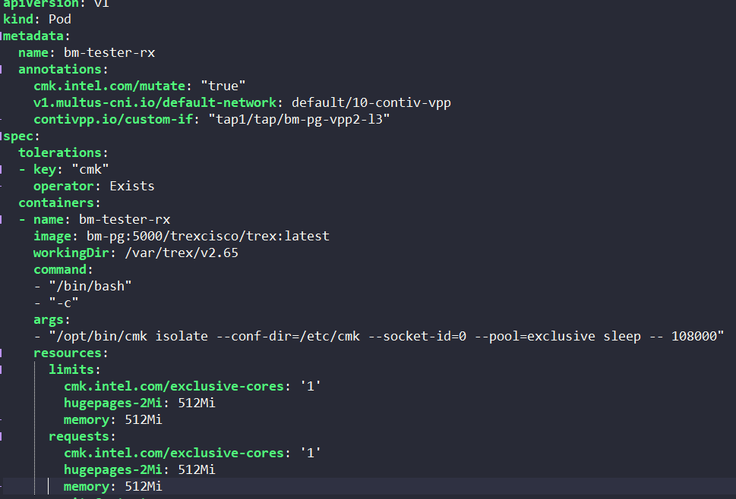
Test Configuration –
POD Configuration 예제
[T-Rex Server side POD example]

