Slide 1
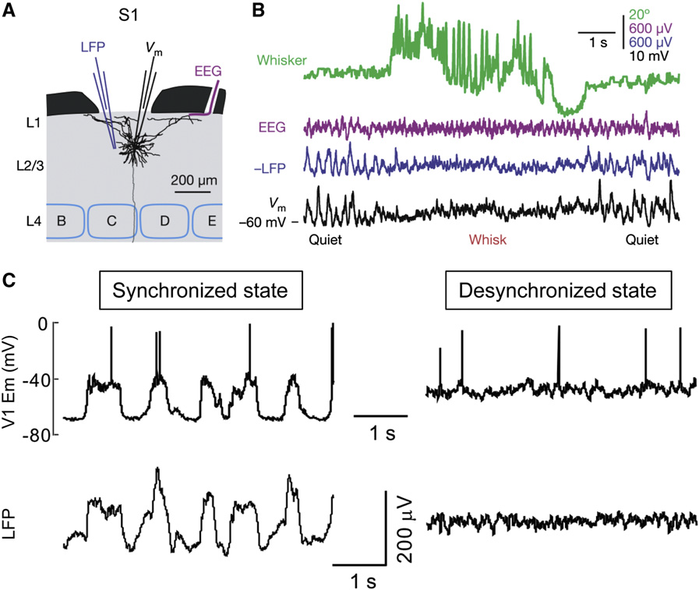
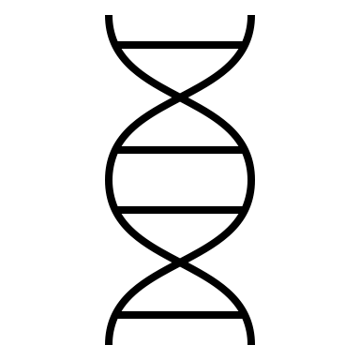
A
learn
rest
B
Inh
i
200uV
I_{inh}
V_{pre,1}
V_{post,1}
tonic
1s
burst
I_{pre,1}
V_{pre,1}
V_{post,1}
I_{post,1}
ii
40mV
I_{pre,2}
…
I_{post,2}
C
tonic
burst
I_{pre,N}
V_{pre,N}
V_{post,M}
I_{post,M}
I_{inh}
V_{inh}
E early-phase plasticity (tonic-burst)
I_{j}
100 mV
V_{j}
V_{pre,i}
raster
V_{post,j}
LFP
0.2 a.u.
1s
D
tonic
burst
F late-phase plasticity (burst)
1
2
4
0
3
0
5
eff %
100
0

Slide 2
A
learn
rest
i
LFP
200uV
ii
V_{m}
tonic
1s
burst
40mV
B Network and connectivity
E Models of switches from input-driven tonic firing to synchronized burst firing
Inh
I_{inh}
tonic
burst
I_{inh}
1
1
V_{inh}
I_{pre,1}
I_{post,1}
I_{j}
100 mV
I_{pre,2}
I_{post,2}
V_{j}
…
raster
I_{pre,N}
N
M
I_{post,M}
V_{pre}
V_{post}
LFP
0.2 a.u.
F
1s
early-phase plasticity (tonic-burst)
tonic
burst
(i)
(ii)
(iii)
1
2
4
3
late-phase plasticity (burst)
5
eff %
100
0
0
0

Slide 3
A
B
learn
rest
LFP
tonic
1s
burst
200uV
V_{m}
40mV
1
2
3
4
Plasticity
eff %
100
0
5
B Network and connectivity
C Switches from input-driven tonic firing to synchronized burst firing
tonic
burst
Inh
I_{inh}
I_{inh}
1
1
V_{inh}
I_{pre,1}
I_{post,1}
I_{j}
100 mV
V_{j}
I_{pre,2}
…
I_{post,2}
raster
I_{pre,N}
N
M
I_{post,M}
V_{pre}
V_{post}
LFP
0.2 a.u.
D Models of early-phase and late-phase plasticity
1s
i
I_{pre,i}
V_{pre,i}
l_{ij}
j
I_{post,j}
w_{ij}
w_{ij}
V_{post,j}
[Ca_{ij}]
[Ca_{ij}]

