Slide 1



A
Sequence I
III
II
IV
learn 0
rest
learn 1
…
rest
rest
learn 9
input
tonic
burst
noise
B
I
II
III
IV
RF 0
RF 9
C
I
II
III
IV
RF 0
RF 9

Slide 2
A Simulation protocol for a memory task interleaving input-driven tonic firing and collective burst firing
Sequence I
III
II
IV
learn 0
rest
learn 1
…
rest
rest
learn 9
input
tonic
burst
noise
B RFs at each sequence for a task interleaving input-driven tonic firing and collective burst firing
I
II
III
IV
RF 0
RF 9
C RFs at each sequence for a memory task with only input-driven tonic firing
I
II
III
IV
RF 0
RF 9

Slide 3
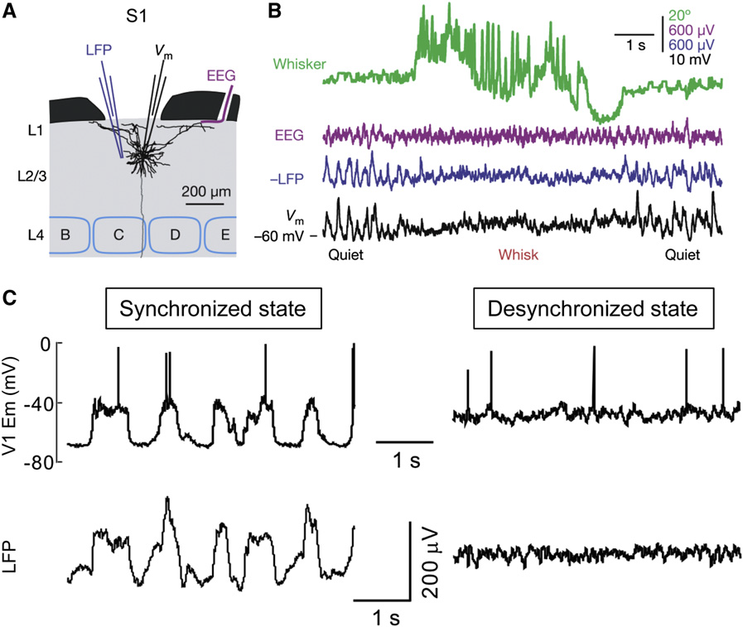
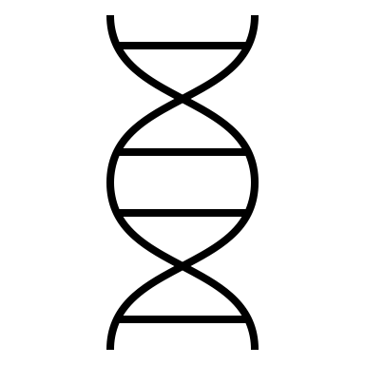
FIGURE 1 (minimalist)
A Brain-states (b-s), neural activity and plasticity mechanisms.
B Switches from input-driven tonic mode to synchronized bursting.
learn
rest
tonic
burst
200uV
I_{inh}
LFP
1s
V_{inh}
I_{j}
V_{m}
tonic
burst
40mV
V_{j}
100 mV
1
3
AMPAr
Network
Plasticity
2
4
eff.
0
5
1
LFP
0.2 a.u.
D Simulation protocol for a learning task interleaved with periods of rest
1s
state #
1
2
3
4
5
6
……
13
14
15
16
time
b-s
learn
rest
……
noise
input
E Evolution of the receptive fields (RF) associated at each output neuron
state #
1
2
3
4
5
6
……
29
30
31
32
time
b-s
learn 5
learn 0
learn 0
……
learn 7
noise
RF 0
……
RF 5
……
RF 9
……

