Slide 1
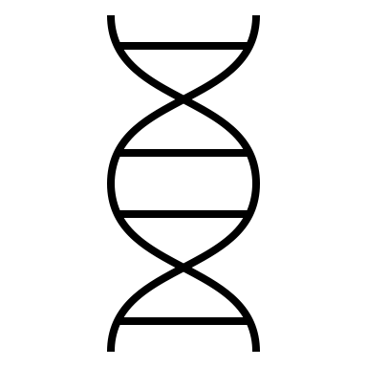
A
circuit
B Burst-driven
late-phase plasticity
C Blocking
late-phase plasticity
D Blocking
collective burst firing
4
3
3
plasticity
eff %
100
5
0
activity
max
early, w
min
max
late, l
min
max
total,, wl
min
0
20
40
60
80
0
20
40
60
80
0
20
40
60
80
corr activity
(weak)
(strong)
tonic
burst
low activity
E Blocking late-phase plasticity
sequence
I
II
III (start)
III (end)
IV
RF 0
RF 9
F Blocking collective burst firing
I
II
III (start)
III (end)
IV
RF 0
RF 9

Slide 2
RESET
State #
Rest
Rest
Rest
Rest
Rest
Rest
Rest
Learn 0
Learn 9
Learn 0
Learn 9
Learn 0
Learn 9
Noise
1
2
19
20
21
22
39
40
41
42
59
60
61
62

Slide 3
noBurst
State #
Rest
Rest
Rest
Rest
Rest
Rest
Rest
Learn 0
Learn 9
Learn 0
Learn 9
Learn 0
Learn 9
Noise
1
2
19
20
21
22
39
40
41
42
59
60
61
62

