Slide 1
ARTICLE
Section 1:
A burst-induced structural plasticity unlocks memory consolidation
Brain-state dependent memory consolidation from a simple model of structural plasticity
Figure 1: simple model of structural plasticity
Figure 2** :
Si on fait du learn tout le temps (2x), jamais de rest
Section 2:
Synchronized bursting robustly regularizes synaptic weights during rest
Figure 3: figure de l’article reset Demo
Figure appendix article: model-independent, HB?
Section 3:
Burst-induced reset provides a physiological input for structural plasticity
Explication de l’équation + “trace” = eligibility trace / tagging…
Plausibilité physiological (ex: tim gene) / integration
Figure 4: explication de la règle avec le cartoon
Démo de Justine (force de consolidation est contrôlee par la modulation du bursting – wreset)
??? Figure 2: consolidation simultaneously requires brain-state switch and structural plasticity
Section 4:
Exploration of the rule
Figure 5: Justine
- SNR experiment
- MNIST experiment
Section 5:
Classification vs consolidation of overlapping patterns
Figure 6: Emmy
- class
- MNIST
Neuron: 7k mots + SI

Slide 2
SECTION 1
A burst-induced structural plasticity unlocks memory consolidation
Brain-state dependent memory consolidation from a simple model of structural plasticity
Figure 1: a simple model of structural plasticity
Figure 2: consolidation simultaneously requires brain-state switch and structural plasticity
TO DO :
- faire une sequence deterministe
- exprimer une observation – aucune explication de mécanisme
Brain-state + plasticity = consolidation
Pdt apprentissage: supervisée [1-2]
Pdt rest: consolidation = augmentation morphologique non supervisée [4-5]
Contribution: consolidation non-supervisée

Slide 3
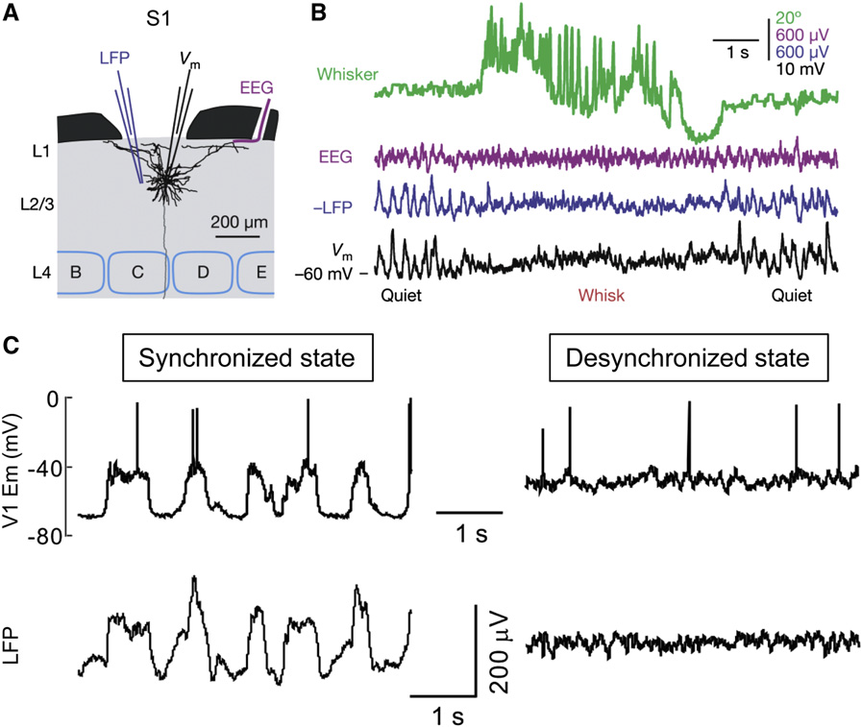




FIGURE 1
A simple model of structural plasticity
A Brain states
learn
rest
LFP
200uV
1s
40mV
V_{m}
tonic
1
burst
3
Plasticity
2
4
AMPAr
efficacy %
5
0
100
B Network and plasticity
C Switches from input-driven tonic mode to synchronized bursting mode
tonic
burst
Inh
I_{inh}
I_{inh}
1
w
V_{inh}
I_{pre,1}
I_{post,1}
I_{j}
100 mV
I_{pre,2}
I_{post,2}
V_{j}
…
I_{pre,N}
Network activity
pre
post
I_{post,M}
LFP
0.2 a.u.
D Simulation protocol for a learning task interleaved with periods of rest
1s
state #
1
2
3
4
5
6
……
29
30
31
32
time
brain-state
learn
rest
……
noise
input
E Evolution of the receptive fields (RF) associated at each output neuron
state #
1
2
3
4
5
6
……
29
30
31
32
time
brain-state
learn 5
learn 0
learn 0
……
learn 7
noise
RF 0
……
RF 5
……

Slide 4
FIGURE 1 (minimalist)
A Brain-states (b-s), neural activity and plasticity mechanisms.
B Switches from input-driven tonic mode to synchronized bursting.
learn
rest
tonic
burst
200uV
I_{inh}
LFP
1s
V_{inh}
I_{j}
V_{m}
tonic
burst
40mV
V_{j}
100 mV
1
3
AMPAr
Network
Plasticity
2
4
eff.
0
5
1
LFP
0.2 a.u.
D Simulation protocol for a learning task interleaved with periods of rest
1s
state #
1
2
3
4
5
6
……
13
14
15
16
time
b-s
learn
rest
……
noise
input
E Evolution of the receptive fields (RF) associated at each output neuron
state #
1
2
3
4
5
6
……
29
30
31
32
time
b-s
learn 5
learn 0
learn 0
……
learn 7
noise
RF 0
……
RF 5
……
RF 9
……

Slide 5
FIGURE 1 (annexe)
B Network and plasticity
Inh
I_{inh}
I_{inh}
1
w
V_{inh}
I_{pre,1}
I_{post,1}
I_{j}
I_{pre,2}
I_{post,2}
V_{j}
…
I_{pre,N}
pre
post
I_{post,M}
E Firing property quantification
100
55 Hz
f_{burst}
0.01 Hz
# neurons
f_{tonic} (Hz)
0
1 2 3
3
4
0
100
2
3
4
5
f_{burst} (Hz)
IBF (Hz)
SPB
IBF
SPB
NMDAr
VDCC
AMPAr
Glu

Slide 6
digits
0
1
2
3
4
5
6
7
8
9
10
intermediaire
11
29
Before noise
State #
30
31
SUPPLEMENTARY MATERIAL
After noise
32
10
11
state #
29
30
31
32
0
1
2
3
4
digits
5
6
7
8
9

Slide 7
Section 2:
Synchronized bursting robustly regularizes synaptic weights during rest
Figure 3: figure de l’article reset Demo
Figure appendix article: model-independent, HB?

Slide 8
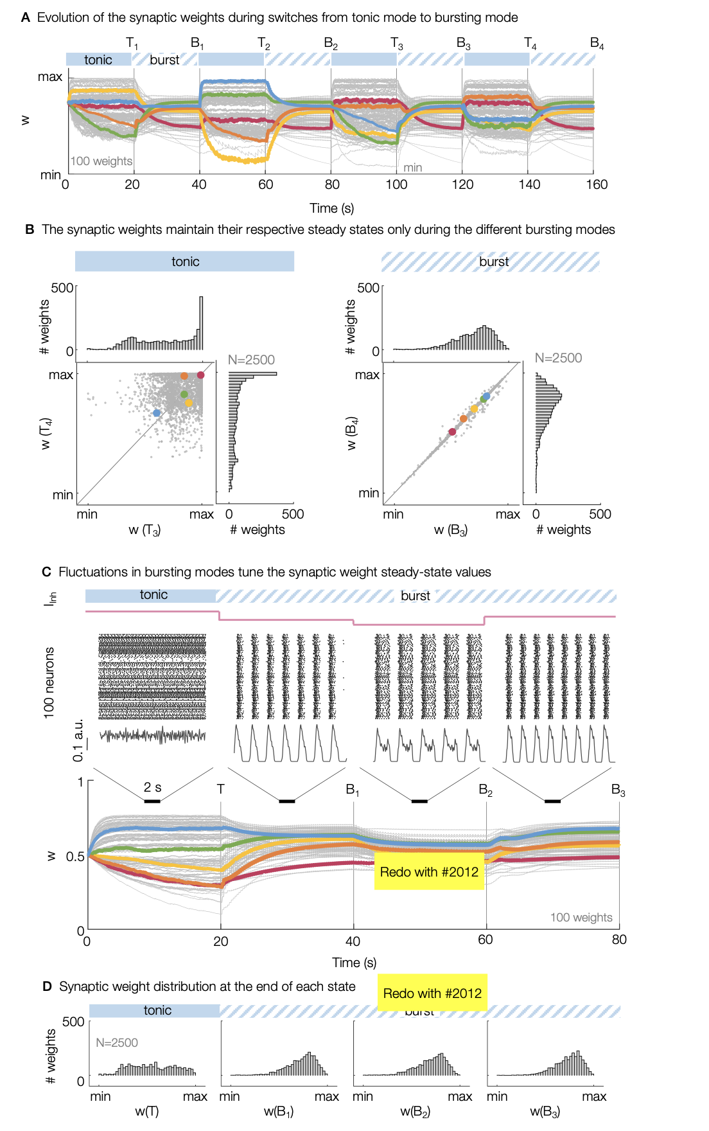

Slide 9
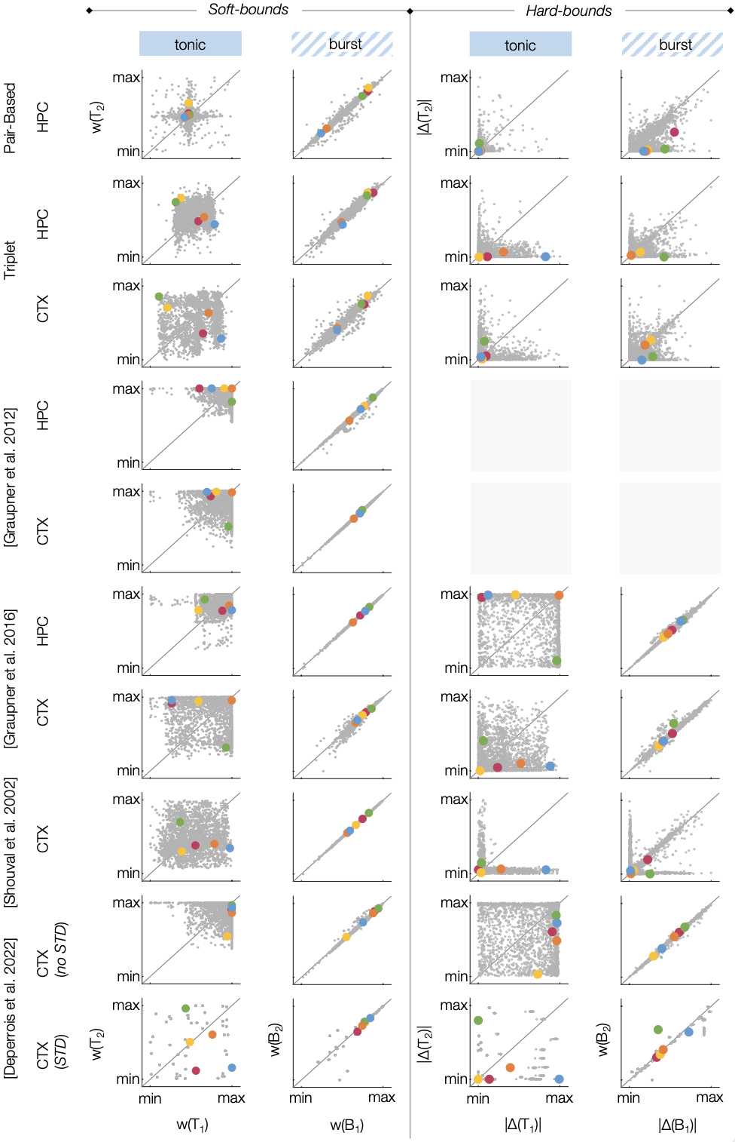
SI: model

Slide 10
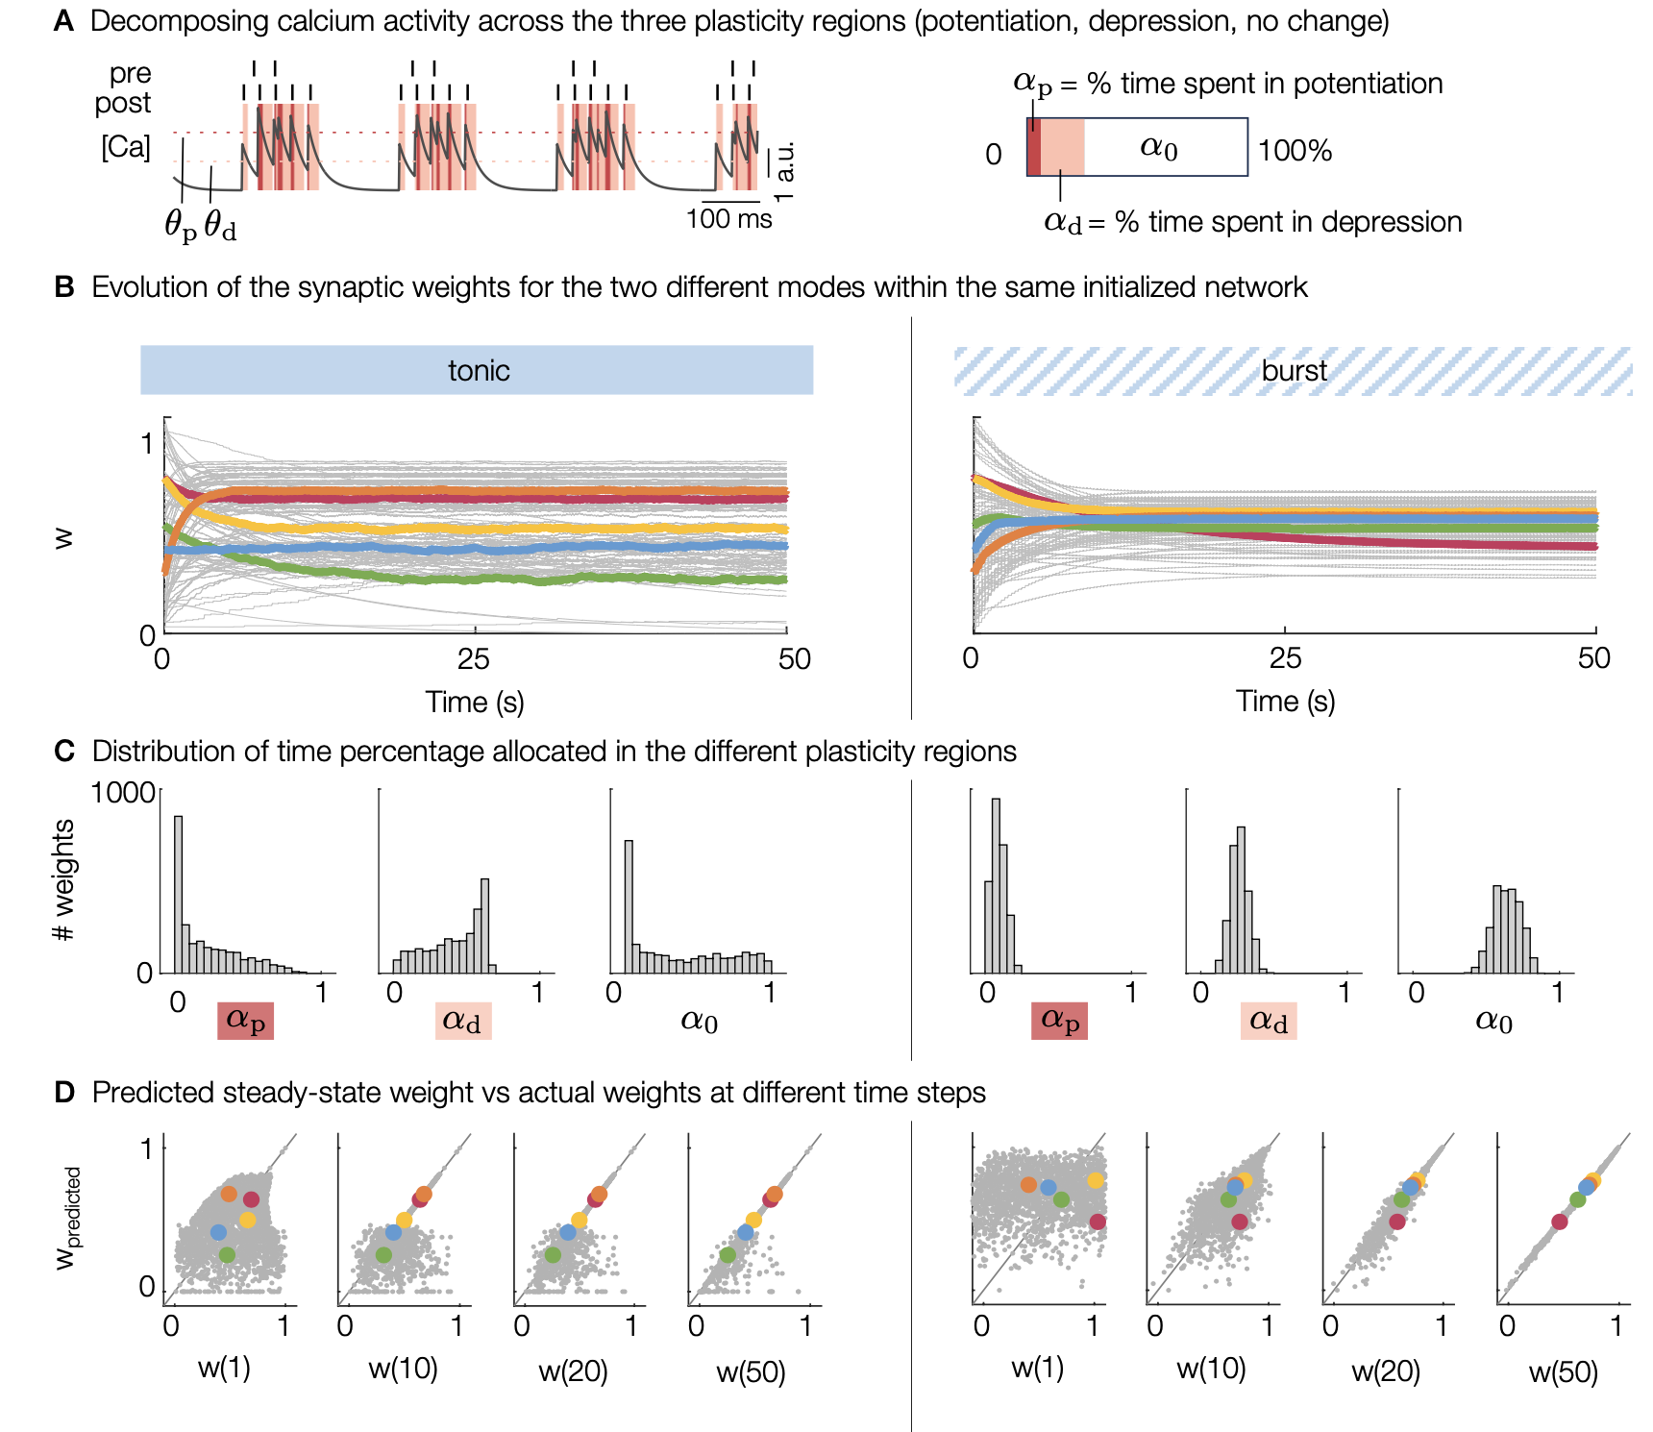
DEMO
Demo is done for Graupner 2016
Not the same exact equation for w…
2012: Dw/dt = w(1-w)(0.5-w)+ gamma_P(1-w) (Ca>Op) – gamma_d w (Ca>Od)

Slide 11
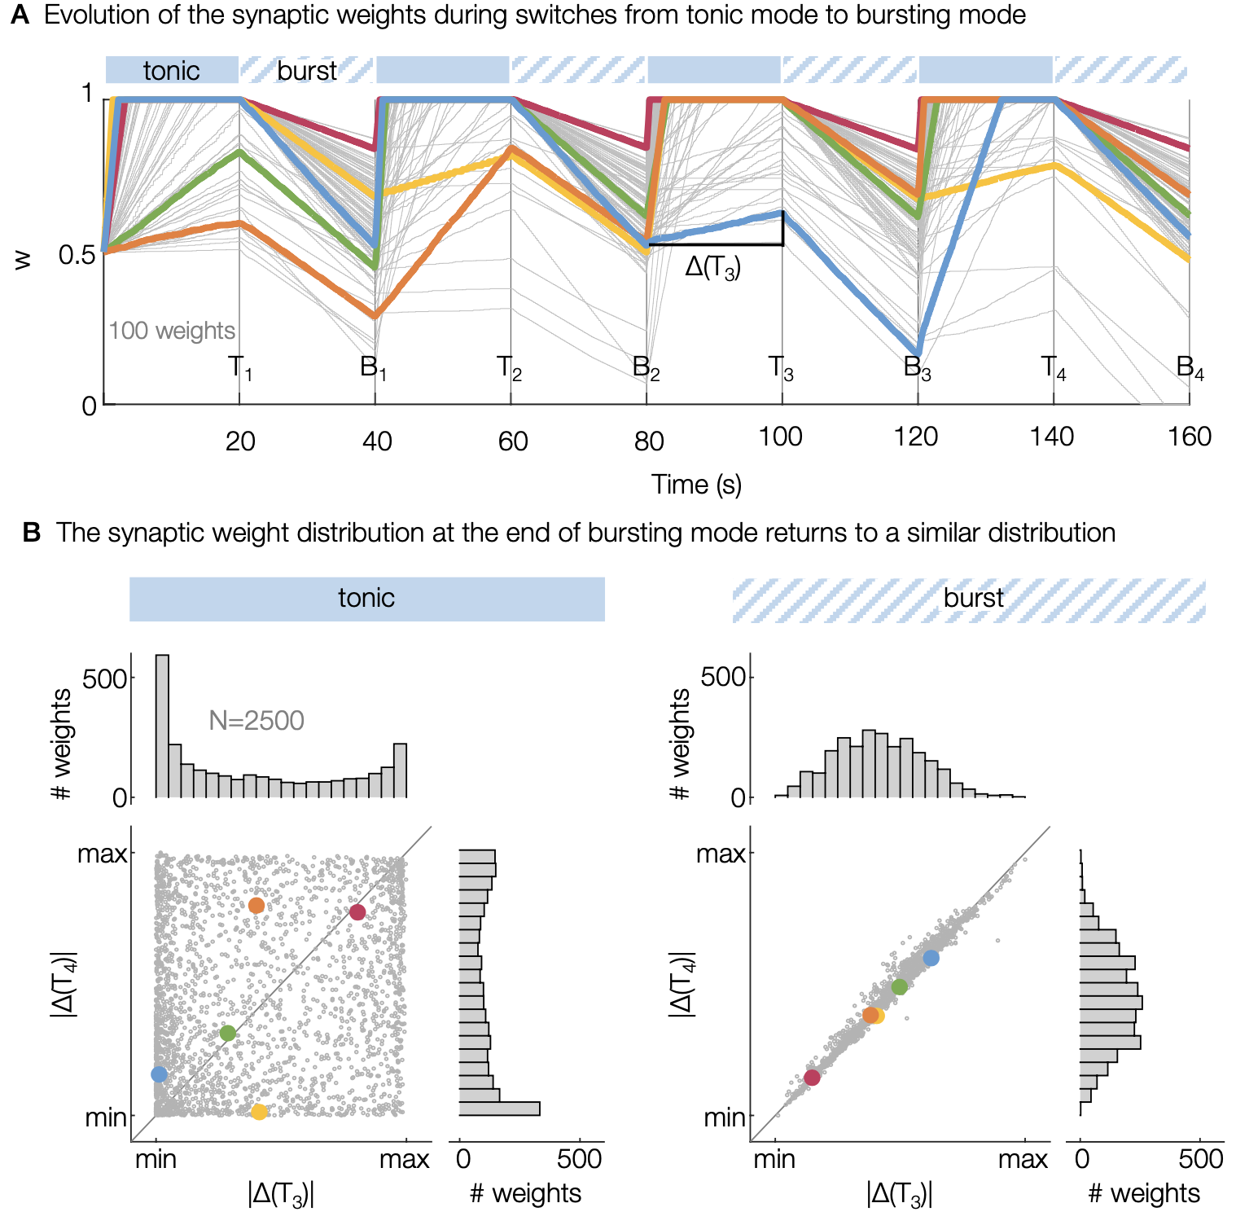
HB

Slide 12
Section 3:
Burst-induced reset provides a physiological input for structural plasticity // titre SLACK
Explication de l’équation + “trace” = eligibility trace / tagging…
Plausibilité physiological (ex: tim gene) / integration
Figure 4: explication de la règle avec le cartoon
Démo de Justine (force de consolidation est contrôlee par la modulation du bursting – wreset)

Slide 13
Figure 4: explication de la règle avec le cartoon
Evolution of the postsynaptic site for two neurons in input-driven tonic activity followed by a period of rest.
(strong, gray curve) Two neurons are strongly correlated in tonic
max
1
2
e-weight
3
1
2
3
4
0
5
max
4
5
strong
weak
l-weight
Time (s)
(weak, black curve) Two neurons are weakly correlated in tonic
0
max
weight
0
0
20
40
60
80
Time(s)

Slide 14
Figure 2:
consolidation simultaneously requires
brain-state switch and structural plasticity
A Memory consolidation simultaneously requires structural plasticity and collective bursting during rest.
Blocking structural plasticity
#
rest
b-s
learn 5
learn 0
learn 0
……
learn 7
noise
3
RF 0
……
RF 5
……
Blocking collective bursting
inactive
……
RF 0
RF 5
……

Slide 15
COSYNE
TEXT
1- definition brain states (learn vs rest) + rhythm with collective bursting (
2- definition des termes liés à la plasticité * LTP
* early-LTP
* late-LTP
* late-LTP implies some synaptic structural changes
* the weight is the product=early-weight x late-weight
3- definition du problème? Memory consolidation during rest periods through structural plasticity created by burst …
4- computational experiments
* MNIST * explication de la règle
* blocking Structural Plasticity or Blocking Burst * ?? consolidation vs downscaling during burst ? Quelle expérience ?

Slide 16
COSYNE
A Brain-states, neural activity and plasticity mechanisms
tonic
burst
learn
rest
I_{inh}
LFP
1s
200uV
V_{inh}
I_{j}
V_{m}
tonic
burst
40mV
V_{j}
100 mV
AMPAr
Network
Plasticity
eff.
0
1
LFP
0.2 a.u.
1s
B Evolution of the receptive fields (RF) associated at each output neuron
state #
1
2
3
4
5
6
……
29
30
31
32
time
brain
state
learn 5
learn 0
learn 0
……
learn 7
noise
RF 0
……
RF 5
……
……
……
……
……

