Slide 1
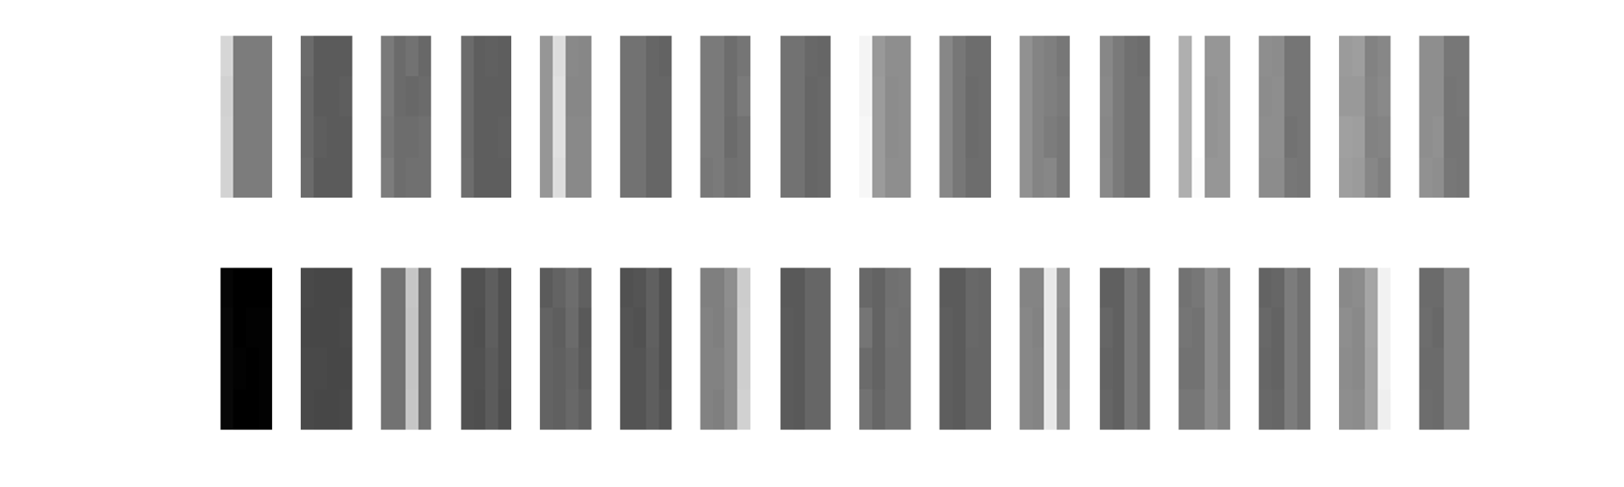
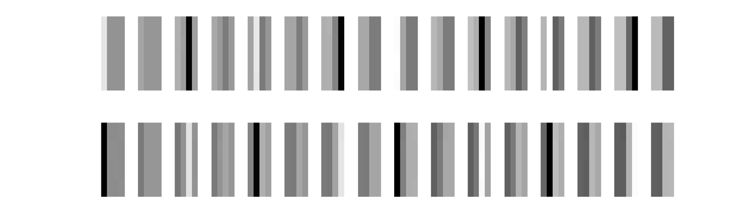
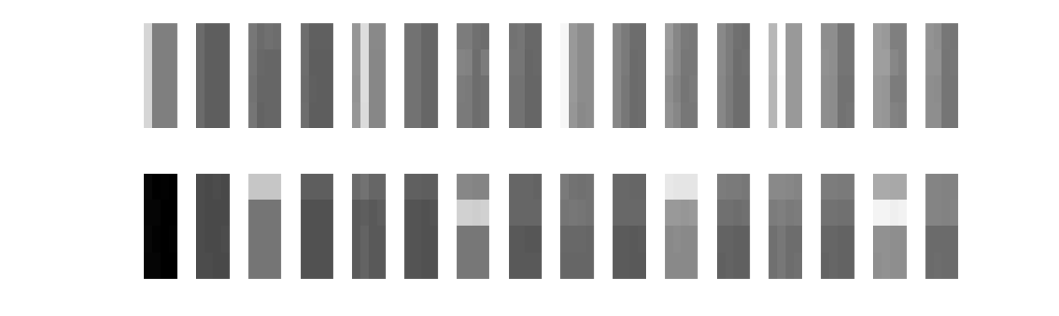
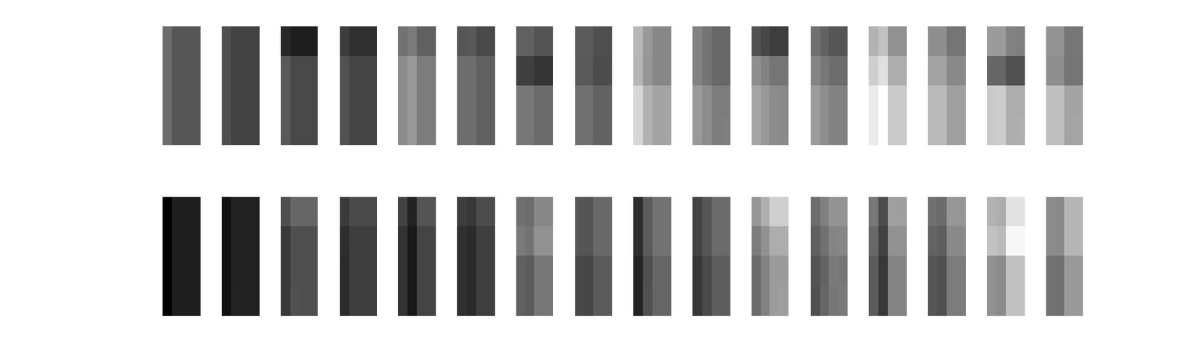
A
Pattern
1
2
1
2
1
2
1
2
state
RF1
RF2
RF1
RF2
B
1
2
1
2
1
2
1
2
RF1
RF2*
RF1
RF2*
1
2
3
4
5
6
7
8
9
10
11
12
13
14
15
16
State #

Slide 2
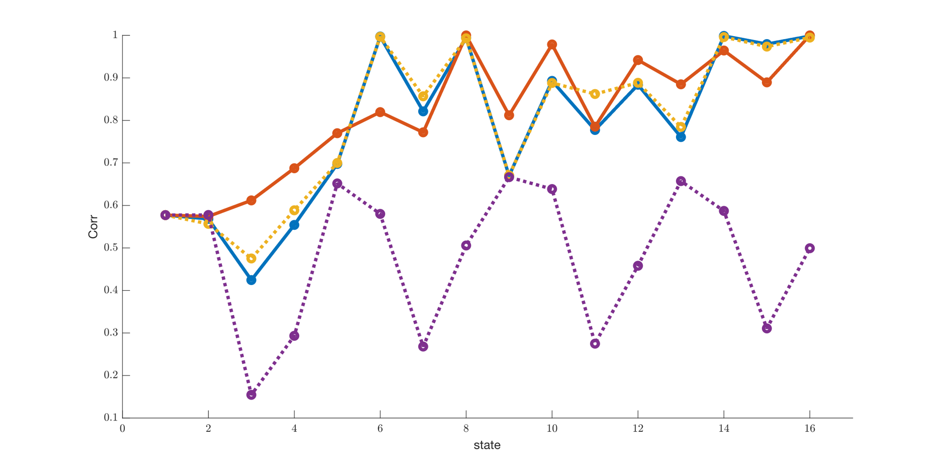
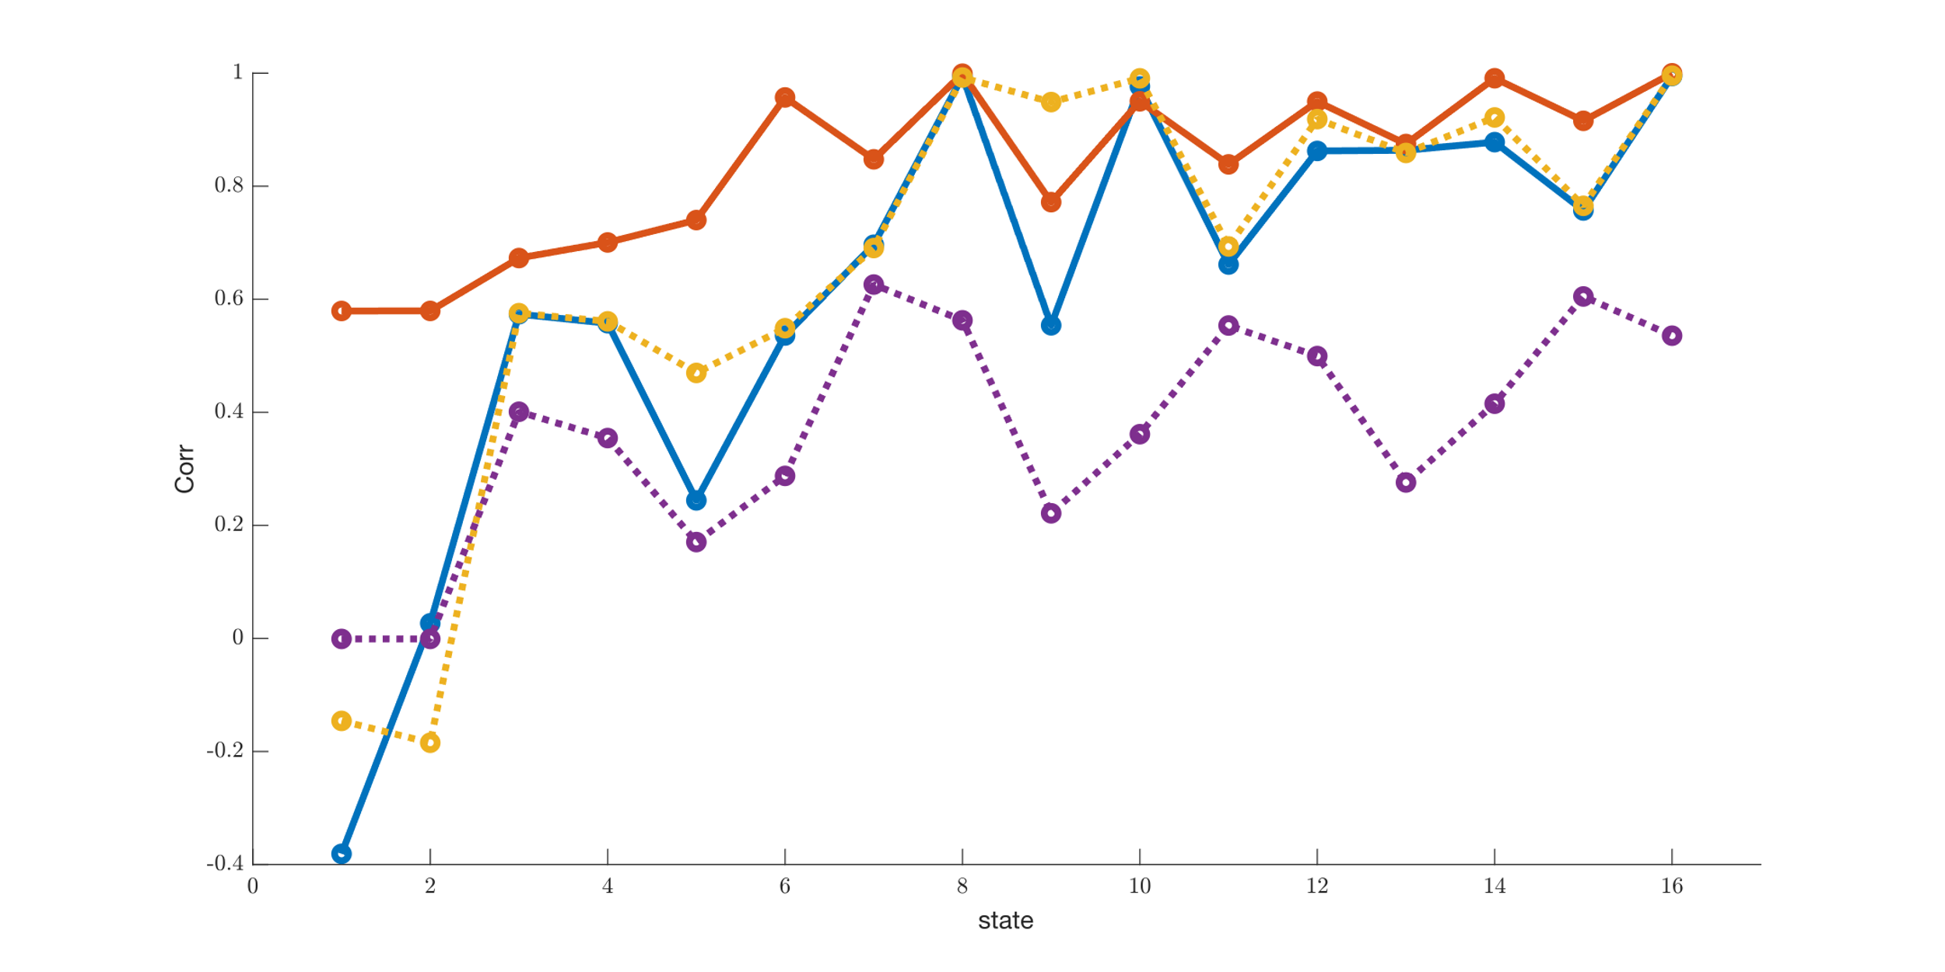
GB2012 | non overlap
GB2012 | overlap
GB2016 | non overlap
GB2016 | overlap

Slide 3
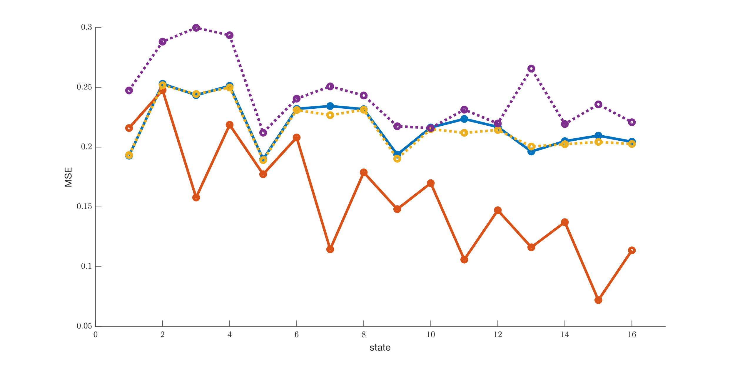
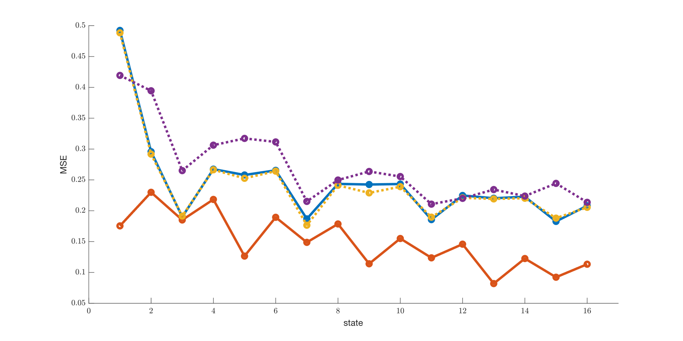
GB2012 | non overlap
GB2012 | overlap
GB2016 | non overlap
GB2016 | overlap
GB2016 | non overlap
Learns well non overlapping patterns better than GB2012 nOL
GB2012 is able to classify (nOL and OL)

Slide 4
