Slide 1
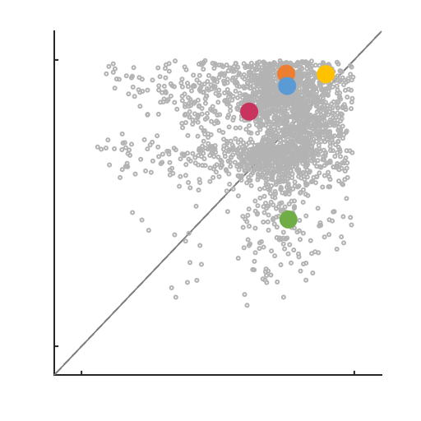
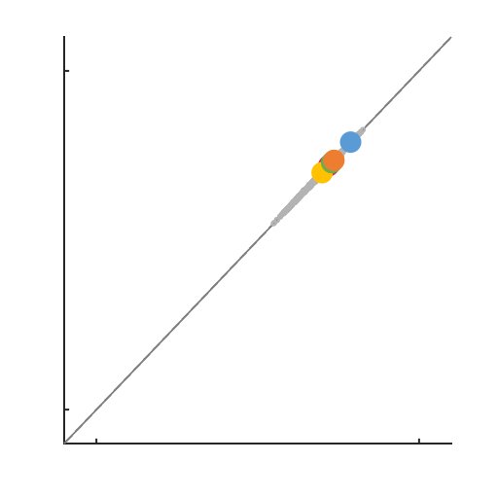
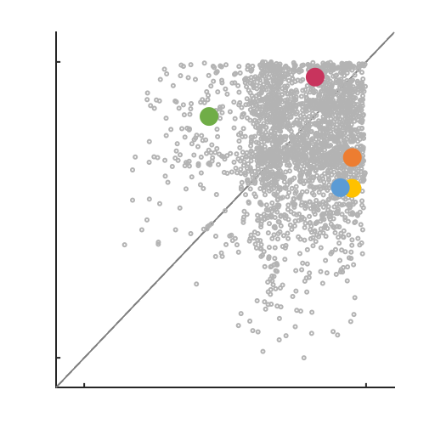

A
tonic
T₁
burst
B₁
T₂
B₂
T₃
B₃
T₄
B₄
0.71
0.18
0
20
40
60
80
100
120
140
160
B
Time (s)
max
R²=0.0030
R²=0.9988
R²=0.0016
R²=0.9991
min
min
max
min
max
min
max
min
max

