Slide 1
A
Cell region
Network size
Neuron model
Synaptic strength
V_{m}
w
V_{th}
V_{reset}
t_{spike}
EPSP
B
Synaptic Rule
pre
V_{pre}
Activity
Phenom.
model
w
Ca
V_{post}
Calcium
Biophysical
model
w
post
B

Slide 2
A
Cell Region
Network size
L-1
HPC
Cortex
Striatum
Retina
Adaptable
Abstract
1
1-1
S > XL
Assembly
Neuron model
Synaptic strength
Cond-based
IF
w
I_{syn}
V_{m}
V_{th}
V_{reset}
∆EPSP
AMPA
Event-based
Others
bio
t_{spike}
EPSP
B
Activity
Synaptic Rule
pre
Phenom.
model
w
Calcium
Ca
Biphysical
model
w
post
time

Slide 3
A
Cell region
Synaptic strength
w
Network size
Activity
Synaptic Rule
B
pre
Phenom.
model
w
Ca
Calcium
Neuron model
Biphysical
model
V_{m}
post
time
w
V_{th}
V_{reset}
t_{spike}
EPSP
B

Slide 4
A
Cell Region
Network size
HPC
Cortex
Striatum
Retina
Adaptable
Abstract
1
1-1
L-1
pre
S > XL
Assembly
Neuron model
Synaptic strength
Ca
Cond-based
IF
w
I_{syn}
V_{th}
post
V_{reset}
∆EPSP
AMPA
Event-based
Others
bio
t_{spike}
EPSP
B
Activity
Synaptic Rule
Phenom.
model
w
Calcium
Biphysical
model
w
time

Slide 5
Cell Region
HPC
Cortex
Striatum
Retina
Adaptable
Abstract
Network size
L-1
1
1-1
Ca
S > XL
Assembly
Neuron model
Activity
Synaptic Rule
Cond
V_{m}
IF
pre
V_{th}
Phenom.
model
w
V_{reset}
EB
Others
post
t_{spike}
V_{d}
V_{s}
EPSP
Synaptic strength
Calcium
w
I_{syn}
AMPA
Biological
model
w
∆EPSP
time
bio

Slide 6
Cell Region
Network size
L-1
HPC
Cortex
Striatum
Retina
Adaptable
Abstract
1
1-1
S > XL
Assembly
Synaptic strength
Neuron model
w
I_{syn}
Cond
V_{m}
IF
AMPA
V_{th}
∆EPSP
V_{reset}
EB
Others
bio
t_{spike}
V_{d}
V_{s}
EPSP
Activity
Synaptic Rule
pre
Phenom.
model
w
post
Ca
Calcium
Biological
model
w
time

Slide 7
Cell Region
Network size
Hippocampus
1-1
L-1
Cortex
Striatum
1
S > XL
Assembly
Adaptable
Abstract
Neuron model
IF
Synaptic strength
Cond
V_{m}
w
I_{syn}
V_{th}
V_{reset}
∆EPSP
AMPA
EB
Others
bio
t_{spike}
V_{d}
V_{s}
EPSP
Cell Region
1-1
Network size
H
L-1
C
S
1
S > XL
Assembly
Ad
Ab
Ca
Neuron model
Synaptic strength
Cond
V_{m}
IF
w
I_{syn}
V_{th}
w
V_{reset}
AMPA
Event
Others
∆EPSP
t_{spike}
V_{d}
bio
V_{s}
EPSP

Slide 8
Network size
Cell Region
Network size
Hippocampus
1-1
L-1
Cortex
Striatum
1
S > XL
Assembly
Adaptable
Abstract
Ca
w
Neuron model
IF
Synaptic strength
Cond
V_{m}
w
I_{syn}
V_{th}
V_{reset}
∆EPSP
AMPA
EB
Others
bio
t_{spike}
V_{d}
V_{s}
EPSP

Slide 9
Cell Region
Network size
Hippocampus
1-1
L-1
Cortex
Striatum
1
S > XL
Assembly
Adaptable
Abstract
Neuron model
IF
Synaptic strength
Cond
V_{m}
w
I_{syn}
V_{th}
V_{reset}
∆EPSP
AMPA
EB
Others
bio
t_{spike}
V_{d}
V_{s}
EPSP
Cell Region
1-1
Network size
H
L-1
C
S
1
S > XL
Assembly
Ad
Ab
Ca
Neuron model
Synaptic strength
Cond
V_{m}
IF
w
I_{syn}
V_{th}
w
V_{reset}
AMPA
Event
Others
∆EPSP
t_{spike}
V_{d}
bio
V_{s}
EPSP

Slide 10



Activity
Synaptic Rule
pre
Phenom.
model
w
w
post
Calcium
Ca
Biological
model
w
pre
post
time
Cell Region

Slide 11
Activity
Synaptic Rule
pre
Phenom.
model
w
w
post
Calcium
Ca
Biological
model
w
pre
post
time

Slide 12
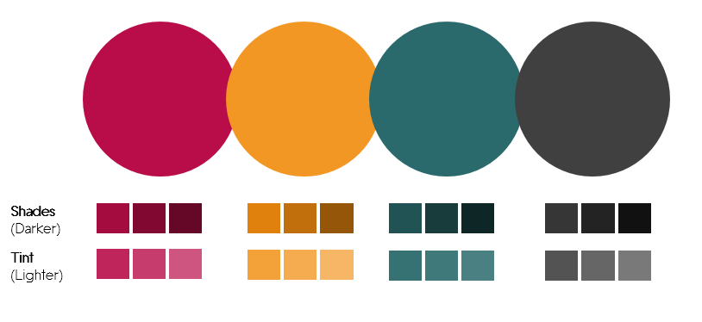
test

