Slide 1

Data Encryption and Transmission Based on ESP32 Boards
Group members:
Jialun KOU
Han BAO
Andi SULA

Slide 2
Introduction
This project aims to design a data exchange platform that meet data availability, integrity, and authentication. In general , the project will be split into three steps:
Step One: Ensuring the availability of data. make data accessible in real-time to any user visiting the broker server (Public mode)
Step two: able to switch public mode to security mode by pushing button
Step three: Ensuring data integrity and authentication by implementing a security protocol.
If the user have no permission , then the user cannot access data from broker.
(Security mode)

Slide 3
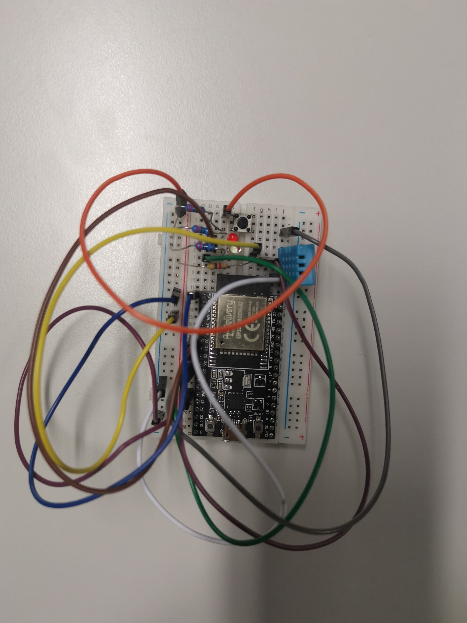
Schematic
Button
We will use DHT11 sensor to collect temperature and humidity data from the room, then the temperature and humidity data will be processed and transmitted by ESP32.
DH 11 Sensor
Red led indicate the connection status of wifi and mqtt broker
White led indicate the status of mode
ESP-32

Slide 4
What is ESP32?
The ESP32 is a microcontroller that is designed for low-power, connected applications.
How ESP32 communicate with MQTT broker ?
It has built-in Wi-Fi functionality, which allows it to connect to wireless networks and communicate with MQTT broker.

Slide 5
Public mode
We will use an MQTT broker as server to exchange data between ESP32 devices.
Node-Red as a user access and plot temperature and humidity chart in real time
Topic A: ESP32-A: Humidity & Temperature
Topic B: ESP32-B: Humidity & Temperature
MQTT broker
ESP32-A: Humidity & Temperature
ESP32-B: Humidity & Temperature
ESP32-A: Humidity & Temperature
ESP32-B: Humidity & Temperature
ESP32-A
ESP32-B

Slide 6
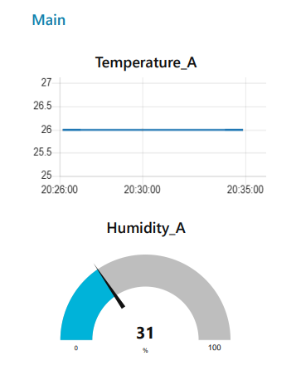
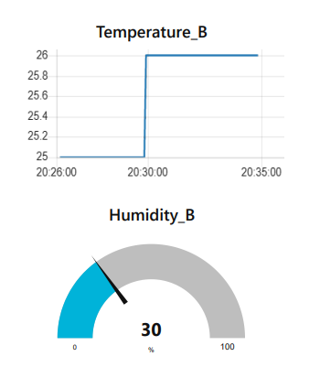
Node red Result (public mode )

Slide 7
From Single Core to Dual Core
To ensure the availability of data, the ESP32 devices need periodically check wifi and mqtt connection status and fix any disconnections on their own.
Core1
Core
Core0
DATA Process
&
transmission
DATA Process
&
transmission
WIFI
Connection check
MQTT
Connection check
WIFI
Connection check
MQTT
Connection check
However, For the single core case . running the Wi-Fi stacks can consume a significant amount of processing power, which can impact the performance of other tasks running on the microcontroller.
By using a dual-core design can solve this problem , the ESP32 can dedicate one core to handle the Wi-Fi and MQTT connection , while the other core can be used to process sensor data. This allows the ESP32 to handle network connectivity and data processing concurrently, without compromising performance.

Slide 8
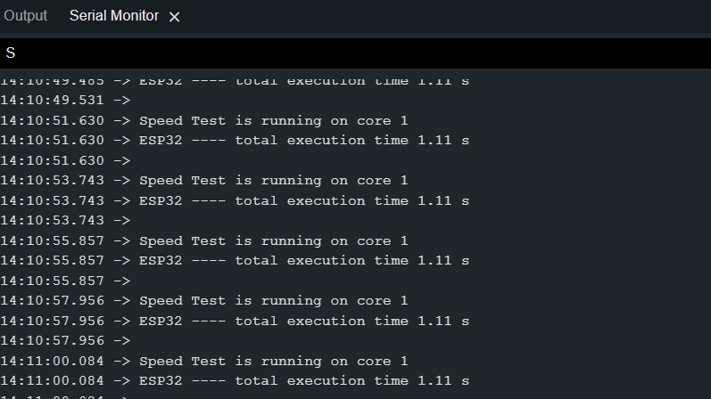
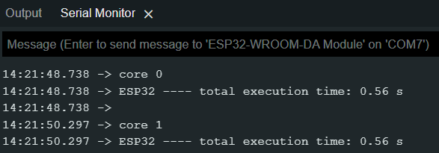
Compare the performance between Single Core and Dual Core

Slide 9
Order and Priority issue
Since the MQTT connection is dependent on the WiFi connection, To ensure secure and efficient data transmission, the ESP32 devices establish the WiFi connection first, before attempting to establish the MQTT connection.
Data processing and transmission tasks are only initiated once both connections are securely established
To maintain data availability, the ESP32 devices regularly check the status of both connections and fix any disconnections. The priority for connection checking is given to WiFi over MQTT."
To ensure this, we can use semaphores and multitask scheduling.
Core1
Core0
MQTT
Connection check
DATA Process & transmission
WIFI
Connection check

Slide 10
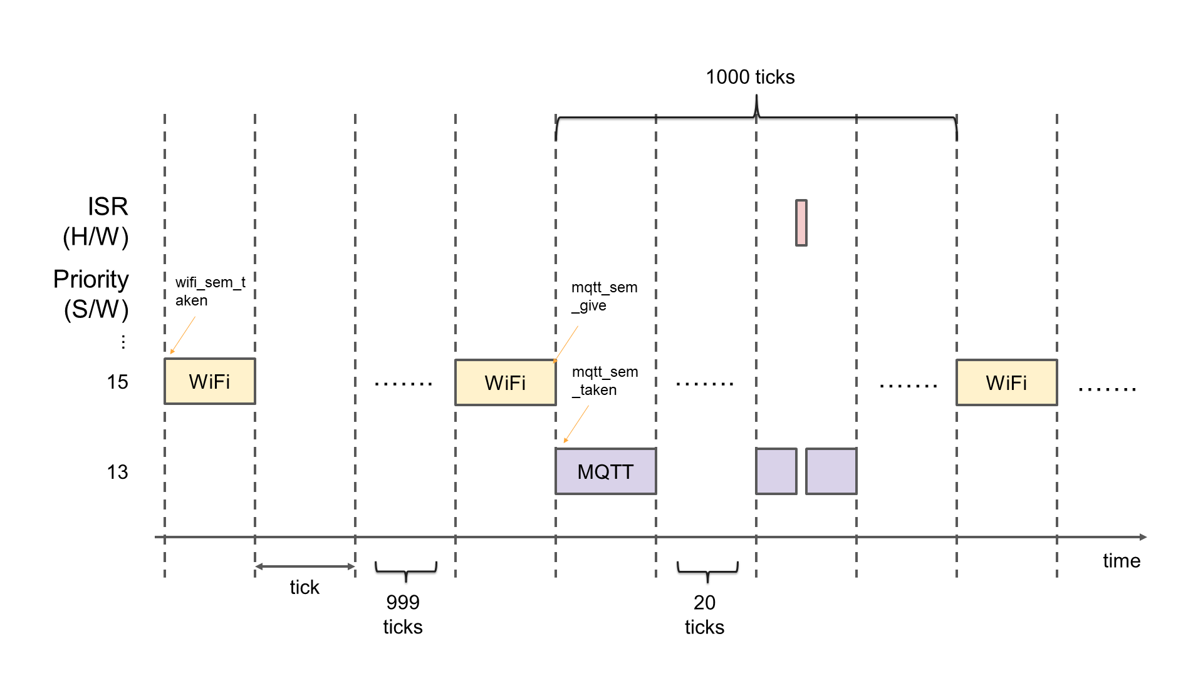
Multi-task scheduling for core 1
Button switch mode
Sensor-sem give

Slide 11
Ensuring data integrity and authentication by implementing a security protocol. (Security mode)
In this case , if the user have no permission , then user cannot access data from broker
Security mode
Topic A: ESP32-A Encrypted Data
Topic B: ESP32-B Encrypted Data
MQTT
borker
ESP32-B Encrypted Data
ESP32-A Encrypted Data
ESP32-A Encrypted Data
ESP32-B Encrypted Data
ESP32-A
ESP32-B

Slide 12
Security mode
Temperature
2 bytes
Humidity
2 bytes
Sensor
Plain Text
4 bytes
Temperature
2 bytes
Humidity
2 bytes
Pkcs5 Padding
Padded Plain Text
16 bytes
Temperature
2 bytes
Humidity
2 bytes
0C 0C 0C 0C 0C 0C 0C 0C 0C 0C 0C 0C
0C × 12

Slide 13
Data encryption
Padded Plain Text
16 bytes
16 bytes AES Key
HMAC
Key
Authentication Data
32 bytes
AES Cipher
16 bytes
AES Cipher
16 bytes
Hash
Algorithm
Integrity Data
32 bytes
Length of AES Cipher
1 byte
AES Cipher
16 bytes
Authentication Data
32 bytes
Integrity Data
32 bytes
Final Ciphered Data

Slide 14
Security mode
Encrypted data seen from MQTT
Topic A: ESP32-A Encrypted Data
Topic B: ESP32-B Encrypted Data
MQTT
broker
ESP32-B Encrypted Data
ESP32-A Encrypted Data
ESP32-A Encrypted Data
ESP32-B Encrypted Data
ESP32-A
ESP32-B

Slide 15
Data decryption
AES Cipher
16 bytes
Authentication Data
32 bytes
Integrity Data
32 bytes
Divide According to the Last byte
i.e first 16 bytes
From
16 to
16 + 31
From
16 + 32 to
16 + 63
Length of AES Cipher
1 byte
(Assume 16 here)
AES Cipher
16 bytes
Authentication Data
32 bytes
Integrity Data
32 bytes
Authentication Check
Integrity Check
PASS
PASS
AES Cipher
16 bytes
16 bytes
AES key
Plain Text
4 bytes
Temperature
2 bytes
Humidity
2 bytes
Unpadding

Slide 16
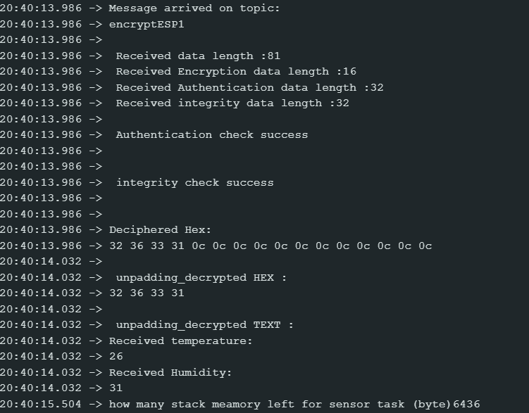
Result
Data encryption

Slide 17
Thank you for listening

