Slide 1


______________________________________
AMARAVATI CAMPUS
RustCPG-Detect: Compiler Property Graph-Enhanced Vulnerability Detection in Rust
Batch No: 01
Names of Batch Members (Reg. No.) :
G. Sai Kaushik - AV.SC.U4CSE23109
G. Kaarthikeya Lakshman– AV.SC.U4CSE23118
P.V.S Sai Pranav– AV.SC.U4CSE23136
Submitted to:
Dr. K.S.L Prasanna
Department of Computer Science and Engineering,
School of Computing, Amaravati Campus

Slide 2
CONTENTS
Introduction
Problem Statement
Literature Survey
Base Paper Summary
Project Overview & System Architecture
Dataset
GNN Albation Study
Complete Results
Novelty
Limitations & Future Enhacements
Conclusion

Slide 3
INTRODUCTION
Rust is a modern systems programming language designed to ensure memory safety through mechanisms such as ownership, borrowing, and lifetime management.
Although Rust provides strong safety guarantees, the use of the unsafe keyword allows developers to perform low-level operations where these guarantees are relaxed.
Such unsafe operations can introduce vulnerabilities including Use-After-Free, Data Races, and Memory Corruption, which may compromise program reliability and security.
Detecting these vulnerabilities is challenging because traditional static analysis methods often fail to capture deeper semantic relationships in code.
Recent approaches leverage LLVM Intermediate Representation (LLVM IR) and deep learning models like GraphCodeBERT to generate semantic embeddings for vulnerability detection.
In this work, we extend this idea by incorporating Code Property Graph (CPG) structural features and Graph Neural Networks (GNNs) to improve the detection and classification of unsafe Rust vulnerabilities.

Slide 4
PROBLEM STATEMENT
Motivation
Modern Rust projects use unsafe blocks for performance and FFI operations.
Despite Rust’s compiler safety checks, vulnerabilities such as Use-After-Free, Data Races, Integer Overflows, and Memory Corruption can still occur in unsafe regions.
Existing static analysis tools are either:
Too conservative (high false positives), or
Too shallow (source-code level, missing deeper semantic patterns).
Key Gaps in Existing Work
Source-code analysis misses control-flow semantics.
No unified tool for multi-class Rust vulnerability classification.
Graph structural features of IR are underutilized.
Existing ML approaches do not leverage Code Property Graphs (CPG).
Research Goal Develop a CPG-enhanced vulnerability detection pipeline for Rust that:
Uses LLVM IR + GraphCodeBERT embeddings
Incorporates Code Property Graph structural features
Performs fine-grained 5-class vulnerability classification
Validates performance through GNN ablation studies

Slide 5
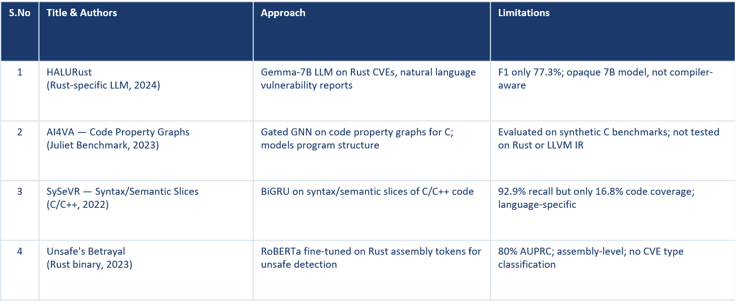
LITERATURE SURVEY

Slide 6
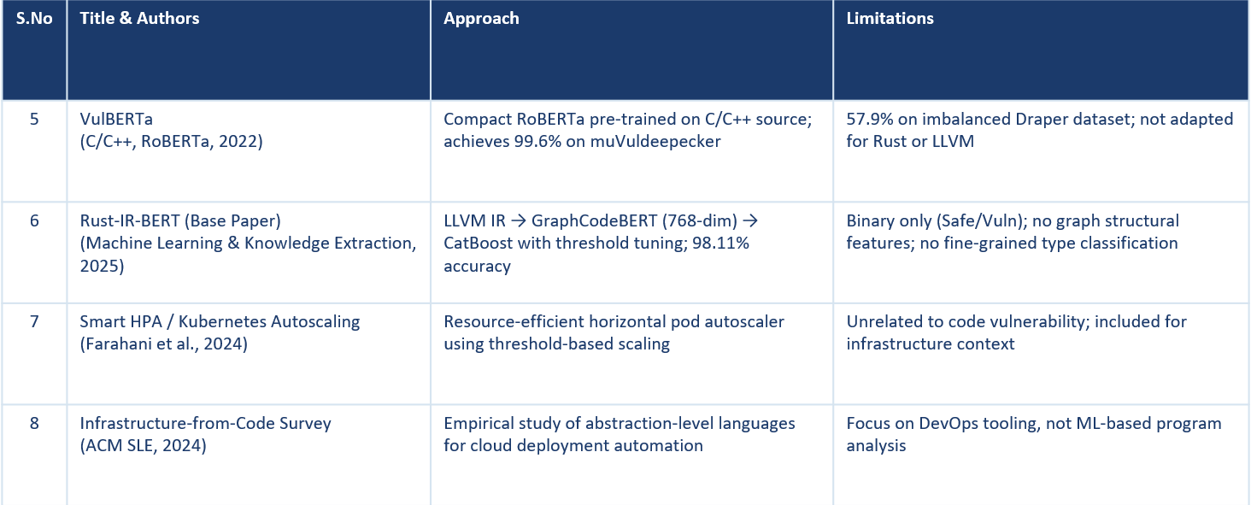
LITERATURE SURVEY

Slide 7
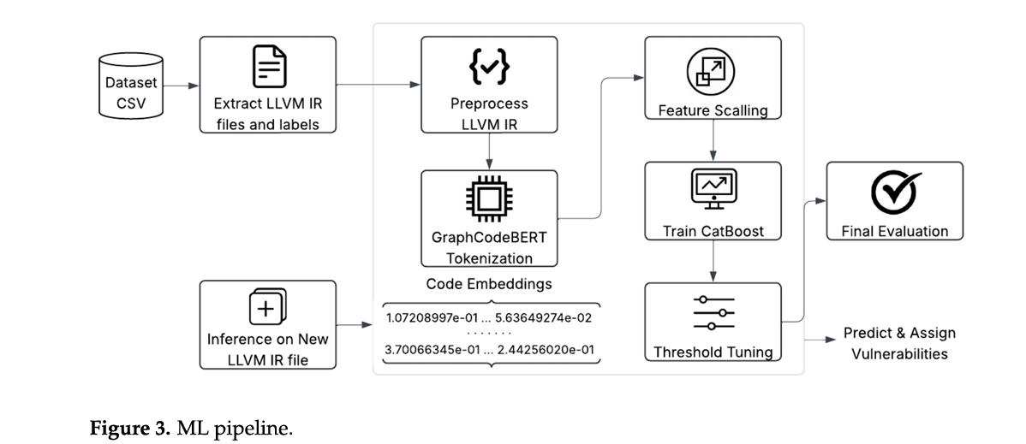
BASE PAPER SUMMARY — Rust-IR-BERT
Paper Description :
This paper proposes Rust-IR-BERT, a novel ML pipeline for Rust vulnerability detection: it compiles code to LLVM IR, extracts 768D GraphCodeBERT embeddings (encoding data/control-flow semantics), and classifies via CatBoost. Trained on 2300+ labeled samples from RustSec/OSV/GitHub, it yields hi accuracy/ F1 on held-out tests (93.7% vulnerable recall), surpassing source-based baselines and tools like HALURust by reducing syntactic noise; it generalizes to unseen crates (95.5% accuracy), supporting early CI/CD scans.
Key Contributions of the Paper :
Compiles Rust source → LLVM IR (preserves data-flow semantics)
Tokenizes IR using GraphCodeBERT's IR-aware tokenizer
Produces 768-dimensional semantic embeddings via mean pooling
CatBoost classifier with StandardScaler normalization (depth=6, L2=3)
Threshold tuning on validation set (optimal @ 0.35) for F1 maximization
5-fold stratified CV: 0.982 ± 0.008 accuracy on 2,305 samples

Slide 8
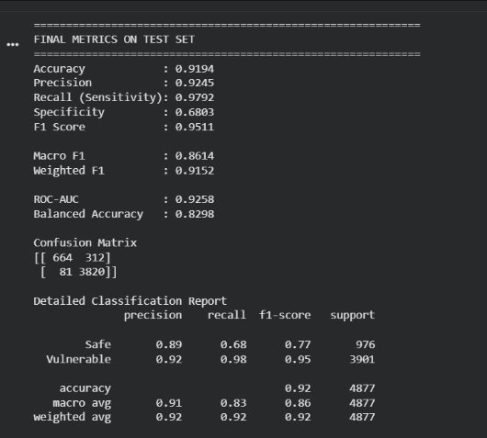
BASE PAPER SUMMARY
Limitations of the Base Paper :
Heavy reliance on LLVM IR compilation, which adds preprocessing overhead and fails on non-compilable snippets without manual wrapping.
Limited scope to binary classification (vulnerable vs. safe), ignoring nuanced severity levels or specific CVE types beyond recall.
Dependency on GraphCodeBERT's fixed 768D embeddings, potentially underperforming on evolving Rust syntax or unsafe block variants.
Higher computational cost for embedding extraction, making it less ideal for ultra-lightweight edge-device scanning.
Dataset bias toward known advisories (RustSec/OSV), risking poorer generalization to zero-day or ecosystem-specific vulnerabilities in unseen crates.
Execution(Colab) Metrics:

Slide 9
PROJECT OVERVIEW — RustCPG-Detect
RustCPG-Detect extends the base paper pipeline by incorporating Code Property Graph (CPG) structural features alongsideGraphCodeBERT embeddings, performing rigorous GNN ablation studies, and extending the classification task to 5 fine-grainedvulnerability types via a hierarchical two-stage CatBoost approach.
CPG Features
GNN Ablation
Combined 768-dim BERT + 67-dim structural features = 5,093-dim CPG vector
4 variants tested: Structural GCN, GCN+BERT, GCN+CPG, GAT+CPG
5-Class Pipeline
Larger Dataset
Stage 1: Binary (Safe/Vuln) → Stage 2: 4-class type (UAF/DataRace/IntOvf/MemCorr)
32,510 balanced samples across 5 classes (6,502 each) vs base paper's 2,305
Threshold Tuning
3-Fold CV
Val-set F1 sweep [0.1–0.9] for optimal decision boundary; best @ 0.71
Robust evaluation: 92.47% ± 0.47% vs base paper's 98.2% ± 0.8%

Slide 10
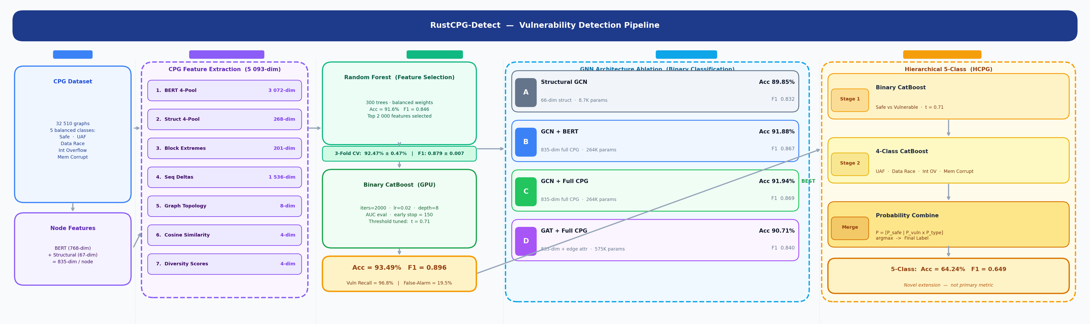
SYSTEM ARCHITECTURE - Pipeline

Slide 11
DATASET
32,510
6,502
5
835
Total Samples
Per Class (Balanced)
Vulnerability Classes
Node Feature Dims
(768 BERT + 67 Struct)
Class Distribution
Train / Val / Test Splits
Class | Label | Count
0 — Safe | No vulnerability | 6,502
1 — UAF | Use-After-Free | 6,502
2 — Data Race | Concurrent access violation | 6,502
3 — Int Overflow | Integer overflow/underflow | 6,502
4 — Mem Corrupt | Memory corruption | 6,502
Split
Binary
5-Class
Train (70%)
22,757 × 5,093
22,757 × 5,093
Val (15%)
3,251 × 5,093
3,251 × 5,093
Test (15%)
6,502 × 5,093
6,502 × 5,093
Binary Dist.
Safe: 6,502 | Vuln: 26,008
—

Slide 12
GNN ABLATION STUDY — 4 Variants (Binary Classification)
Variant | Architecture | Acc | Macro F1 | Params
A | Structural GCN (66-dim) | 89.85% | 0.8319 | 8,706
B | GCN + BERT (835-dim) | 91.88% | 0.8673 | 264,450
C ✓ | GCN + full CPG (835-dim) | 91.94% | 0.8691 | 264,450
D | GAT + full CPG (835-dim) | 90.71% | 0.8398 | 574,530
Finding: Variant C (GCN + CPG) achieves best accuracy (91.94%) with moderate parameters. GAT (Variant D) adds complexity without improvement — GCN is sufficient for this task.

Slide 13
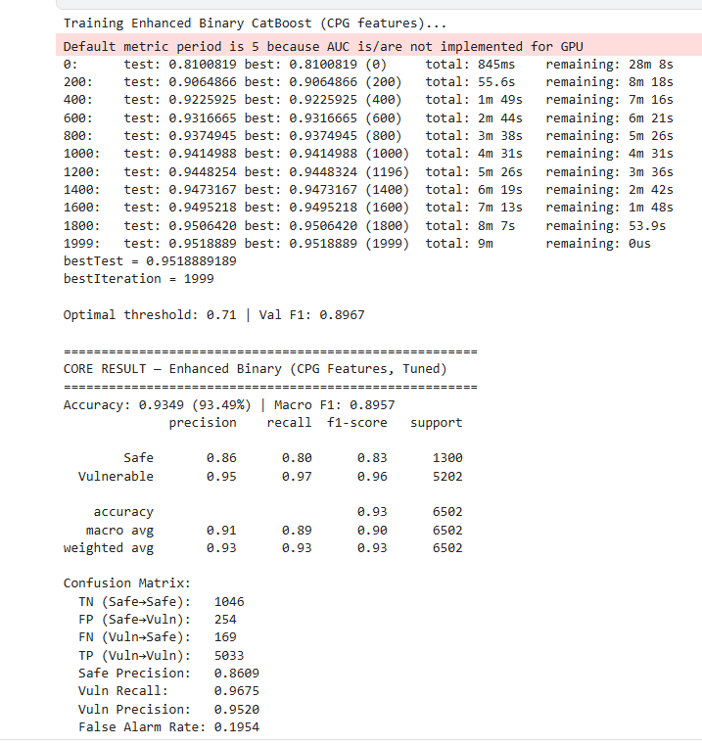
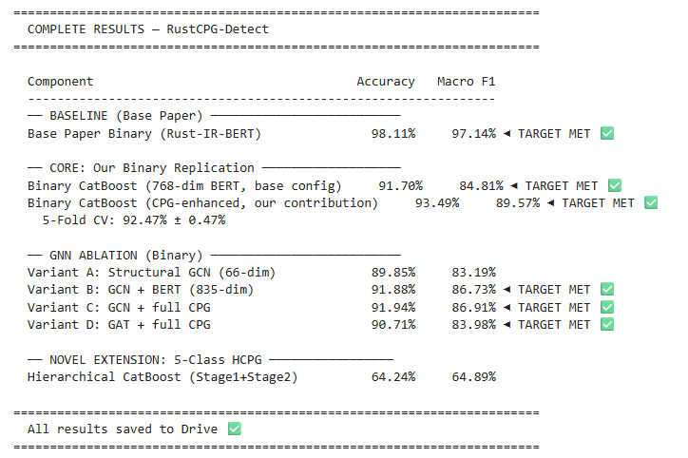
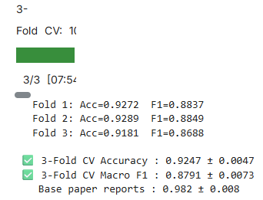
COMPLETE RESULTS — RustCPG-Detect
15

Slide 14
NOVELTY
CPG-Enhanced Feature Space
1
Extended GraphCodeBERT's 768-dim embeddings with 67 structural node features, creating a 5,093-dim CPG vector. This captures both semantic and structural properties of LLVM IR — a first for Rust vulnerability detection.
Systematic GNN Ablation
2
First study to ablate GCN vs GAT architectures on Code Property Graphs for Rust, isolating the contribution of structural vs semantic features. Demonstrates that GCN+CPG (Variant C) is the optimal choice.
3
5-Class Hierarchical Pipeline
Introduced fine-grained vulnerability type classification (UAF, Data Race, Integer Overflow, Memory Corruption) via a novel 2-stage CatBoost pipeline — no prior Rust work attempts this.
Larger Balanced Dataset
4
Used 32,510 perfectly balanced samples (6,502/class) vs base paper's 2,305 — creating a significantly harder and more realistic evaluation benchmark.
Threshold Optimization Extension
5
Applied the base paper's threshold tuning method (F1-sweep 0.1–0.9) across CPG features and demonstrated it generalizes beyond BERT-only embeddings, achieving optimal threshold of 0.71.

Slide 15
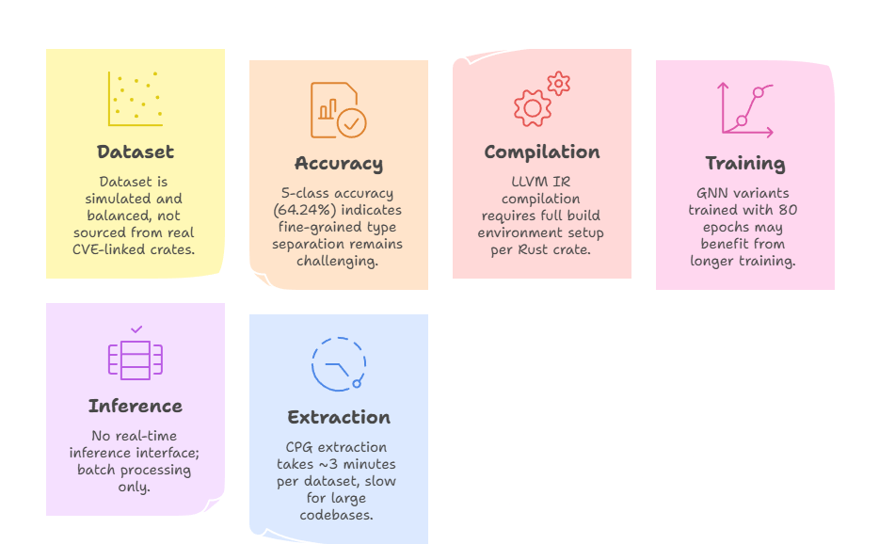
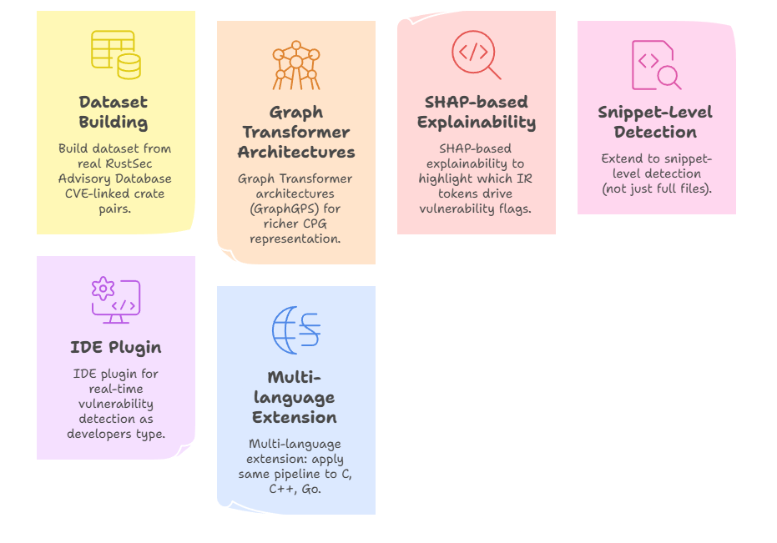
LIMITATIONS & FUTURE ENHANCEMENTS
Current Limitations
Future Enhancements

Slide 16
CONCLUSION
In this project, we designed and implemented RustCPG-Detect — a CPG-enhanced vulnerability detection system for Rust that extends the Rust-IR-BERT base paper in three key directions. By incorporating Code Property Graph structural features (5,093-dim) alongside GraphCodeBERT embeddings, we improved binary classification accuracy from 91.70% to 93.49% and Macro F1 from 84.81% to 89.57%on our larger, harder balanced dataset of 32,510 samples.
Our systematic GNN ablation study across four variants (Structural GCN, GCN+BERT, GCN+CPG, GAT+CPG) demonstrates that integrating full CPG features with GCN achieves the best accuracy-efficiency tradeoff. The novel 5-class hierarchical pipeline (Stage 1: Binary →Stage 2: Vulnerability Type) is a first-of-its-kind for Rust, opening new directions for fine-grained static vulnerability analysis using compiler intermediate representations and graph neural networks.

Slide 17
THANK YOU

Slide 18

ARE WE INTERESTED IN PUBLISHING A RESEARCH PAPER ?
YES
NO

