Slide 1

Debugging Techniques in Linux
Chetan Kumar S
Wipro Technologies

Slide 2

Agenda
Types of debugging
Tools on Linux
Description of tools
Online trails
More information

Slide 3

Types of Debugging
Non-Interactive Debugging
    Live OR on-the-fly
    Postmortem
Interactive Debugging
    On the same resource/system
    From remote system
      Source level and otherwise

Slide 4
User Level Debugging
Applications running at user level
A bug OR a crash do not affect the other process(normally) and limited to current process
Simple (Comparatively), involve debugging following types of applications.
  Simple monolothic single task/thread code
  Multi task applications
  Multi thread applications

Slide 5
Kernel Level Debugging
Kernel code, running part of the kernel
  Assuming Linux, a monotlothic code
More complex, may halt/crash the whole system
  Things are different for micro kernel, we will not look at the now
Debugging of a module OR built in code
  Not much different, only time consideration
    Module, can re-build and re-loaded fast
    Built in need to re-build and re-start, normally slow.

Slide 6

Tools for User Level Debugging

Slide 7
Trace
Trace
  ltrace - Library call trace.
  strace - System call and signal trace.
Both are very good non-interactive debugging methods
Simple, just run the command with arguments
  Can also attach to a existing program

Slide 8
GNU debugger
gdb GNU debugger
  A source level debugger, with lots of facility
    Support threads, remote debugging...
Ddd Data Display Debugger
  Nothing but front-end for gdb
  All those supported by linux are supported
  Much easier to use this, can manupulate the data easily

Slide 9
Trace Example
Is normally used as a first level analysis mode
  If things stop OR give a fault OR just hang some where
Start with ltrace, and find the faulty code based on the result
Use strace to make further investigations when it hangs/suspends/expcting something
Let us try it on LIVE

Slide 10
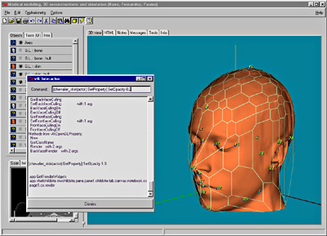
Interactive Debugging

Slide 11
Interactive Debugging
Use gdb OR ddd
Set break point and watch point and 'run'
Do step, next and continue
Analyse the data
Threads
  Gdb support threads, use thread info and attach
Mulit-process
  U need to synchronize the things

Slide 12
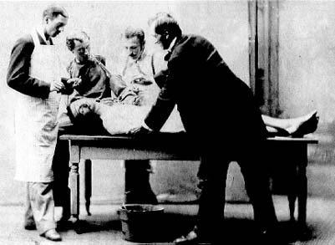
Postmortem

Slide 13
Postmortem
A core is generated when there is expection
  Core contain the system(process) image at the time of expection
Use gdb to analyze the core and find fault
  gdb core=core_file <executable>
Can also use ddd if U want DD (Data Display)
  Caution there are shell variables that control the core file generation
    ulimit -a unlimited should help
LIVE Analysis

Slide 14

Tools for Kernel Level Debugging

Slide 15
Spectrum
kdb - kgdb - oops - printk - uml
Kdb assembly level debugger.
Kgdb extension to gdb, a source level debugging
Oops message generatred by system on expection
Printk printing debugging messages
User Mode Linux run Linux in Linux.

Slide 16
Kgdb
Use gdb to debugg a running kernel
Normally done via serial port
  Via ethernet is also possible
So there are two machines, `host` and `target`.
  Runing gdb on host, we debug the target
Debugging module could be a tricky part
  How do U load the module ??

Slide 17
Kgdb Setup
Obtain the kgdb patch from the kgdb.srourcefourge.net
Apply patch and compile the kernel, preferrably on the host
  In kernel hacking, enable serial-line debugging and other option based on requirements
Copy the bzImage onto the target and update lilo
  Append="gdb gdbttyS=0 gdbbaud=115200"
Reboot the new image

Slide 18
Kgdb Setup ...
Connect target and host using null modem
    Make sure that U check this cable: minicom and cat are ur friends
On the host machine, set the tty speed
    stty ispeed 115200 ospeed 115200 < /dev/ttyS0
Start gdb with the vmlinux as file
Connect to the remote target
    (gdb) remote target /dev/ttys0
Set break point and run, U can also use crt-C to stop the kernel
Ofcource you could use ddd also

Slide 19



Slide 20
Opps
When the kernel gets expection will generate the oops message
OOPS messages are printed via klogd and to the kernel ring buffer
Can get these messages by 'dmesg' OR /var/log/*
If kernel simple breaks down, then copy by hand
Also running the kernel message on the console may be a good idea

Slide 21
Opps
Oops message are depended on the kernel U are running
Run the ksymoops to decipher
Can look at the System.map OR /proc/ksyms
Normally will give the call trace and expetion location
Can be very usefull for debugging a driver

Slide 22
Printk
Easiest way out is printk
Use as many as you like, can be later removed
Module are simple since recompiling do not take too much time
Kernel is bit time comsuming
Look at the klog and syslog and dmesg
Could use /proc also

Slide 23

TUX in TUX*
*User Mode Linux

Slide 24
User Mode Linux
User-Mode Linux gives you a virtual machine
  may have more hardware and software virtual resources than your actual, physical computer.
So debugging is simple, just use gdb for debugging, so also ddd
Driver codes can be debugged, good for networking stack OR filesystem related code
Need only single machine and setup is lot simpler.

Slide 25
User Mode Linux Setup
Download the patch from UML site
Apply patch to the code which U have modified
Configure the source with ARCH=um
  Build the source with ARCH=um, result is linux
Get one root file system (tommy linux, busybox)

Slide 26
User Mode Linux Setup
Start the ddd with symbol of linux
Start uml with following args
  ./linux debug=parent gdb-pid=xxx
Type att 1 at gdb console and 'c'
Let us do it now, look at the PC on your desktop

Slide 27
For Further Information
http://kgdb.sourcefourge.net
http://user-mode-linux.sourcefourge.net
http://www.gnu.org/directory/GNU/gdb.html
Info gdb

