Slide 1
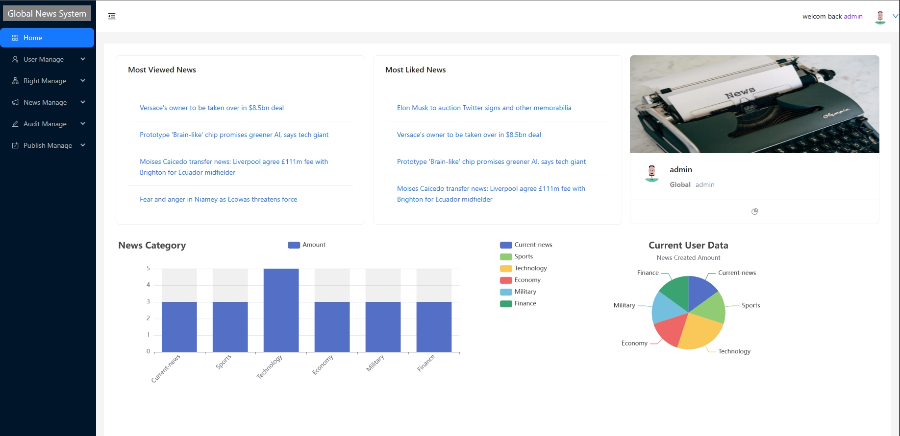
Global News Manage System---A react app with REST API Project
Vicky Kang

Slide 2
Project Objective
User-friendly and intuitive interface.
Responsive and high-performance application that loads quickly,responds promptly to user interactions.
Database highly structured.
Role-based design with customized content and UI.
Tech Stack
React JS
Web API/REST API with JSON server
React Route6
Redux
Data visualization
Methodology---Waterfall

Slide 3
Communicate with client
Requirment gathering meeting.
Face to face meeting and project review
Management of risk
Technical Solutions: Implement best practices in coding, architecture, and design to reduce technical vulnerabilities and potential issues.
Regular Testing: Perform thorough testing, including security testing, functional testing, and performance testing, to identify and fix issues early in the development process.
Code Reviews: Conduct regular code reviews to identify and rectify code-related risks such as bugs, vulnerabilities, and inconsistencies.
Continuous Integration and Continuous Deployment (CI/CD): Automate deployment processes to reduce the risk of human error and ensure consistent and reliable releases.
Backup and Recovery Plans: Develop strategies for data backup and recovery in case of system failures or data breaches.
Documentation: Maintain comprehensive documentation that outlines the architecture, design decisions, and security measures implemented in the application.

Slide 4
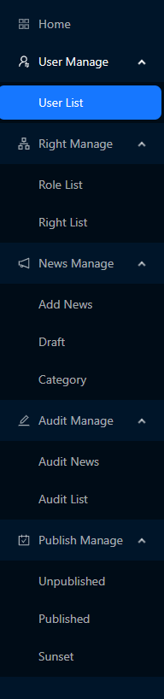
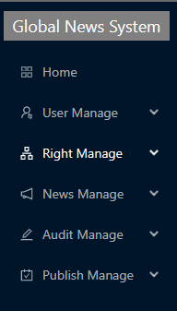
Web Application structure and rights control
Admin: Full access
Region Admin: Manage editor and auditing news only in the belonged region
Region Editor: Editing and publish news
first-level menu
Full menu with all children

Slide 5
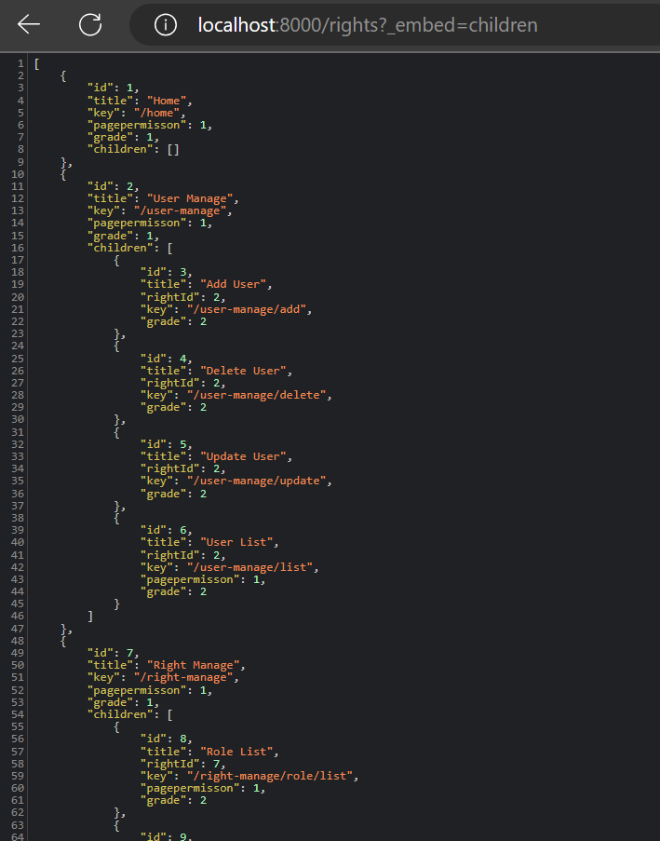
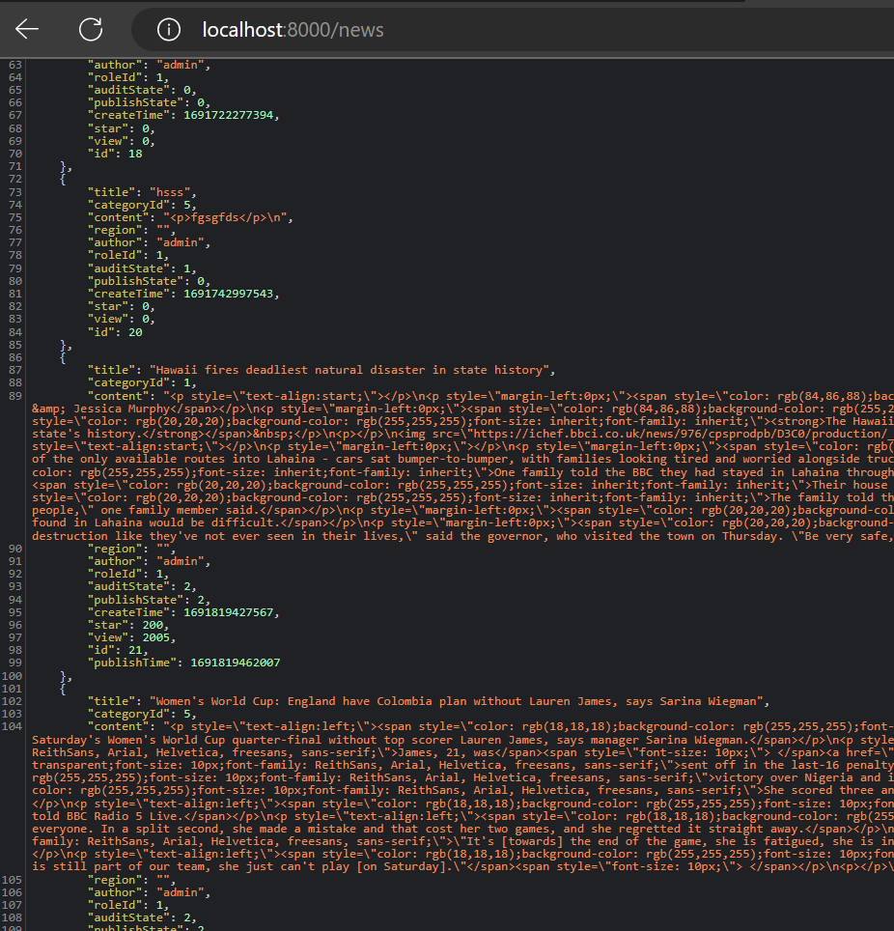
Database sample

Slide 6
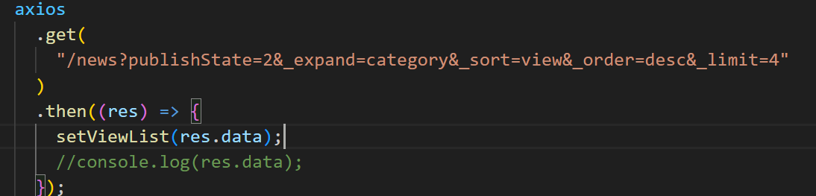
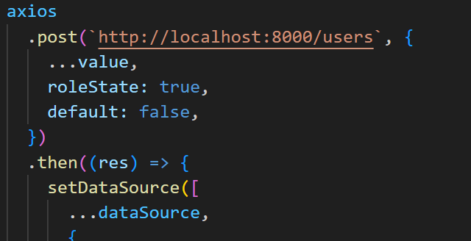
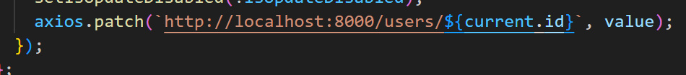
Communication with database - RESTFUL

Slide 7
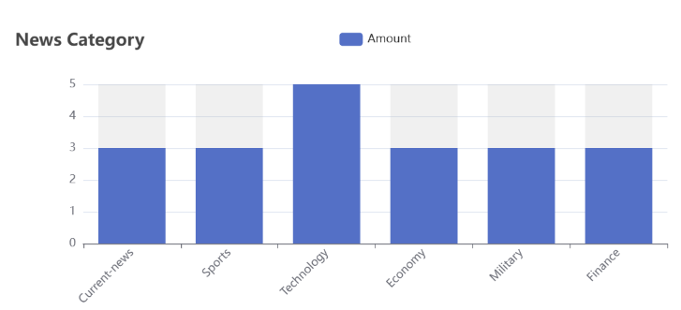
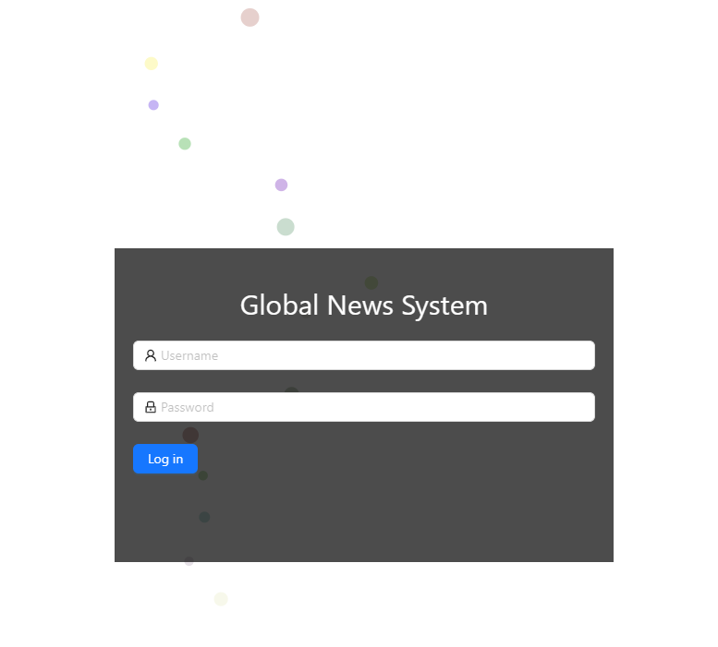
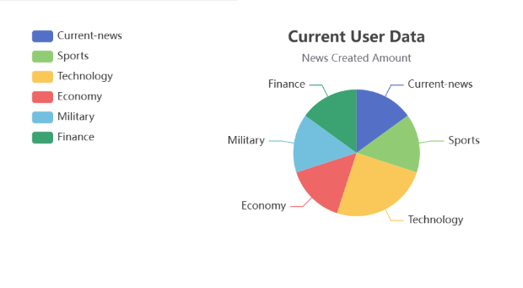
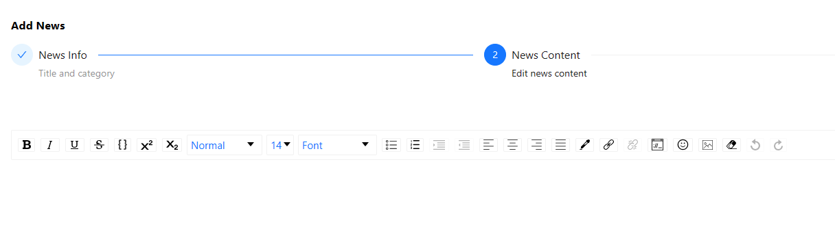
Third-party npm packages usage
Framework--Ant Design
E-chart
React particles-animation
React editor

Slide 8
Now the demo...

