Slide 1
Web Development Project
Ekaterina Dul 2102930

Slide 2
Initial Design

Slide 3
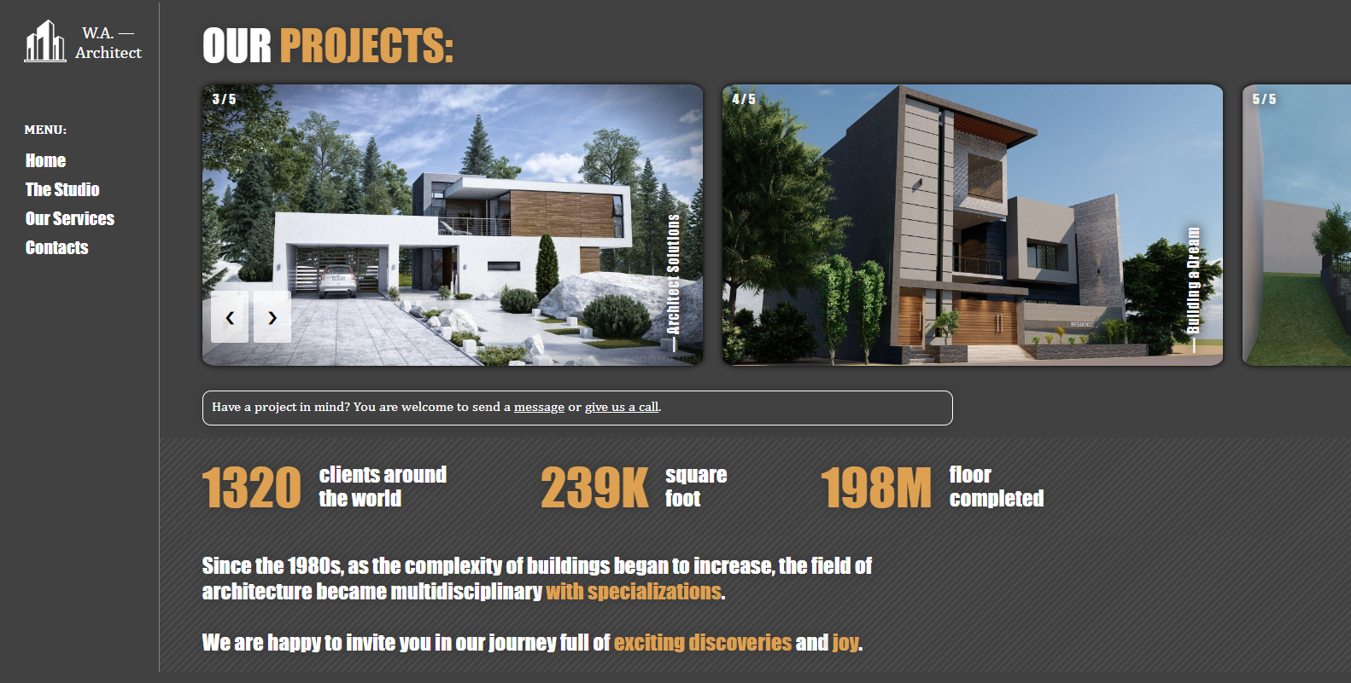
Home Page: Main Result

Slide 4
Home Page: Mobile Version

Slide 5
Main Features of Home Page : Contact Links

Slide 6
Main Features of Home Page : Contact Section

Slide 7
Main Features of Home Page : Slideshow

Slide 8
Services Page: Main Result

Slide 9
Services Page: Mobile Version

Slide 10
Main Features of Service Page : Accordion

Slide 11
Main Features of Service Page : Gallery

Slide 12
General Project Structure: HTML

Slide 13
General Project Structure: CSS

Slide 14
General Project Structure: Java Script

