Slide 1
CargoSync
Konstantin Dinev 11V

Slide 2
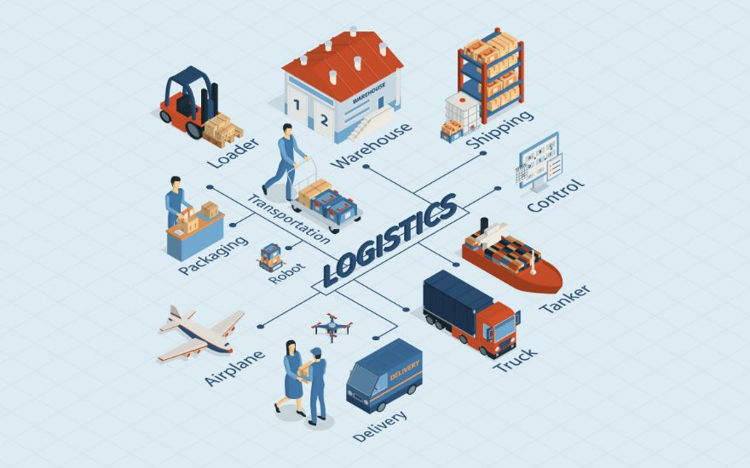

My Idea

Slide 3










Languages & Tools

Slide 4
Let’s continue with the project.

Slide 5
Thank you for the attention!

