Slide 1

Eco-Commerce Platform: Project Milestones
Building a sustainable marketplace, one step at a time.

Slide 2

Milestone 1: User & Authentication Module
Secure Access
Role-Based Control
Registration, Login, and JWT authentication for robust security.
Differentiated access for Users, Sellers, and Admins.
Profile Management
Users can easily manage their personal profiles and settings.

Slide 3
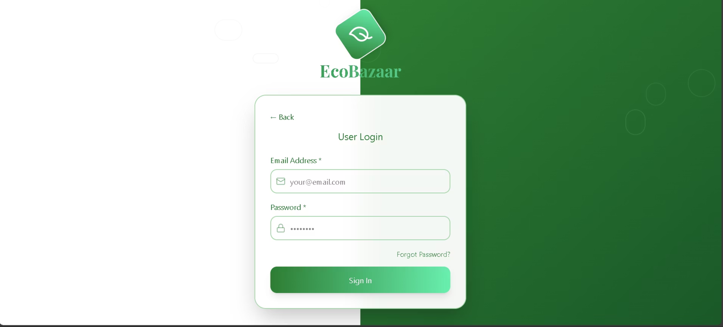
Expected Output: User & Authentication
Registration & Login
Intuitive and secure forms for new users and returning members.

Slide 4
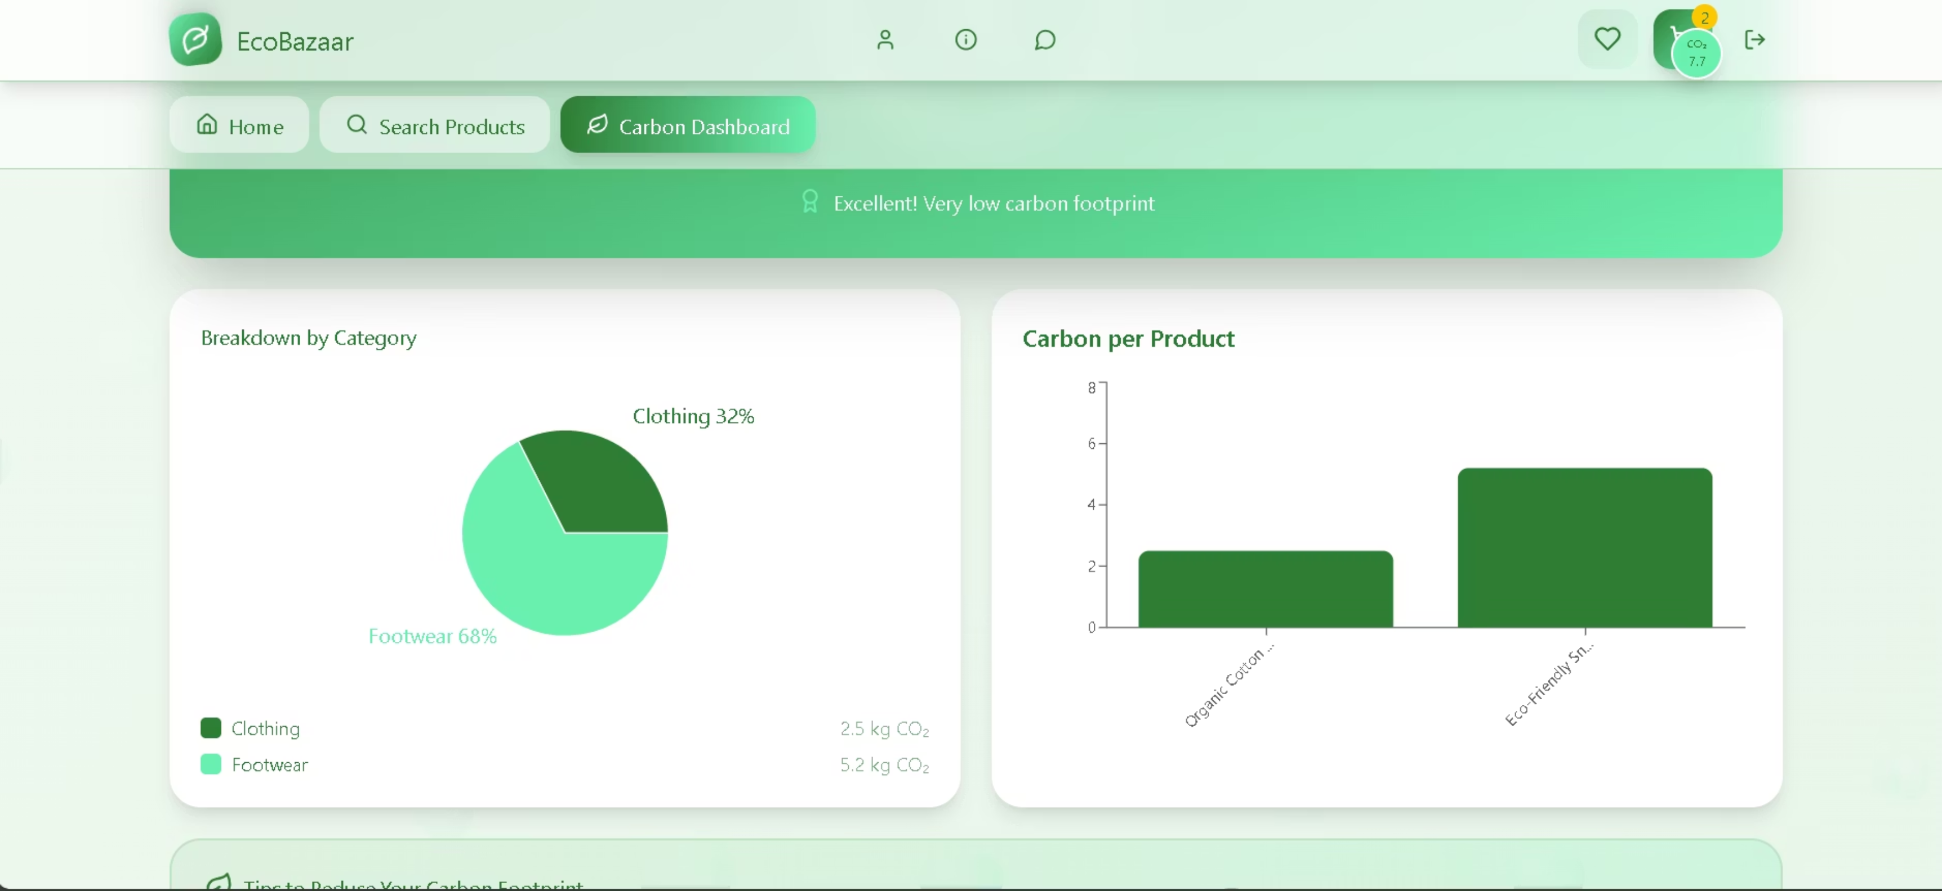
Personalized Dashboard
A customized user experience with relevant content and features.

Slide 5

Milestone 2: Product Catalog & Carbon Data
01
02
Product Listings (CRUD)
Carbon Footprint Input
Sellers and Admins can Create, Read, Update, and Delete product information.
Manual or auto-calculated carbon data for each product.
03
Eco-Friendly Filtering
Browse, search, and filter products based on environmental impact.

Slide 6
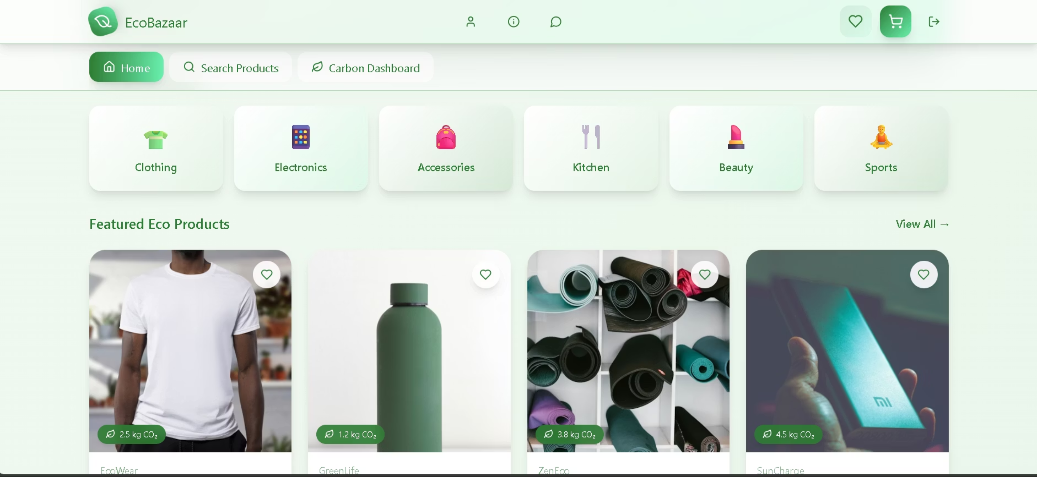
Expected Output: Product Catalog
Detailed Product List
Products displayed with images, price, carbon footprint (CO₂e/kg), and eco-rating/badge.

Slide 7
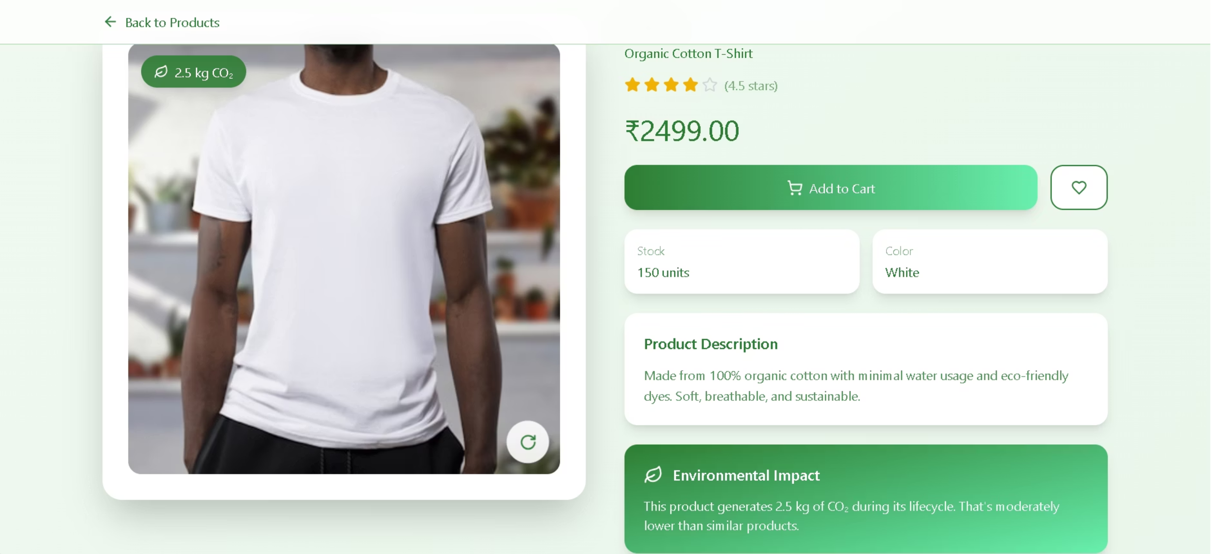
Carbon Impact Breakdown
Detailed product pages showcasing the full carbon impact breakdown for informed choices.

Slide 8




Milestone 3: Smart Cart & Checkout
Real-time Emissions
Shopping cart displays estimated total CO₂ emissions.
Seamless Checkout
Streamlined process with clear order confirmation.
Greener Alternatives
Suggestions for sustainable options before finalizing purchase.

Slide 9
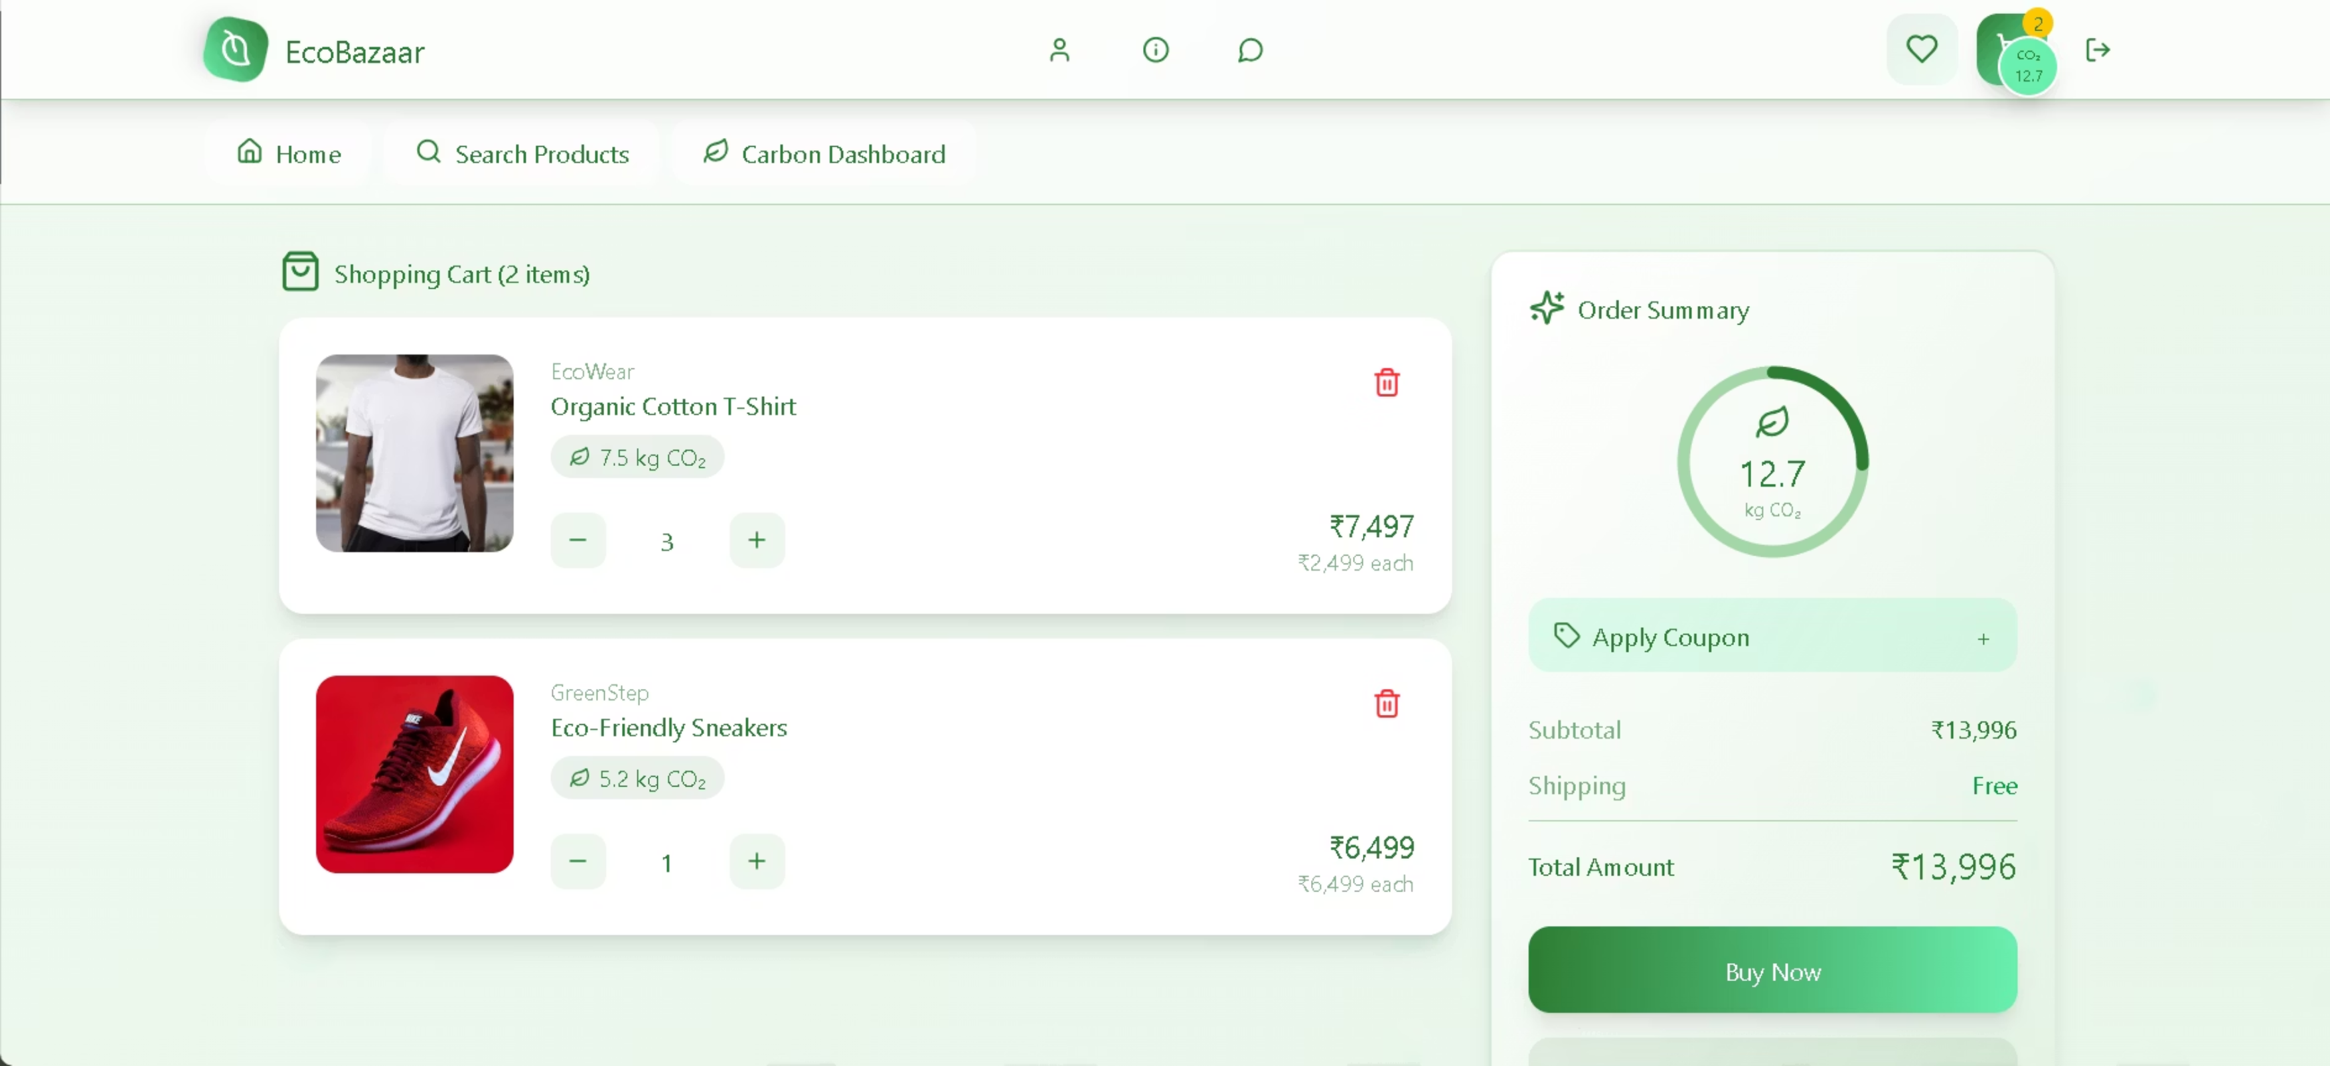
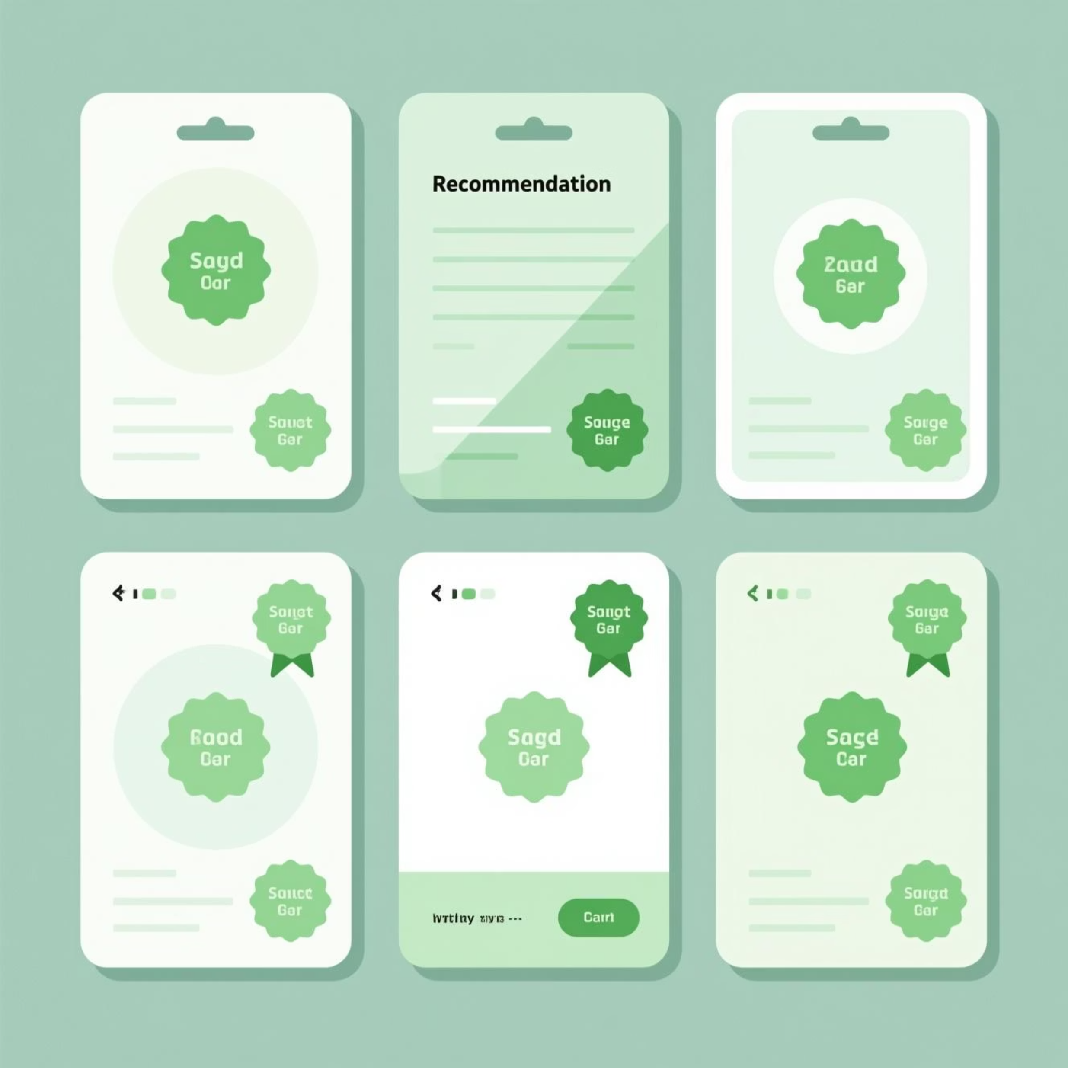
Expected Output: Smart Cart
Cart Page Overview
Items, subtotal, and estimated total CO₂ emissions at a glance.
Alternative Recommendations
Suggestions for more eco-friendly products to reduce impact.

Slide 10

The Journey Towards Sustainability
Our platform is designed to make eco-conscious shopping easy and transparent.

Slide 11

Future Vision: A Greener Marketplace
Empowering consumers and businesses to make a positive environmental impact.

