Slide 1
Car Price Classification Project Evaluation
To classify car prices as "High Price" or "Low Price" based on various features

Slide 2
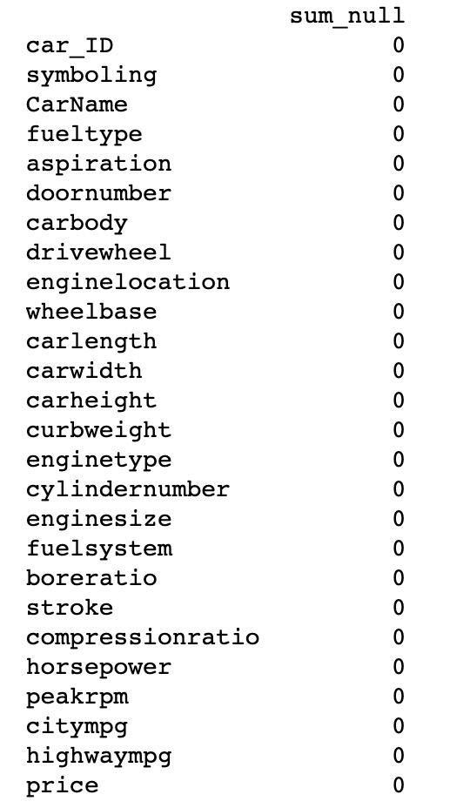
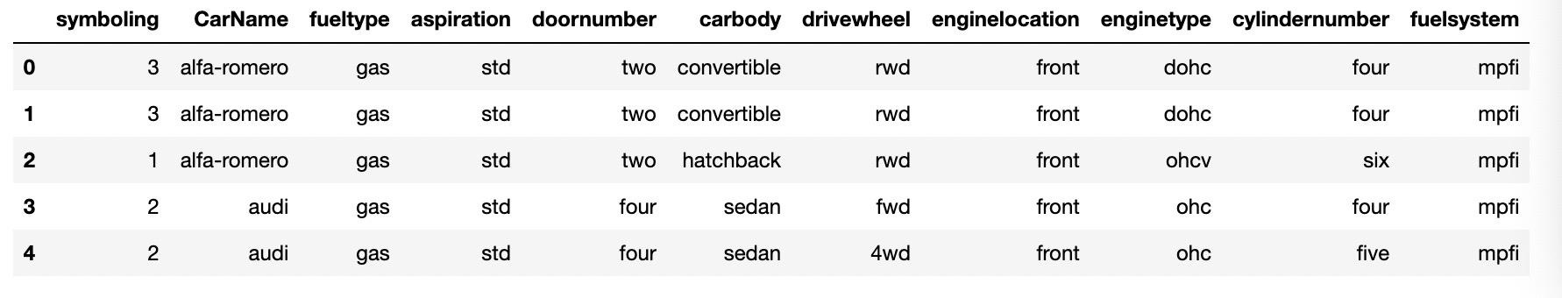
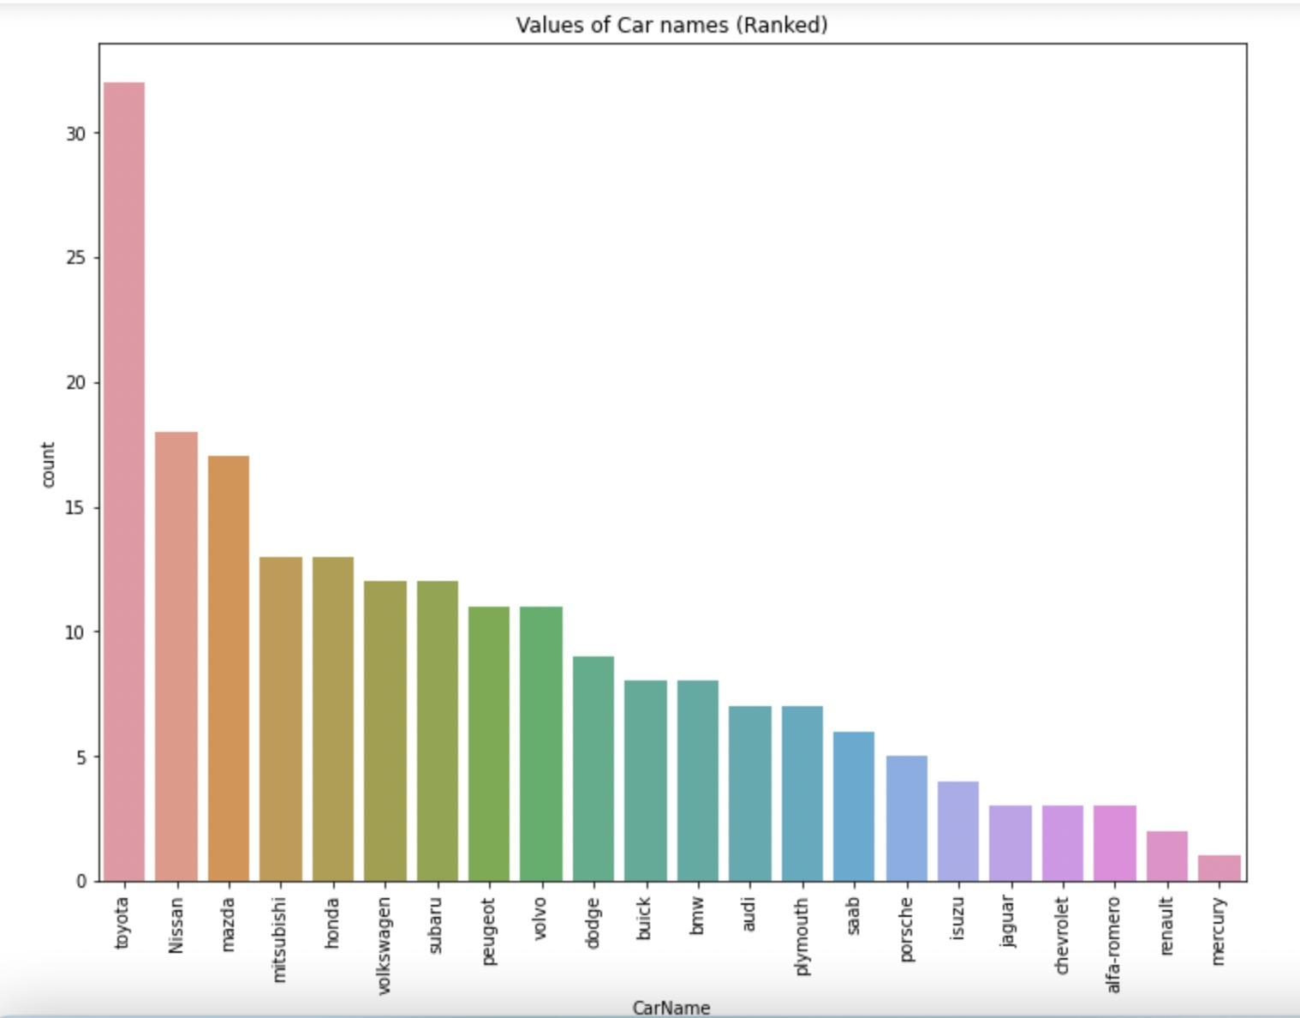
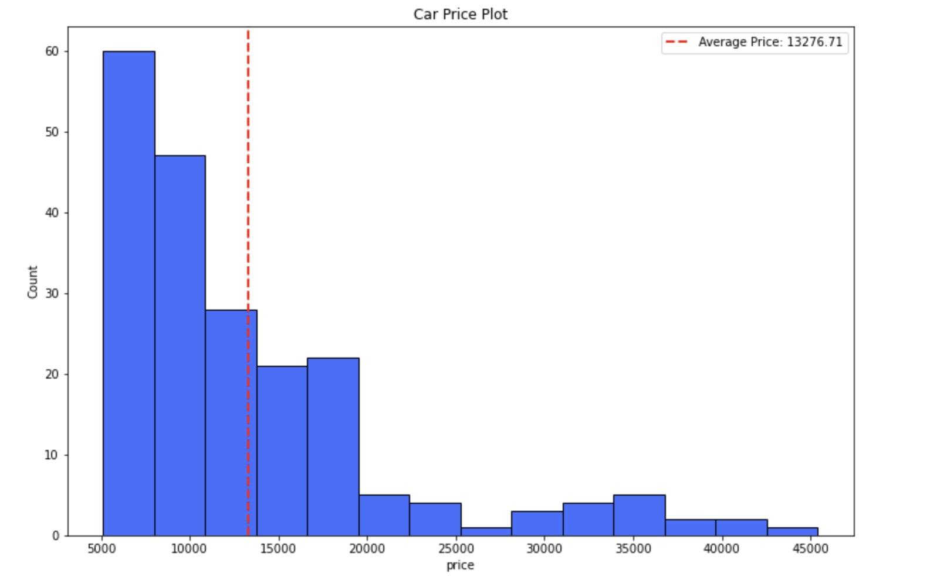
Database

Slide 3
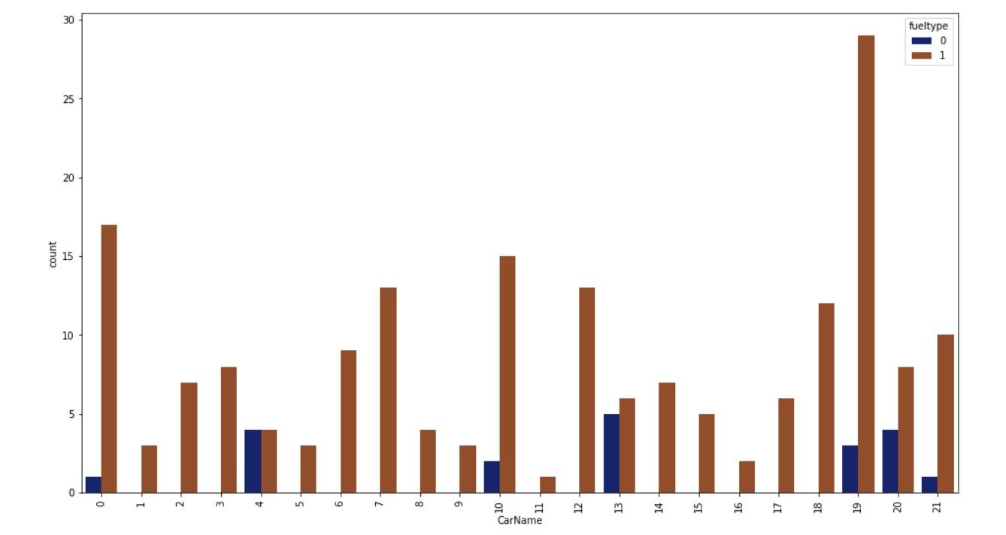
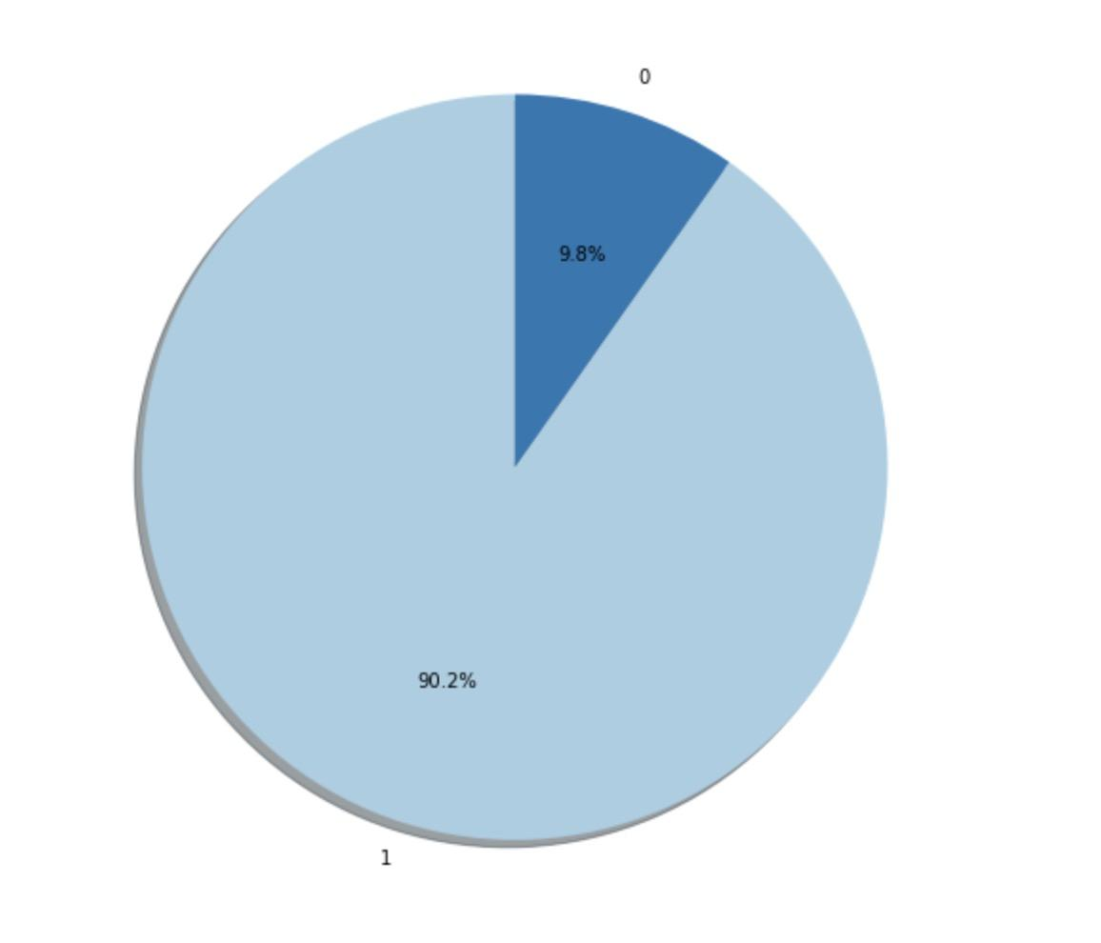
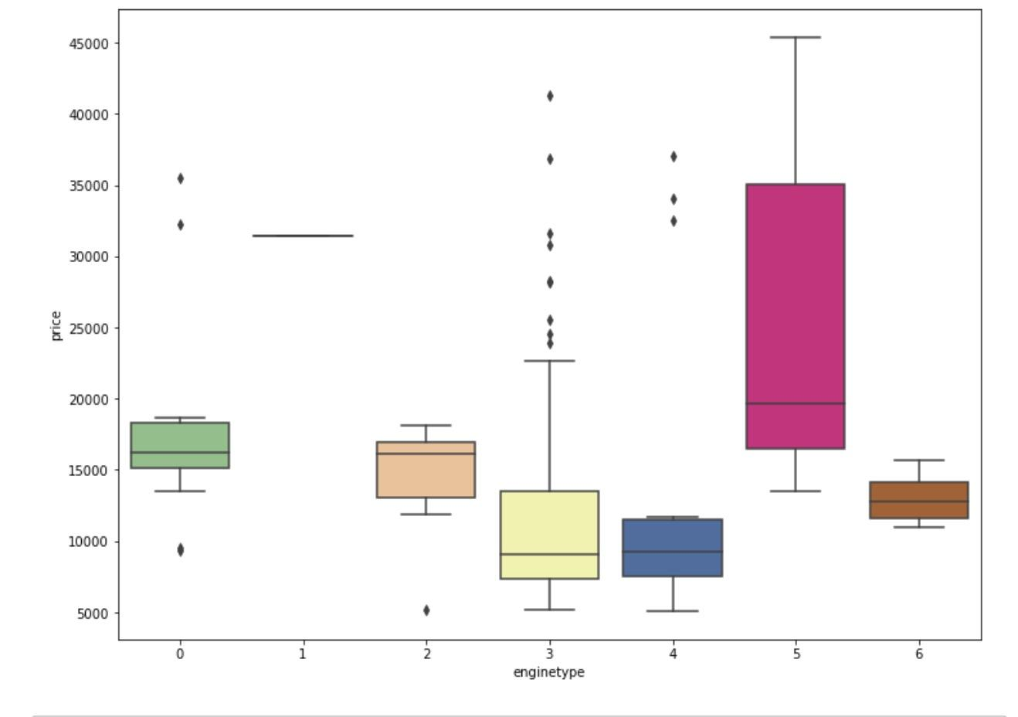
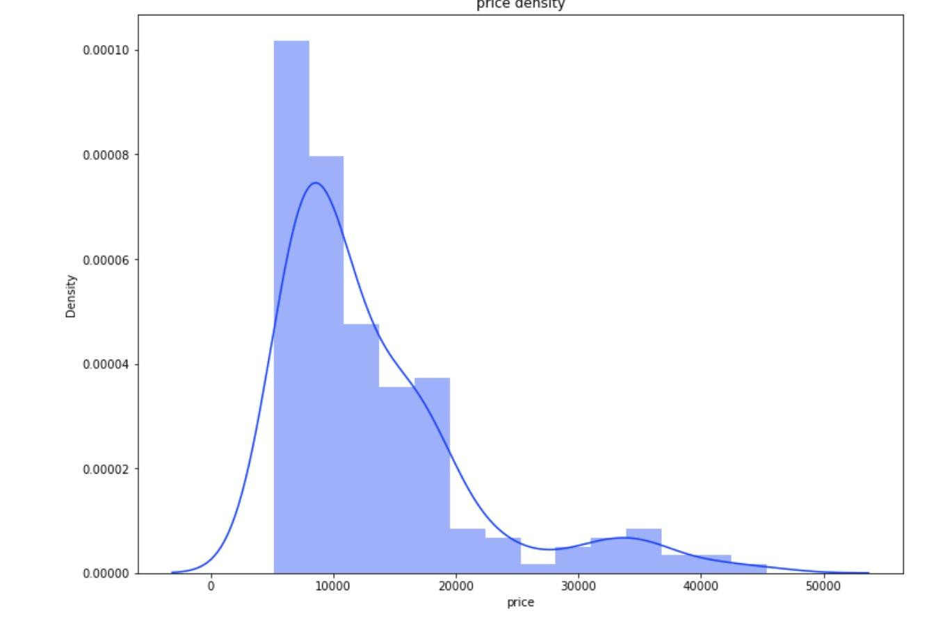
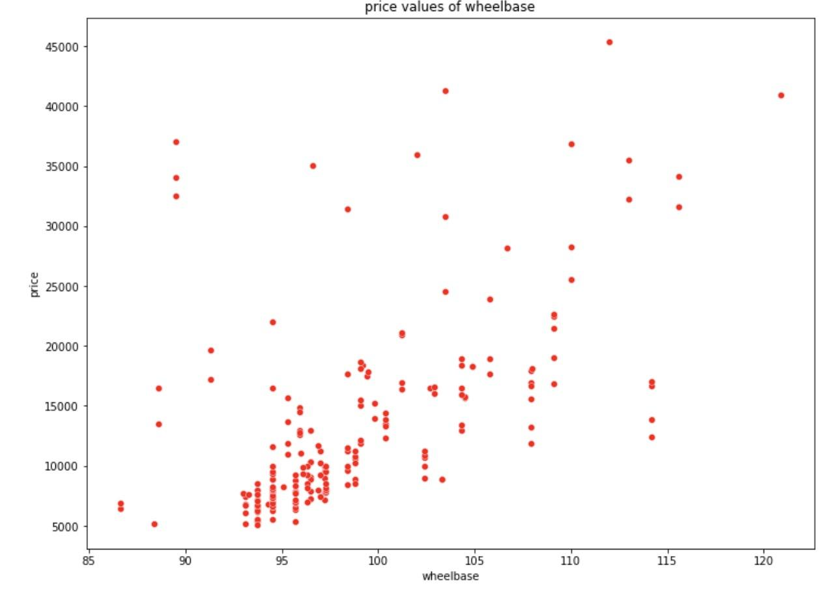
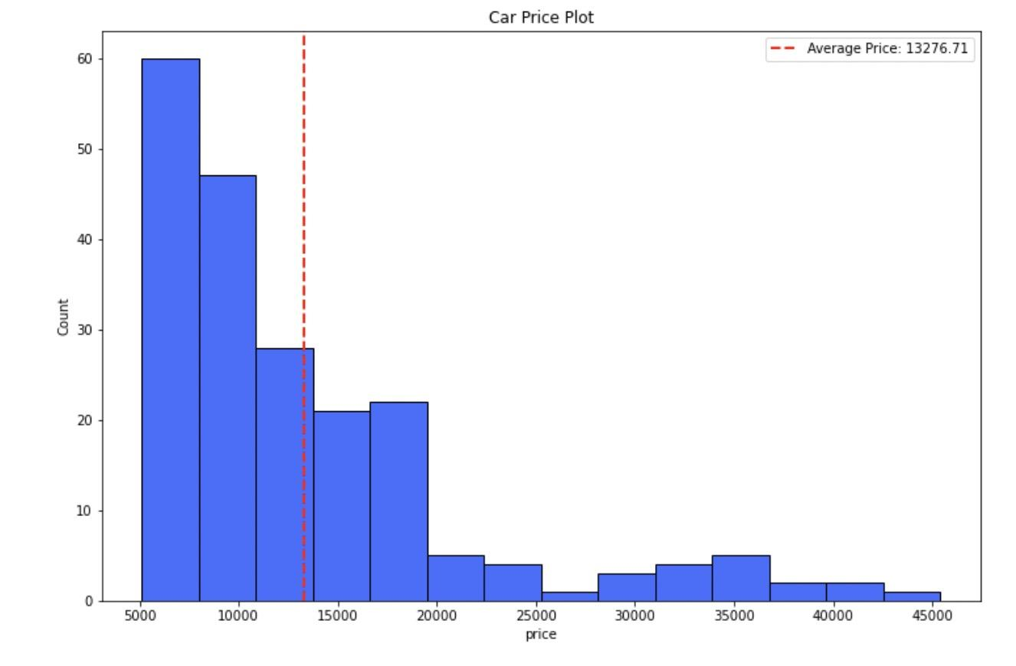
Data Exploration

Slide 4
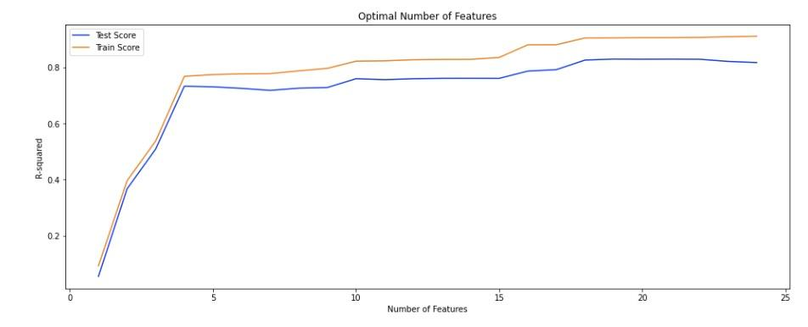
Techniques Used for Modeling
Modeling Techniques
Utilized Logistic Regression and Support Vector Machines (SVM) with different kernels.
grid search cross validation

Slide 5
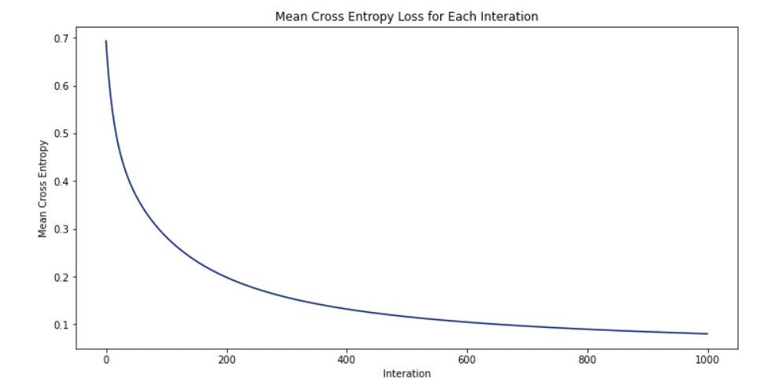
Logistic Regression
Model Training and Evaluation
Utilized logistic regression algorithm to predict car price classes.
Evaluated the model using metrics such as accuracy, sensitivity, specificity, precision, and F1-score.
Explored the mean cross-entropy loss to assess model convergence.

Slide 6
SVM with Linear Kernel
Model Selection
Model Evaluation
Chose SVM with a linear kernel to capture linear relationships.
Applied one-hot encoding for categorical variables and standard scaling for numerical features.
Split data into training and testing sets.
Used AUC as the evaluation metric.
Conducted 10-fold cross-validation using both random and stratified strategies.

Slide 7
SVM with Polynomial Kernel
Model Selection
Model Evaluation
Employed SVM with polynomial kernel (degree 2) to capture non-linear relationships.
Applied similar preprocessing steps as with linear kernel.
Used AUC as the evaluation metric.
Conducted 10-fold cross-validation using both random and stratified strategies.

Slide 8
SVM with RBF Kernel
Model Selection
Model Evaluation
Used AUC as the evaluation metric.
Conducted 10-fold cross-validation with grid search for hyperparameter tuning.
Utilized SVM with radial basis function (RBF) kernel for complex non-linear relationships.
Similar preprocessing as with other kernels.

Slide 9
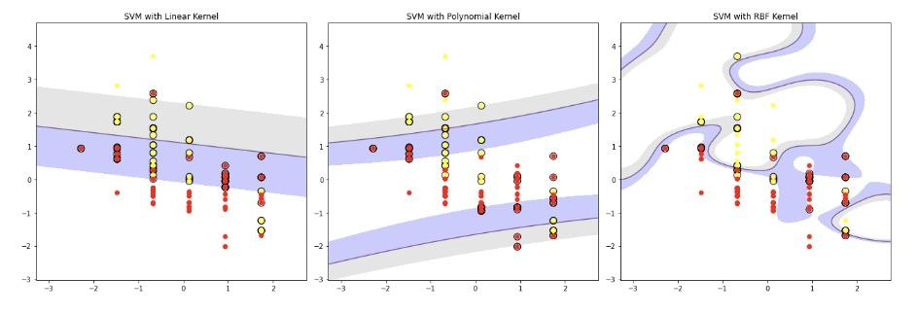
Visualization of Results
Decision Boundaries
Visualized decision boundaries for each SVM kernel.
Linear Kernel: Captures linear relationships.
Polynomial Kernel: Captures non-linear relationships (degree 2).
RBF Kernel: Captures complex non-linear relationships.

Slide 10
Conclusion
Explored and evaluated different modeling techniques using Logistic Regression and SVM with various kernels.
Demonstrated strengths and limitations of each model.
Highlighted SVM's ability to capture different relationships based on kernel choice.

Slide 11
Future Considerations
Suggested exploring further hyperparameter tuning and feature engineering to improve model performance.
Encouraged experimenting with additional metrics for evaluation.

Slide 12
Q&A Session
Open the floor for questions and discussions.

