Slide 1

Policies

Slide 2
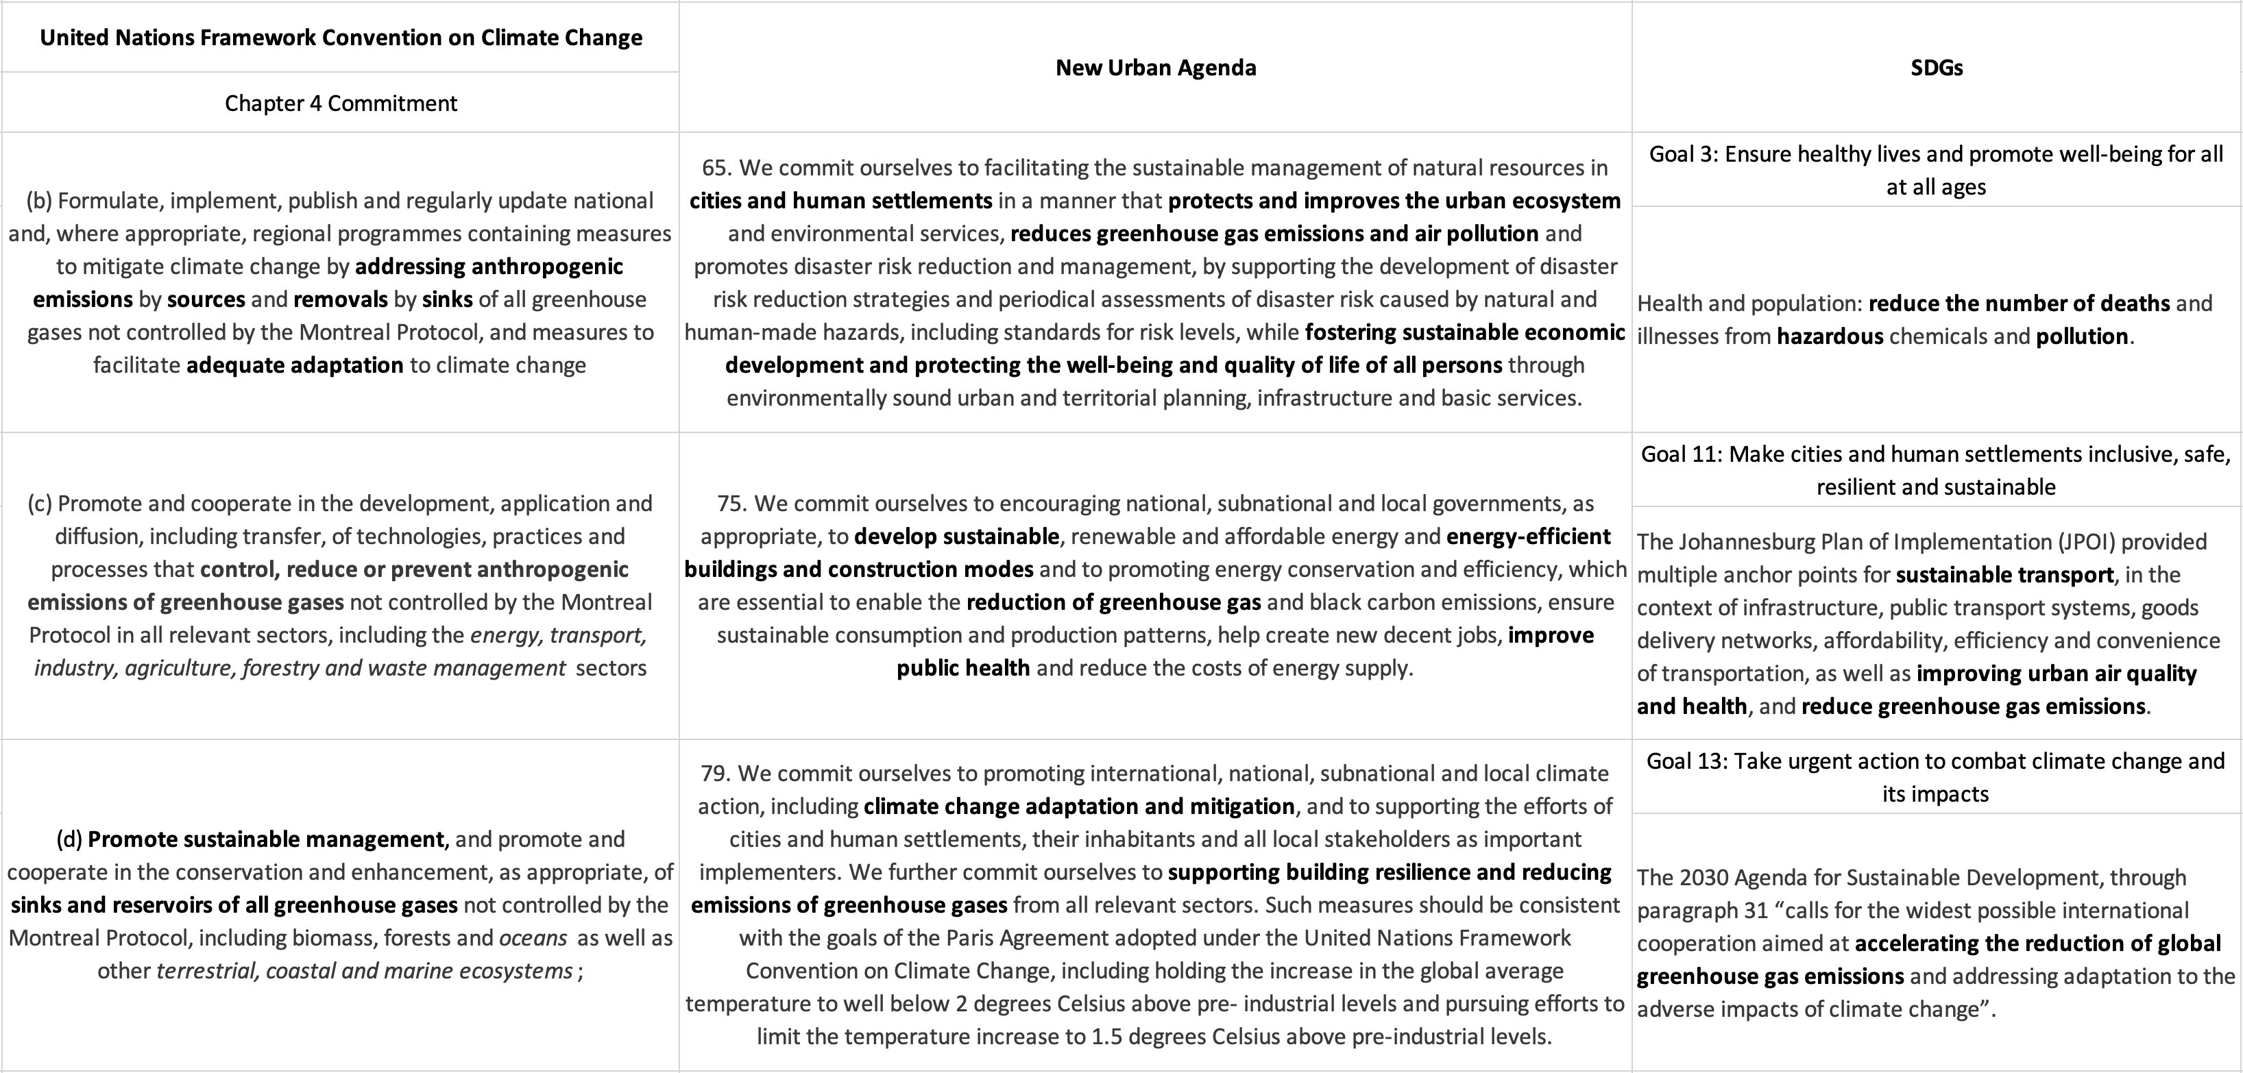
Policies: Global Agendas
Global Agendas Alignment: UNFCCC Article 4, New Urban Agenda (65, 75, 79), and SDGs (3, 11, 13).
Source: UNFCCC, The New Urban Agenda, SDGs

Slide 3
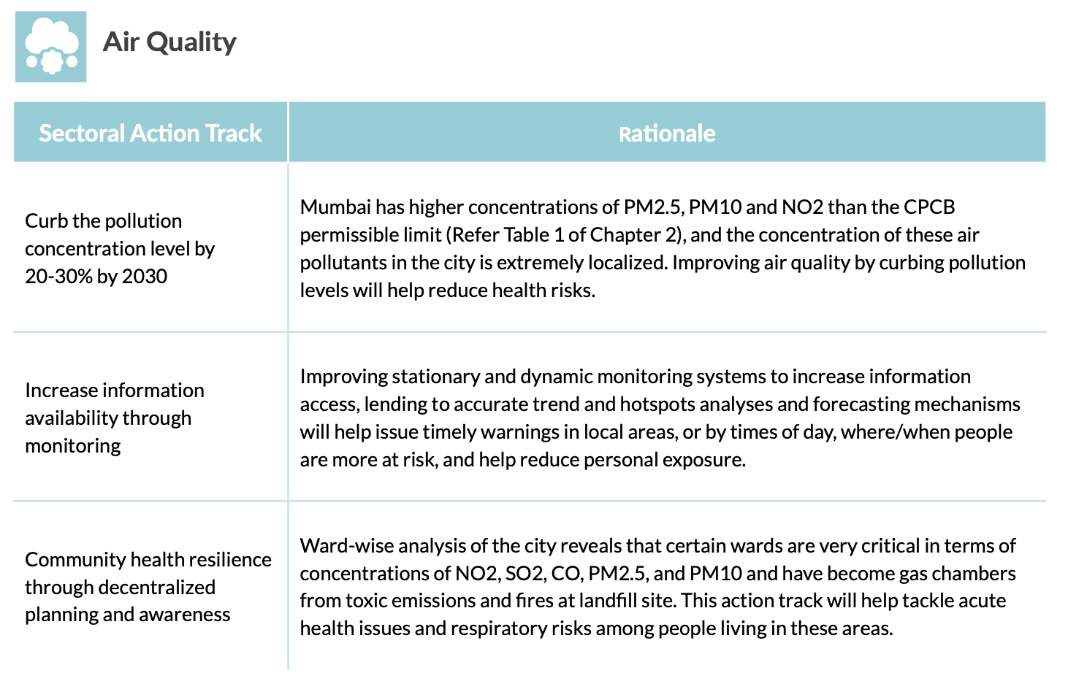
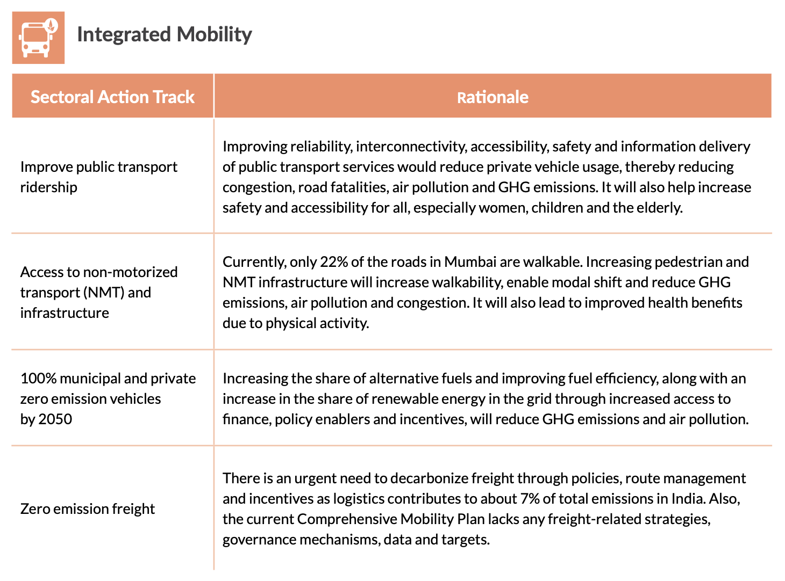
Policies: Local Actions
Location Actions Alignment: Mumbai Climate Action Plan 2022
Source: Mumbai Climate Action Plan 2022
Notes:
Health and Sustainability Focus: Highlight how current policies aim to protect health through sustainable transport and air quality management.

Slide 4
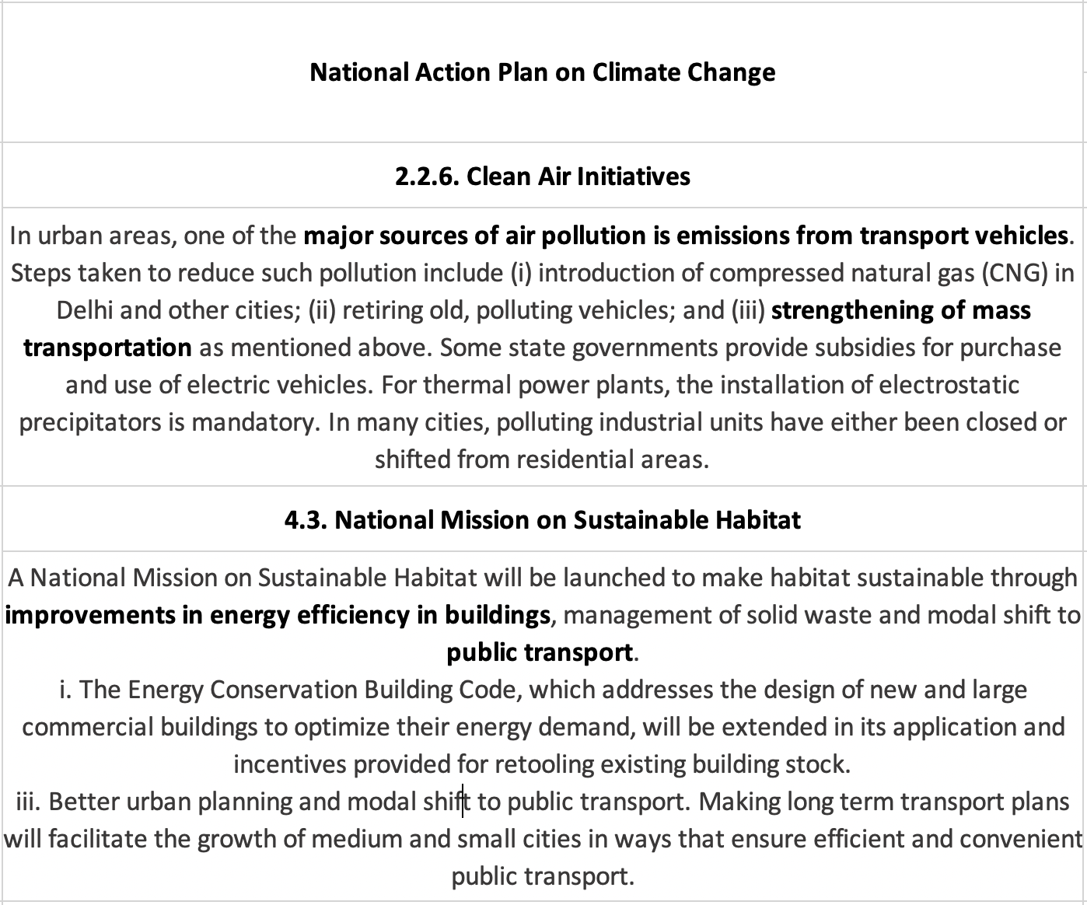
Policies: Local Actions
Location Actions Alignment: National Action Plan on Climate Change
Source: Government of India
Notes:
Health and Sustainability Focus: Highlight how current policies aim to protect health through sustainable transport and air quality management.

Slide 5
Goals
Enhancing Air Quality: Propose strategies for reducing air pollution to meet UNFCCC, New Urban Agenda, and SDGs mandates. Curb pollution levels by 20-30% by 2030.
Implement decentralized planning for community health resilience.
Integrated Mobility for Sustainable Development:
Improve public transport ridership.
Provide access to non-motorized transport.
Aim for 100% zero-emission vehicles by 2050.

Slide 6
Benefits to the City and Population
Health Benefits:
Reduced health risks by curbing air pollution levels.
Improved urban air quality leading to enhanced public health.
Economic and Social Advancements:
Sustainable transport systems contributing to job creation.
Decarbonizing freight to improve logistics and reduce emissions.
Long-term Sustainability:
Strengthening mass transportation aligns with energy efficiency initiatives and sustainable urban planning.
Ensuring a safer, more inclusive urban environment for all citizens.

