Slide 1
My Multi Purpose Connected Robot Midterm Demonstration November 3rd – 2016 Android Development

Slide 2
Bullet Points:
- What is MP-ConBot
- What does the original app do
- What is the proposed feature
- How far I am in implementing the new feature
- What is stopping me from completing the new feature

Slide 3
What is MP-ConBot?
- MP-Conbot is a UDP Client/Server system.
- Android App on the client side – Mobile Phone
- C# App on the server side – Console Application

Slide 4
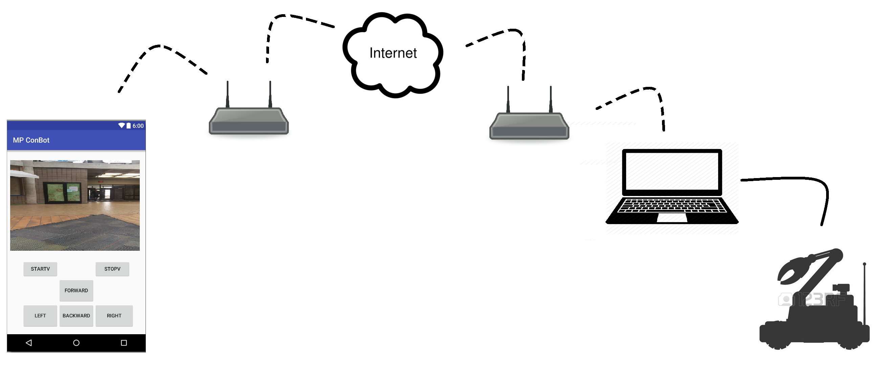
What does the Original App do?
- Provides the ability to control the mobility of the bot
- Provides the ability to establish a live video stream

Slide 5
What is the proposed feature?
- The ability to record what is being live streamed
- Start/Pause/Resume/Stop Recording
- The ability to list/show previous recorded videos
- The ability to play a selected video

Slide 6
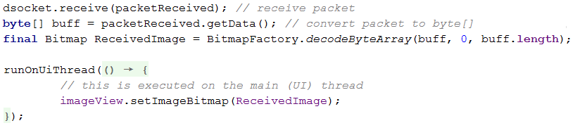
How to do it?
What originally is happening?
In Brief:

Slide 7
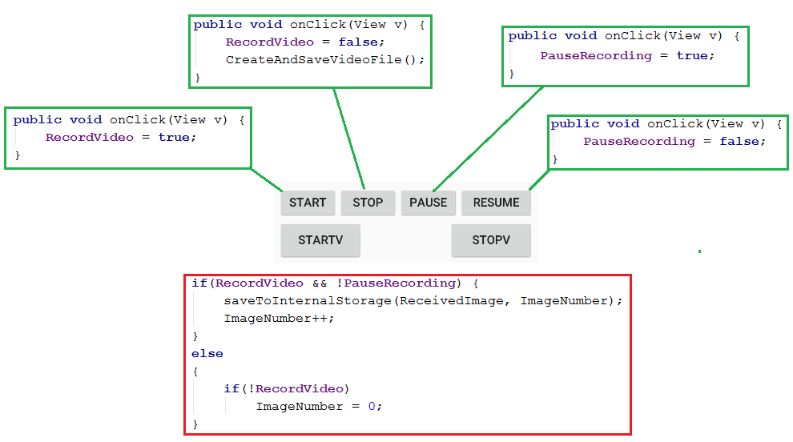
How to do it? (Continued)
What is a video? It is a population of images.
So I implemented a simple state machine to populate recorded images on user selection:

Slide 8
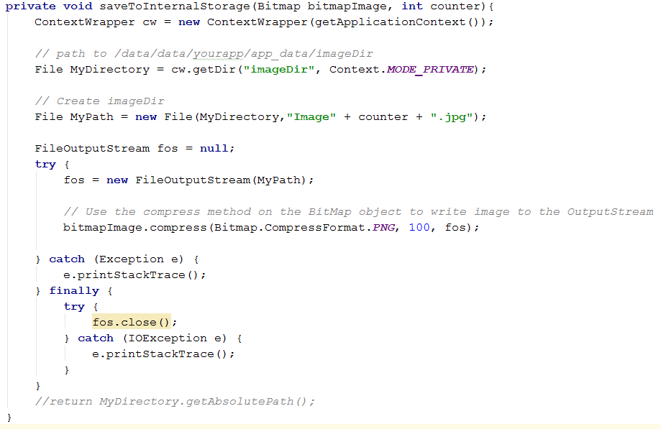
How to do it? (Continued)
SaveToInternalStorage() Function: http://stackoverflow.com/questions/17674634/saving-and-reading-bitmaps-images-from-internal-memory-in-android

Slide 9
How to do it? (Continued)
- I have the images series populated
- Could be an array of images but that is memory consuming
- Convert the population to a video file
- Using third party libraries:
FFMpeg: A complete, cross-platform solution to record, convert and stream audio and video. https://www.ffmpeg.org/
JCodec JCodec is an open source pure java implementation of video and audio codecs and formats. http://jcodec.org/
Drawable Animation Lets you load a series of Drawable resources one after another to create an animation. https://developer.android.com/guide/topics/graphics/drawable-animation.html

Slide 10

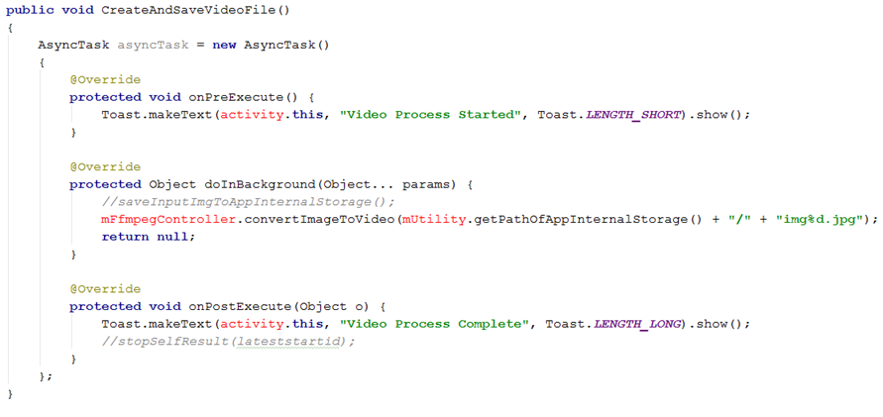
Trials:
Using FFmpeg:

Slide 11
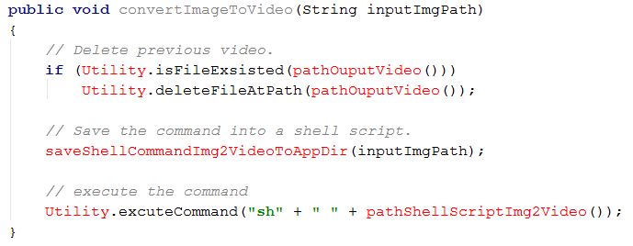
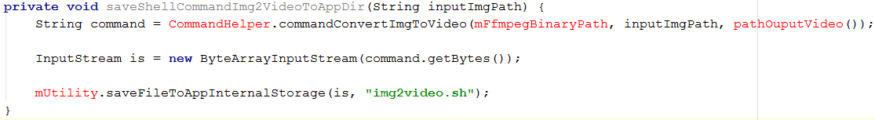
Trials: (Continued)
Using Ffmpeg:
Make one file FfmpegController.java:

Slide 12
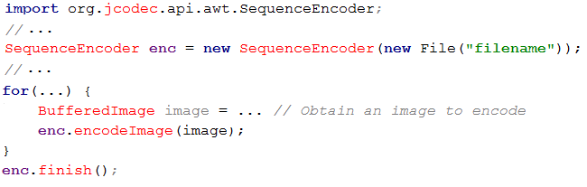
Trials: (Continued)
Using Jcodec:
- I could use the Class SequenceEncoder to convert a series of images to a MP4 Video:
More documentation here: http://stackoverflow.com/questions/10284708/android-make-animated-video-from-list-of-images

Slide 13
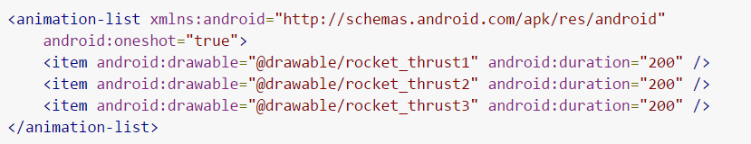
Trials: (Continued)
Using Drawable Animation:
.xml file:
Example

Slide 14
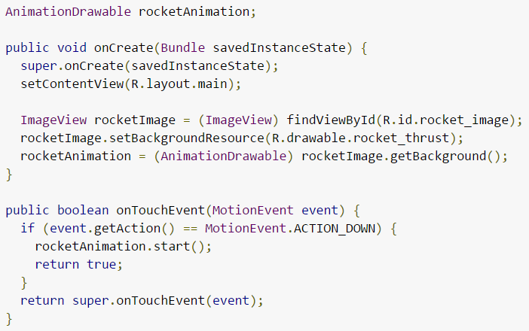
Trials: (Continued)
Using Drawable Animation:
Function:

Slide 15
New Approach and better strategy:
Last minute idea:
Why to do the whole thing on the Android side? Why not on the server side?
Fast and easy.
Design:
- Start Recording -> Send command to the server to start populating images
- Stop Recording -> Send command to create the video and send it back

Slide 16
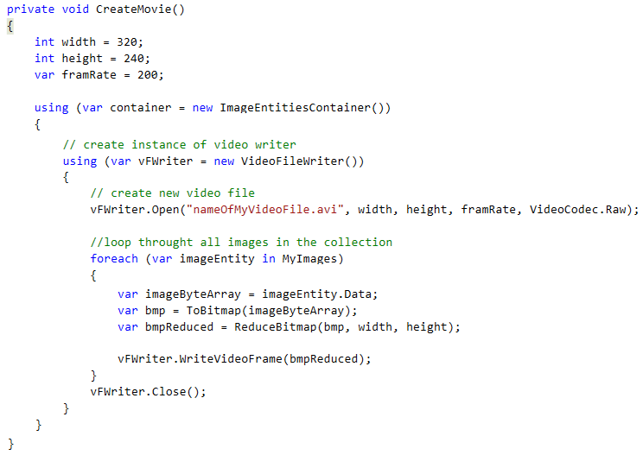
New Approach and better strategy:
- The main part of it comes from the open source
project AForge.Net which is a is a C# framework
for Image processing and other stuff:
http://www.aforgenet.com/
- It has VideoFileWriter class
(A class for writing video files
with help of FFmpeg).

Slide 17
New Approach and better strategy:
Send the whole file via UDP: ??????????????????????
I don’t know how, but I know that:
- I can convert the video to byte[]
- Break it to some ordered portions
- Iterate the series of packets and send each one by one
- Receive and re order the packets to one single byte[]
- Covert the byte[] to a video file
- Hurah!
It will as well be time consuming and there will be some packet lose and probably noise..

