Slide 1
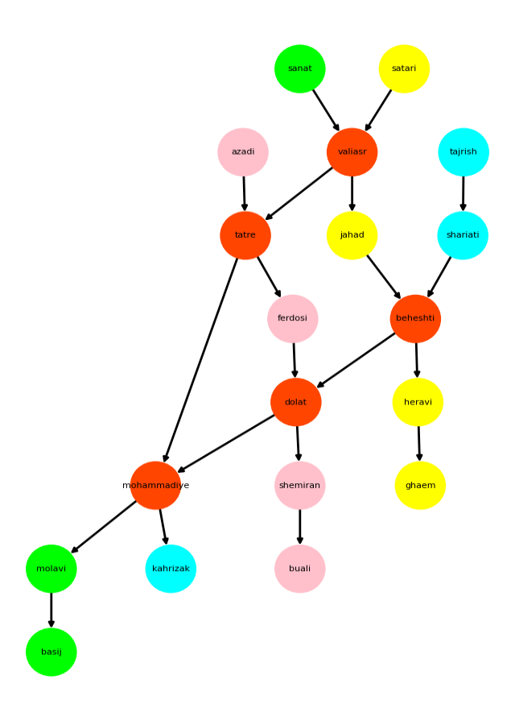

Slide 2











+
$$S_{t}$$
$$S_{t}$$
$$_mask$$
*
④
①
⑦
⑧
$$S_{t}$$
$$S_{t}$$
0,1,0,0,0,0,0,
-
$$S_{t}$$
@
0,0,0,.5,0,.5,0,
$$S_{t}$$
⑨
…
*
$$_mask$$
⑥
③
$$S_{t}$$
②
$$S_{t}$$
⑤
$$round(S_{t}+δ)$$

Slide 3
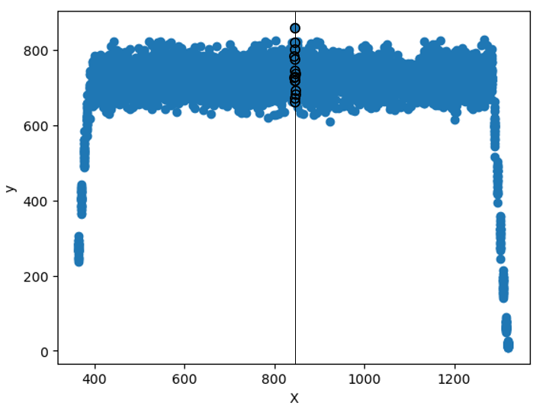
Data Distribution Per Time
6D GMM Parameter Space
3x2D Regressors in Extended Space

