Slide 1
IoT BASED CIVIL INFRASTUCTURAL MONITORING SYSTEM WITH MEMS SENSOR
KEERTHANA.K 412918106008 Under the guidance of Mr. S. HARI RAMAKRISHNAN M.Tech., AP/ECE

Slide 2
ABSTRACT
Monitoring of civil infrastructures is critically needed to track aging, damages and ultimately to prevent severe failures which can endanger many lives.
Long range wireless connectivity, cabling-free installation and multi-year lifetime are a unique combination of features, not available, to the best of our knowledge, in any commercial or research device.
ARDUINO MKR WAN 1300 is a powerful board that combines the functionality of the MKR Zero and LoRa connectivity.
By using 3 axis MEMS accelerometer, vibrator, weight sensor and power supply with LORAWAN which exploits the narrowband IoT protocol to establish long distance connection infrastructure network.

Slide 3
EXISTING SYSTEM
Nowadays, the ability to monitor the integrity of a wide variety of buildings with low-cost and real-time measurements is essential from both an economic and a life-safety standpoint.
In this work, we proposed a completely un tethered wireless sensor node specifically designed to support long-term model analysis with long-range connectivity at low power consumption.
The existing system has got the design of both hardware and software, of a SHM node that can operate unattended for more 10 years, or even indefinitely with the support of external power source.

Slide 4
PROPOSED SYSTEM
In this proposed system which provide a general overview of application especially in bridges, Several case studies in the literatures demonstrate that MEMS technology
Has the potential to offer significant benefits to the civil engineering and transportation fields.
A bridge monitoring is needed for public safety.
The proposed system can also give notification about of bridge and some concrete problems time to time which will help or maintenance.
IOT system with MEMS sensor technique is used to examine the lifetime, vibration of the bridge, strong, weakness and weight bearing capacity by using 3 axis MEMS accelerometer.

Slide 5
BLOCK DIAGRAM

Slide 6
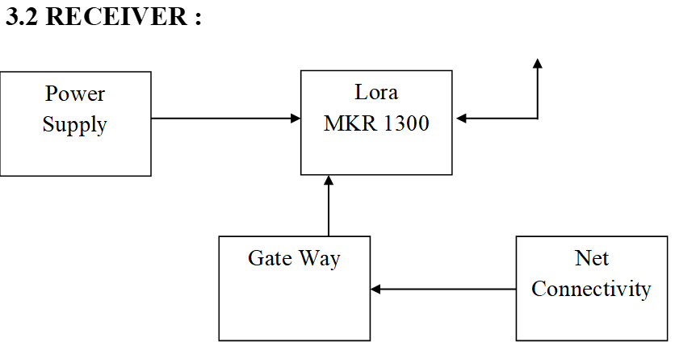

Slide 7
WORKING
The LoRa MKR 1300 gateway has many input channel the input has different functionality. The output can be transmitted over the transmitting antenna.
If the vibrator activates from the mechanical vibration into electrical signal. This electrical signal has process by means of LoRa MKR 1300 and perform the output function which is received by another gateway present in the receiver stage.
The resistance of material varies depends upon the application of weight, which displays the output from the receiver unit in the distance place.
Receiver consist of the same gateway which provide a proper synchronization. This lora covers the area up to 25km.
Another gateway of some LoRaWAN is used to additive the coverage area. The same LoRaWAN act as a repeaters which will cover the desirable range.

Slide 8
HARDWARE REQUIREMENTS
Microcontroller ESP 8266
LoRaWAN MKR1300
Vibration sensor
Accelerometer.
Weight load cell sensor
Transformer
Power supply
LCD Display

Slide 9
SOFTWARE REQUIREMENTS
Arduino IDE
Embedded C Language
Cloud (Ubidots)

Slide 10
APPLICATION
Home Auto machine
Data Acquisition system
Image processing
Audio processing
Vehicle tracking system

Slide 11
CONCLUSION
A bridge monitoring is needed for public safety.
The proposed system can also give notification about the bridge and some concrete problems time to time which will help or maintenance.
In future, similar system can be designed for building and railway monitoring IOT system with MEMS sensor technique is used to examine the lifetime, vibration of the bridge, strong, weakness and weight bearing capacity by using 3 axis MEMS accelerometer.
The system is tested and it results in the successful conclusion.

Slide 12
REFERENCES
[1]B. Romano, F. Zullo, L. Fiorini, A. Marucci, and S. Ciabo, “Land ` transformation of italy due to half a century of urbanization,” Land use policy, vol. 67, pp. 387–400, 2017.
[2] G. M. Calvi, M. Moratti, G. J. O’Reilly, N. Scattarreggia, R. Monteiro, D. Malomo, P. M. Calvi, and R. Pinho, “Once upon a time in italy: The tale of the morandi bridge,” Structural Engineering International, vol. 29, no. 2, pp. 198–217, 2019.
[3] C. A. Tokognon, B. Gao, G. Y. Tian, and Y. Yan, “Structural health monitoring framework based on internet of things: A survey,” IEEE Internet of Things Journal, vol. 4, no. 3, pp. 619–635, 2017
[4] F. Zonzini, A. Girolami, L. De Marchi, A. Marzani, and D. Brunelli, “Cluster-based vibration analysis of structures with gsp,” IEEE Transactions on Industrial Electronics, vol. 68, no. 4, pp. 3465–3474, 2021.
[5] M. R. Dhage and S. Vemuru, “Structural health monitoring of railway tracks using wsn,” in 2017 International Conference on Computing, Communication, Control and Automation (ICCUBEA). IEEE, 2017, pp. 1–5.

Slide 13
THANK YOU

