Slide 1
ANALOGY CIRCUIT AUDIT
The shared circuit survives a stricter recurrence test
Corrected feature overlap and a BIC-selected three-phase model
J-Lawrence10 | July 2026
Notes:
We reproduced the original five analogy attribution graphs and asked two questions: which features genuinely recur across prompts, and whether their layer-wise organization supports a three-phase description.

Slide 2
We reproduced the graphs, then corrected the comparison
1
2
3
Reproduce
Count correctly
Select phases
Same five prompts
Same Gemma 2 2B model
Same pruning parameters
Published graph sizes matched
Identity = layer + SAE index
Collect unique graph IDs
Repeated token positions remain one cross-prompt vote
Four layer-wise graph metrics
Exact 1–5 segment fits
BIC complexity penalty
1,000 bootstrap reruns
Source: regenerated Neuronpedia attribution graphs and audit scripts
2
Notes:
The regenerated graphs use the published model, prompts, and pruning parameters, and their node and edge counts match the published summaries. The correction happens downstream. We count how many distinct graphs contain each SAE feature. Repeated activations at several token positions within one graph remain multiple contexts, but they contribute only one vote toward cross-prompt recurrence.

Slide 3
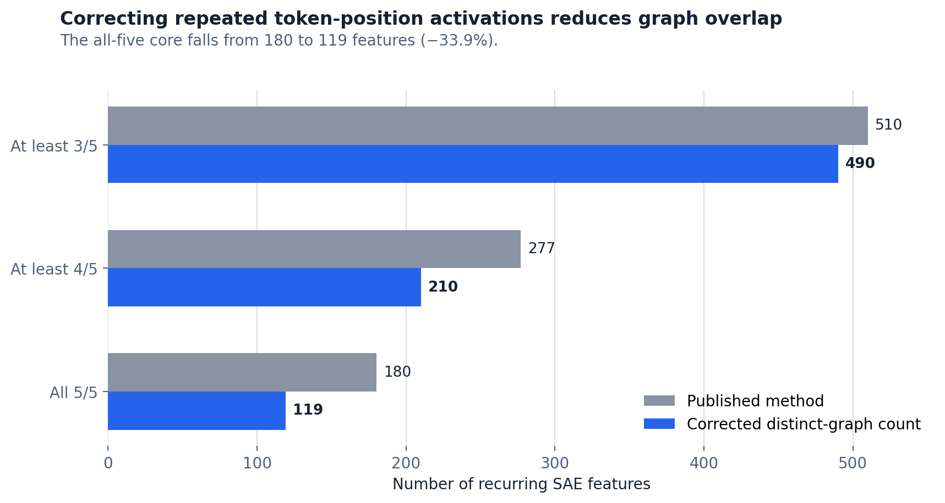
All five headline manuscript features survive
Source: summary.json; corrected distinct-graph feature membership
3
Notes:
The all-five core falls from 180 to 119 features, a 33.9 percent reduction. The at-least-four-of-five result falls from 277 to 210. Importantly, all five headline manuscript features genuinely survive in all five graphs. This preserves the interesting shared signal while giving it a more accurate size.

Slide 4
BIC selects three phases among the segmented models
BIC
−1.9
1 phase
—
Bayesian Information Criterion
2 phases
L10
−53.8
3 phases
L7, L15
−74.4
Measures model fit
+
penalizes extra parameters
4 phases
L3, L7, L15
−70.4
5 phases
L7, L14, L18, L22
−68.3
Lower is better
BIC values from objective layer segmentation; lower is better
4
Notes:
BIC is the Bayesian Information Criterion. It rewards a model for fitting the data and penalizes it for adding unnecessary complexity; lower is better. Among the one- through five-phase models, three phases have the lowest BIC, minus 74.4. Four and five phases improve some fit measures, but not enough to justify their extra boundaries and parameters.

Slide 5
The selected boundaries define three numeric regimes
PHASE 1
PHASE 2
PHASE 3
L0–L6
L7–L14
L15–L25
Broad representation
Selective transformation
Output consolidation
Most unique features
Broadest context coverage
Lower median activation
Fewer, more selective features
Highest median influence
Intermediate activation
Sparse feature population
Highest median activation
Lower average influence
Working functional descriptions; blinded semantic annotation is the next validation step.
5
Notes:
The data-selected phases begin at layers 7 and 15. Phase 1, layers 0 through 6, has many broadly recurring features and lower activation. Phase 2, layers 7 through 14, is sparser and has the highest average influence. Phase 3, layers 15 through 25, is sparse and has the highest median activation. We can use broad representation, selective transformation, and output consolidation as working descriptions, but the semantic names remain provisional.

Slide 6
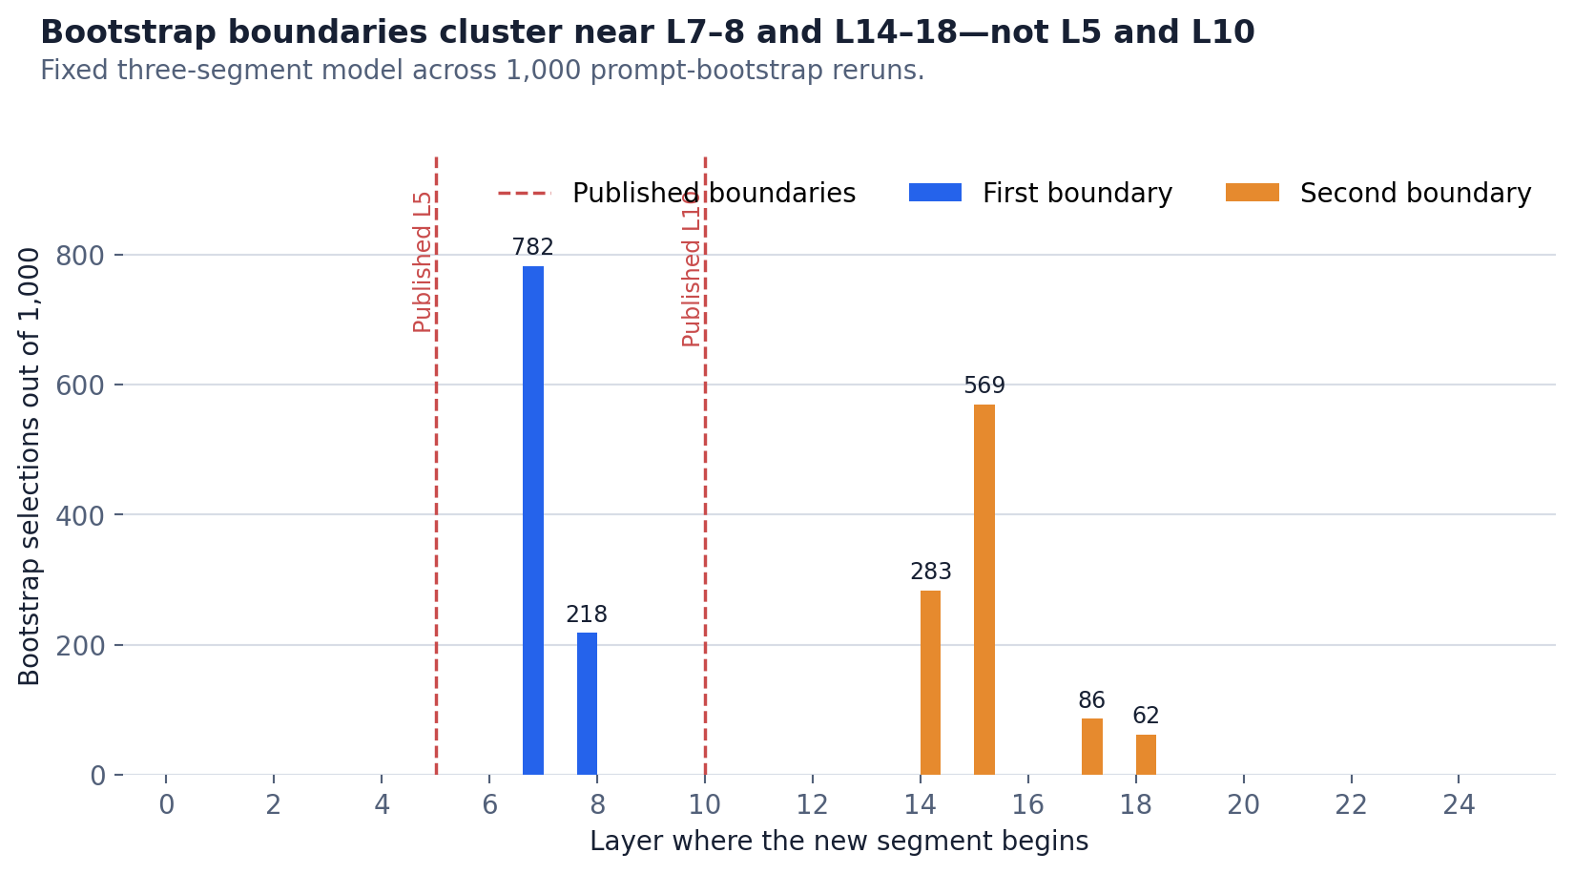
Source: 1,000 prompt-bootstrap reruns of the fixed three-segment model
6
Notes:
Across 1,000 prompt-bootstrap reruns, the first boundary lies at L7 in 782 runs and L8 in 218. The second boundary is most often L15, with uncertainty from L14 to L18. The result supports a three-part summary, while also showing that the later transition is less precisely located.

Slide 7
SUPPORTED CONCLUSION
The signal survives the correction
119 shared all-five features
All 5 headline features retained
3 phases selected by BIC
NEXT VALIDATION STEPS
Expand held-out prompts • Blind semantic annotation • Matched causal interventions
Current result: a defensible three-regime summary; causal hierarchy remains to be tested.
7
Notes:
We reproduced the original graphs, corrected the recurrence calculation, and retained a substantial shared circuit. BIC selects a three-phase organization: an early broad feature regime, a middle high-influence regime, and a late high-activation regime. The next step is to validate the boundaries on more prompts, blind the semantic annotation, and test each phase with matched causal controls.

