Slide 1
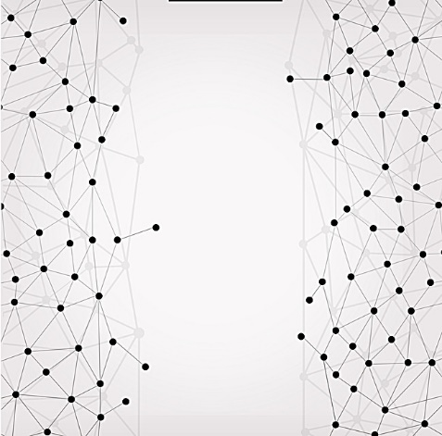
Building an Interpretable NLP model to classify tweets
Kasia Kulma & Grace Meyer

Slide 2
Prerequisites
Download the data from Kaggle
https://www.kaggle.com/benhamner/clinton-trump-tweets/data#
Have R & RStudio installed (of course!)
Packages:
Quanteda
Tidyverse (dplyr, ggplot)
Caret
LIME
Notes:
UPDATE

Slide 3


Introductions
Kasia uses NLP and customer focused ML to personalise the insurance market at Aviva
Grace is exploring the use of R & ML in economics at Oxera Consulting
Notes:
Let’s get a photo of us together!
KASIA TO UPDATE

Slide 4
Why are we here today?
More data is textual
We want to be able to get closer to people’s actual thoughts
There is now an analysis framework for text analysis and new packages that make it more simple
We want to show off how cool LIME is

Slide 5
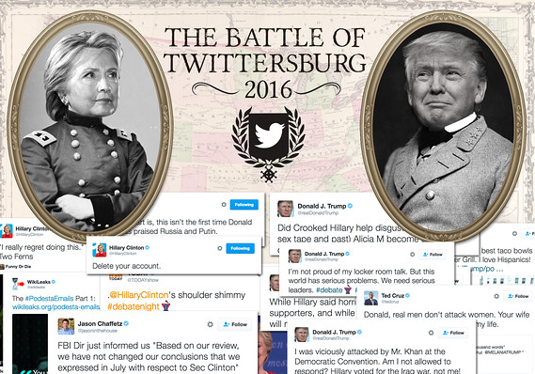

Slide 6
Agenda
Look at our data
Introduce Text data formats
Format and explore our data
Create a classification model for the tweets
Introduce LIME
Interpret our models with LIME
Summary & Learnings

Slide 7
Our Text Data
Our data is ~3,000 tweets by Hilary Clinton and Donald Trump from over 2016 (during the run up to the election)
Includes other meta-data such as date, time and whether it was a retweet or not
Stored in a .csv file
Notes:
Data description, what is it, where does it come from
Data structure
How to download

Slide 8
Read in data and first look
Notes:
Head, str, summary, missmap, some tables

Slide 9

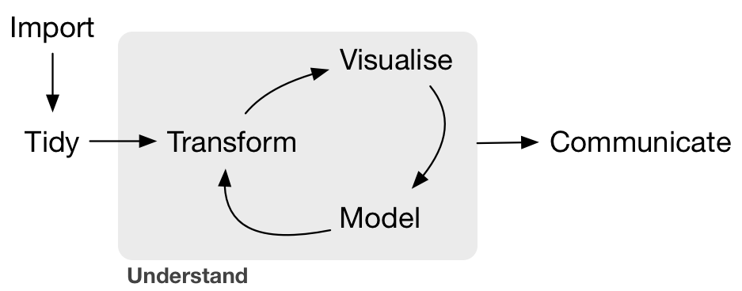

Slide 10


Slide 11
What is a corpus?
A collection of text data is called a corpus
The corpus structure contains multiple text data (documents) and metadata
Often how data is extracted (some R packages contains data in corpus format)
Notes:
We don’t really have a corpus as our text is in csv format and if we wanted to
In quanteda summary(corpus) also has the number of tokens and sentences but not the tokens themselves

Slide 12
What is tokenising?
The main features of text data are tokens
Breaks down each document into words and punctuation
Text: “This is my TWEET!”
Tokens: This is my TWEET !
Notes:
These are our features
Good resources
Tokenisation: https://nlp.stanford.edu/IR-book/html/htmledition/tokenization-1.html

Slide 13
What is a dfm?
Document Feature Matrix
A frequency table for each token per document
This is the stage where we can start analysis
this | is | my | tweet | !
1 | 1 | 1 | 1 | 1
Notes:
This is in quanteda, in the tm package it is called term-document matric (tdm)

Slide 14
What is a sparse matrix?
Most dfms are extremely sparse as each column is every word in the corpus and each row is a document
Sparse matrices can be treated as a normal matrix but are stored in a much more efficient way

Slide 15
What is the tidy text format?
Stores the data in a dataframe with tidy data principles
Reduces storage
Doc | word | count
1 | this | 1
1 | Is | 1
1 | my | 1
1 | tweet | 1
1 | ! | 1
2 | my | 1
2 | tweet | 1
2 | happy | 1
Doc | this | is | my | tweet | ! | happy
1 | 1 | 1 | 1 | 1 | 1 | 0
2 | 0 | 0 | 1 | 1 | 0 | 1

Slide 16
How should I clean my data?
You can choose from many different options:
Make all letters lower case
Truncate words to the root of the word (stem)
Remove small repetitive words (to)
Remove punctuation
Remove urls
Remove repetitive words that don’t make sense

Slide 17
What packages are available for text?
tidytext
tm
quanteda

Slide 18
Format our data More exploration
Notes:
Create the corpus, create the dfm and make word clouds

Slide 20
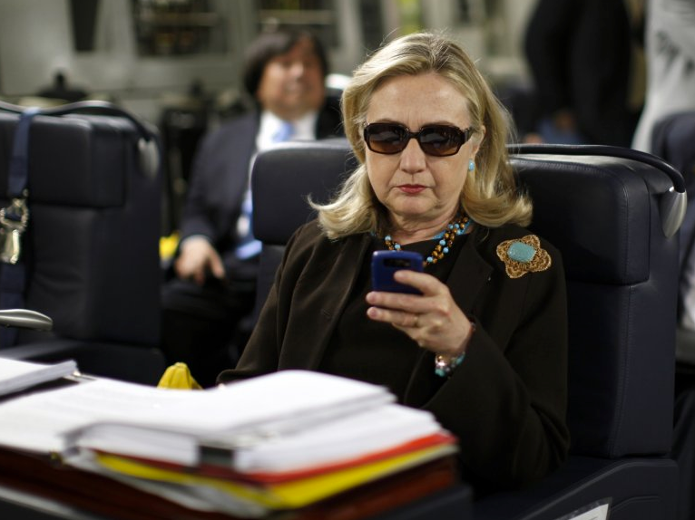

Slide 21
Build a classification model
We are going to use glmnet in the workshop
Would normally use CARET or H20ML for flexibility
Normal data science workflow
Split train/test
Feature engineering
Fit models
Predict & evaluate
Notes:
Boosted Forest- already done in Kasia’s blog
Native Bayes- https://datascienceplus.com/text-message-classification/
SVM
KNN- easy
https://www.quora.com/What-are-popular-text-classification-algorithms-in-commercial-use-and-how-are-they-used

Slide 22
Split train/test Feature engineering Fit models, predict & evaluate

Slide 24


Slide 25
What is my model doing?
One of the big downfalls of machine learning models is how “black box” they are due to their structures of averaging many models or having multiple feature creation layers.
This raises questions such as:
What is driving this model?
What insights can I gain?
How reliable are the results?
What might happen if the inputs change?
It would be amazing to be able to explain the why of our models and results

Slide 26
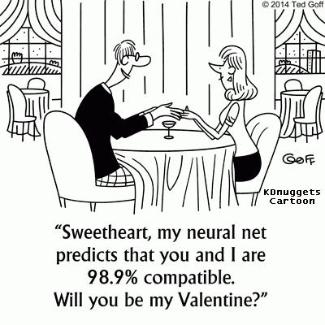

Slide 27
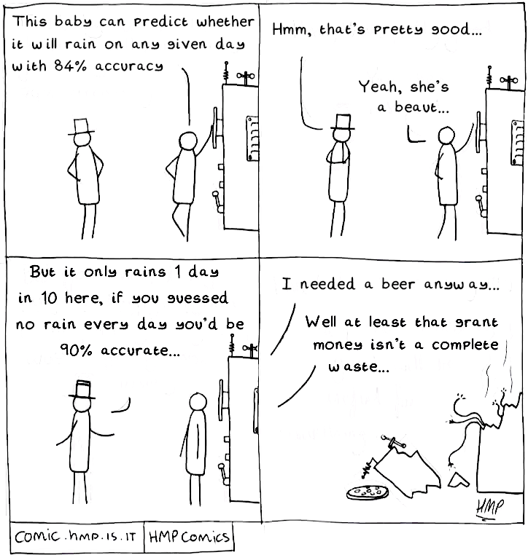

Slide 28
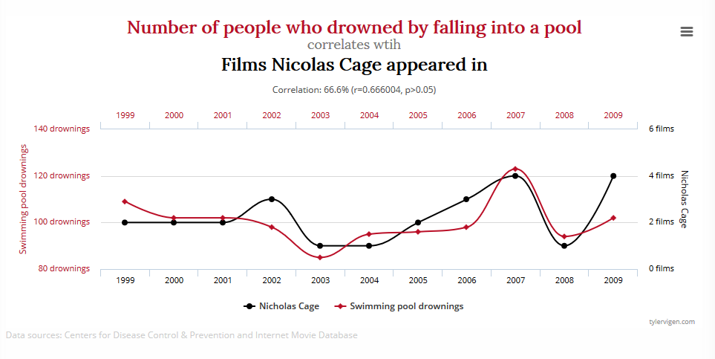

Slide 29
It’s all about trust
Should I trust the results of this prediction and take action?
Cancer diagnosis, movie recommendations
Will the results give me my desired effect?
High propensity for users to read “click-bait” type ads, but will that actually be detrimental to long term goals?
Will my model work “in the wild”?
Which model should I choose?

Slide 30
What is LIME?
Local – describes drivers for local areas, not globally
Interpretable – results are understandable to normal people
Model-agnostic – works on all models, treated as black-box
Explanations – shows the drivers of the model predictions
Can be used on text, images and numerical data

Slide 31
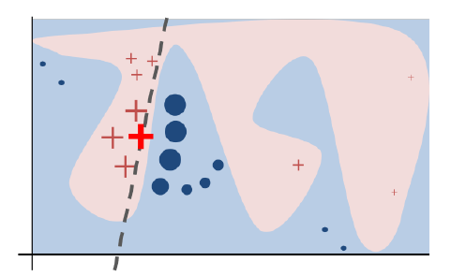

Slide 32
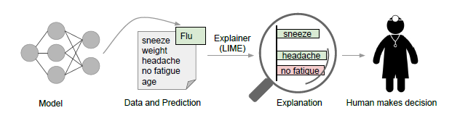

Slide 33
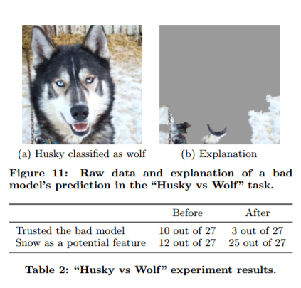

Slide 34
Evaluate models with LIME

Slide 36


Slide 37
What did we find out?
During the election cycle they used each other’s names a lot
Clinton uses the words president and candidate more
Trump uses words like “to” to call to action
A question is would this be a good model for today’s tweets as they probably don’t talk about each other as much?
Notes:
UPDATE

Slide 39
What have we done today?
Talked about how to tidy and store text data
Converted text data into different formats
Created additional features
Trained a classification model and predicted results
Introduced LIME and explained our predictions
Summarised our results

Slide 40
Learnings
More about 2016 election tweets
R packages make text analysis straightforward
We can use LIME to test whether we can trust our models
Converting text data into different formats allows us to run machine learning models
Reinforced data science is all about testing results against common sense

Slide 41
Additional References
Text Mining in R
https://www.tidytextmining.com/
Quanteda Documentation
https://docs.quanteda.io/
LIME Documentation
https://cran.r-project.org/web/packages/lime/vignettes/Understanding_lime.html
R-tactic
https://kkulma.github.io/2018-01-26-Trump-VS-Clinton-Interpretable-Text-Classifier/
Github
https://github.com/KKulma/eRum_2018_prep
Biased data
https://www.slideshare.net/ChaToX/detecting-algorithmic-bias-keynote-at-dir-2016

