Slide 1
Year 2 Short Semester Design & Build Project Summer 2025
Autonomous Mobile Robot for Maze Mapping and Navigation with 2D LiDAR
Jonathan Loo and Qihui Ye
June 2025

Slide 2
Design & Build 2025: Learning Outcome
Demonstrate an understanding of the engineering design lifecycle and the interdependencies within a multidisciplinary project
Apply core engineering principles and structured problem-solving methods in real-world engineering scenarios
Design and conduct experiments or simulations to validate system performance and iterate solutions
Exhibit initiative, creativity, and innovation in developing engineering solutions
Translate theoretical knowledge into a functional design and working prototype
The D&B project contributes to part of your engineering environment marks.

Slide 3
Design & Build 2025: General Information
Group Compositions:
Each group consist of approx. 10-12 students, combining talents from Telecom, EIE, IoT and IST.
Each group functions as a mini engineering company with the following team specialism:
Hardware Team (Telecom + EIE)
Software Team (IoT + IST)
Project Resources:
Access to hardware components, coding libraries and references. (see detail)
Project Assessment:
Project assessment is based on the project completion level and quality. (see detail)
Competition:
All project groups are eligible to participate in a fair competition. (see detail)
Top three groups will receive an award/recognition.

Slide 4
Design & Build 2025: Project Overview
Topic:
Autonomous Mobile Robot for Maze Mapping and Navigation with 2D LiDAR
Key objectives:
Design and build of an autonomous mobile robot equipped with a 2D LiDAR system, capable of performing real-time environment mapping and navigation within a maze.
Able to explore an unknown maze environment autonomously, locate the exit point, and then return to its original starting position without human intervention.
Figure 1. Example Maze with Starting Position and Exit Point

Slide 5
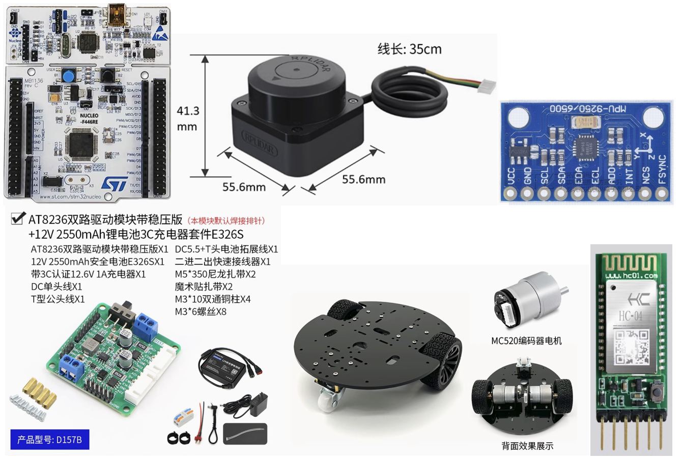
Design & Build 2025: Project Overview
Hardware components:
STM32F446RE MCU + Arduino Framework
AT8236 Motor Driver
520 Geared Encoder DC Motor
SLAMTEC RPLIDAR C1 (2D LiDAR)
MPU6500 IMU
HC-04 Bluetooth Module (SPP/BLE)
The project will be achieved by the integration of the hardware components, firmware, and host software computation.
Figure 2. Hardware Components

Slide 6




Design & Build 2025: Project Overview
AT8236
Motor Driver
Firmware
PWM
Software
Bluetooth
Control motor with PID to navigate robot to a Target position (x,y,$θ)$
RX
Target Position (x,y,$θ)$
TX
Autonomous navigation for map construction and locate the Exit Point
UART: 2D Lidar
(distance and angle)
Motor Encoder
RPLIDAR C1
Motor Encoder &
IMU Data
Compute Odometry and Position estimate of the robot’s Current position (x,y,$θ)$
Path Planning for navigation from Exit Point back to Starting Point
MPU6500
IMU
Sensor data acquisition
I2C/SPI:
IMU Data
Current position (x,y,θ)
2D map
2D Lidar
(distance and angle)
Current Position (x,y,$θ)$ and 2D Lidar (distance and angle)
TX
RX
SLAM Map construction and visualisation
MCU
PC
Figure 3. Overview of the firmware and software architecture

Slide 7
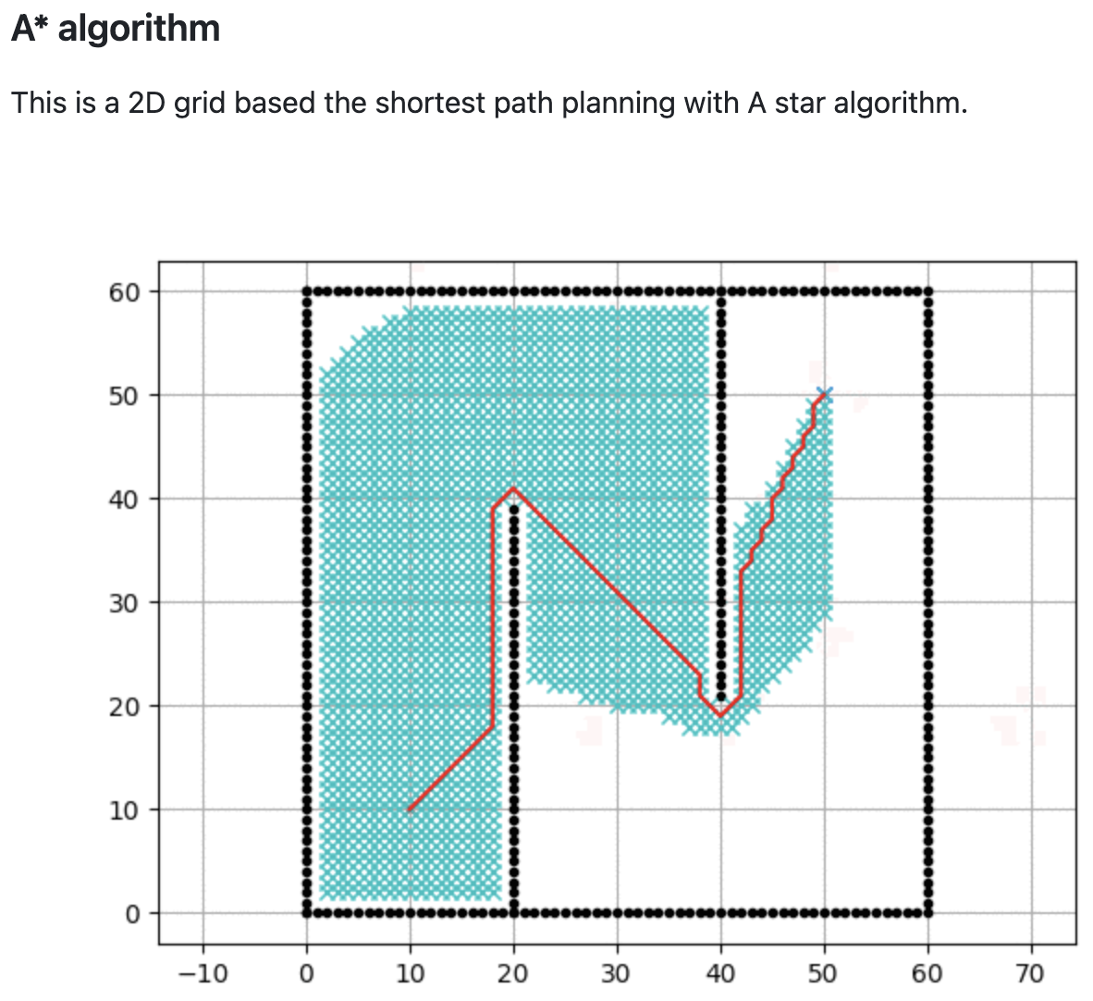
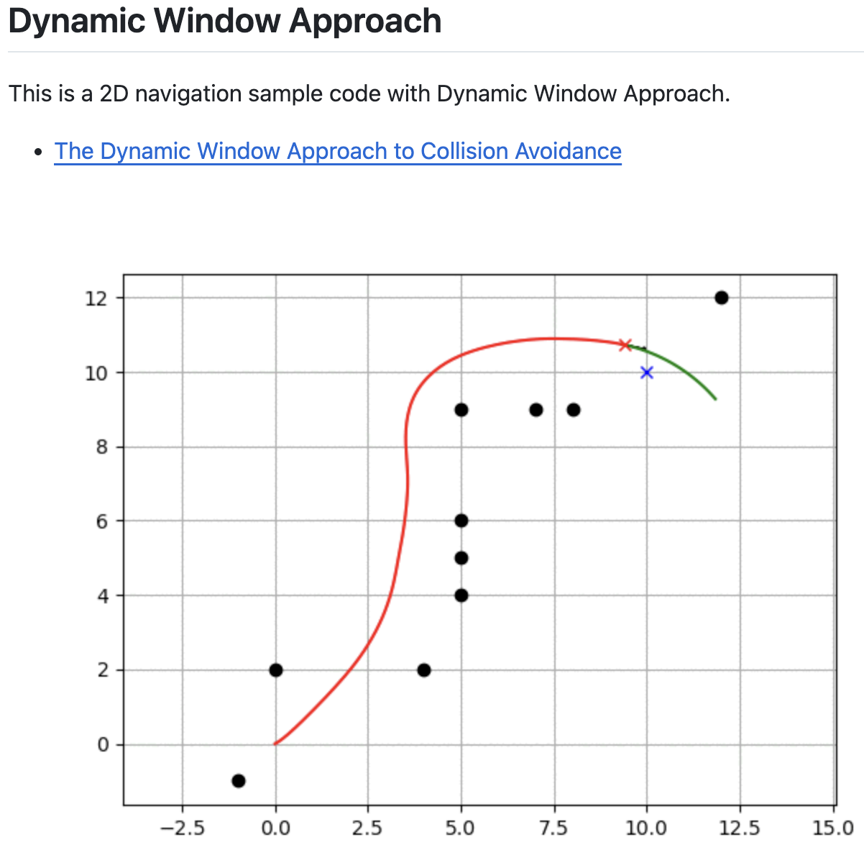
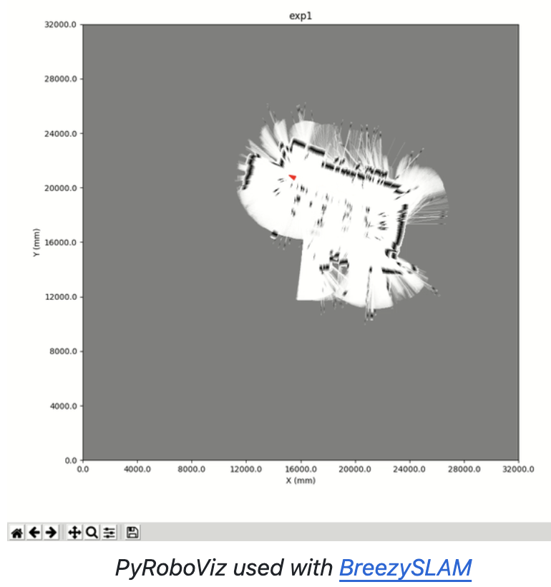
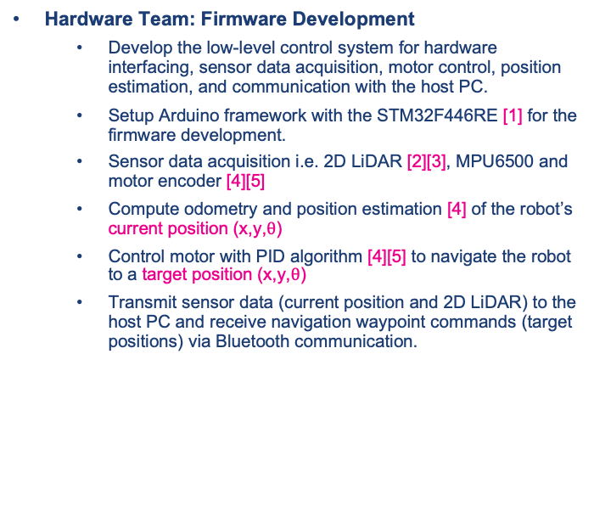
Design & Build 2025: Project Overview
Hardware Team: Firmware Development
Develop the low-level control system for hardware interfacing, sensor data acquisition, motor control, position estimation, and communication with the host PC.
Setup Arduino framework with the STM32F446RE [1] for the firmware development.
Sensor data acquisition i.e. 2D LiDAR [2][3], MPU6500 and motor encoder [4][5]
Compute odometry and position estimation [4] of the robot’s current position (x,y,$θ$)
Control motor with PID algorithm [4][5] to navigate the robot to a target position (x,y,$θ$)
Transmit sensor data (current position and 2D LiDAR) to the host PC and receive navigation waypoint commands (target positions) via Bluetooth communication.
Software Team: Host PC Software Development
Develop the high-level control system for the robot using Python includes computing navigation waypoint (target positions) for autonomous exploration, SLAM map construction, and path planning between two points.
Setup BreezySLAM [6] and PyRoboViz [7] to explore SLAM mapping and localization in a simulated environment, and use this framework to support the software development.
Autonomous navigation, e.g. frontier detection, for mapping an unknown maze and locate the Exit point. This will generate a series of target positions (x,y,θ) to be executed by the firmware.
SLAM map construction and visualisation using data received from the firmware, specifically the current position (x,y,θ) and 2D LiDAR scans.
Path planning algorithm e.g., A*, Dynamic Window Approach (DWA), for navigation from the Exit point back to the Starting position, using references and algorithms from PythonRobotics [8].
References:
[1] https://github.com/stm32duino/Arduino_Core_STM32/wiki/Getting-Started
[2] https://github.com/Slamtec/rplidar_sdk
[3] https://github.com/DanielKalicki/RPLidar_Arduino/tree/main
[4] https://github.com/farooqueesamiya/Odometry-and-Position-Estimation-for-Mobile-Robot
[5] https://youtu.be/dTGITLnYAY0?si=K3ijiWW-yeb7LXuf
[6] https://github.com/simondlevy/BreezySLAM
[7] https://github.com/simondlevy/PyRoboViz
[8] https://github.com/AtsushiSakai/PythonRobotics

Slide 8
Design & Build 2025: Development Methodology
Phase 1: Training
Students will be trained on their respective skills (hardware and software) separately, guided by experienced instructors.
During this phase, the Hardware and Software teams of each group, initiate communication and begin to conceive the overall system, including the logic of autonomous robot behaviour, expected data exchange between firmware and host PC software, and project specifications. This collaborative process results in a shared development plan that sets the foundation for implementation.
Phase 2: Project Development
With the system concept clearly established, both Hardware and Software teams proceed to design and develop their respective components in parallel:
The Hardware team works with target positions (x,y,θ) manually sent via Bluetooth from a PC. The firmware controls the motors to reach the target, while acquiring sensor data, computing odometry and position estimates, and transmitting the current position and 2D LiDAR data to the host PC.
The Software team uses a simulation environment and open-source Python libraries to develop and test autonomous navigation. This includes simulating 2D LiDAR and odometry, applying SLAM for map construction, visualising the robot’s pose and trajectory, and implementing path planning between two points based on the generated map.
Maintain ongoing collaboration and communication to ensure successful integration of both hardware and software components.

Slide 9
Design & Build 2025: Development Methodology
Phase 3: System Integration and Evaluation
This is the final development phase, which involves integrating the firmware and software to test, evaluate, and validate the complete robot system.
The robot should autonomously explore an unknown maze, identify the Exit Point, and return to its Starting Position.
Based on testing outcomes, further refine and enhance both hardware and software.
Add new features and innovative solutions to advance the project.
Phase 4: Project Assessment and Competition
Project assessment is based on both the level of completion namely Basic, Intermediate, and Advanced, and the quality of work within each completed level and other deliverables namely video, documentation and presentation.
Groups that achieve Intermediate-level and Advanced-level completion will be eligible to participate in the competition.
The combined scores from the project assessment and the competition will determine the top three groups, who will receive awards/recognition.

Slide 10
Design & Build 2025: Deliverables
Promotion Video (Maximum 60 seconds)
Showcasing the capability of your robot at the achieved level of completion.
Project Report (PDF, Maximum 10 pages) and Codes in Zip
Covering the design and development of the firmware and the software.
Complete codes: Firmware (Arduino) and Software (Python)
Presentation and Live demo (Maximum 10 mins)
Present the key achievements and innovation
Important dates to be announced

Slide 11
Design & Build 2025: Level of Completion
Basic Level Completion – Fundamental Integration and Autonomous Operation
The robot successfully completes low-level control using PID for motion toward given target positions.
Firmware reliably computes odometry and current position (x,y,θ) and transmits 2D LiDAR and position data to the host PC via Bluetooth.
The system responds to navigation waypoint commands from the host PC.
Host PC software visualises robot movement and LIDAR data in real-time using PyRoboViz.
A simple autonomous navigation behaviour with dynamic obstacle avoidance is demonstrated.
SLAM or mapping is not included at this level.
Intermediate Level Completion – Autonomous Exploration and Mapping
All Basic Level functionalities are complete and fully integrated.
The robot autonomously explores unknown environments using improved navigation logic (e.g., frontier-based exploration).
A dynamic SLAM map construction of the environment using BleezySLAM.
The host PC visualises both the evolving SLAM constructed map and real-time robot trajectory using PyRoboViz.
The software detects and marks the Exit Point within the map as part of its autonomous behaviour.
Advanced Level Completion – Return Navigation and Mission Completion
All Intermediate Level functionalities are successfully implemented and stable.
The robot plans and navigates a path from the Exit Point back to the Starting Position using a path planning algorithm (e.g., A*, DWA).
The system maintains localisation, avoids obstacles, and executes the return path autonomously.
Advanced features are added, such as a user interface, real-time parameter tuning, or extended capabilities (e.g., adaptive behaviour, performance analysis).

Slide 12
Design & Build 2025: Scoring System
Project Assessment (80 points)
Competition (20 points)
Combined Score = Project Score (out of 80) + Competition Score (out of 20)
The top 3 highest-scoring groups will be recognised for their excellence in engineering design, implementation quality, and system performance.
Criteria | Weight | Max Points | Description
Level of Completion | 80% | 64 | Based on how fully the system works: Basic (max 60), Intermediate (max 64), Advanced (max 64)
Quality of Work | 20% | 16 | Assessed on innovation, system robustness, evaluation, documentation.
Event | Max Points | Scoring Method
Fastest time to Exit Point | 10 | 1st = 10 pts, 2nd = 8, 3rd = 6, others = 4, incomplete = 0
Fastest time back to Starting Point | 10 | 1st = 10 pts, 2nd = 8, 3rd = 6, others = 4, incomplete = 0
Note: Groups that achieved Intermediate-level completion qualifies for one event; Advanced-level qualifies for both.

Slide 13
Design & Build 2025: Module Mark
Design & Build project (50%)
BUPT Lab (50%)

Slide 14
Happy designing and building.
Wishing you all an adventurous summer!

