Slide 1

CentRes
A restaurant Centralization software

Slide 2

Meet the Team
Mentor: Susan Rizzo Project Manager: Katherine Landsman Team Members Carson Pribble Chase Jamison David Utshudiema Mohamed Ibensilalen Sergio Mainville

Slide 3

Team Collaboration and project Management
Team Collaboration
GitHub
GitHub Projects
Microsoft teams
Project Management Plan
Agile Principles
Scum Methodology

Slide 4
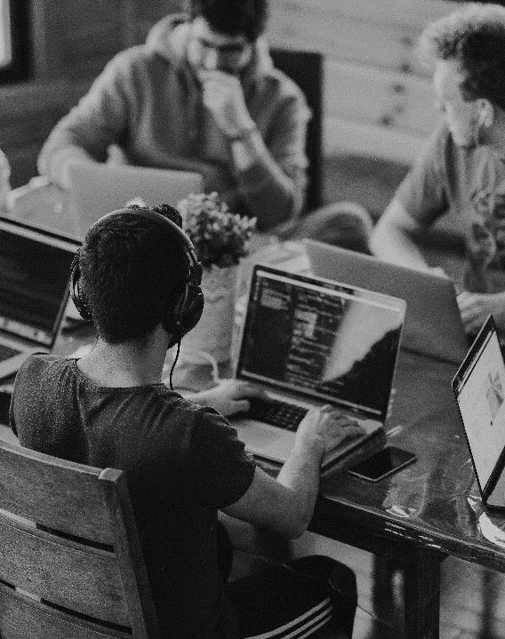
Project Overview
CentRes is a software for small restaurant owners that:
Helps employees streamline the order process
Helps employees manage tables easily.
CentRes allows employees to:
Easily interact with customers’ orders
Reduces miscommunication
Transmits orders directly to the kitchen.

Slide 5
Project Description
Servers will have an easy-to-read display that keeps track of things such as menu items, prices, order times and order status.
Chefs will have access to real time order data and will have the ability to provide status updates to servers.
Hosts can manage the restaurant flow via table assignments and can view server availability. Managers have the ability to update the menu, edit orders, alter the bill, view wait times and more!

Slide 6
Server management (allows host to assign tables) Table management (track customer orders, and generate itemized bill) Order management (server/kitchen order tracking) Menu management (CRUD operations)
Project Features

Slide 7
As a server, I want to only see available tables so I can reserve it for the customer. As a server, I want to place an order in my device and send it directly to the kitchen. As a line cook, I want to receive notification for every new order and can mark it ready after preparation. As a server, I want to receive notification from the kitchen on every order that is ready so I can mark it completed after serving it to the right table.
User Stories

Slide 8
Actor: Server Basic Use Case Description: Server reserves available table for the customer. Server sends order to the kitchen. Server gets notification of order completion and marks the order complete after order is served to the customer. Actor: Line Cook Basic Use Case Description: Line cooks receive placed order with time stamps. Line cooks check off individual items within order. Line cooks mark the order ready after all items within the order are prepared.
Use Cases
Actor: Host
Basic Use Case Description:
Host can manage table availability.
Host can assign tables to servers.
Actor: Manager
Basic Use Case Description:
Manager can edit orders.
Manager can alter bill.
Manager can view overall wait times
for all orders.
Manager can view time stamps on orders.

Slide 9
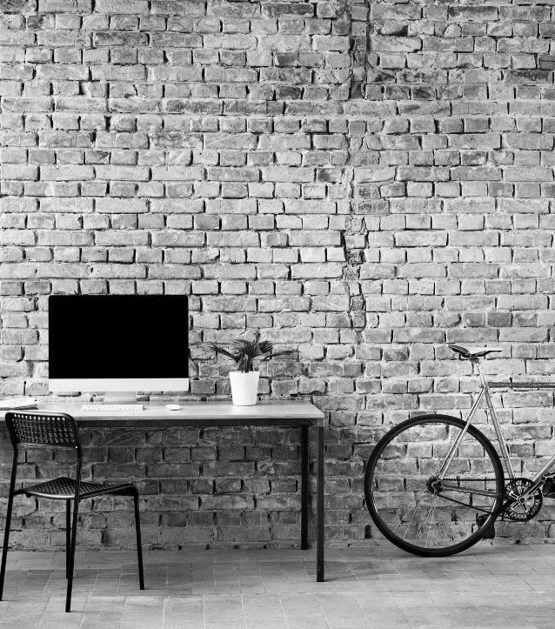
Requirement Specifications
Business requirements:
Must be available on both IOS and Android
Must Effectively manage tables and orders
Must generate weekly efficiency reports
Must provide real-time business metrics to track sales, operations, and customer service performance.
Should keep long term data in a cloud or off-site server database with a data storage model allowing for frequent input of data but infrequent querying of that data (AWS)
Should roll out special opportunities and events for customers in the rewards program

Slide 10
Requirement Specifications
User Requirements:
Must allow manager to edit orders, alter bill, overview of wait times, view time stamps in order
Must allow chef to view orders, time stamps for orders, and mark as ready
Must allow chef to view orders, view tables, time stamp for orders, alter bill, view menu
Must allow server to add to order, print check
Must allow user to login with username and password
Should allow host to manually mark tables as: a) Open for seating b) Seated c) Need bussing.

Slide 11
Requirement Specifications
Functional requirements
Must display menu when requested
Must display orders, bill, wait times, and time stamps when requested
Must allow user to login when successfully entering in user an password
Should use 2fa for manager login to secure admin privileges (two factor authentication)
Should keep track of volume over time to create a predictive model for future use
Should require user log back in after tablet/device is idle for more than 60 seconds

Slide 12
Requirement Specifications
NON-Functional requirements
Must have database that will update in a timely manner to keep communication between users accurate
Must display orders, bill, wait times, and time stamps when requested
Must have password that meets defined criteria
Must not allow fault input to a field
Must allow users to be able to access what they have permission to see
Must allow the system to support enough logged in users at any given time to satisfy the restaurants requirements for access frequency

Slide 13
Requirement Specifications
NON-Functional requirements (continued)
Should scale the restaurant table display volume and placement based on remodeling and rearrangement
Should use local database for efficiency and external/cloud-based database for long term data collection for aggregation
Should keep track of each table as an object with data attributes such as item orders per seat, bill cost, wait time
Could use a third-party security/authentication system to avoid unwanted manipulation
Could implement customer rewards program with customer email

Slide 14

High Level Design
Security
Data Security:
Ensure that the cloud service encrypts all stored data(Data in rest).
Control access to viewable data using least privileged access determined by user roles (Data in use).
Usage of a cloud VPN to protect trafficked data (Data in transit)
Network Security:
Firewall rules to allow employee only access the application
Ensure access to website is limited to only tcp port 443

Slide 15
High Level Design
Hardware
Network:
Switch, Cabling, CAT6, Universal Power Supply (UPS)
Tablet:
IOS, Android, or any OS that has web browser capability
Printer:
Customer bills, server shift report, manager daily monetary report

Slide 16
High Level Design
User Interface
Each user type will have their own interface that will automatically refresh periodically and allow for manual page refreshing.
Once the URL is opened, a user will need to enter their unique ID/Username as well as password to access their interface.
There will be four unique versions of the UI: Manager, Server, Hosting Staff, Kitchen Line.
There will be a main login screen UI that is accessed through a common URL. This will be where the user logs in and their version of the UI is opened.

Slide 17
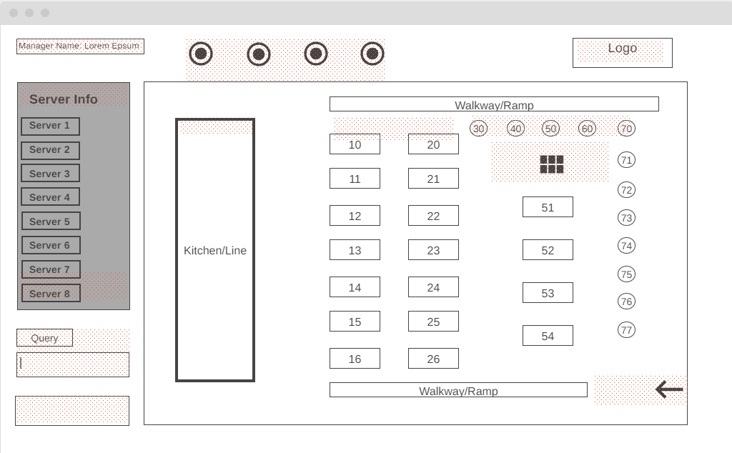
High Level Design
User Interface Wireframe: manager

Slide 18
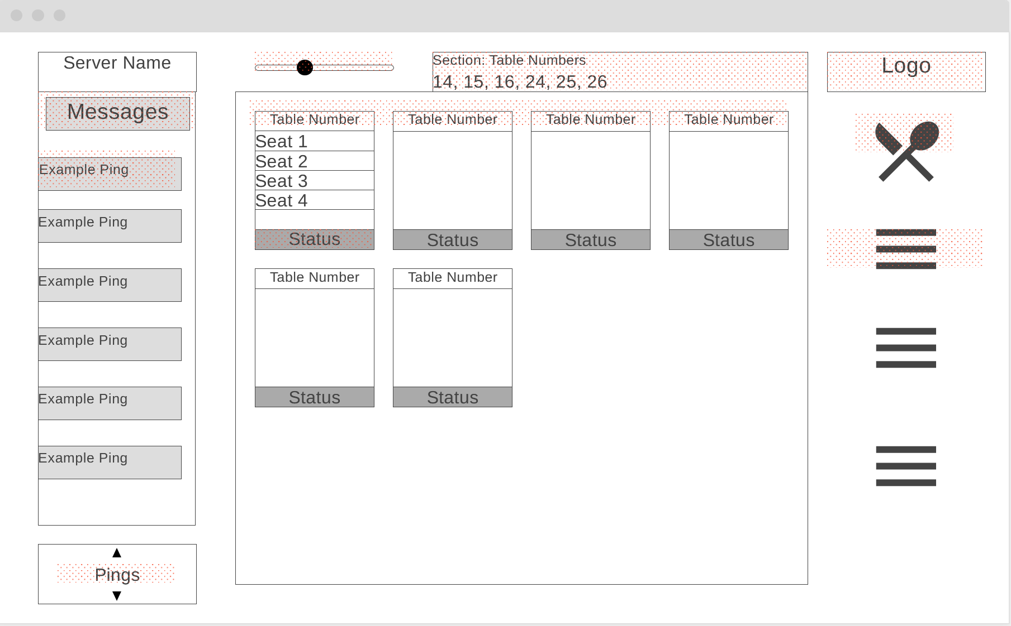
High Level Design
User Interface Wireframe: Server

Slide 19
High Level Design
Architecture
Event-driven:
CentRes will utilize time stamps for orders in and orders out.
Data-centric:
Utilizes a database to track menu items, prices and inventory
Database
CentRes will be using a MySQL relational database to store employee information and communicate information related to sales transactions and product inventory. MySQL can help the restaurant to keep tracking the inventory. See what foods are selling more and which foods are selling less, and this can help to optimize the menu and minimize waste.

Slide 20
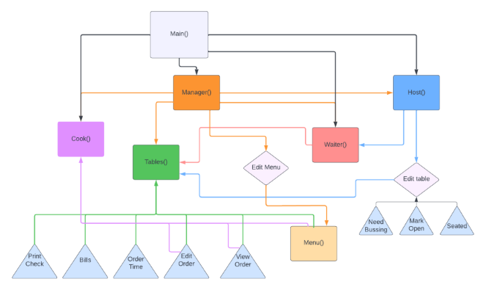
High Level Design
Class Diagram

Slide 21
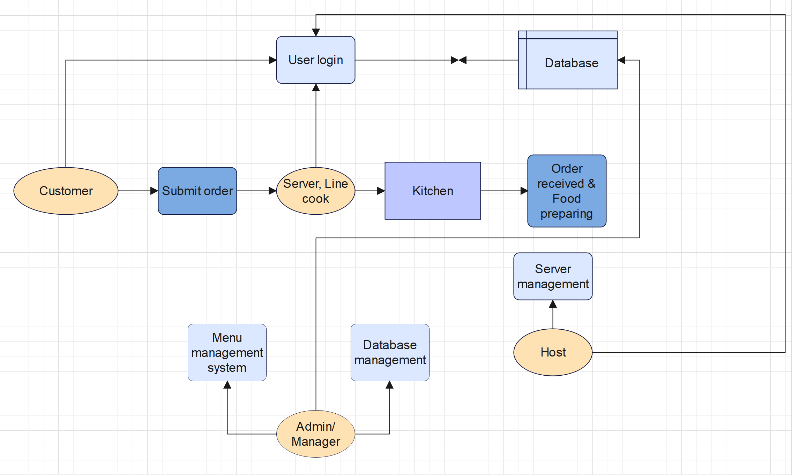
High Level Design
Data Flow Diagram

Slide 22
Achievements and challenges
Achievements:
Successfully hosted sprint meetings with all members present weekly and participating
Individual team members feel more satisfied with their roles which gives them extra motivation to perform.
Tasks are completed on time and in full.
Challenges:
Microsoft word formatting for SRS document.
Solving the compatibility issue by choosing a web-based application.
Choosing the priority of the requirements specification using the MOSCOW method. All requirements would be nice to have so it is difficult to consider a rating for each one.

Slide 23
Future Development Plan
Create a Mobile application version to give restaurant owners the option to use either a web application or mobile application based on their needs.
Add online reservation for customers .
Implement 2FA for user logins.
Create another UI that is accessible by managers that allows them to change the restaurant’s table layout and modify the server’s menu selection buttons on their own without the need to contact the developer for an update to the predefined interface.
Add another UI for take-out orders as described below.
Allow for take-out orders to be processed. These can come from an individual on the restaurant’s website or from services such as Uber Eats, GrubHub, etc.

Slide 24
THANK YOU
CentRes Team

