Slide 1



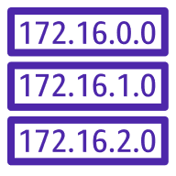



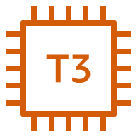





us-east-1
Region
Virtual private cloud (VPC)
Route table
us-east-1a
us-east-1b
Dynamo DB
Availability Zone
Availability Zone
Application Load Balancer
Auto Scaling group
Public subnet 1a
Public subnet 1b
T3 instance
T3 instance
Lamda
Private subnet 1a
Private subnet 1b
Backend process failover
NAT gateway
Backend process
S3
no
public access
Private subnet
RDS/Spare
Private subnet
RDS/Spare

