Slide 1

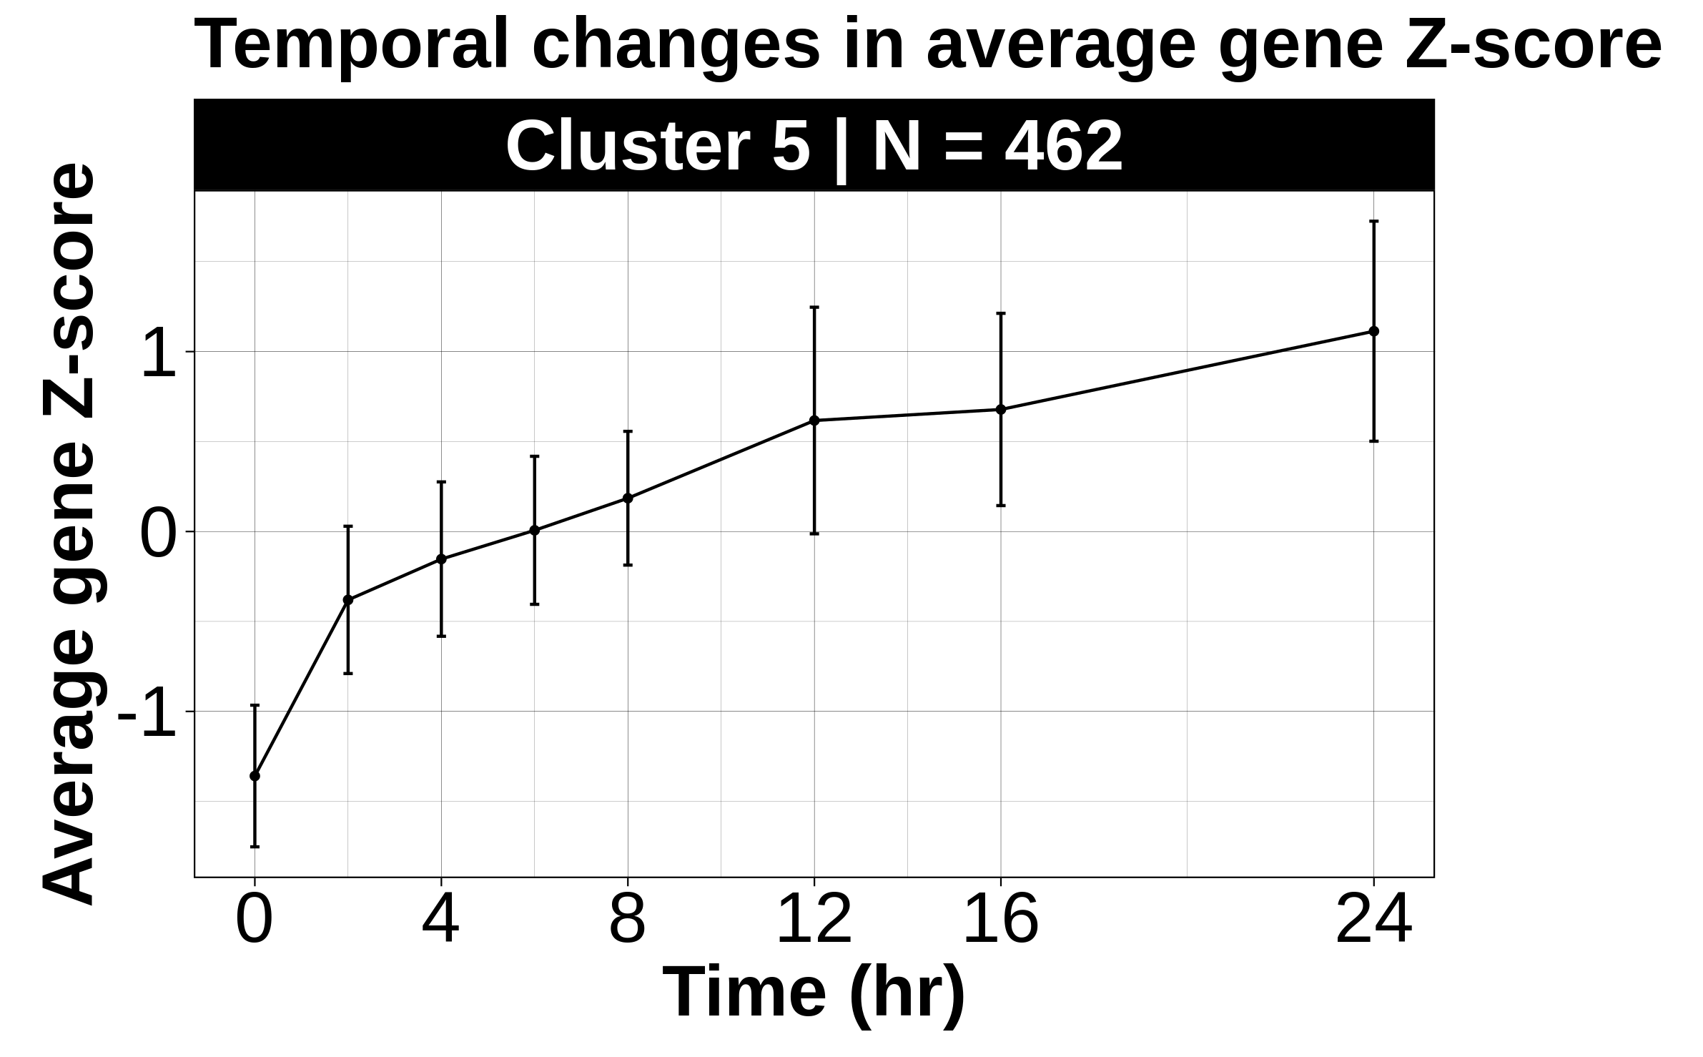
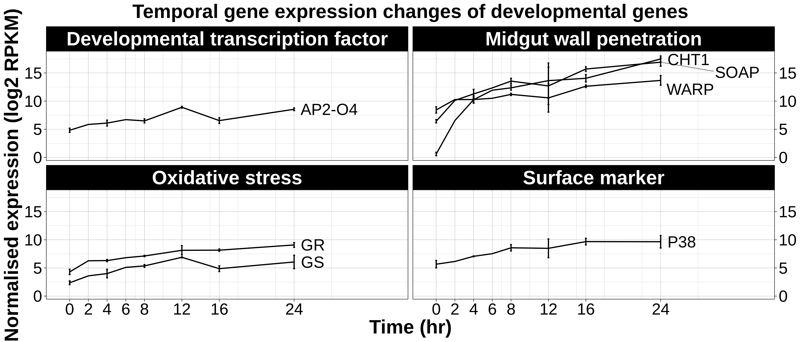
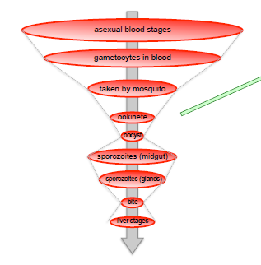
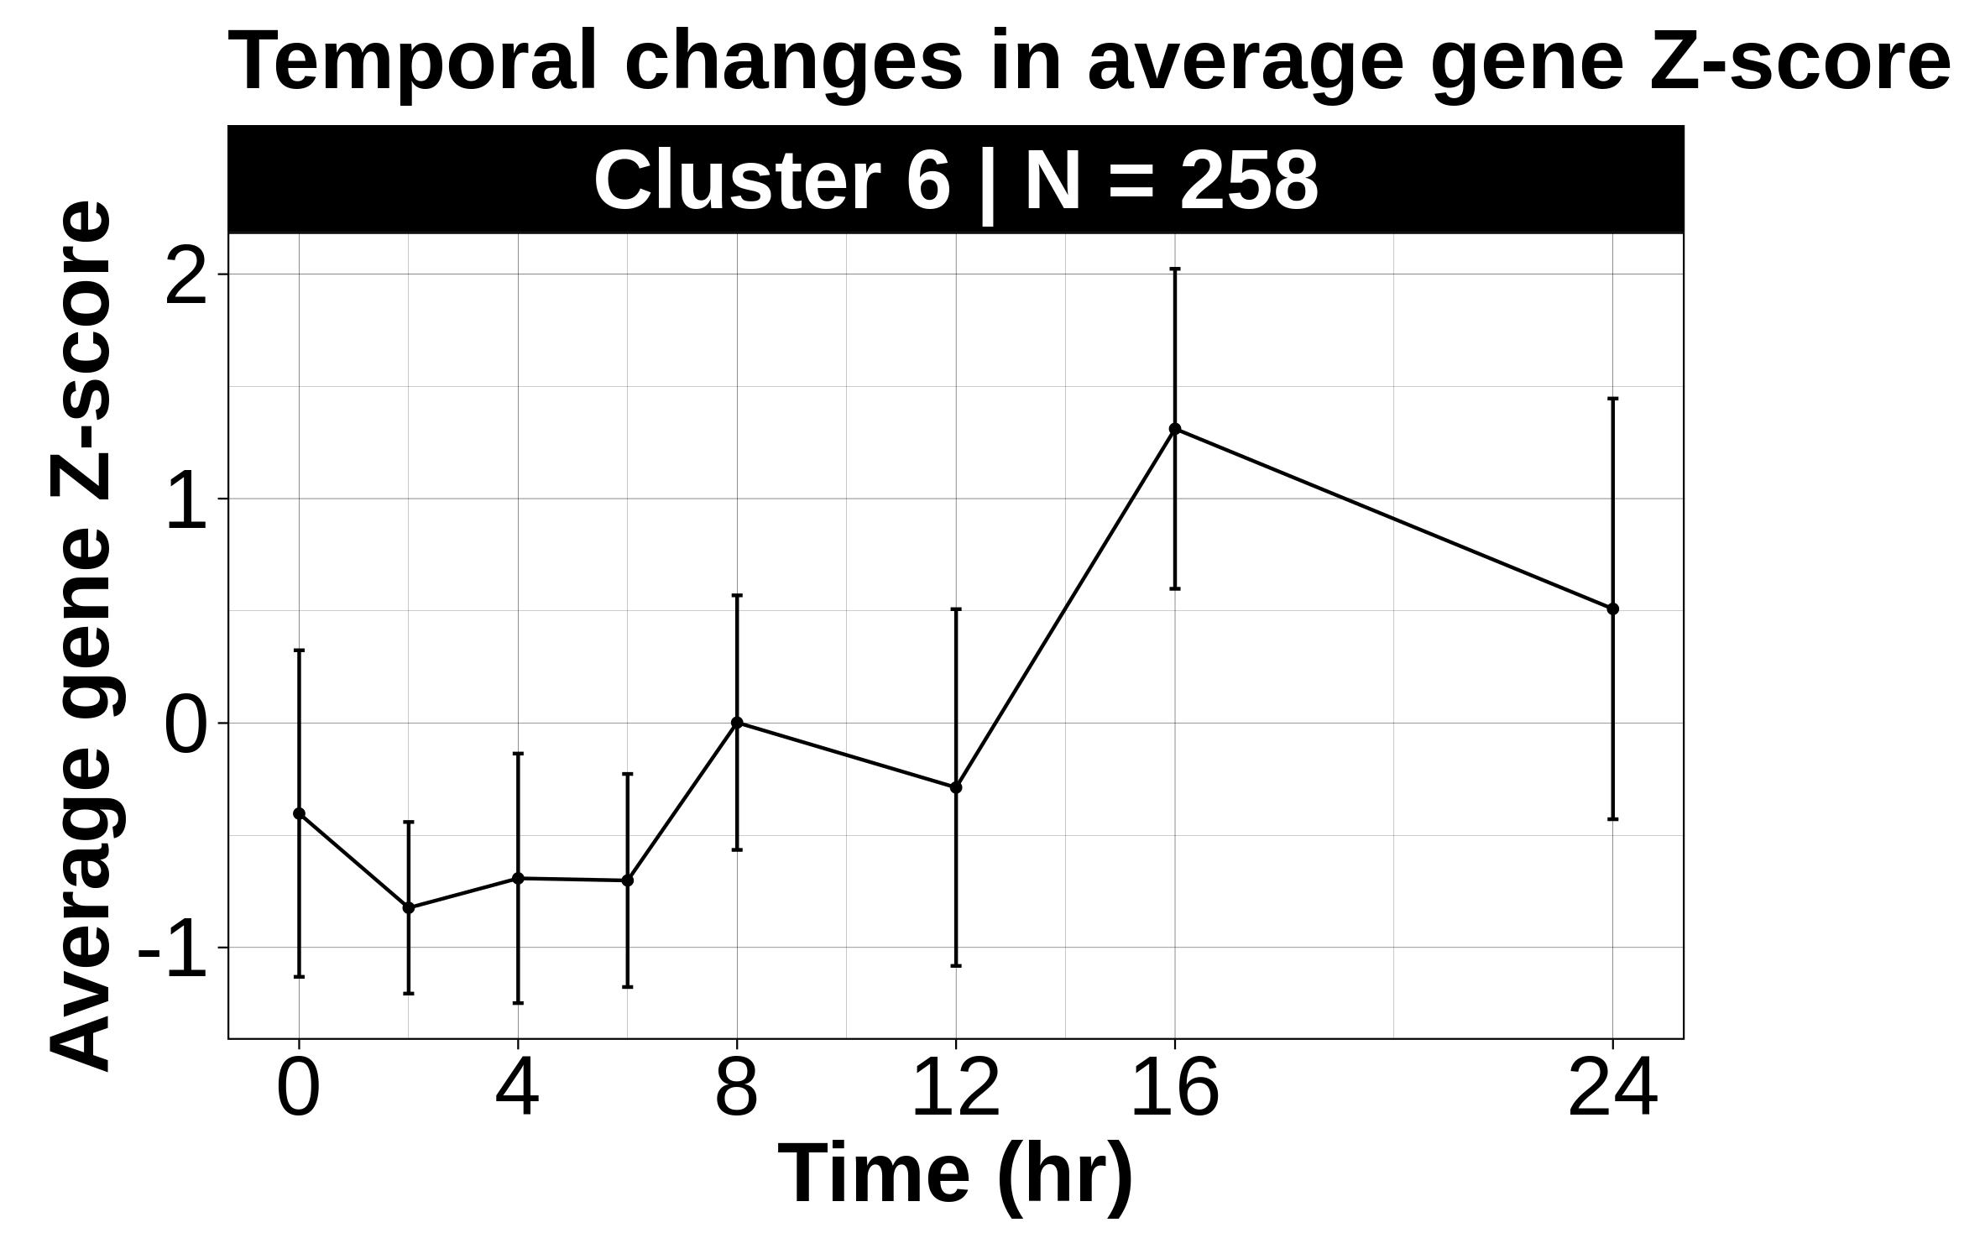
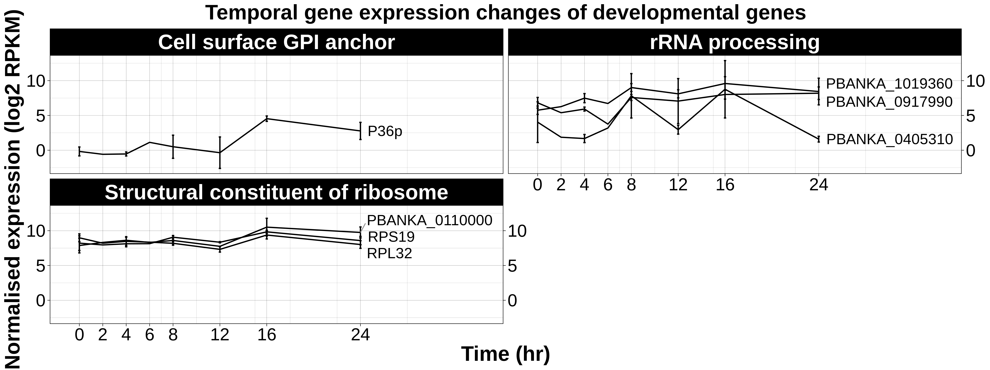
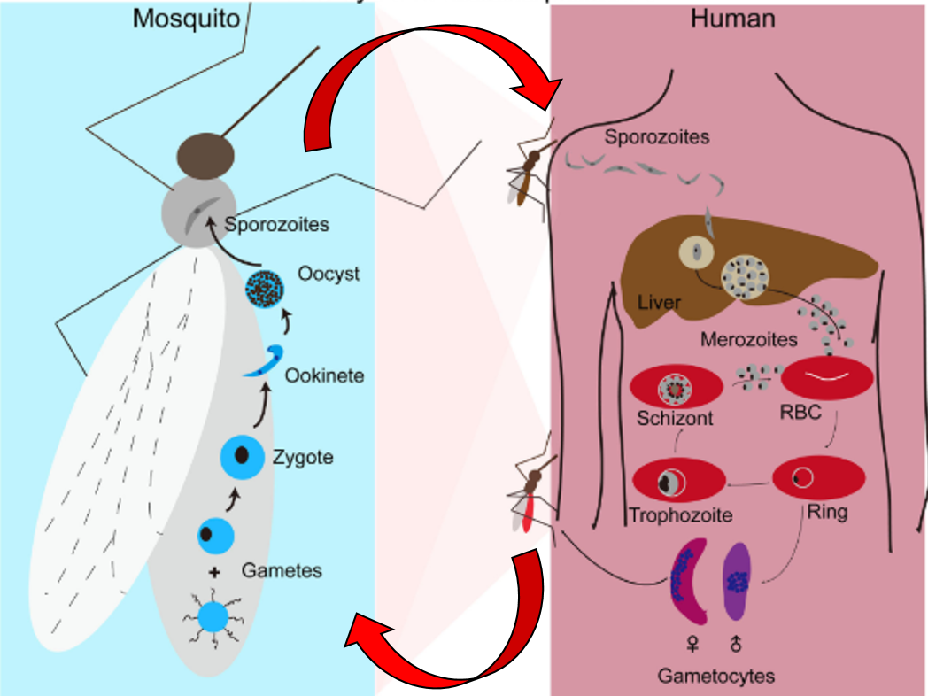
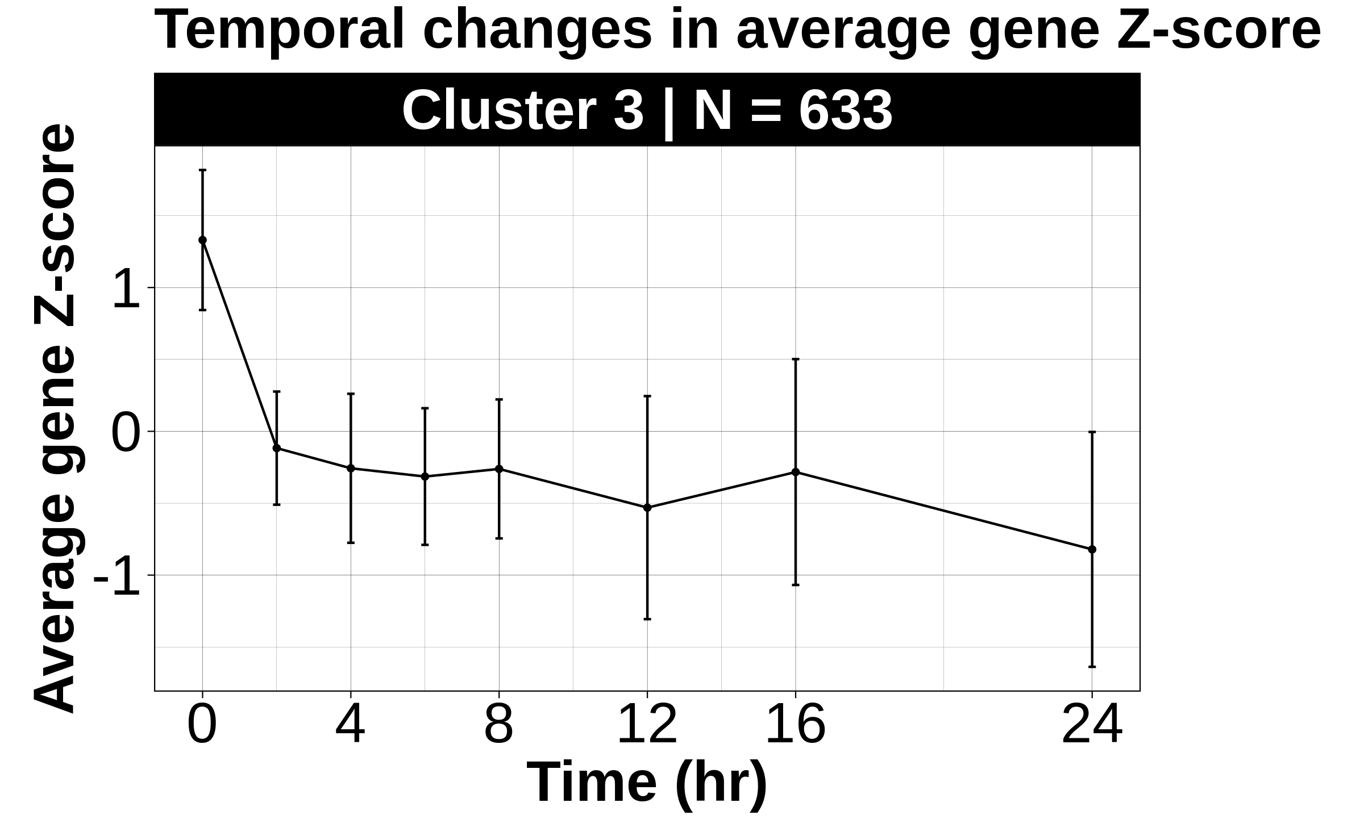
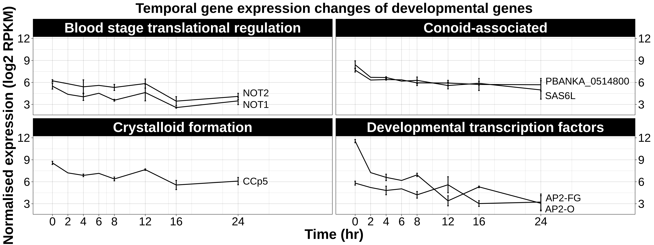
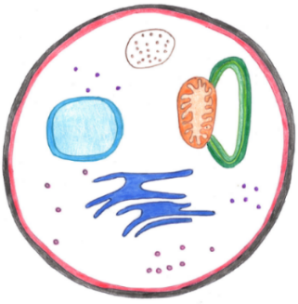
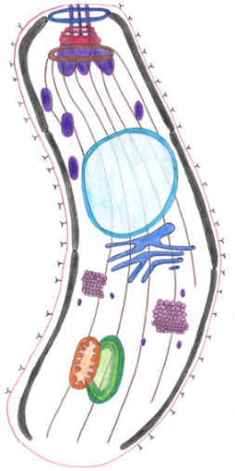
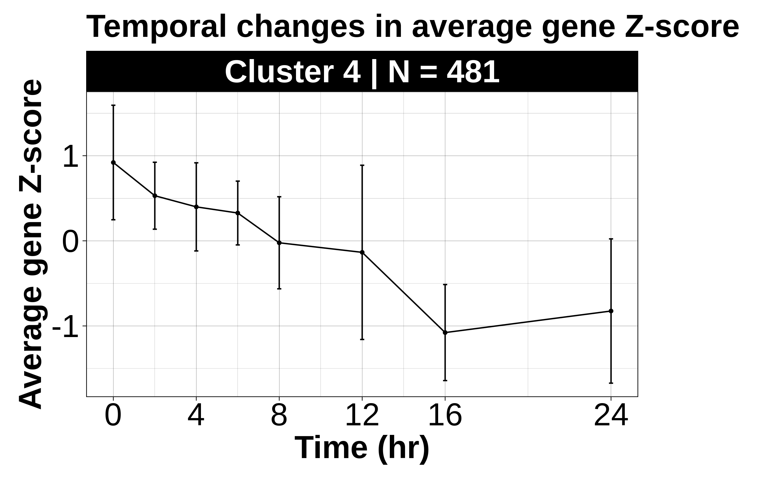
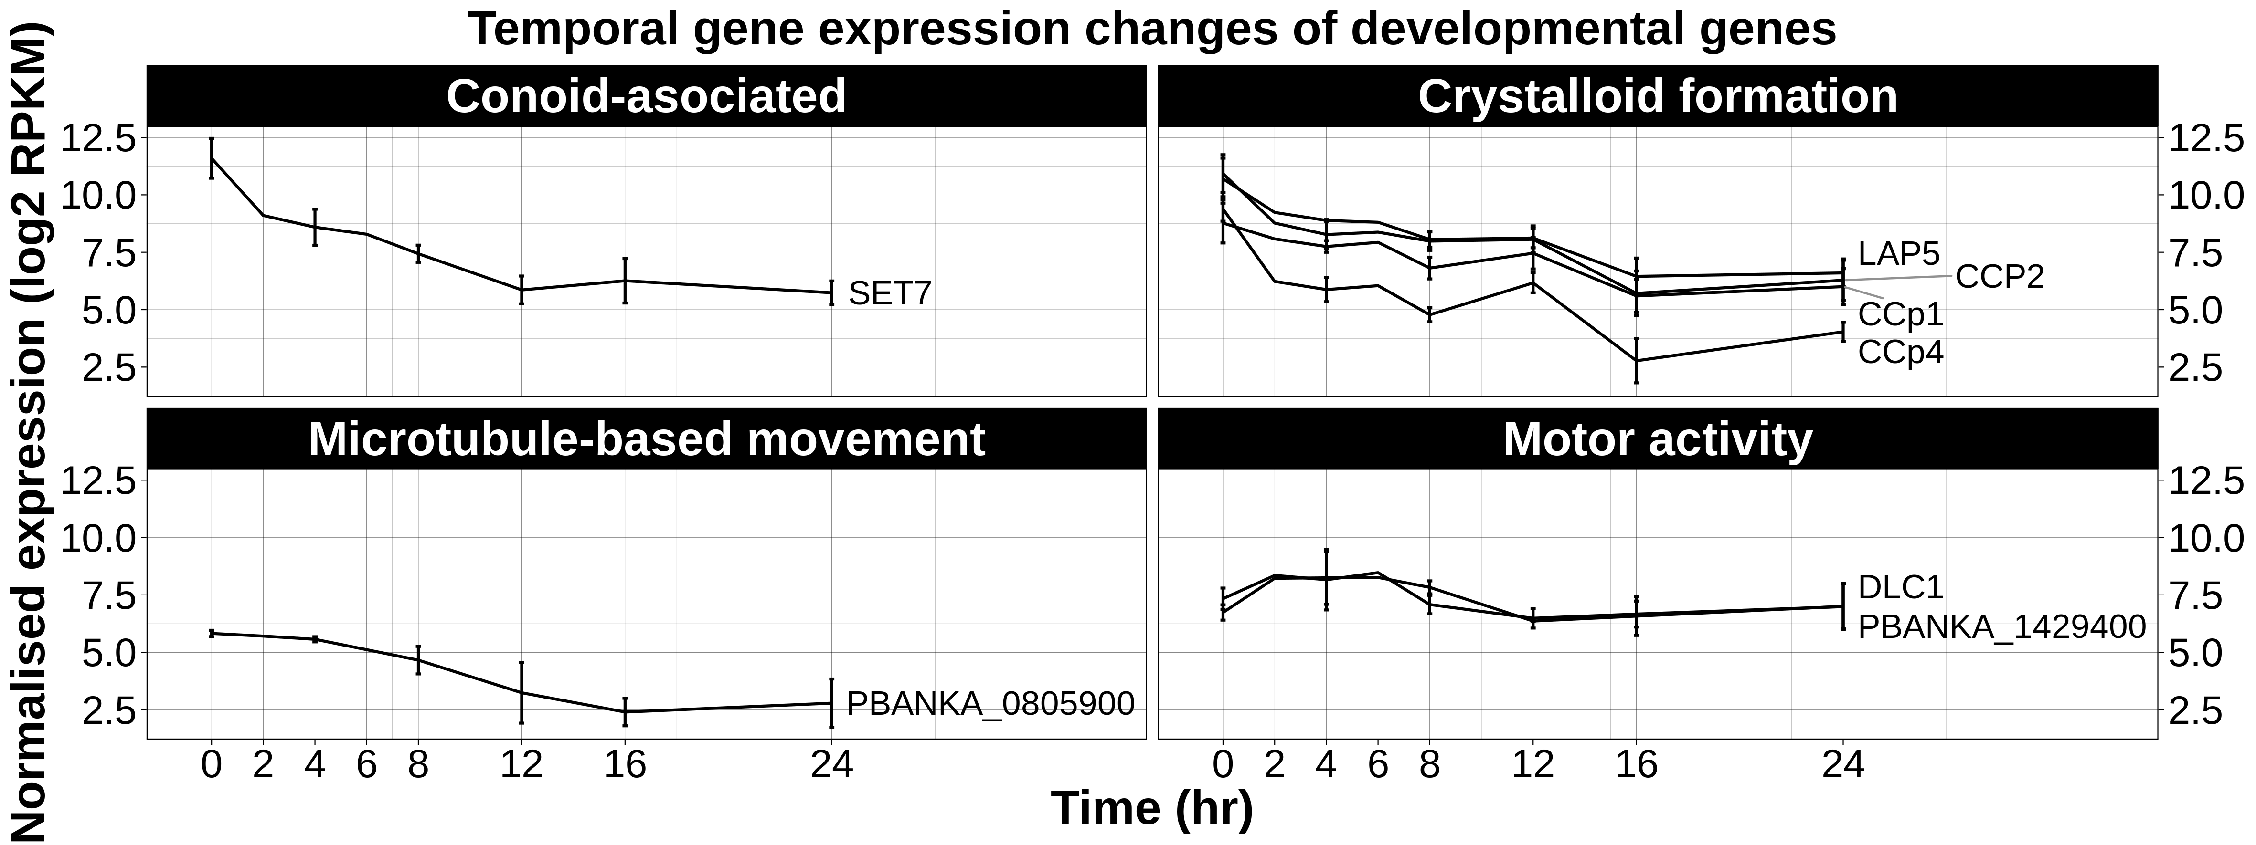
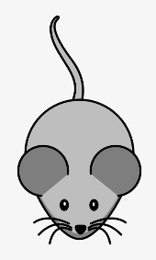

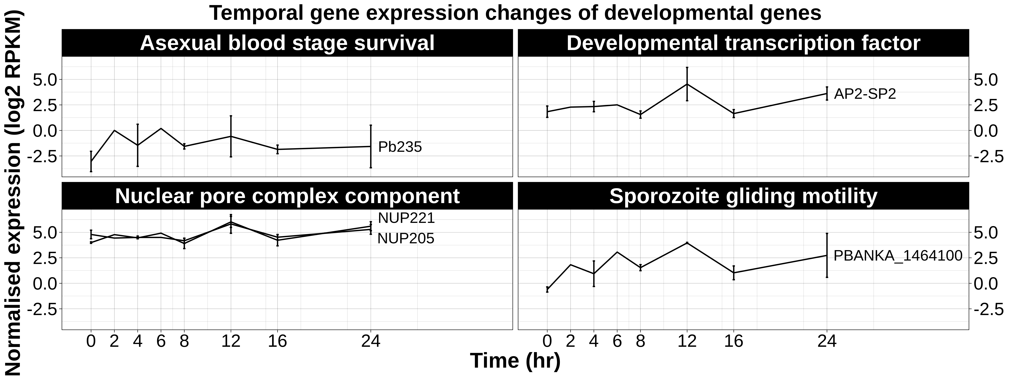
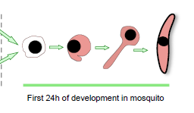
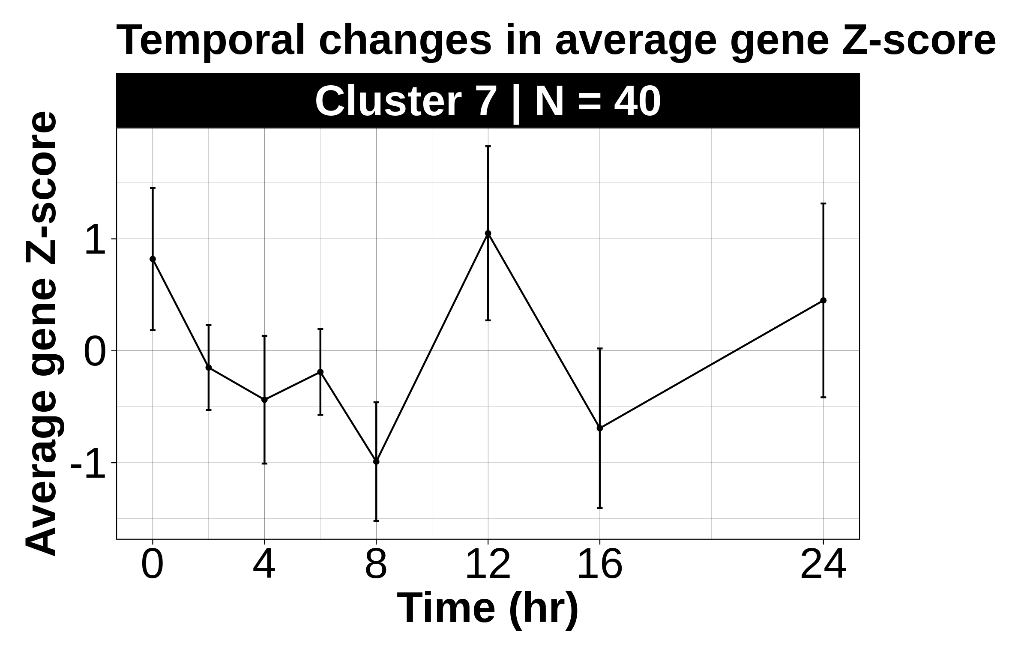
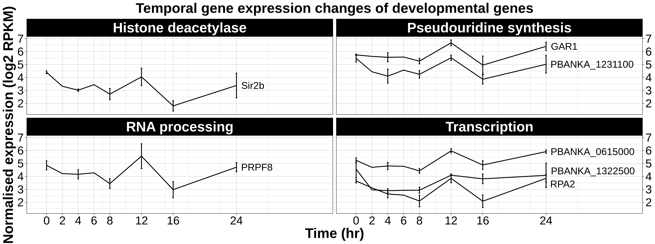
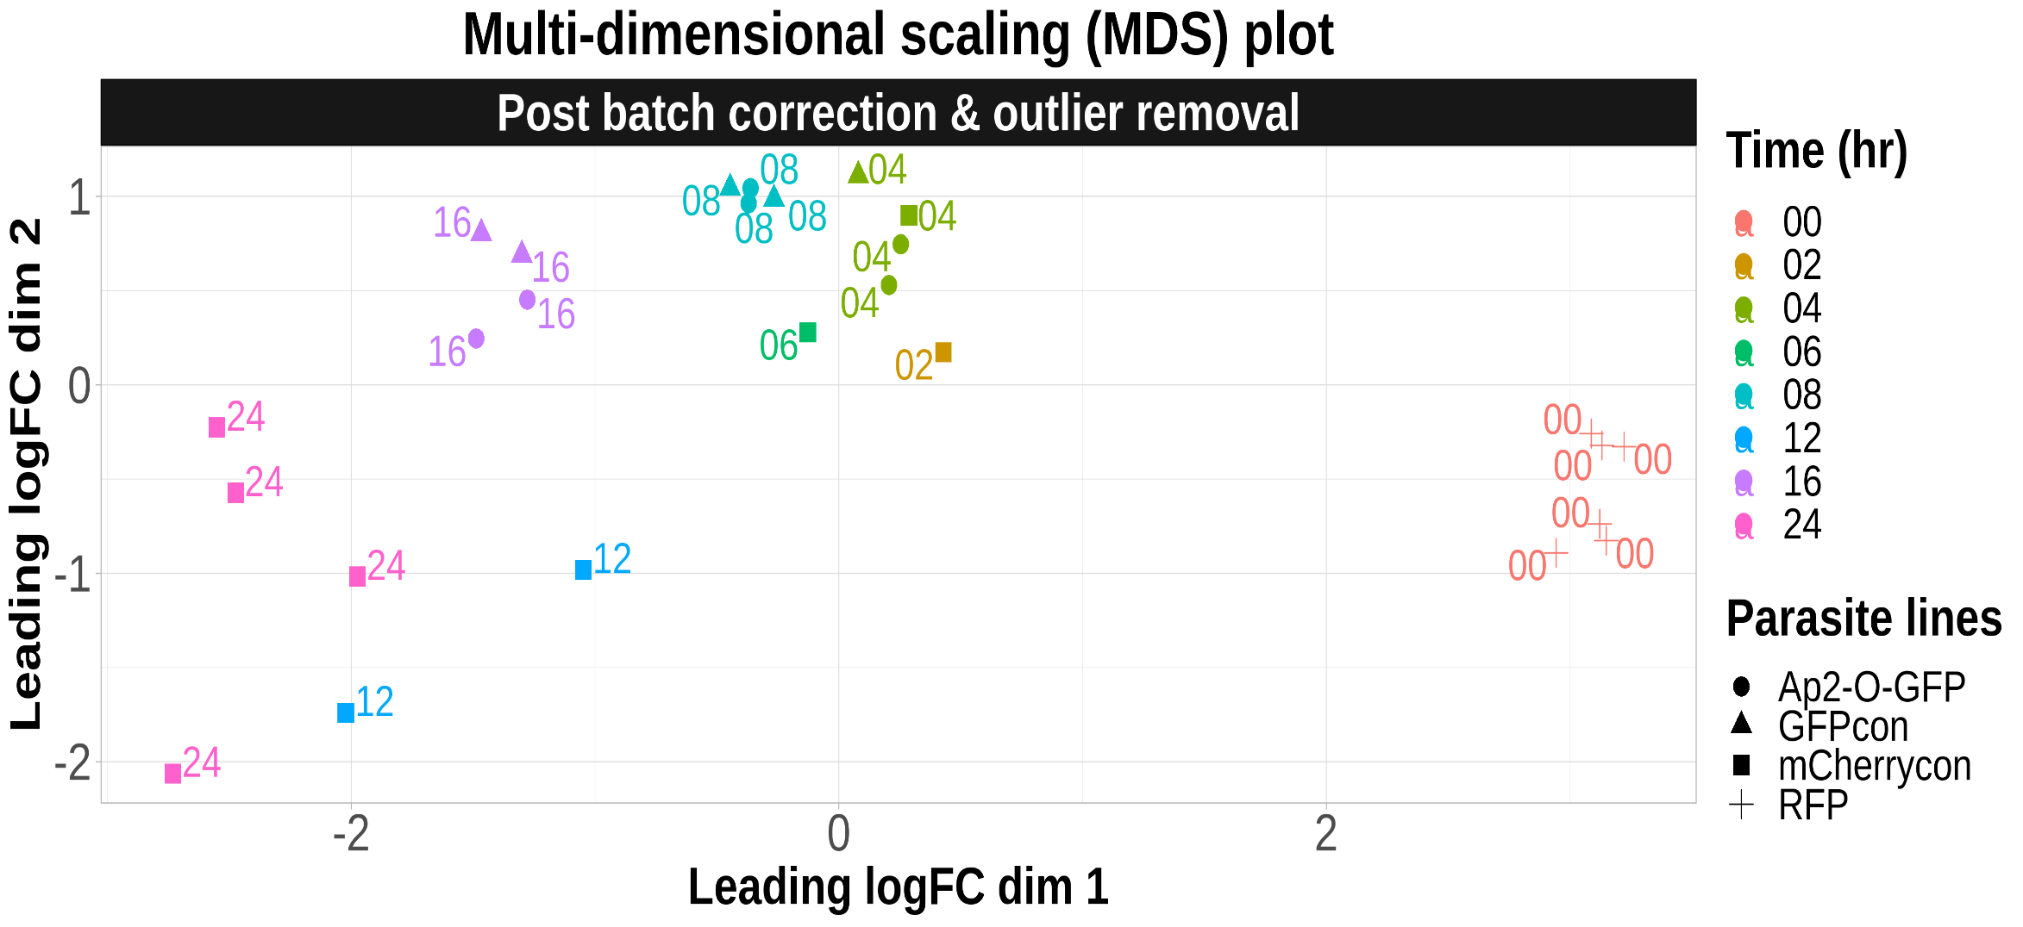
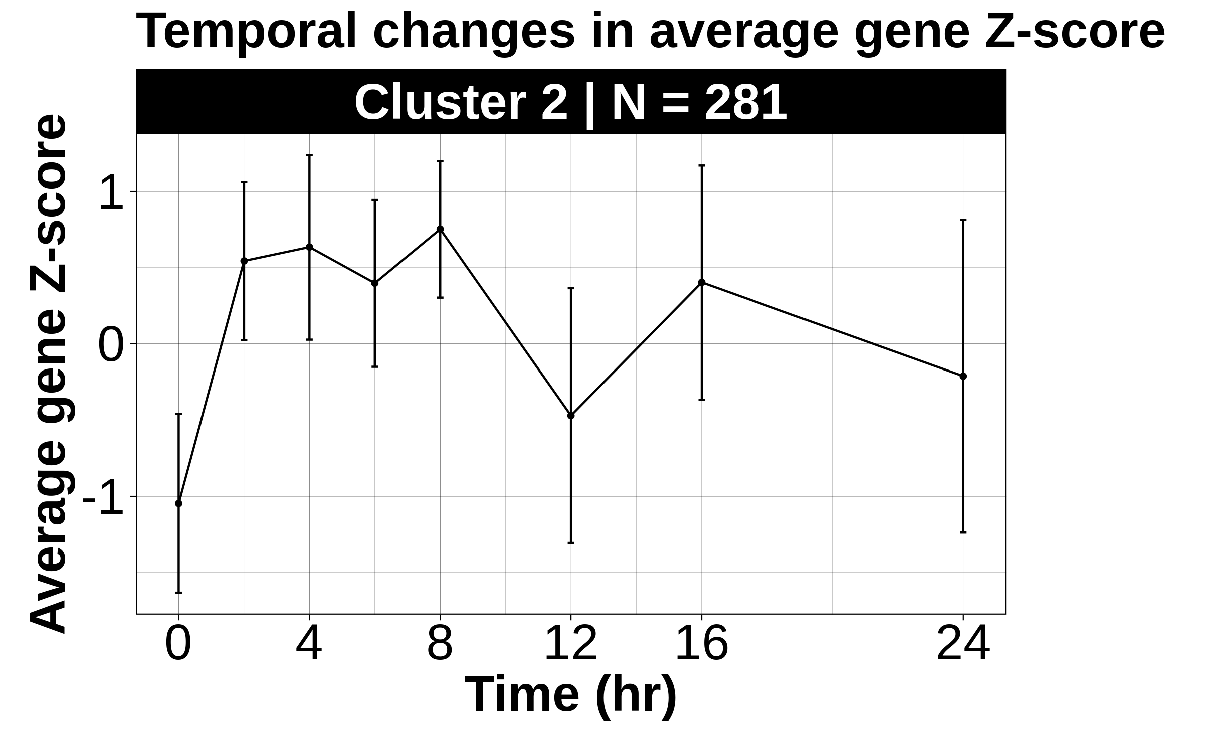
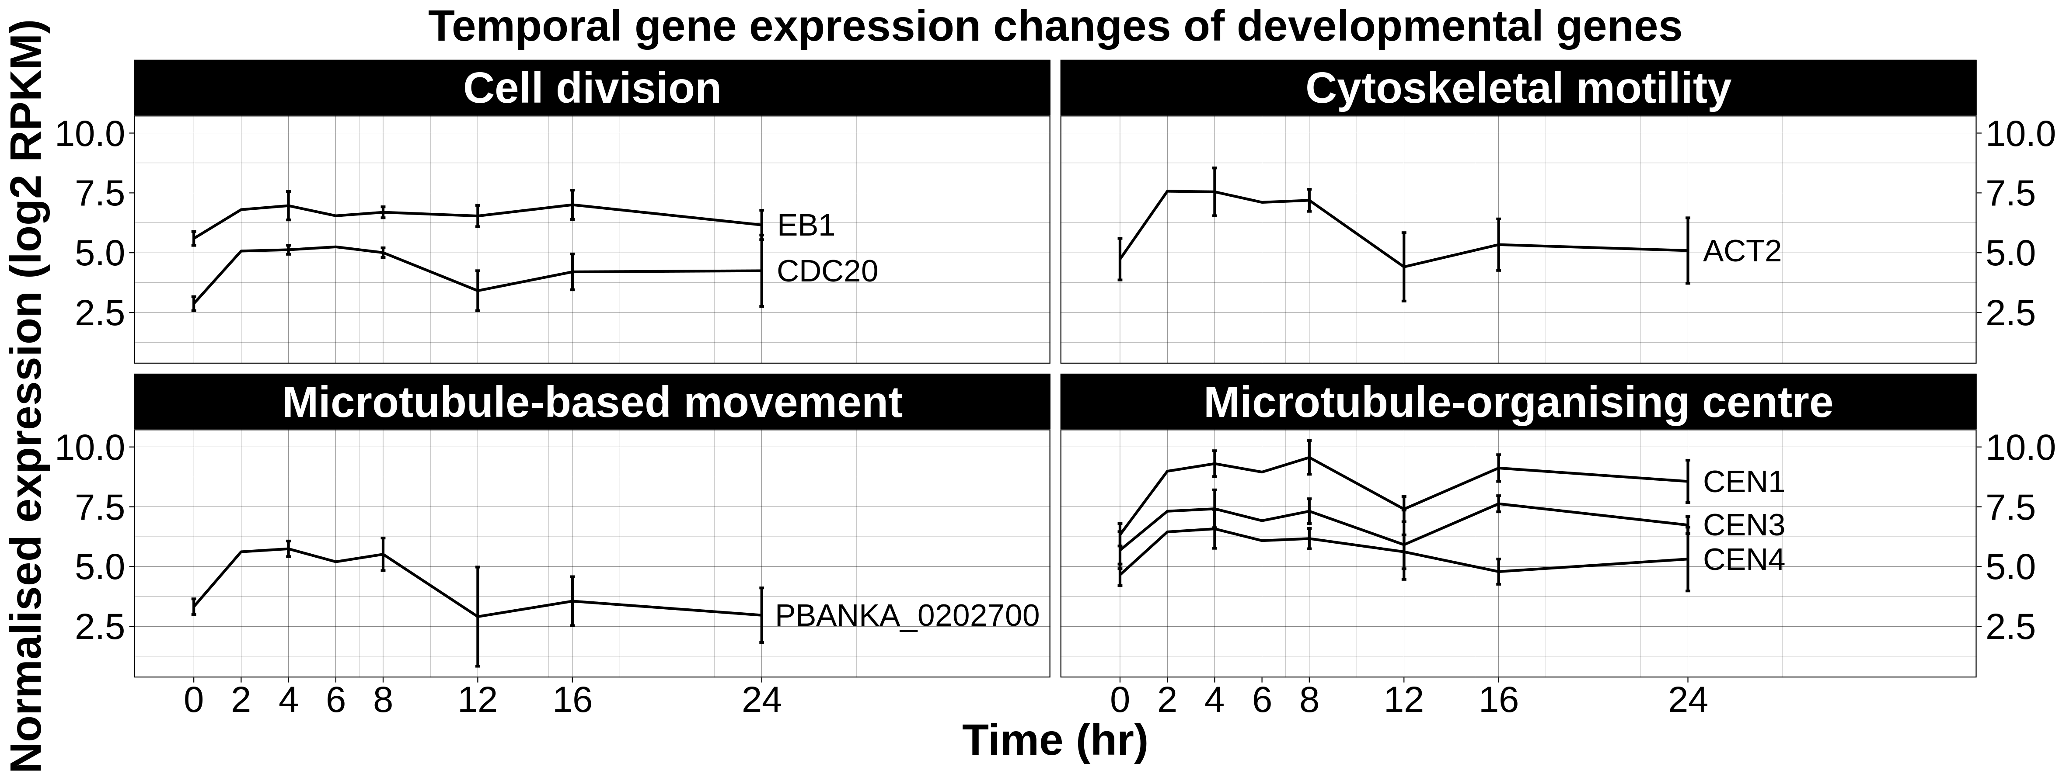

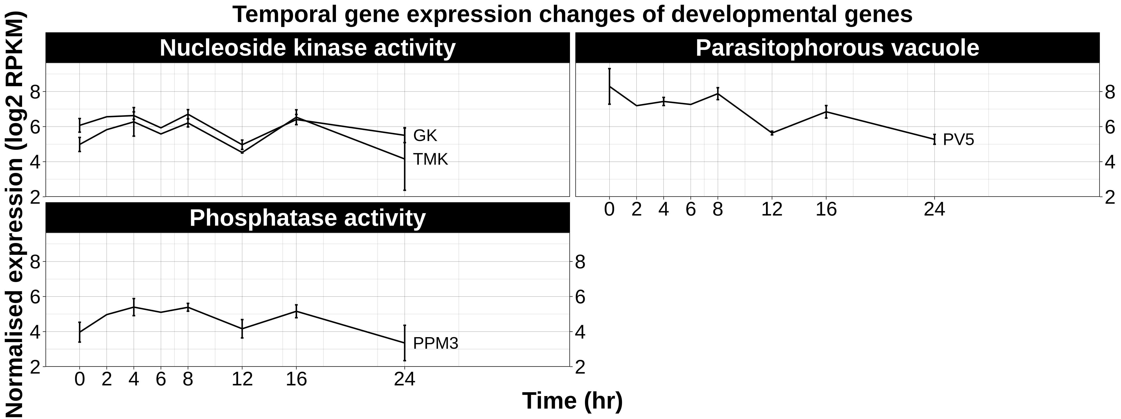
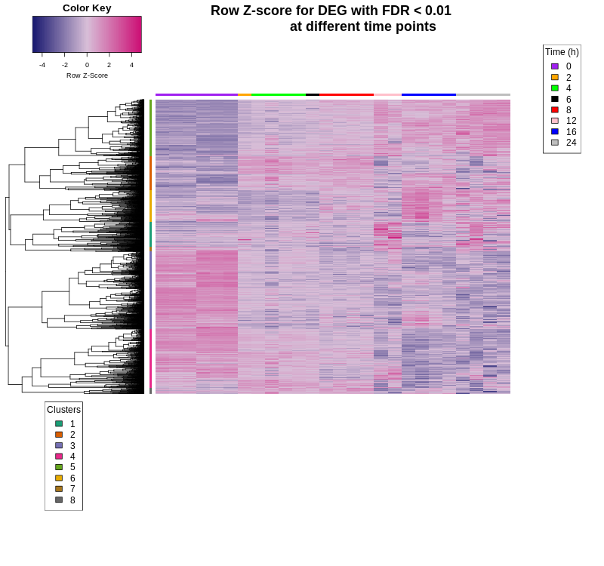
Dissecting changes in Plasmodium berghei gene expression at the initial stages of mosquito midgut transmission
K.L. Bloomer¹, R. Morton¹, B.M. Mugambi², D. Beraldi³, K.K. Modrzynska³
¹Institute of Infection, Immunity and Inflammation, University of Glasgow, UK; ²Centre for Biotechnology and Bioinformatics, University of Nairobi, Kenya; ³Wellcome Trust Centre for Molecular Parasitology, University of Glasgow, UK
1. Background
3.2 Results
Malaria, a devastating disease, is caused by the unicellular protozoan parasite, Plasmodium.
The parasite has a complex life cycle with > 10 different stages transitioning between asexual replication within a mammalian host and sexual development in the female Anopheles mosquito¹.
These stages are defined by distinct morphologies, metabolism and environments which requires tight regulation by stage-specific transcription factors³.
Mosquito midgut stages are promising targets to block transmission due to a parasite load bottleneck⁴.
Identifying protein targets requires in depth knowledge of gene regulation.
Large transcriptional changes have been observed in the gametocyte and ookinete^{5,6,7}, yet the temporal resolution during this transition is poorly understood.
We sought to elucidate transcriptional dynamics during midgut development at an enhanced temporal resolution.
GO:0020009: microneme
GO:0044409:
entry into host
GO:0009986:
cell surface
Bottleneck
-----------------------------------------------------------------------------------------------------------------
GO:0006364: rRNA processing
GO:0005730: nucleolus
-----------------------------------------------------------------------------------------------------------------
GO:0006355:
regulation of transcription, DNA-templated
GO:0009405: pathogenesis
Plasmodium life cycle²
?
Female gametocyte
Ookinete
-----------------------------------------------------------------------------------------------------------------
GO:0044312: crystalloid
GO:0003777: microtubule motor activity
2. Methods
Analysed bulk RNA-seq libraries at 8 time points
during Plasmodium berghei (rodent malaria model) development in the mosquito midgut
4 transgenic parasite lines which do not affect life cycle progression^{8,9,10}.
-----------------------------------------------------------------------------------------------------------------
Time (h)
0
2
4
6
8
12
16
24
GO:0016021: integral component of membrane
GO:0005643: nuclear pore
Female
gametocyte
Zygote
Immature ookinete
Ookinete
-----------------------------------------------------------------------------------------------------------------
-----------------------------------------------------------------------------------------------------------------
Bioinformatics workflow
Heatmap & clustering
GO:0003899: DNA-directed 5'-3' RNA polymerase activity;
GO:0006448: regulation of translational elongation
Read alignment
Raw gene read counts
MDS plot
Differential gene expression analysis
GO term enrichment
Read quality control
Developmental genes expression plots
3.1 Results
-----------------------------------------------------------------------------------------------------------------
The parasite transcriptome changes throughout ookinete development.
2 major shifts in the transcriptome are observed: one immediately after fertilisation (2hr) and another at ≈12hr.
8 gene clusters with unique expression profiles were identified to elucidate biologically significant genes that may be co-regulated.
GO:0007018: microtubule-based movement
GO:0005509: calcium-ion binding
GO:0005874: microtubule
-----------------------------------------------------------------------------------------------------------------
Figure 1: MDS plot with libraries clustering according to time.
Black arrow = increasing temporal gradient.
GO:0005509: calcium-ion binding
GO:0050145:
nucleoside monophosphate kinase activity
Time (hr)
0
2
4
6
8
12
16
24
4. Conclusion & future work
Genes
Mosquito stages of the Plasmodium parasite are promising targets to block malaria transmission. However, identifying targets for vaccines is needed which requires insight into the gene regulatory networks at these stages which is poorly understood.
We have shown that changes in gene expression are observed immediately post-fertilisation and identified 8 gene clusters with distinct expression patterns. Integration of these data with existing genomic accessibility data and transcription factor occupancy profiles will further elucidate gene regulatory dynamics at the initial mosquito midgut transmission stages.
References
Libraries
Figure 2: Gene Z-score for differentially expressed genes with false discovery rate < 0.01 at different time points during mosquito midgut development. Black boxes indicate time points at which major transcriptome shifts are observed.

