Slide 1


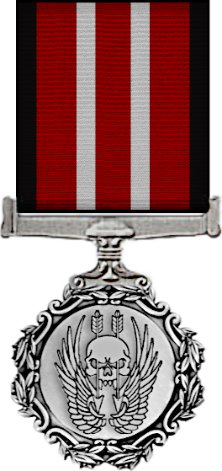

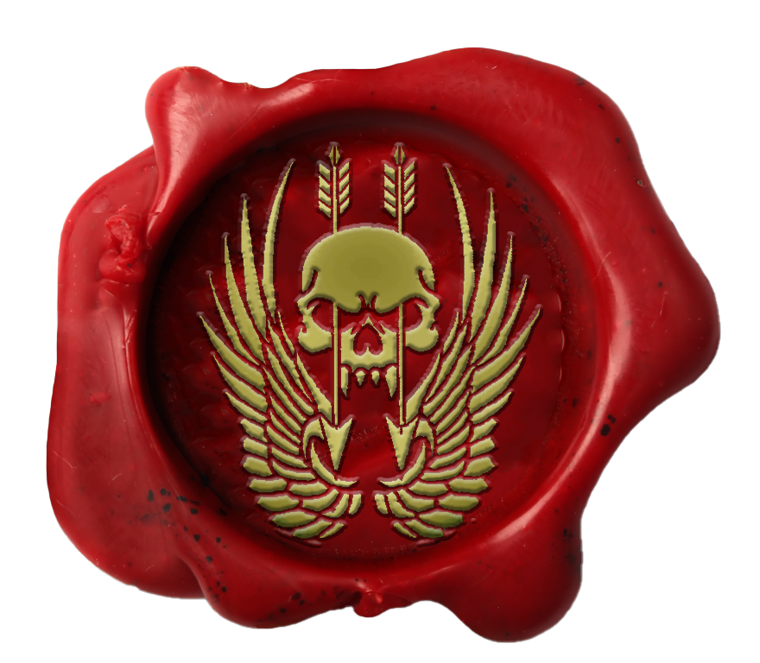
AUSTRALIAN SPECIAL OPERATIONS TASKFORCE
This is to certify that command has awarded the
1 Year of Service Citation
TO
{name}
{name} joined on the {jdnum}^{{jdsuffix}} {jddate} and has been a part of the community for a period of 1 year or more.
On today’s date, {dateNumber}^{{suffix}} {date}, {name} is therefore awarded the 1 Year Service Citation.
{signaturerRankShort} {signaturer}
{signaturerRankShort} {signaturer} Officer Commanding Australian Special Operations Taskforce HQ

Slide 2
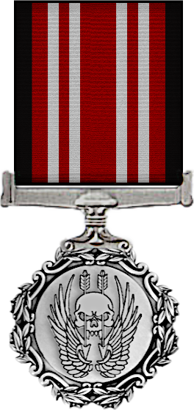
AUSTRALIAN SPECIAL OPERATIONS TASKFORCE
This is to certify that command has awarded the
2 Year of Service Citation
TO
{name}
{name} joined on the {jdnum}^{{jdsuffix}} {jddate} and has been a part of the community for a period of 2 years or more.
On today’s date, {dateNumber}^{{suffix}} {date}, {name} is therefore awarded the 2 Year Service Citation.
{signaturerRankShort} {signaturer}
{signaturerRankShort} {signaturer} Officer Commanding Australian Special Operations Taskforce HQ

Slide 3
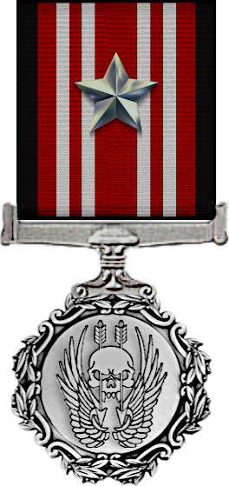
AUSTRALIAN SPECIAL OPERATIONS TASKFORCE
This is to certify that command has awarded the
3 Year of Service Citation
TO
{name}
{name} joined on the {jdnum}^{{jdsuffix}} {jddate} and has been a part of the community for a period of 3 years or more.
On today’s date, {dateNumber}^{{suffix}} {date}, {name} is therefore awarded the 3 Year Service Citation.
{signaturerRankShort} {signaturer}
{signaturerRankShort} {signaturer} Officer Commanding Australian Special Operations Taskforce HQ

Slide 4

AUSTRALIAN SPECIAL OPERATIONS TASKFORCE
This is to certify that command has awarded the
Long Term Service Citation
TO
{name}
{name} joined on the {jdnum}^{{jdsuffix}} {jddate} and has been a part of the community for a period of 4 years or more.
On today’s date, {dateNumber}^{{suffix}} {date}, {name} is therefore awarded the Long Term Service Citation.
{signaturerRankShort} {signaturer}
{signaturerRankShort} {signaturer} Officer Commanding Australian Special Operations Taskforce HQ

Slide 5
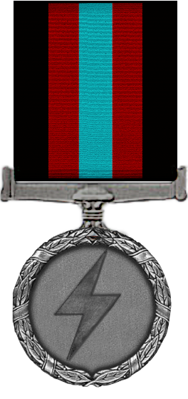
AUSTRALIAN SPECIAL OPERATIONS TASKFORCE
This is to certify that command has awarded the
Atlas Award
TO
{name}
{name} has shown a high level of dedication and enthusiasm to Zeusing for missions and events. This has directly contributed to the enjoyable experience of those attending missions, even when it’s sometimes at the expense of the Zeus’s own enjoyment.
On today’s date, {dateNumber}^{{suffix}} {date}, {name} is therefore awarded the Atlas Award.
{signaturerRankShort} {signaturer}
{signaturerRankShort} {signaturer} Officer Commanding Australian Special Operations Taskforce HQ

Slide 6

AUSTRALIAN SPECIAL OPERATIONS TASKFORCE
This is to certify that command has awarded the
Architect Award
TO
{name}
{name} has shown a high level of dedication towards mission making, Zeusing of missions and assisting other members with mission creation and general editing knowledge. Mission making is the life blood of the unit and enables us to conduct operations regularly and to such a high standard.
On today’s date, {dateNumber}^{{suffix}} {date}, {name} is therefore awarded the Architect Award.
{signaturerRankShort} {signaturer}
{signaturerRankShort} {signaturer} Officer Commanding Australian Special Operations Taskforce HQ

Slide 7

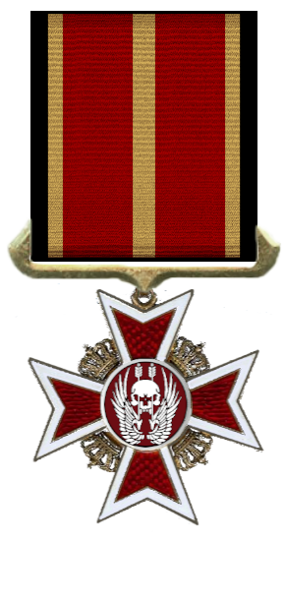
AUSTRALIAN SPECIAL OPERATIONS TASKFORCE
This is to certify that command has awarded the
Beyond Award
TO
{name}
{name} has continuously displayed ASOT’s values, standards and ethics above the expected levels with the utmost enthusiasm and dedication. they have performed professionally, maturely and displayed personality traits to the highest level which has directly contributed to the improvement of the unit.
On today’s date, {dateNumber}^{{suffix}} {date}, {name} is therefore awarded the Beyond Award.
{signaturerRankShort} {signaturer}
{signaturerRankShort} {signaturer} Officer Commanding Australian Special Operations Taskforce HQ

Slide 8
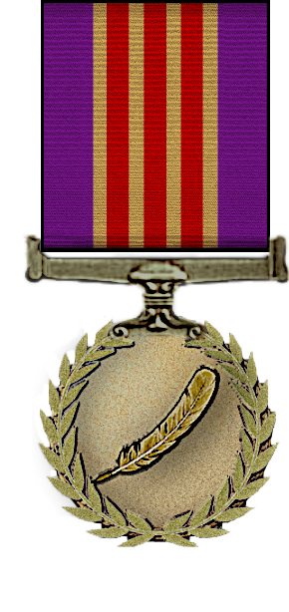
AUSTRALIAN SPECIAL OPERATIONS TASKFORCE
This is to certify that command has awarded the
Broken Lance Award
TO
{name}
{name} has shown a high level of dedication to administration, trainings and group development to an outstanding level which has directly contributed to the growth and advancement of the unit.
On today’s date, {dateNumber}^{{suffix}} {date}, {name} is therefore awarded the Broken Lance Award.
{signaturerRankShort} {signaturer}
{signaturerRankShort} {signaturer} Officer Commanding Australian Special Operations Taskforce HQ

Slide 9
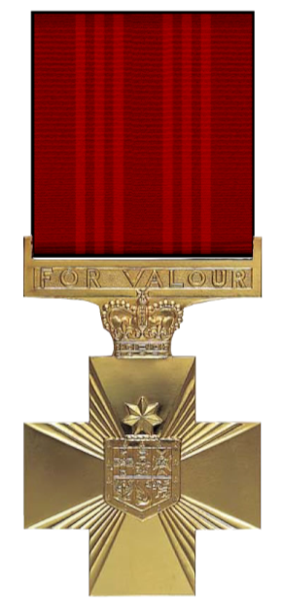
AUSTRALIAN SPECIAL OPERATIONS TASKFORCE
This is to certify that command has awarded the
Cross Of Valour
TO
{name}
The Cross Of Valour is awarded to members who have previously received the Star Of Courage and the Gallantry Award. {name} has continuously displayed significant acts of professionalism and dedication within operations at a standard above what is expected of his worn rank.
On today’s date, {dateNumber}^{{suffix}} {date}, {name} is therefore awarded the Cross Of Valour.
{signaturerRankShort} {signaturer}
{signaturerRankShort} {signaturer} Officer Commanding Australian Special Operations Taskforce HQ

Slide 10
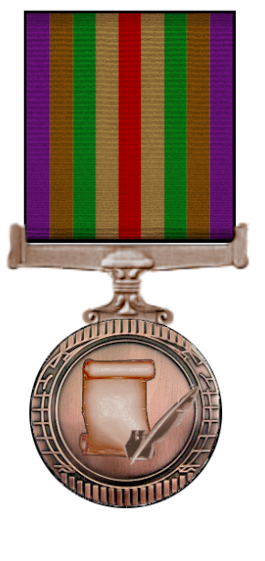
AUSTRALIAN SPECIAL OPERATIONS TASKFORCE
This is to certify that command has awarded the
Diplomat Award
TO
{name}
{name} has shown a high level of dedication to recruitment of new members and promoting of the unit to the public which has directly contributed to the growth and advancement of the unit.
On today’s date, {dateNumber}^{{suffix}} {date}, {name} is therefore awarded the Diplomat Award.
{signaturerRankShort} {signaturer}
{signaturerRankShort} {signaturer} Officer Commanding Australian Special Operations Taskforce HQ

Slide 11

AUSTRALIAN SPECIAL OPERATIONS TASKFORCE
This is to certify that command has awarded the
Founding Member Award
TO
{name}
The Founding Member Award is awarded to members who were part of the initial admin team during the creation and launch of ASOT. Being part of the team, {name} significantly contributed to the creation, launch and maintenance of the unit upon it’s inception. This directly contributed to the success of the launch and set the foundations of what ASOT is today.
On today’s date, 11th January 2023, {name} is therefore awarded the Founding Member Award.
{signaturerRankShort} {signaturer}
{signaturerRankShort} {signaturer} Officer Commanding Australian Special Operations Taskforce HQ

Slide 12
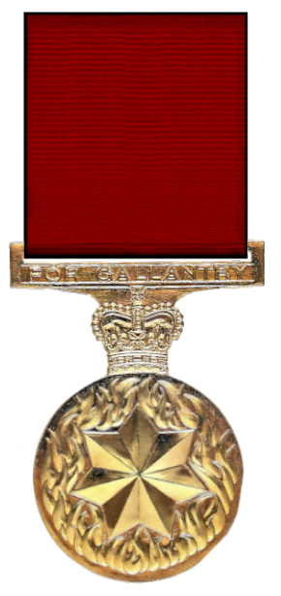
AUSTRALIAN SPECIAL OPERATIONS TASKFORCE
This is to certify that command has awarded the
Gallantry Award
TO
{name}
The Gallantry Award is awarded to members who have displayed during a single significant event, acts of professionalism and dedication within an operation at a standard above what is expected of his worn rank. {name} conducted themselves with a high level of skill, knowledge and attitude which significantly altered the outcome of a situation in a positive manner during an operation.
On today’s date, {dateNumber}^{{suffix}} {date}, {name} is therefore awarded the Gallantry Award.
{signaturerRankShort} {signaturer}
{signaturerRankShort} {signaturer} Officer Commanding Australian Special Operations Taskforce HQ

Slide 13

AUSTRALIAN SPECIAL OPERATIONS TASKFORCE
This is to certify that command has awarded the
Group Development Award
TO
{name}
{name} has shown a high level of dedication and performance related to group development, document and/or training creation and development, encouraging and assisting new members and assisting in training and recruitment which has directly contributed to the improvement of the unit.
On today’s date, {dateNumber}^{{suffix}} {date}, {name} is therefore awarded the Group Development Award
{signaturerRankShort} {signaturer}
{signaturerRankShort} {signaturer} Officer Commanding Australian Special Operations Taskforce HQ

Slide 14
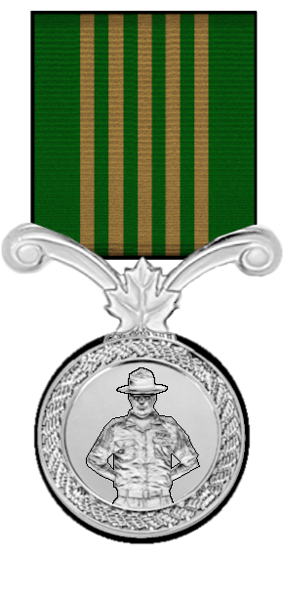
AUSTRALIAN SPECIAL OPERATIONS TASKFORCE
This is to certify that command has awarded the
Instructor Award
TO
{name}
{name} has shown a high level of dedication to training of new recruits and ASOT members, furthering personal knowledge through his own training and study and has assisted with creation of trainings and documentation.
On today’s date, {dateNumber}^{{suffix}} {date}, {name} is therefore awarded the Instructor Award.
{signaturerRankShort} {signaturer}
{signaturerRankShort} {signaturer} Officer Commanding Australian Special Operations Taskforce HQ

Slide 15
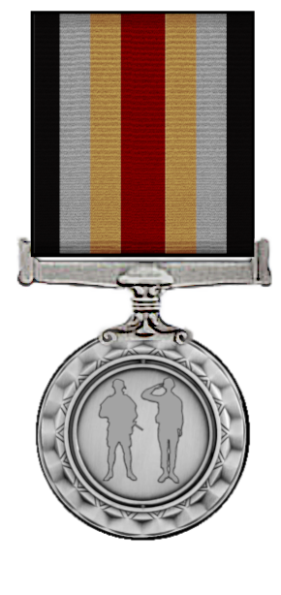
AUSTRALIAN SPECIAL OPERATIONS TASKFORCE
This is to certify that command has awarded the
Junior Leadership Award
TO
{name}
{name} has demonstrated ASOT’s leadership values, standards and skill level to a quality higher than his worn rank whilst currently holding a junior leadership position. they have shown initiative, quick decision making, professionalism and tactical knowledge to an excellent standard and has set an example for other members.
On today’s date, {dateNumber}^{{suffix}} {date}, {name} is therefore awarded the Junior Leadership Award.
{signaturerRankShort} {signaturer}
{signaturerRankShort} {signaturer} Officer Commanding Australian Special Operations Taskforce HQ

Slide 16

AUSTRALIAN SPECIAL OPERATIONS TASKFORCE
This is to certify that command has awarded the
Medical Medallion
TO
{name}
{name} has demonstrated a clear understanding and performs at a high level of competence with the ASOT medical system. they displays great enthusiasm in trainings and regularly engages in informal education of the medical system to new and current members. they are also well mannered during medical incidents in operations which directly contributes to other members’ enjoyment.
On today’s date, {dateNumber}^{{suffix}} {date}, {name} is therefore awarded the Medical Medallion
{signaturerRankShort} {signaturer}
{signaturerRankShort} {signaturer} Officer Commanding Australian Special Operations Taskforce HQ

Slide 17
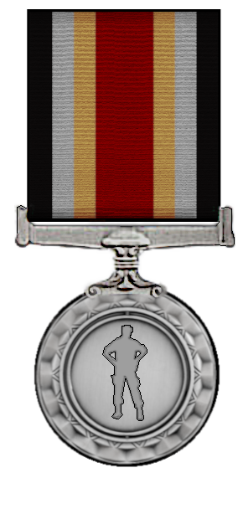
AUSTRALIAN SPECIAL OPERATIONS TASKFORCE
This is to certify that command has awarded the
Protagonist Award
TO
{name}
{name} has demonstrated ASOT’s leadership values, standards and skill level to a quality higher than his worn rank whilst currently not holding a leadership position. they have shown initiative, quick decision making, professionalism and tactical knowledge to an excellent standard and has set an example for other members.
On today’s date, {dateNumber}^{{suffix}} {date}, {name} is therefore awarded the Protagonist Award.
{signaturerRankShort} {signaturer}
{signaturerRankShort} {signaturer} Officer Commanding Australian Special Operations Taskforce HQ

Slide 18
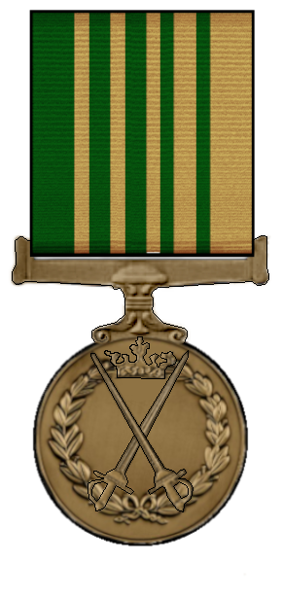
AUSTRALIAN SPECIAL OPERATIONS TASKFORCE
This is to certify that command has awarded the
Public Relations Award
TO
{name}
{name} has shown a high level of dedication and performance to the promotion of the unit, media creation and distribution, social media promotion and/or organisation of intercommunity events which has directly contributed to the growth and advancement of the unit.
On today’s date, {dateNumber}^{{suffix}} {date}, {name} is therefore awarded the
Public Relations Award.
{signaturerRankShort} {signaturer}
{signaturerRankShort} {signaturer} Officer Commanding Australian Special Operations Taskforce HQ

Slide 19
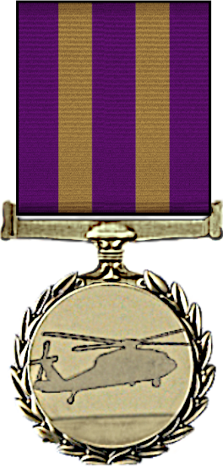
AUSTRALIAN SPECIAL OPERATIONS TASKFORCE
This is to certify that command has awarded the
Rotary Aviation Medal
TO
{name}
{name}completed the Basic Rotary Course on {jdnum}^{{jdsuffix}} {jddate} and achieved a score of 350 or higher showing exceptional knowledge and skill required to be a rotary wing pilot.
On today’s date, {dateNumber}^{{suffix}} {date}, {name} is therefore awarded the Rotary Aviation Medal.
{signaturerRankShort} {signaturer}
{signaturerRankShort} {signaturer} Officer Commanding Australian Special Operations Taskforce HQ

Slide 20
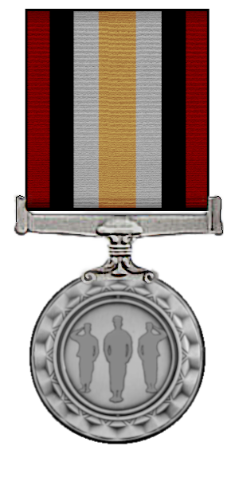
AUSTRALIAN SPECIAL OPERATIONS TASKFORCE
This is to certify that command has awarded the
Senior Leadership Award
TO
{name}
{name} has demonstrated ASOT’s leadership values, standards and skill level to a quality higher than his worn rank whilst currently holding a senior leadership position. they have shown initiative, quick decision making, professionalism and tactical knowledge to an excellent standard and has set an example for other members.
On today’s date, {dateNumber}^{{suffix}} {date}, {name} is therefore awarded the Senior Leadership Award.
{signaturerRankShort} {signaturer}
{signaturerRankShort} {signaturer} Officer Commanding Australian Special Operations Taskforce HQ

Slide 21
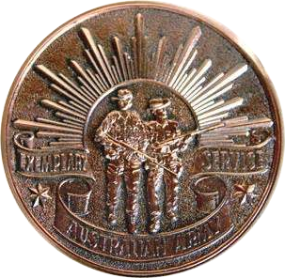
AUSTRALIAN SPECIAL OPERATIONS TASKFORCE
This is to certify that command has awarded the
Bronze Soldiers Medallion
TO
{name}
{name} has demonstrated a number of ASOT’s values, high standards and skill across one or multiple areas within the unit. The soldiers medallion is a sign of recognition and appreciation to members who excel across multiple award criteria but might not meet the needs for the specific award.
On today’s date, {dateNumber}^{{suffix}} {date}, {name} is therefore awarded the Bronze Soldiers Medallion.
{signaturerRankShort} {signaturer}
{signaturerRankShort} {signaturer} Officer Commanding Australian Special Operations Taskforce HQ

Slide 22
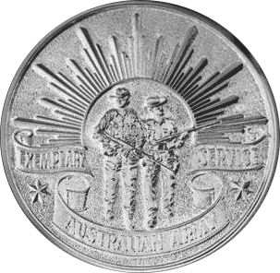
AUSTRALIAN SPECIAL OPERATIONS TASKFORCE
This is to certify that command has awarded the
Silver Soldiers Medallion
TO
{name}
{name} has demonstrated a number of ASOT’s values, high standards and skill across one or multiple areas within the unit. The soldiers medallion is a sign of recognition and appreciation to members who excel across multiple award criteria but might not meet the needs for the specific award. This member has also previously received the bronze soldiers medallion.
On today’s date, {dateNumber}^{{suffix}} {date}, {name} is therefore awarded the Silver Soldiers Medallion.
{signaturerRankShort} {signaturer}
{signaturerRankShort} {signaturer} Officer Commanding Australian Special Operations Taskforce HQ

Slide 23

AUSTRALIAN SPECIAL OPERATIONS TASKFORCE
This is to certify that command has awarded the
Gold Soldiers Medallion
TO
{name}
{name} has demonstrated a number of ASOT’s values, high standards and skill across one or multiple areas within the unit. The soldiers medallion is a sign of recognition and appreciation to members who excel across multiple award criteria but might not meet the needs for the specific award. This member has also previously received the silver soldiers medallion.
On today’s date, {dateNumber}^{{suffix}} {date}, {name} is therefore awarded the Gold Soldiers Medallion.
{signaturerRankShort} {signaturer}
{signaturerRankShort} {signaturer} Officer Commanding Australian Special Operations Taskforce HQ

Slide 24
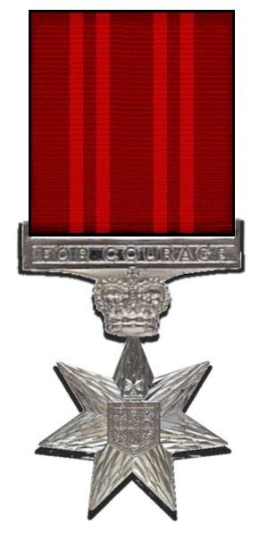
AUSTRALIAN SPECIAL OPERATIONS TASKFORCE
This is to certify that command has awarded the
Star Of Courage
TO
{name}
The Star Of Courage is awarded to members who have previously received the Gallantry Award and have shown during multiple significant events, acts of professionalism and dedication within an operation at a standard above what is expected of his worn rank. {name} has conducted themselves with a high level of skill, knowledge and attitude which significantly altered the outcomes of situations in a positive manner during multiple operations.
On today’s date, {dateNumber}^{{suffix}} {date}, {name} is therefore awarded the Star Of Courage.
{signaturerRankShort} {signaturer}
{signaturerRankShort} {signaturer} Officer Commanding Australian Special Operations Taskforce HQ

Slide 25
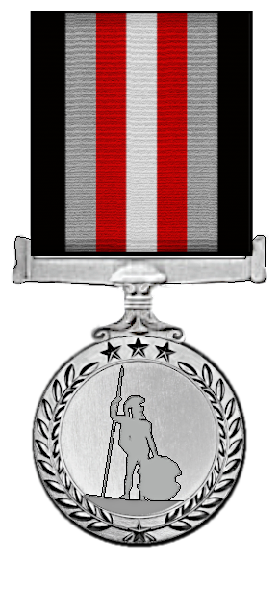
AUSTRALIAN SPECIAL OPERATIONS TASKFORCE
This is to certify that command has awarded the
Watchman Award
TO
{name}
{name} has demonstrated extremely high levels of ASOT’s values and standards whilst displaying very positive personal attributes including but not limited to; selflessness, kindness, sacrifice, generosity, compassion, sympathy and understanding. they have set an example for others to strive for and emulate which directly contributes to the improvement of the community.
On today’s date, {dateNumber}^{{suffix}} {date}, {name} is therefore awarded the
Watchman Award.
{signaturerRankShort} {signaturer}
{signaturerRankShort} {signaturer} Officer Commanding Australian Special Operations Taskforce HQ

Slide 26

AUSTRALIAN SPECIAL OPERATIONS TASKFORCE
This is to certify that command has awarded the
Campaign Medallion
TO
{name}
{name} has seen service with the Australian Special Operations Taskforce in multiple theatres of operations, successfully providing aid and conducting combat operations across the globe.
They are characterised by their commitment to duty and peace.
On today’s date, {dateNumber}^{{suffix}} {date}, {name} is therefore awarded the
Campaign Medallion.
{signaturerRankShort} {signaturer}
{signaturerRankShort} {signaturer} Officer Commanding Australian Special Operations Taskforce HQ

Slide 27

AUSTRALIAN SPECIAL OPERATIONS TASKFORCE
This is to certify that command has awarded the
Campaign Medallion, First Clasp
TO
{name}
{name} has seen service with the Australian Special Operations Taskforce in multiple theatres of operations, successfully providing aid and conducting combat operations across the globe.
They are characterised by their commitment to duty and peace.
On today’s date, {dateNumber}^{{suffix}} {date}, {name} is therefore awarded the
Campaign Medallion with first clasp.
{signaturerRankShort} {signaturer}
{signaturerRankShort} {signaturer} Officer Commanding Australian Special Operations Taskforce HQ

Slide 28
AUSTRALIAN SPECIAL OPERATIONS TASKFORCE
This is to certify that command has awarded the
Campaign Medallion, Second Clasp
TO
{name}
{name} has seen service with the Australian Special Operations Taskforce in multiple theatres of operations, successfully providing aid and conducting combat operations across the globe.
They are characterised by their commitment to duty and peace.
On today’s date, {dateNumber}^{{suffix}} {date}, {name} is therefore awarded the
Campaign Medallion with second clasp.
{signaturerRankShort} {signaturer}
{signaturerRankShort} {signaturer} Officer Commanding Australian Special Operations Taskforce HQ

Slide 29
AUSTRALIAN SPECIAL OPERATIONS TASKFORCE
This is to certify that command has awarded the
Campaign Medallion, Third Clasp
TO
{name}
{name} has seen service with the Australian Special Operations Taskforce in multiple theatres of operations, successfully providing aid and conducting combat operations across the globe.
They are characterised by their commitment to duty and peace.
On today’s date, {dateNumber}^{{suffix}} {date}, {name} is therefore awarded the
Campaign Medallion with third clasp.
{signaturerRankShort} {signaturer}
{signaturerRankShort} {signaturer} Officer Commanding Australian Special Operations Taskforce HQ

Slide 30
AUSTRALIAN SPECIAL OPERATIONS TASKFORCE
This is to certify that command has awarded the
Campaign Medallion, Fourth Clasp
TO
{name}
{name} has seen service with the Australian Special Operations Taskforce in multiple theatres of operations, successfully providing aid and conducting combat operations across the globe.
They are characterised by their commitment to duty and peace.
On today’s date, {dateNumber}^{{suffix}} {date}, {name} is therefore awarded the
Campaign Medallion with fourth clasp
{signaturerRankShort} {signaturer}
{signaturerRankShort} {signaturer} Officer Commanding Australian Special Operations Taskforce HQ

Slide 31


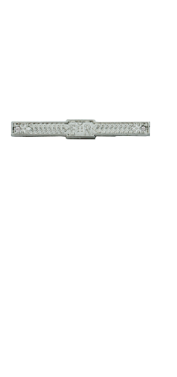

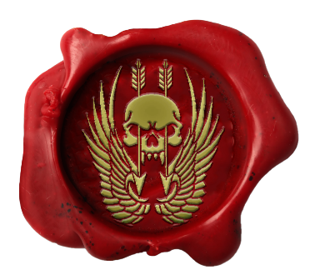
AUSTRALIAN SPECIAL OPERATIONS TASKFORCE
This is to certify that command has awarded the
Campaign Medallion Tier 2 First Clasp
TO
{name}
{name} has seen service with the Australian Special Operations Taskforce in multiple theatres of operations, successfully providing aid and conducting combat operations across the globe.
They are characterised by their commitment to duty and peace.
On today’s date, {dateNumber}^{{suffix}} {date}, {name} is therefore awarded the
Campaign Medallion Tier 2 with first clasp.
{signaturerRankShort} {signaturer}
{signaturerRankShort} {signaturer} Officer Commanding Australian Special Operations Taskforce HQ

Slide 32

AUSTRALIAN SPECIAL OPERATIONS TASKFORCE
This is to certify that command has awarded the
Campaign Medallion Tier 2 Second Clasp
TO
{name}
{name} has seen service with the Australian Special Operations Taskforce in multiple theatres of operations, successfully providing aid and conducting combat operations across the globe.
They are characterised by their commitment to duty and peace.
On today’s date, {dateNumber}^{{suffix}} {date}, {name} is therefore awarded the
Campaign Medallion Tier 2 with second clasp.
{signaturerRankShort} {signaturer}
{signaturerRankShort} {signaturer} Officer Commanding Australian Special Operations Taskforce HQ

Slide 33
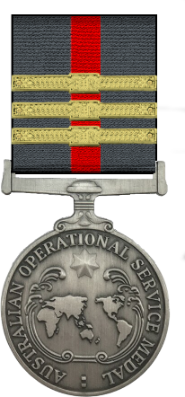
AUSTRALIAN SPECIAL OPERATIONS TASKFORCE
This is to certify that command has awarded the
Campaign Medallion Tier 2 Third Clasp
TO
{name}
{name} has seen service with the Australian Special Operations Taskforce in multiple theatres of operations, successfully providing aid and conducting combat operations across the globe.
They are characterised by their commitment to duty and peace.
On today’s date, {dateNumber}^{{suffix}} {date}, {name} is therefore awarded the
Campaign Medallion Tier 2 with third clasp.
{signaturerRankShort} {signaturer}
{signaturerRankShort} {signaturer} Officer Commanding Australian Special Operations Taskforce HQ

Slide 34
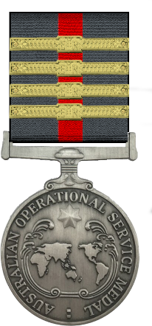
AUSTRALIAN SPECIAL OPERATIONS TASKFORCE
This is to certify that command has awarded the
Campaign Medallion Tier 2 Fourth Clasp
TO
{name}
{name} has seen service with the Australian Special Operations Taskforce in multiple theatres of operations, successfully providing aid and conducting combat operations across the globe.
They are characterised by their commitment to duty and peace.
On today’s date, {dateNumber}^{{suffix}} {date}, {name} is therefore awarded the
Campaign Medallion Tier 2 with fourth clasp.
{signaturerRankShort} {signaturer}
{signaturerRankShort} {signaturer} Officer Commanding Australian Special Operations Taskforce HQ

Slide 35

AUSTRALIAN SPECIAL OPERATIONS TASKFORCE
This is to certify that command has awarded the
Campaign Medallion Tier 3 First Clasp
TO
{name}
{name} has seen service with the Australian Special Operations Taskforce in multiple theatres of operations, successfully providing aid and conducting combat operations across the globe.
They are characterised by their commitment to duty and peace.
On today’s date, {dateNumber}^{{suffix}} {date}, {name} is therefore awarded the
Campaign Medallion Tier 3 with first clasp.
{signaturerRankShort} {signaturer}
{signaturerRankShort} {signaturer} Officer Commanding Australian Special Operations Taskforce HQ

Slide 36

AUSTRALIAN SPECIAL OPERATIONS TASKFORCE
This is to certify that command has awarded the
Campaign Medallion Tier 3 Second Clasp
TO
{name}
{name} has seen service with the Australian Special Operations Taskforce in multiple theatres of operations, successfully providing aid and conducting combat operations across the globe.
They are characterised by their commitment to duty and peace.
On today’s date, {dateNumber}^{{suffix}} {date}, {name} is therefore awarded the
Campaign Medallion Tier 3 with second clasp.
{signaturerRankShort} {signaturer}
{signaturerRankShort} {signaturer} Officer Commanding Australian Special Operations Taskforce HQ

Slide 37

AUSTRALIAN SPECIAL OPERATIONS TASKFORCE
This is to certify that command has awarded the
Campaign Medallion Tier 3 Third Clasp
TO
{name}
{name} has seen service with the Australian Special Operations Taskforce in multiple theatres of operations, successfully providing aid and conducting combat operations across the globe.
They are characterised by their commitment to duty and peace.
On today’s date, {dateNumber}^{{suffix}} {date}, {name} is therefore awarded the
Campaign Medallion Tier 3 with third clasp.
{signaturerRankShort} {signaturer}
{signaturerRankShort} {signaturer} Officer Commanding Australian Special Operations Taskforce HQ

Slide 38

AUSTRALIAN SPECIAL OPERATIONS TASKFORCE
This is to certify that command has awarded the
Campaign Medallion Tier 3 Fourth Clasp
TO
{name}
{name} has seen service with the Australian Special Operations Taskforce in multiple theatres of operations, successfully providing aid and conducting combat operations across the globe.
They are characterised by their commitment to duty and peace.
On today’s date, {dateNumber}^{{suffix}} {date}, {name} is therefore awarded the
Campaign Medallion Tier 3 with fourth clasp.
{signaturerRankShort} {signaturer}
{signaturerRankShort} {signaturer} Officer Commanding Australian Special Operations Taskforce HQ

Slide 39

AUSTRALIAN SPECIAL OPERATIONS TASKFORCE
This is to certify that command has awarded the
Campaign Medallion Tier 4 First Clasp
TO
{name}
{name} has seen service with the Australian Special Operations Taskforce in multiple theatres of operations, successfully providing aid and conducting combat operations across the globe.
They are characterised by their commitment to duty and peace.
On today’s date, {dateNumber}^{{suffix}} {date}, {name} is therefore awarded the
Campaign Medallion Tier 3 with first clasp.
{signaturerRankShort} {signaturer}
{signaturerRankShort} {signaturer} Officer Commanding Australian Special Operations Taskforce HQ

Slide 40

AUSTRALIAN SPECIAL OPERATIONS TASKFORCE
This is to certify that command has awarded the
Campaign Medallion Tier 4 Second Clasp
TO
{name}
{name} has seen service with the Australian Special Operations Taskforce in multiple theatres of operations, successfully providing aid and conducting combat operations across the globe.
They are characterised by their commitment to duty and peace.
On today’s date, {dateNumber}^{{suffix}} {date}, {name} is therefore awarded the
Campaign Medallion Tier 3 with second clasp.
{signaturerRankShort} {signaturer}
{signaturerRankShort} {signaturer} Officer Commanding Australian Special Operations Taskforce HQ

Slide 41

AUSTRALIAN SPECIAL OPERATIONS TASKFORCE
This is to certify that command has awarded the
Campaign Medallion Tier 4 Third Clasp
TO
{name}
{name} has seen service with the Australian Special Operations Taskforce in multiple theatres of operations, successfully providing aid and conducting combat operations across the globe.
They are characterised by their commitment to duty and peace.
On today’s date, {dateNumber}^{{suffix}} {date}, {name} is therefore awarded the
Campaign Medallion Tier 3 with third clasp.
{signaturerRankShort} {signaturer}
{signaturerRankShort} {signaturer} Officer Commanding Australian Special Operations Taskforce HQ

Slide 42

AUSTRALIAN SPECIAL OPERATIONS TASKFORCE
This is to certify that command has awarded the
Campaign Medallion Tier 4 Fourth Clasp
TO
{name}
{name} has seen service with the Australian Special Operations Taskforce in multiple theatres of operations, successfully providing aid and conducting combat operations across the globe.
They are characterised by their commitment to duty and peace.
On today’s date, {dateNumber}^{{suffix}} {date}, {name} is therefore awarded the
Campaign Medallion Tier 3 with fourth clasp.
{signaturerRankShort} {signaturer}
{signaturerRankShort} {signaturer} Officer Commanding Australian Special Operations Taskforce HQ

