Slide 1

SUDOKU SOLVER using backtracking algorithm
BATCH MEMBERS:
2010030512 – L.Keerthana
2010030517 – M.Manideepa
2010030526 – D.Dedeepya
2010030530 – K.Sri Teja
Guided By
UDAYA RANI MA’AM

Slide 2
Abstract
We present the detailed development and implementation of simple sudoku game.
The sudoku game consists of graphical user interface ,solver and implemented using python
The solver finds the solution to the puzzles entered by the user.
This project gives an insight to the different aspects of python programming

Slide 3
Problem statement
1/
The aim of the puzzle is to enter a numerical digit from 1 through 9 in each cell of a 9x9 grid made up of 3×3 subsquares or subgrids.
starting with various digits given in some cells; each row, column, and subsquares region must contain each of the numbers 1 to 9 exactly once.
A sudoku solution must satisfy all of the following rules:-
1. Each horizontal row contains each digit exactly once
2. Each vertical column contains each digit exactly once
3. Each subgrid or region contains each digit exactly once

Slide 4
Algorithm Used
BACKTRACKING ALGORITHM :-
In simple terms, we first start with the first empty space on the sudoku board. We add the first element that can come in that space, let's say 1.
Next, we move on to the second empty space, and add the first element, 1, to it.
If this is valid, it will go to next space, or else the element will become 2. This repeats for every element that can be placed in that space.
This process is repeated for every empty space and if the sudoku is not solved, it goes to the first empty space and places next possible element, that is, 2, in our case.
This whole process is repeated until the sudoku is solved.
Backtracking checks all possible combinations but it provides correct solution. Although, it Takes More Time, But is Able to Provide Correct Answer

Slide 5
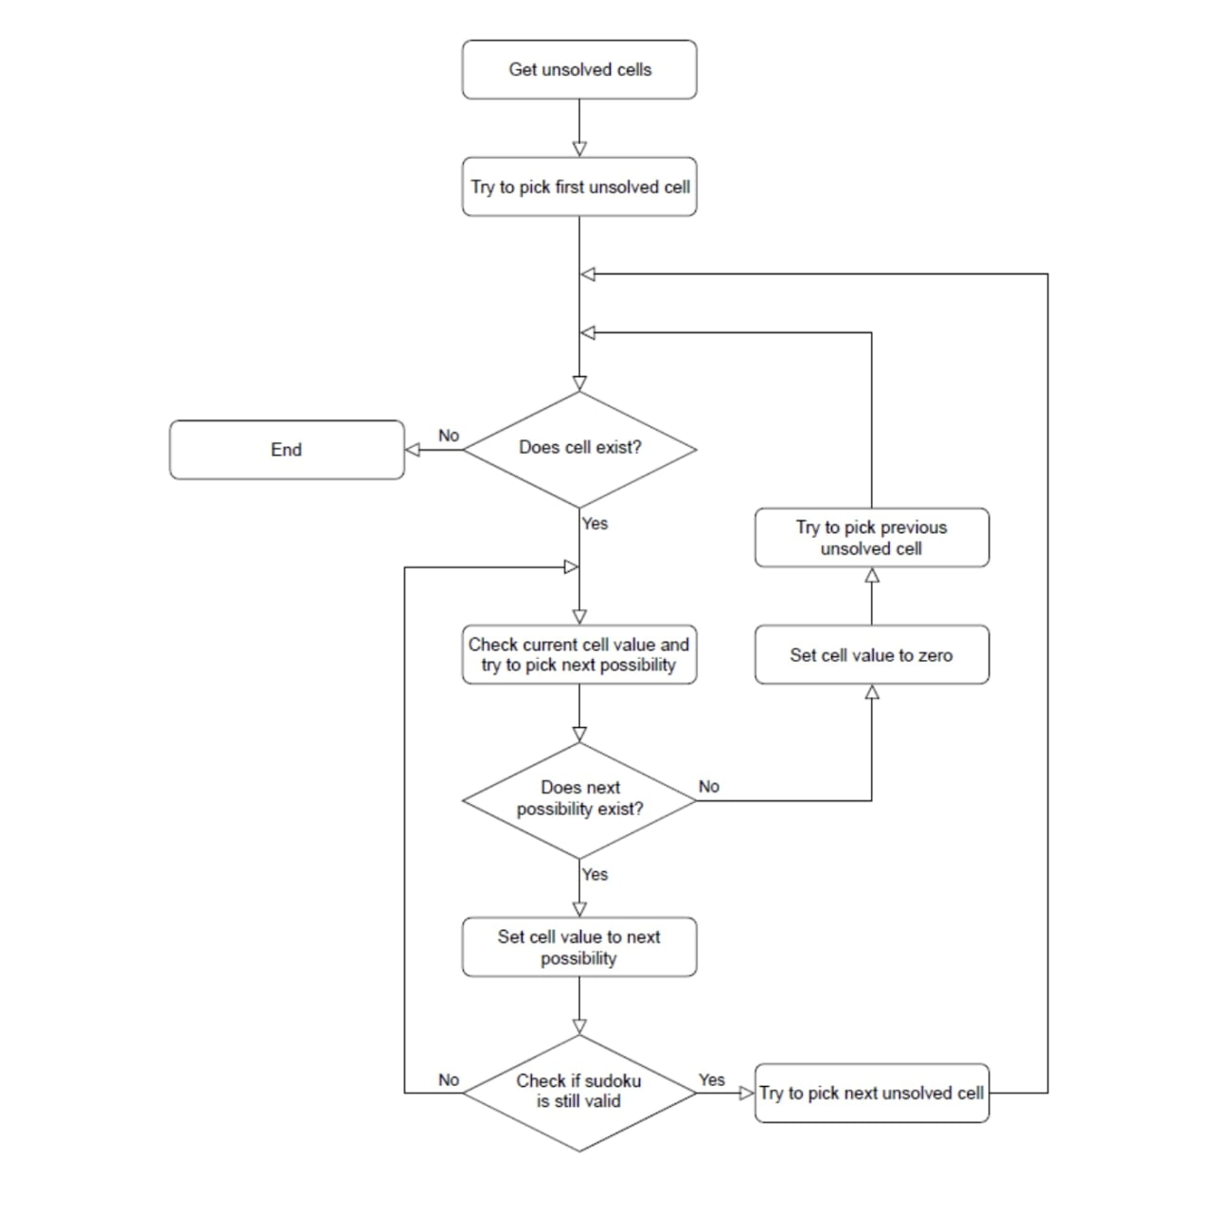
Flow Chart

Slide 6
Software and Hardware Used
SOFTWARE REQUIREMENTS : python(pycharm) ,windows operating
system (can’t use mac coz have compatibility issues )
HARDWARE REQUIREMENTS :mouse or trackpad

Slide 7
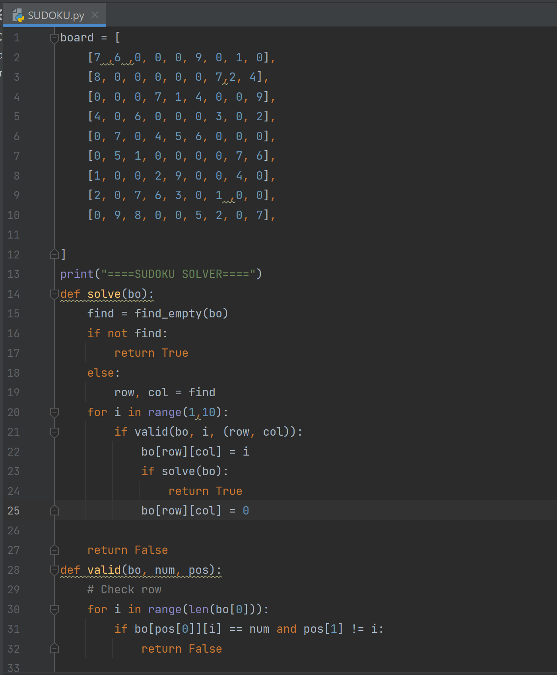
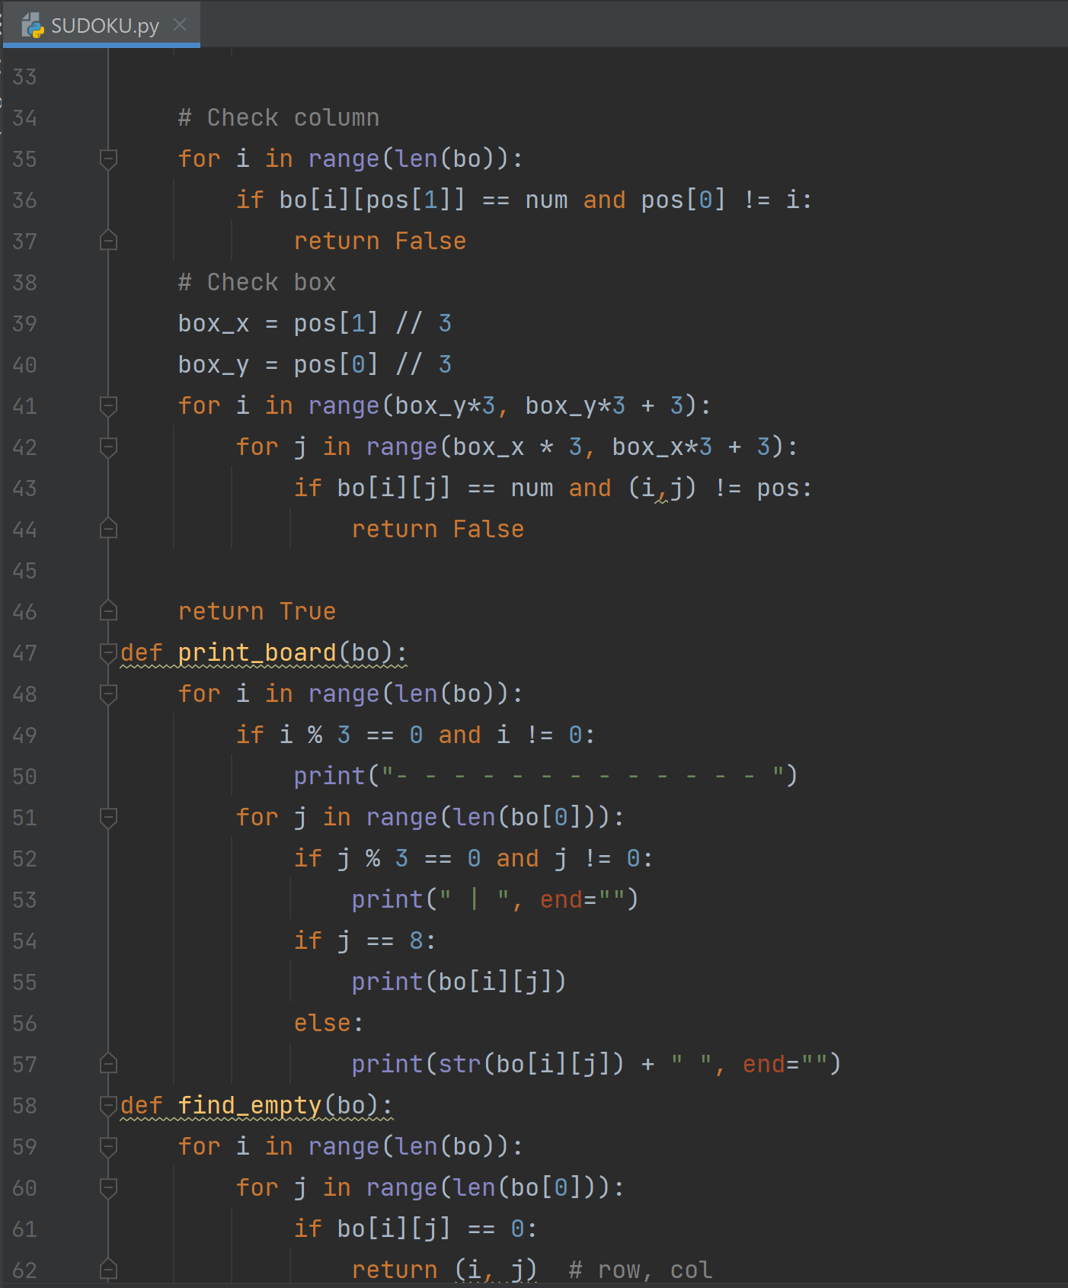
Implementation

Slide 8
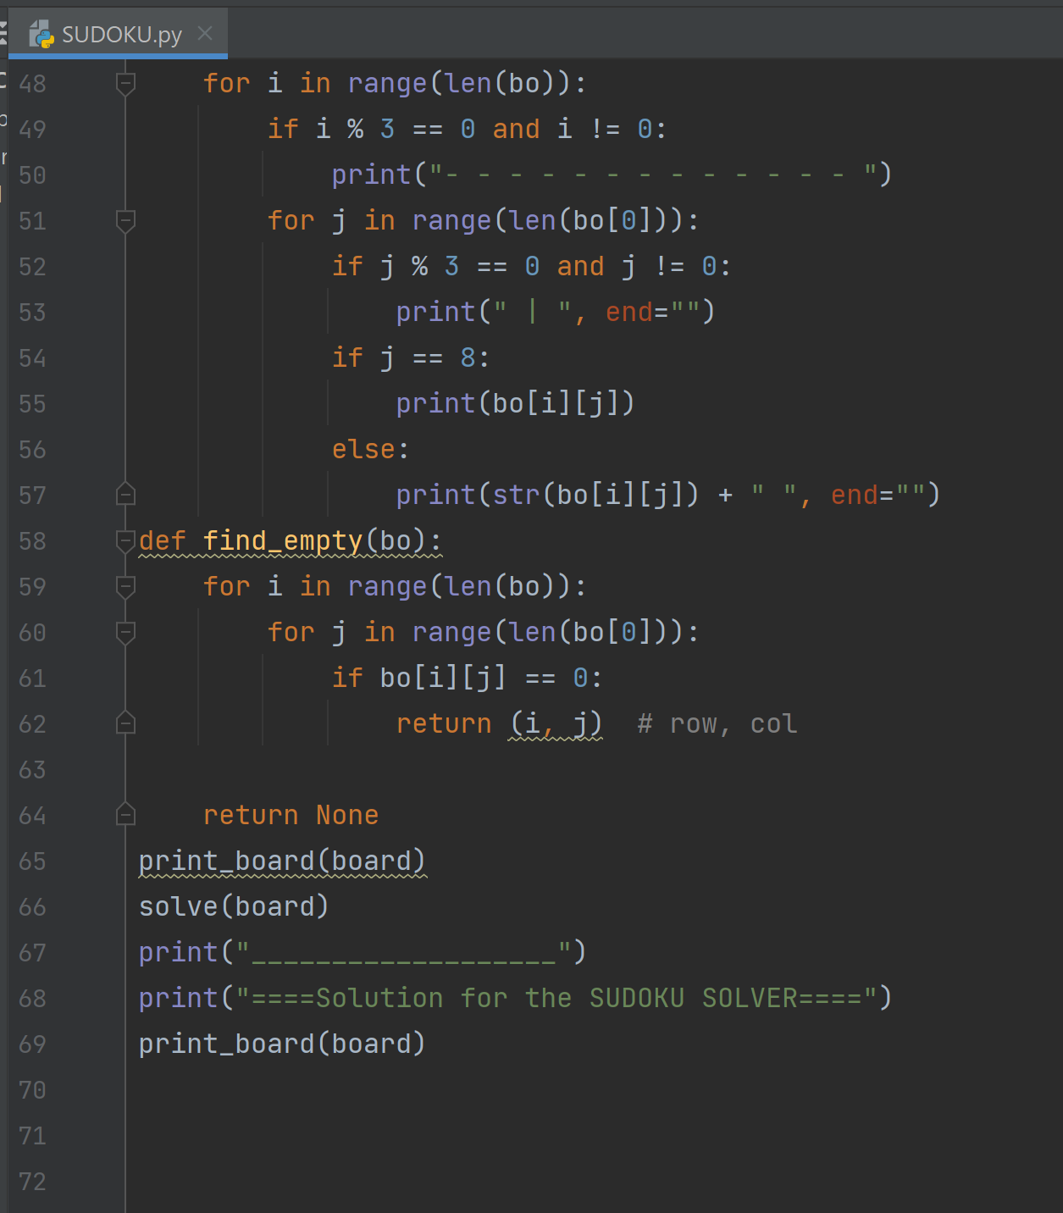
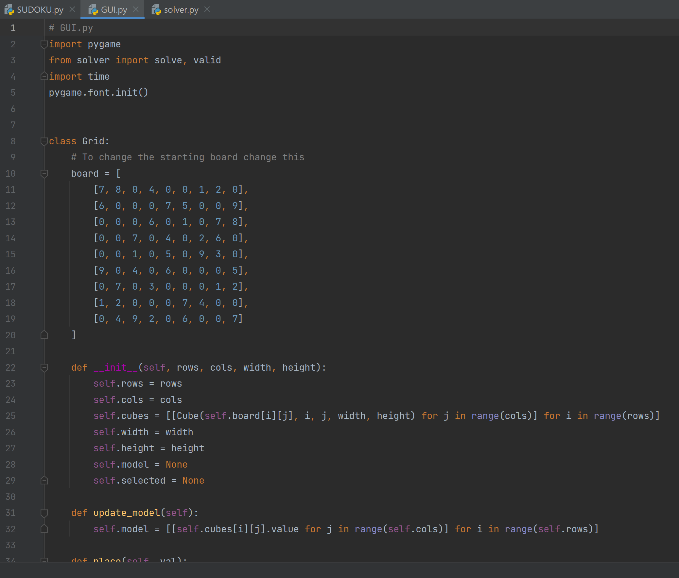

Slide 9
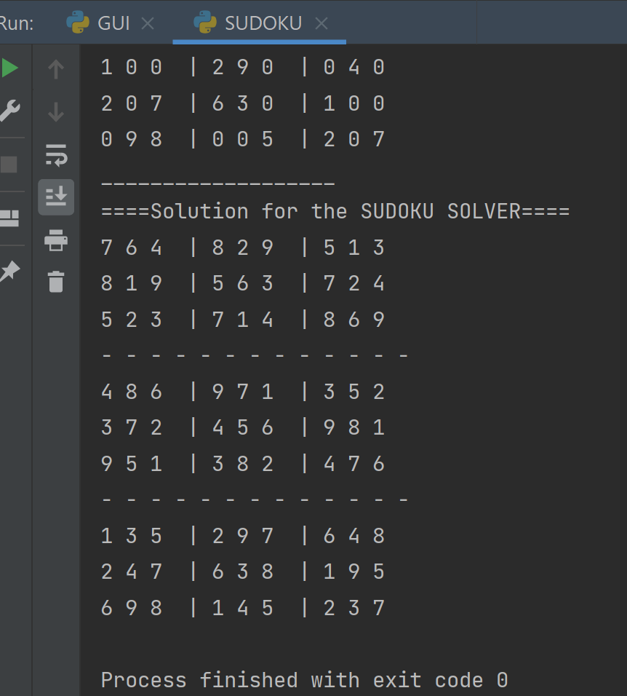
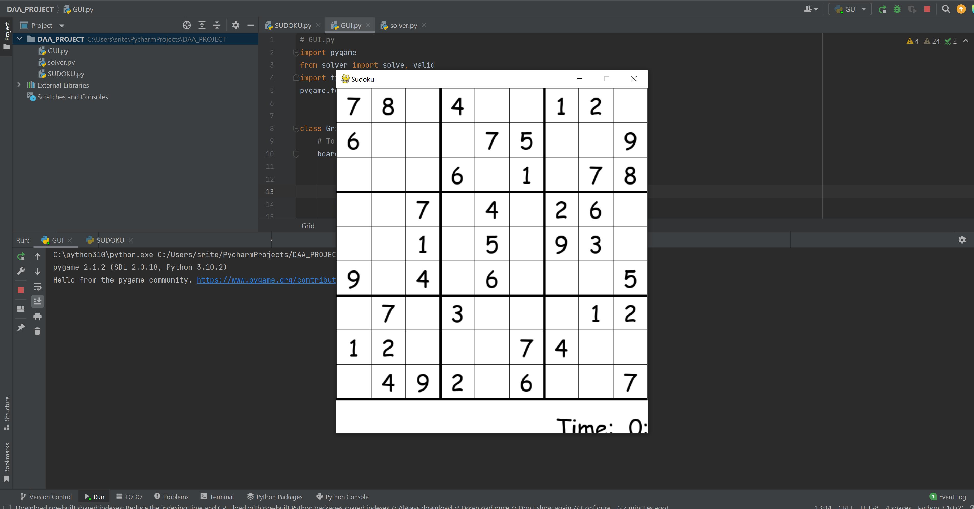
Results

Slide 10
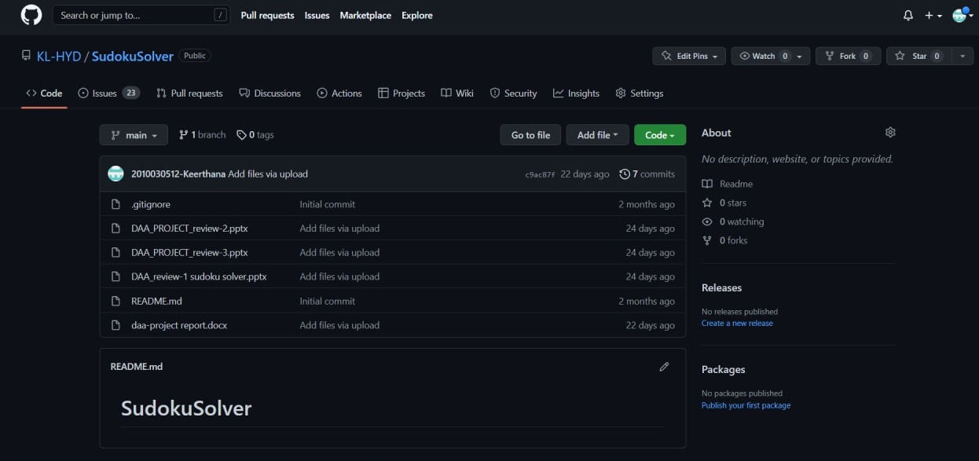
Github Setup

Slide 11
Future Scope
The objectives of the proposed project is to increase the thinking capability.
The game having all the records which you perform in playing. you can make your own sudoku at any step you can go back to one step as well as you can see the solution of it.
It is manually a very difficult job to perform and its need a lot of recalling , reminding and mathematical calculation.
The game of “ SUDOKU“ helps to increase mental thinking , vision , etc.

Slide 12
Thank You….!!

