Slide 1
SUDOKU SOLVER using backtracking algorithm
PRESENTED BY:
2010030512 – L.Keerthana
2010030517 – M.Manideepa
2010030526 – D.Dedeepya
2010030530_K.Sriteja
GUIDED BY
UDAYA RANI MA’AM

Slide 2
TABLE OF CONTENTS
Problem statement
Algorithm used- its description
Flow chart of the proposed solution
Numeric example of the algorithm (Sample input - expected output)
Coding status and testing
Work progress
Github commits

Slide 3
PROBLEM STATEMENT
The aim of the puzzle is to enter a numerical digit from 1 through 9 in each cell of a 9x9 grid made up of 3×3 subsquares or subgrids, starting with various digits given in some cells; each row, column, and subsquares region must contain each of the numbers 1 to 9 exactly once.
A sudoku solution must satisfy all of the following rules:-
1. Each horizontal row contains each digit exactly once
2. Each vertical column contains each digit exactly once
3. Each subgrid or region contains each digit exactly once

Slide 4
ALGORITHM USED
BACKTRACKING ALGORITHM :-
In simple terms, we first start with the first empty space on the sudoku board. We add the first element that can come in that space, let's say 1.
Next, we move on to the second empty space, and add the first element, 1, to it.
If this is valid, it will go to next space, or else the element will become 2. This repeats for every element that can be placed in that space.
This process is repeated for every empty space and if the sudoku is not solved, it goes to the first empty space and places next possible element, that is, 2, in our case.
This whole process is repeated until the sudoku is solved.

Slide 5
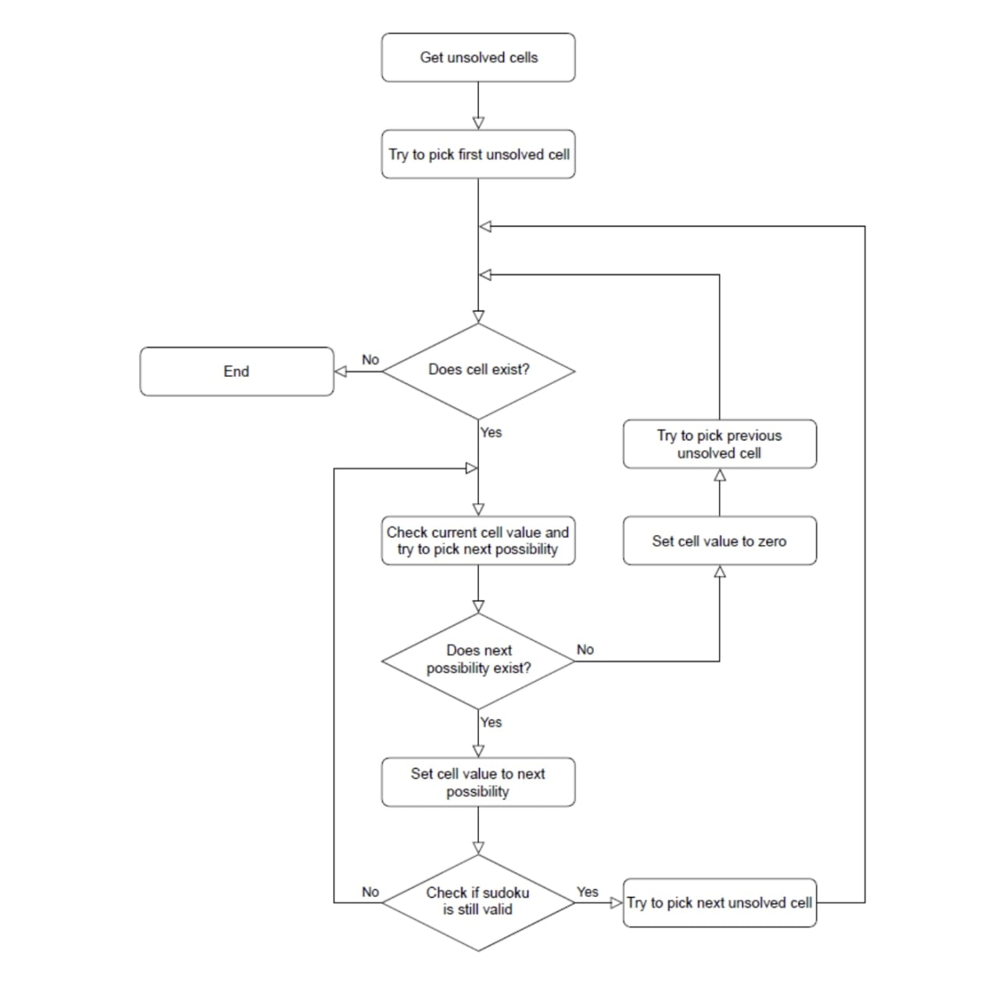
Flow chart of the proposed solution

Slide 6
Numeric example of the algorithm (Sample input - expected output)
Program will read the sudoku puzzle
Sample input is given below as an example
Program will display sudoku board via console
Sample console input:
7 6 0 0 0 9 0 1 0
8 0 0 0 0 0 7 2 4
0 0 0 7 1 4 0 0 9
4 0 6 0 0 0 3 0 2
0 7 0 4 5 6 0 0 0
0 5 1 0 0 0 0 7 6
1 0 0 2 9 0 0 4 0
2 0 7 6 3 0 1 0 0
0 9 8 0 0 5 2 0 7
Sample console output:
7 6 4 | 8 2 9 | 5 1 3
8 1 9 | 5 6 3 | 7 2 4
5 2 3 | 7 1 4 | 8 6 9
- - - - - - - - - - - - -
4 8 6 | 9 7 1 | 3 5 2
3 7 2 | 4 5 6 | 9 8 1
9 5 1 | 3 8 2 | 4 7 6
- - - - - - - - - - - - -
1 3 5 | 2 9 7 | 6 4 8
2 4 7 | 6 3 8 | 1 9 5
6 9 8 | 1 4 5 | 2 3 7

Slide 7
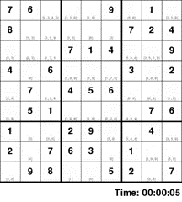
expected output

Slide 8
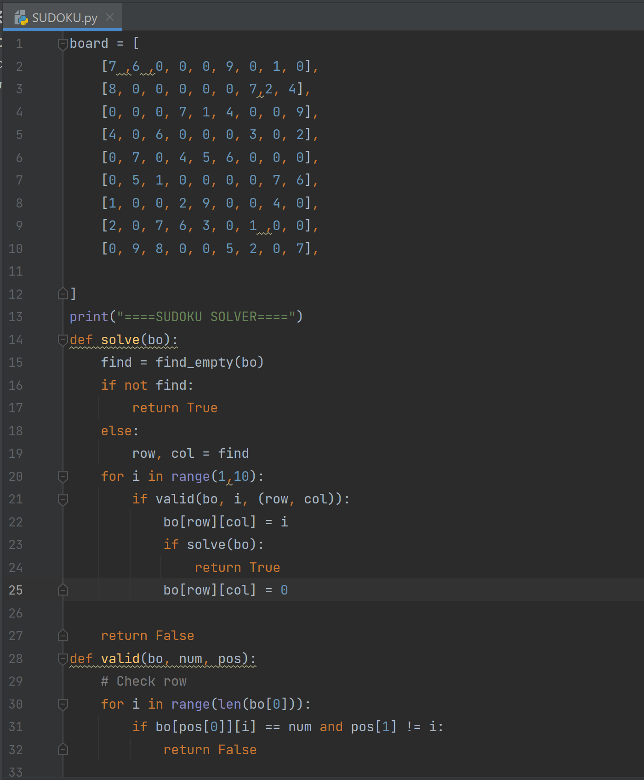
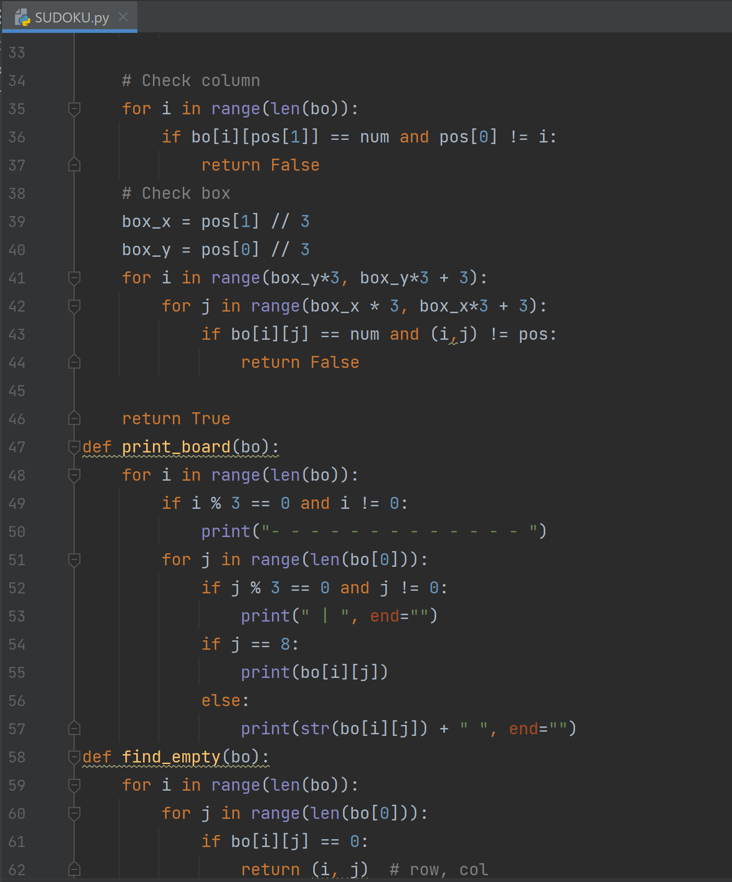
Coding status and testing

Slide 9
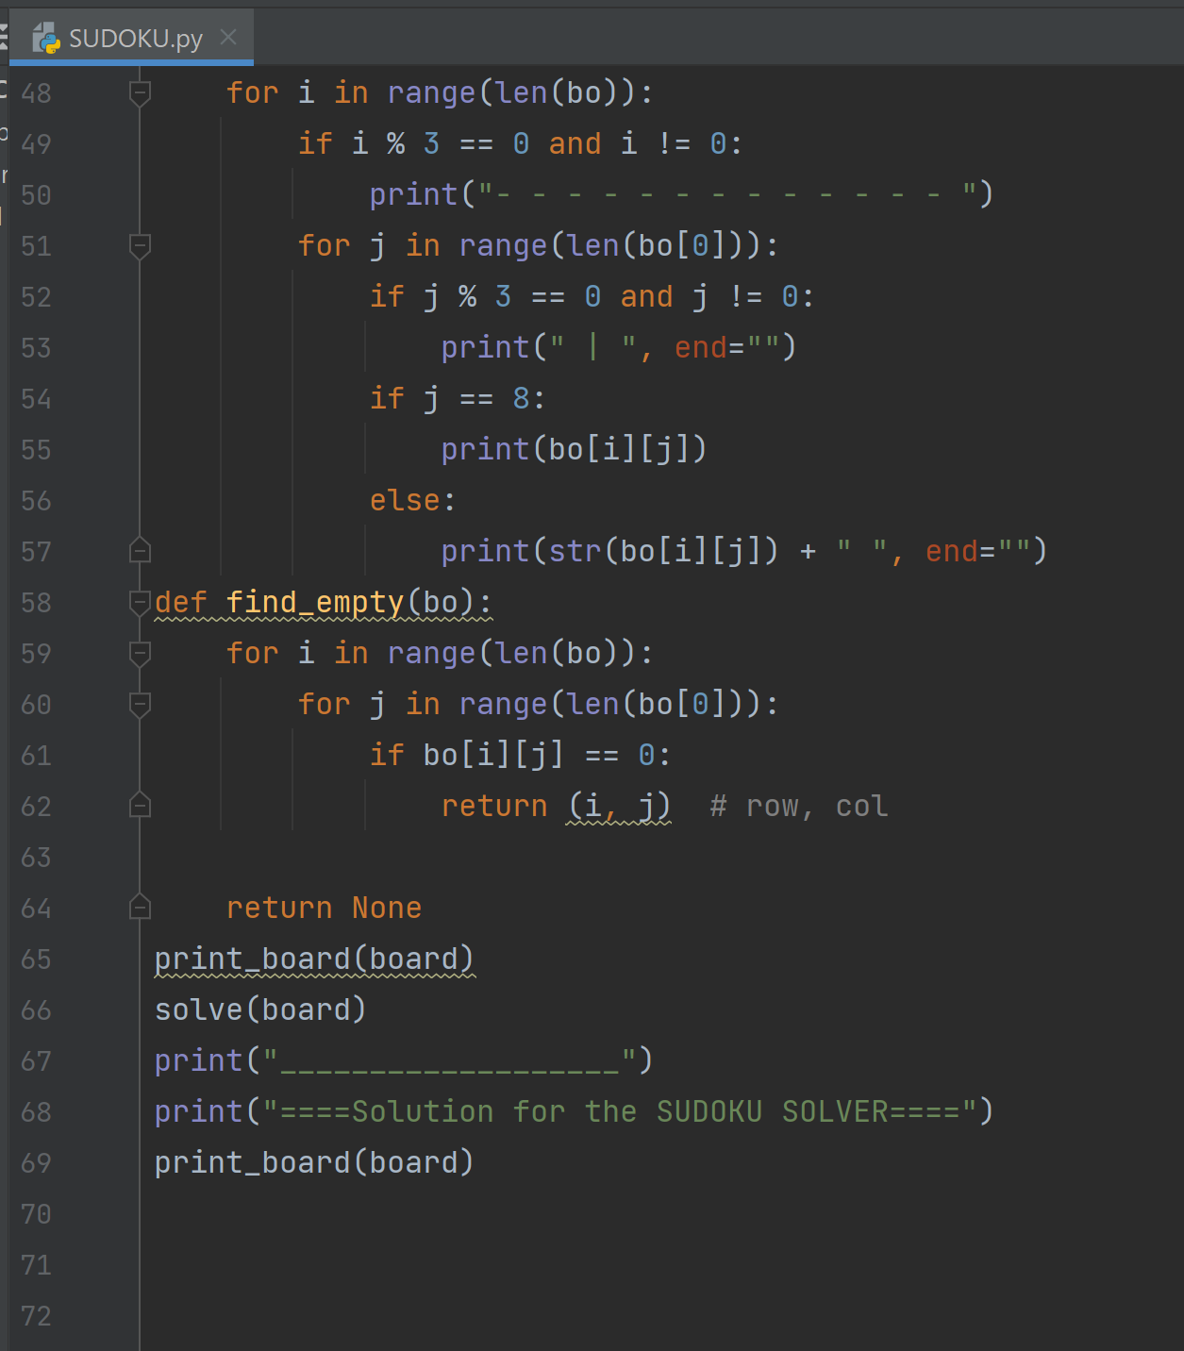

Slide 10
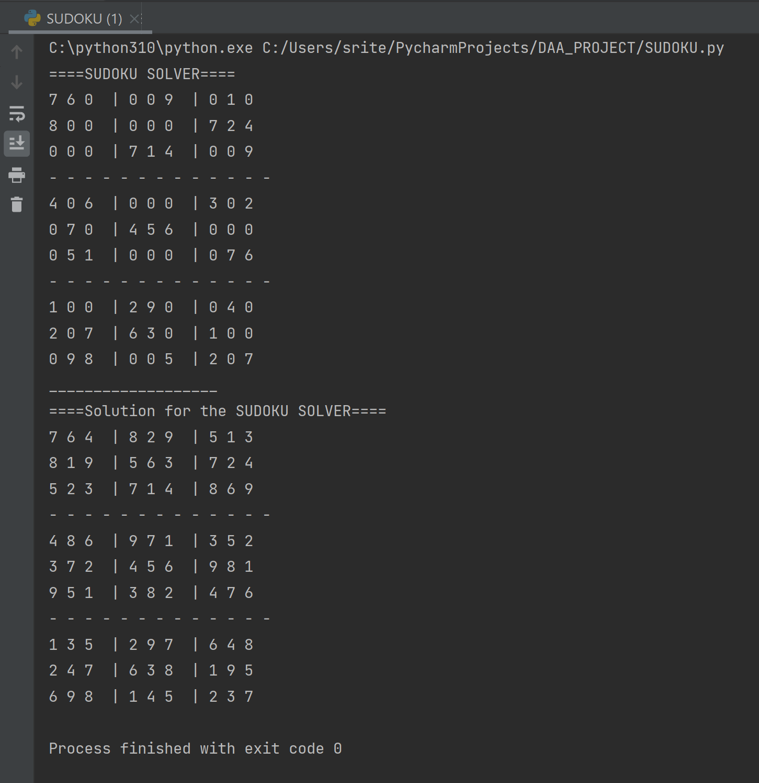
ALPHA TESTING
As a Solving technique is already written in code there will not be any alpha testing for the SUDOKU SOLVER in the console.

Slide 11
WORK progress
Our project mainly focuses on solving sudoku problems using Backtracking algorithm.
In our first review, we’ve explored different algorithms used for solving sudoku.
Based on our research we’ve decided to use a backtracking algorithm as it is more convenient to solve sudoku.
Now in our second review, we have successfully implemented sudoku using console input.
Currently, we’re working with the graphical user interface for our project. We are in a process of fixing errors.

Slide 12
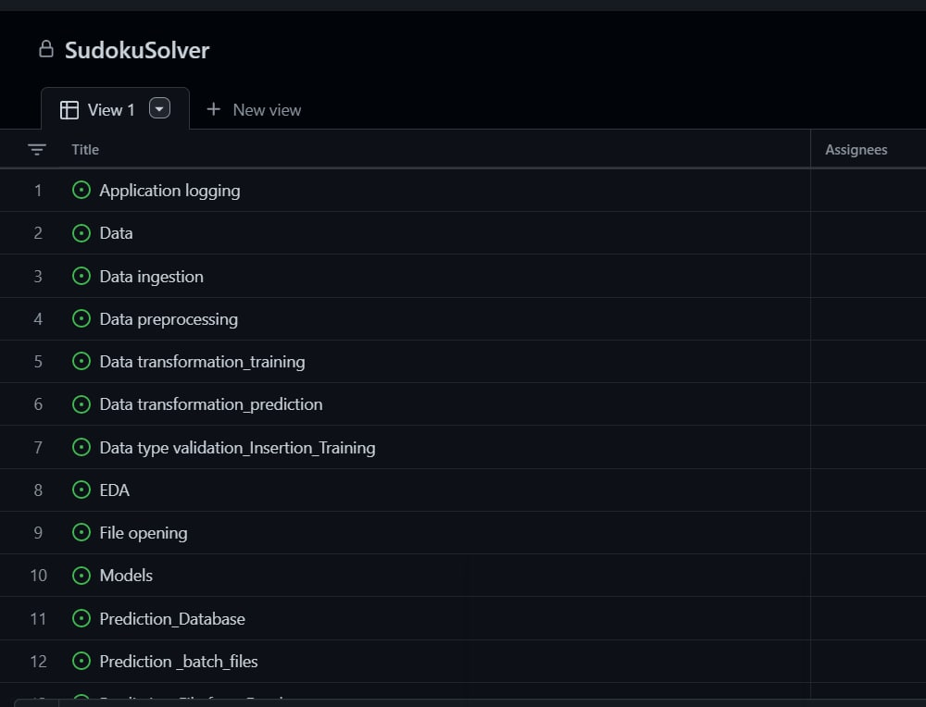
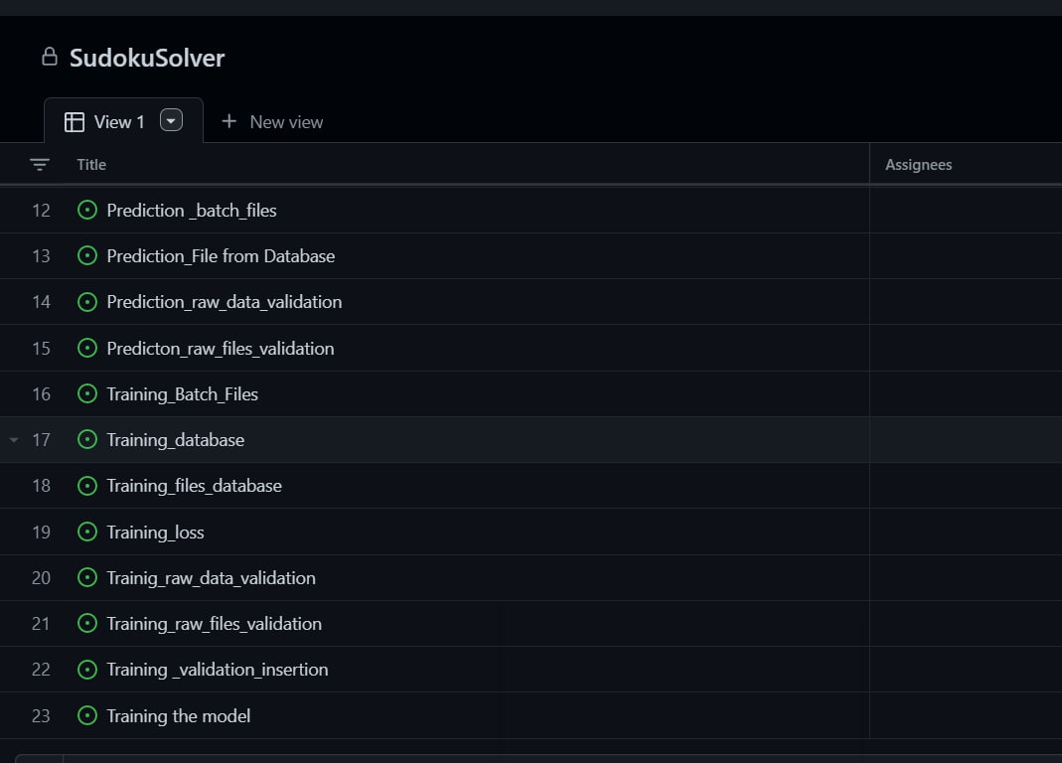
GITHUB COMMITS

Slide 13
THANK YOU…!

