Slide 1

ONLINE SCHEDULING FOR BUSINESS APPLICATIONS
PRESENTER:
Malepati Haneesh - 2010030323
Mounika Kolli - 2010030384
Lahari Pydikondala - 2010030372
Rithvik - 2010030421
UNDER THE GUIDANCE OF:
Udaya Rani Gurala

Slide 2
INDEX
Topics Covered
1. ABSTRACT
2. INTRODUCTION
3. PROBLEM STATEMENT
4. EXISTING SOLUTIONS
5. ALGORITHM DESIGN TECHNIQUE
6. DATA STRUCTURES
7. GITHUB SETUP
8. DIVISION OF WORK

Slide 3
ABSTRACT
For a service provider that gets paid by the hour, time is a precious resource. With automatic online scheduling, you will have more time to actually help your clients during appointments.
When you’re growing your business, it’s key to make it as easy as possible for clients to book. Having to pick up the phone or get into an email chain is a barrier that will make many clients simply move onto the next provider - one who offers seamless booking that takes no time at all. No-shows are one of the most frustrating elements of running a service business, you end up wasting an hour that could have brought in money. Most scheduling apps should offer one critical feature to reduce cancelations: automatic text reminders.

Slide 4
INTRODUCTION
Web applications have helped in streamlining many of the tasks we perform on a daily basis, and have made our lives easier. In the past, these appointment processes were done manually and, because of this, there were many instances of overbooking or forgetting to cancel an appointment which could free up the space to schedule another in its place. To eliminate human error due to setting appointments manually, a web application will be developed to make the scheduling process easier

Slide 5
PROBLEM STATEMENT
Time is a supreme for any human being. We try to schedule our time to accomplish tasks that we have in a day, as time is a limited resource. This online scheduling apps can be useful for businesses as it works by making client interaction seamless and faster. Online scheduling apps allow clients to book from wherever they are on whatever device is most convenient for them, so they’re more likely to book instead of giving up in frustration and taking their business elsewhere.

Slide 6
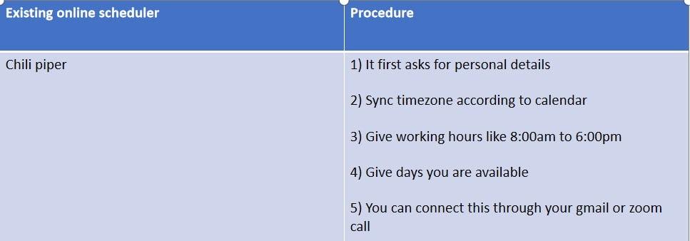
EXISTING SOLUTIONS

Slide 7
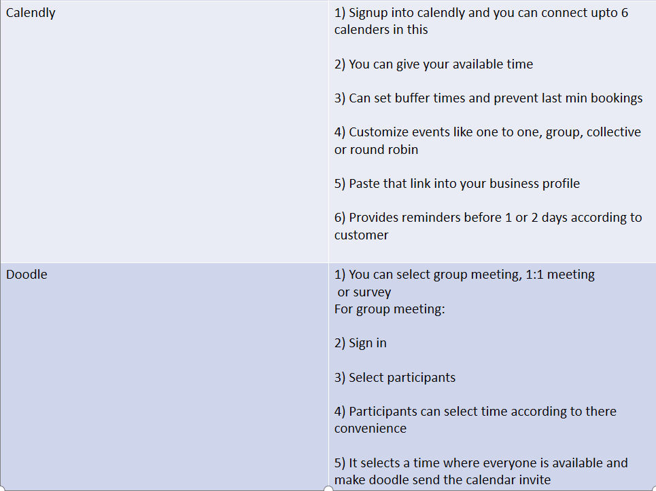

Slide 8
ALGORITHM
We have to schedule appointments into available slots. If a service provider has a fixed number of time slots available for consultations, and a number of clients who want to take appointment, then we need to work out the most efficient way to match these together. so we use hopcroft algorithm,
Hopcroft-Karp Algorithm:
The hopcroft-karp algorithm works in phases, where each phase is looking for augmenting paths.
BFS:
At the start of each phase, we perform a breadth-first search across the entire graph to discover if any augmenting paths exist, and the lengths of them

Slide 9
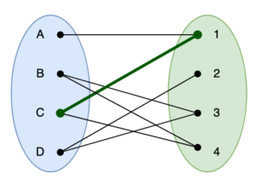
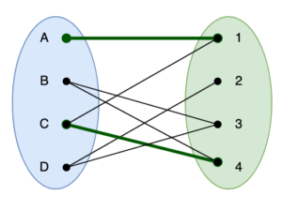
DFS:
If we find an augmenting path, then we will expand our matching. This is done by iterating over every vertex in that is not currently paired and running a depth-first search across the graph starting from there.
Here C - 1 gets removed from the matching, whilst adding and into it. The end result is that we now have 2 paths in the matching.

Slide 10
DATA STRUCTURES:
1. Graphs
2. Queues
3. Stacks

Slide 11
GITHUB SETUP
https://github.com/KL-UH/Online-Scheduling-.git

Slide 12
DIVISION OF WORK:
1. Mounika Kolli( 2010030384 ) - Backend
2. Malepati Haneesh( 2010030323) - Algorithm connectivity
3. Lahari Pydikondala( 2010030372 ) - Frontend
4. Rithvik(2010030421 ) - Database

Slide 13
Thank you!

