Slide 1

OTP VERIFICATION SYSTEM USING PYTHON
TEAM MEMBERS:
U Bharath (2010030391)
B Mani Teja (2010030422)
M Roshan (2010030441)
B Varshith (2010030370)

Slide 2
Introduction
Flow chart
GitHub Commits
Work Progress
Alpha Testing
References
TABLE OF
CONTENTS:

Slide 3
OTP Verification verifies the Mobile Number of users by sending a unique OTP verification code during registration and login. It removes the possibility of a user registering with a fake Mobile Number. So we will be creating an application mirroring the process of an OTP verification application using Python. One time password (OTP) is a password that is only valid for a single login session or transaction. OTP is widely used as a password that is not planted in the database, but only as a single use password and immediately forfeited.
INTRODUCTION:

Slide 4
FLOWCHART:

Slide 5
START
If response == otp
YES
Input phone number and gmail
Send otp to EMAIL using SMTP
NO
Generate random number(OTP) of 4 digits
print “INCORRECT OTP “
STOP
Enter OTP
Send the OTP to phone number through fast2sms API
NO
If response == otp
print “Verified”
Enter OTP
YES

Slide 6
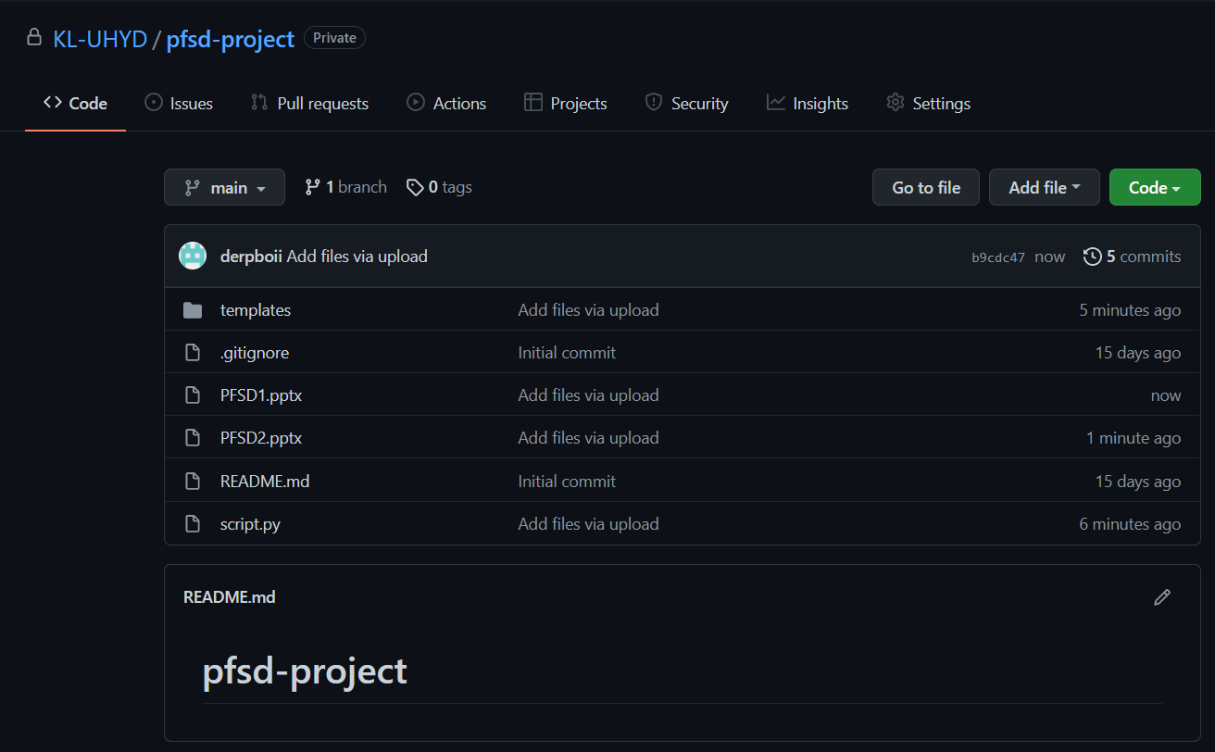
We have uploaded files in GitHub and added team members and faculty
Link for GitHub repository: https://github.com/KL-UHYD/pfsd-project
GITHUB:

Slide 7
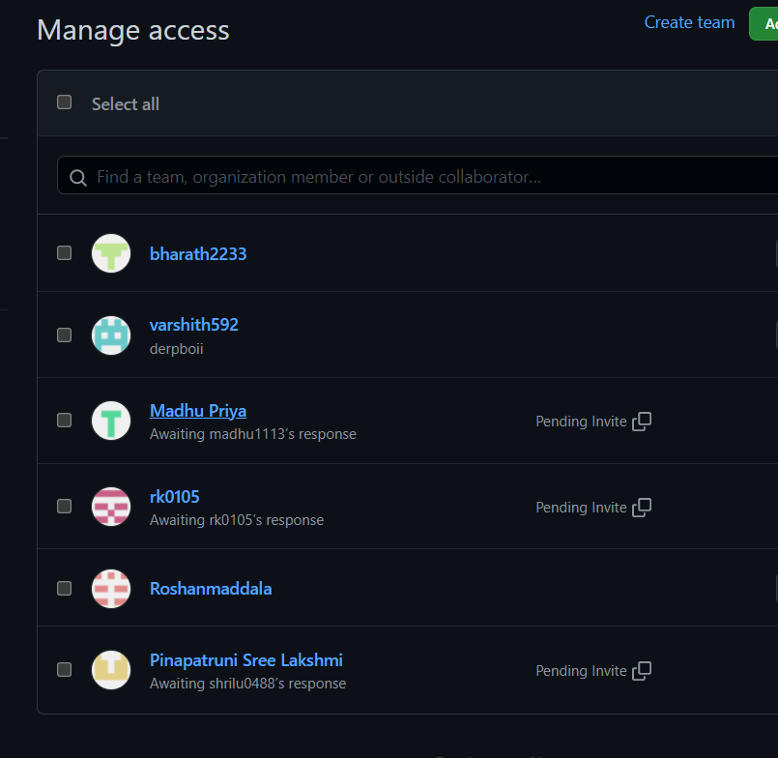
We have created a GitHub repository for PFSD project
Link for GitHub repository https://github.com/KL-UHYD/pfsd-project
GITHUB:

Slide 8

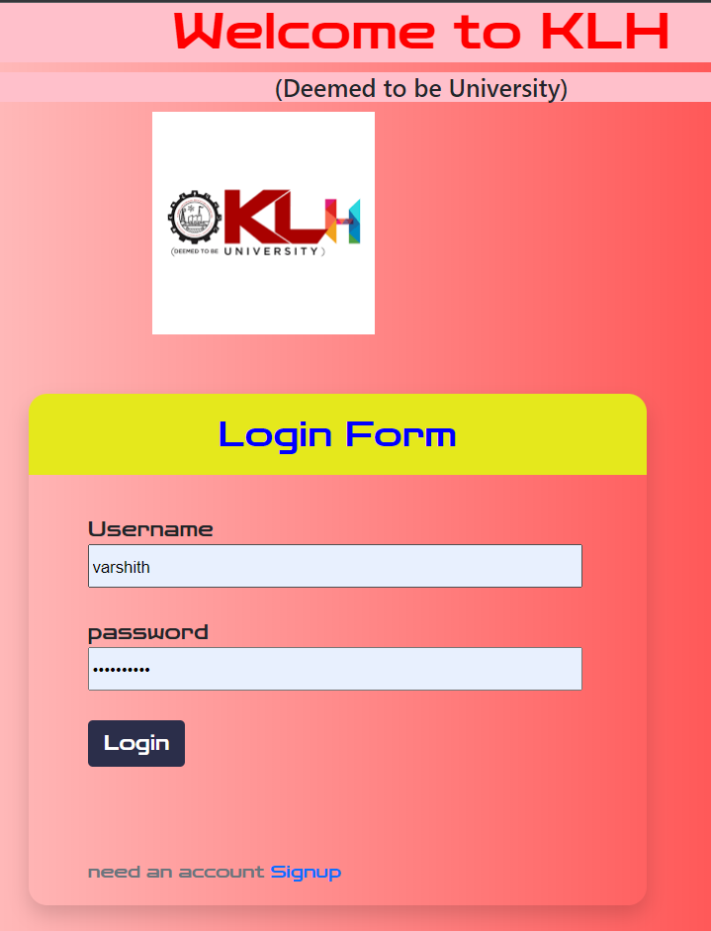
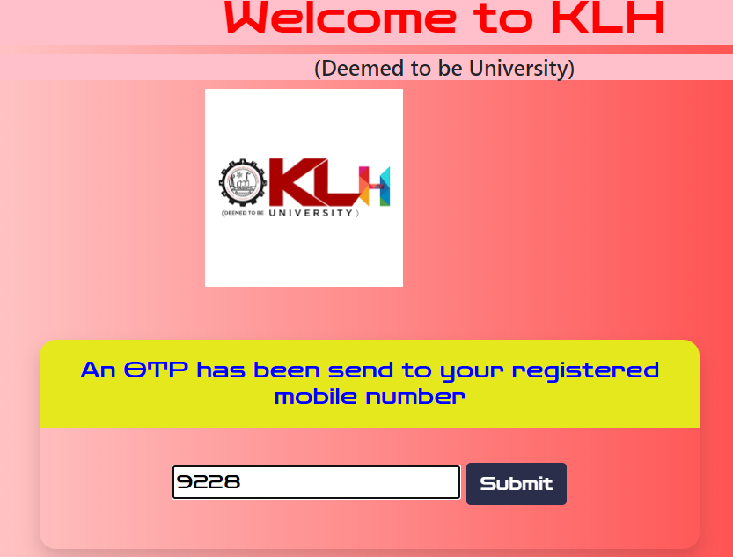
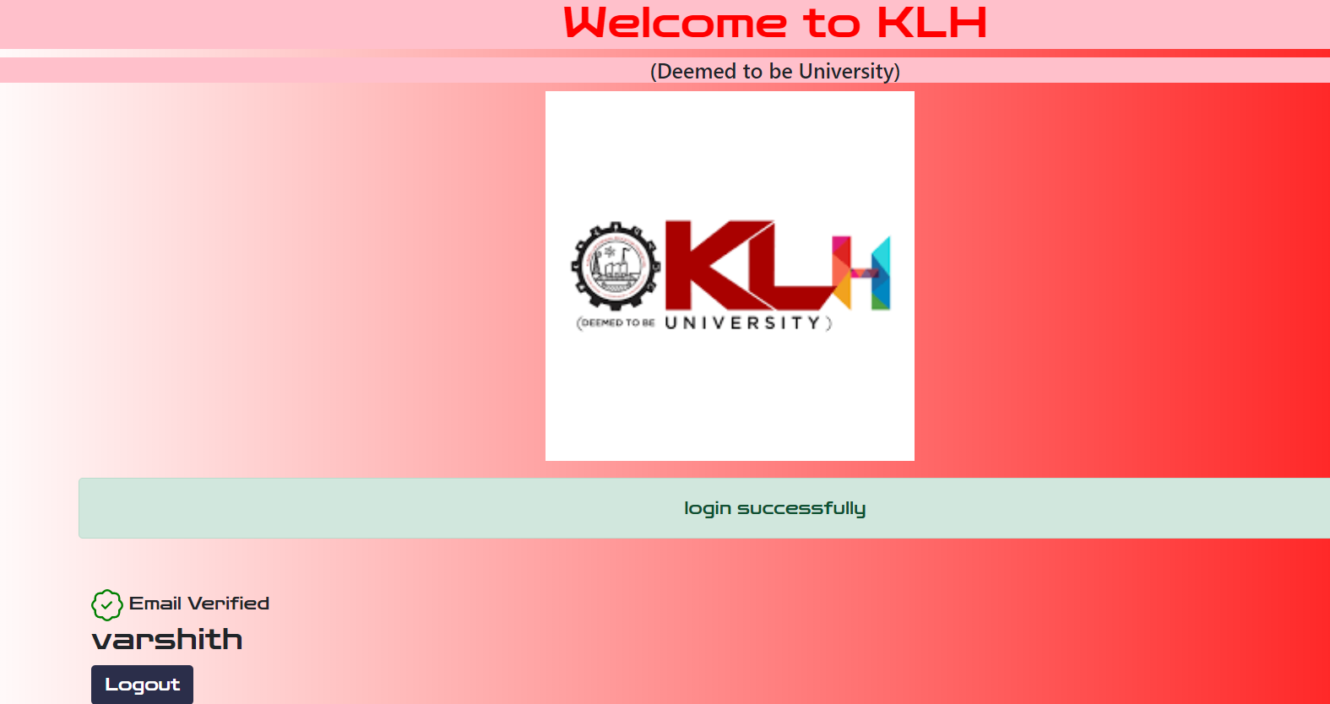

Working Prototype:

Slide 9
https://prataplyf.medium.com/send-otp-on-mobile-using-python-491a472853a9
https://aka-trip.medium.com/otp-verification-using-python-598959e84f78
https://thecleverprogrammer.com/2021/04/14/otp-verification-using-python/
https://www.quora.com/How-do-I-send-an-OTP-using-Python
REFERENCES:

Slide 10
THANKS

